Slide 1
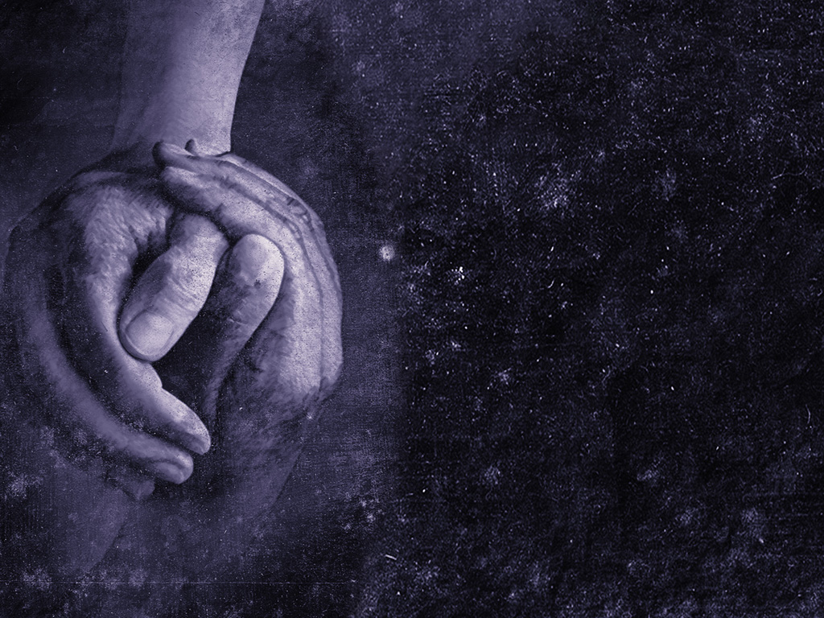
Embracing Unity!
Galatians 3:28
Pastor Richard “ Rico” Tubbs

Slide 2
Galatians 3:28:
"For as many of you as were baptized into Christ have put on Christ. There is neither Jew nor Greek, there is neither slave nor free, there is no longer male and female, for you are all one in Christ Jesus".

Slide 3
This verse emphasizes spiritual equality, showing that human differences like ethnicity, social status, and gender do not matter in Christ.

Slide 4
1 Corinthians 12:12-13:
"For just as the body is one and has many members, and all the members of the body, though many, are one body, so it is with Christ. For in one Spirit we were all baptized into one body—Jews or Greeks, slaves or free—and all were made to drink of one Spirit".

Slide 5
This passage highlights that unity doesn't mean sameness; instead, the church is like a body with many distinct, diverse parts all functioning together as one.

Slide 6
Revelation 7:9:
"After this I looked, and behold, a great multitude in white robes, with palm branches in their hands, and from every nation, from all tribes and peoples and languages, standing before the throne and before the Lamb".

Slide 7
This vision illustrates the ultimate fulfillment of unity in diversity, showing a diverse group of people from all backgrounds united in worship of God.

Slide 8
Promoting equity and justice
The biblical principle that all people are created in God's image (Genesis 1:27) emphasizes the inherent worth of every individual, regardless of their background, race, or status. This can be applied to modern society
How???

Slide 9
Encouraging equal opportunity:
This principle rejects favoritism and calls for the fair treatment of all people

Slide 10
Advocating for the marginalized:
Many biblical texts, such as the laws concerning sojourners in the Old Testament, mandate care and protection for the vulnerable and marginalized. This translates to modern advocacy for social justice causes and support for the disadvantaged

Slide 11
Cultivating an environment of love and forgiveness
The call to practice humility, patience, and love (Ephesians 4:2–3) offers a roadmap for resolving conflict in a modern context.

Slide 12
Practicing compassion:
In a digital age where conflicts can escalate instantly, these virtues encourage empathy and restraint. Instead of resorting to insults, a biblical approach prioritizes grace and forgiveness.

Slide 13
Focusing on shared humanity:
By prioritizing love as the central ethic, these teachings compel individuals to see the inherent worth in every person, even those with whom they disagree.

Slide 14
The Bible provides several examples of diverse communities united by a common purpose, often reflecting God's inclusive nature and the transformative power of faith.

Slide 15
Jesus' selection of his disciples deliberately brought together individuals from starkly different backgrounds
His followers included fishermen (Peter, Andrew, James, John) and tax collectors (Matthew), who were viewed as outcasts by many Jews.
United in mission: Though they had varied perspectives and occasional disagreements, they were ultimately united by their common purpose and mission in Jesus

Slide 16
The mixed multitude during the Exodus
When the Israelites departed from Egypt, they were joined by a "mixed multitude"—a group of non-Israelites of various ethnicities. This group united with the Israelites in their shared purpose of escaping slavery and journeying toward the Promised Land, bound by a common faith in God's deliverance.

Slide 17
The prophetic and eschatological vision
The prophets also envisioned a future where diversity and unity would coexist under God.
Inclusion of foreigners: The prophet Isaiah foretold that God's house would be "called a house of prayer for all the nations," a vision of inclusivity.
Multicultural worship: This vision culminates in the Book of Revelation (7:9), where John sees a multitude from "every nation, tribe, people, and language" worshipping God together in perfect unity.

Slide 18
Ephesians 4:3-6: "Make every effort to keep the unity of the Spirit through the bond of peace. There is one body and one Spirit, just as you were called to one hope when you were called; one Lord, one faith, one baptism; one God and Father of all, who is over all and through all and in all
This passage highlights the singular spiritual reality of believers, grounded in one Spirit, one hope, one faith, one baptism, and one God.

Slide 19
Cultivate unity with God
Practical ways to live out spiritual oneness involve both intentional habits and a renewed mindset, focusing on unity with God and fellow believers

Slide 20
Study Scripture and pray consistently.
The Bible is the primary way God reveals his nature and character, and prayer is a two-way conversation with him. Regularly engaging in both practices is vital for fostering your personal relationship with God.

Slide 21
Seek humility.
Recognize that all you have, including your gifts, comes from God and that you need his grace every day. Humility allows you to rely on God rather than your own abilities and keeps your focus on him.

Slide 22
Spend time in quiet reflection.
Meditation and contemplation can help you quiet your mind and focus on God's presence. Spending time in silence, whether in nature or a peaceful room, can help you feel connected to a larger, divine reality.

Slide 23
Surrender control.
Release the need to have every aspect of your life go according to your own will. By surrendering your concerns to God, you can find a sense of peace and trust in his plan.

Slide 24
Keep a gratitude journal.
Focusing on God's blessings shifts your perspective from scarcity to abundance. Writing down what you're thankful for daily can help you appreciate your life and recognize the interconnectedness of all things.

Slide 25
Homework
This week Love one another.
Jesus himself said that love would be the ultimate sign of his disciples. Express love through patience, kindness, and compassion, especially towards those you disagree with.

