Slide 1
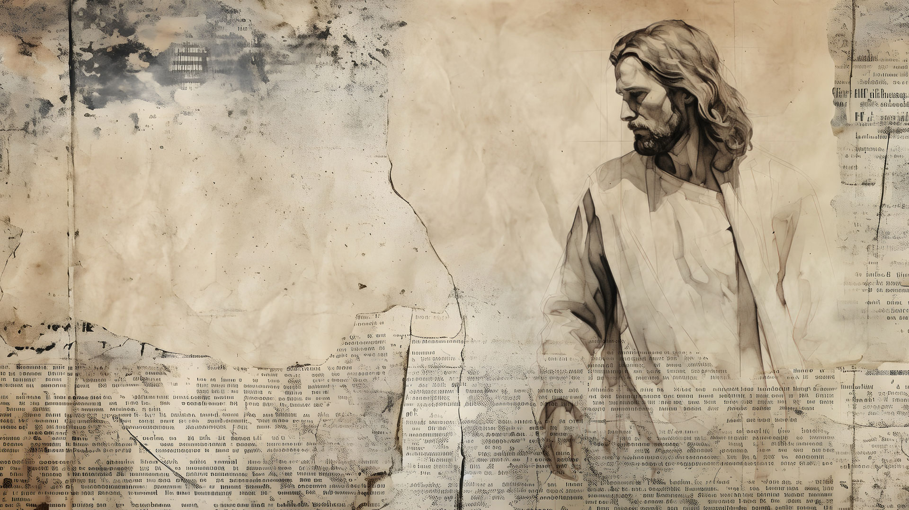
“What do you want me to do for you?”
Pastor Richard “Rico” Tubbs

Slide 2
Mark 10:46-52
⁴⁶ Then they came to Jericho. As Jesus and his disciples, together with a large crowd, were leaving the city, a blind man, Bartimaeus (which means “son of Timaeus”), was sitting by the roadside begging. ⁴⁷ When he heard that it was Jesus of Nazareth, he began to shout, “Jesus, Son of David, have mercy on me!”
⁴⁸ Many rebuked him and told him to be quiet, but he shouted all the more, “Son of David, have mercy on me!”
⁴⁹ Jesus stopped and said, “Call him.”
So they called to the blind man, “Cheer up! On your feet! He’s calling you.” ⁵⁰ Throwing his cloak aside, he jumped to his feet and came to Jesus.
⁵¹ “What do you want me to do for you?” Jesus asked him.
The blind man said, “Rabbi, I want to see.”
⁵² “Go,” said Jesus, “your faith has healed you.” Immediately he received his sight and followed Jesus along the road.

Slide 3
This is Jesus' final healing miracle in Mark's Gospel and serves as a powerful illustration of faith and discipleship, in contrast to the spiritual blindness of many, including the disciples.

Slide 4
Bartimaeus demonstrates persistent and confident faith, believing that Jesus is the Messiah ("Son of David") and can heal him, despite being an outcast.

Slide 5
Jesus was certainly a master of what is now known as the Socratic method of teaching

Slide 6
Verses 33-34:
Jesus was going to Jerusalem to die, and he knew it. He tries to tell his disciples, but they don't understand.

Slide 7
Mark explicitly translates the name as "Son of Timaeus". Timaeus is a Greek name related to the word for "honor" or "value". Naming him the "son of Timaeus" (the "son of honor”)
Then describing him as a blind beggar creates a powerful contrast, emphasizing his transformation from a social outcast to a "valuable" and true follower of Christ.

Slide 8
Unlike many others who were healed and went their way, Bartimaeus' story concludes with him immediately following Jesus on the way to Jerusalem.

Slide 9
“What do you want me to do for you?”
This opens a wonderful opportunity for some self-reflection as we consider the implications of the question both for Bartimaeus and for us.

Slide 10
It reveals God’s servant heart for humanity, especially in our brokenness, poverty, and blindness. Jesus said he came “not to be served, but to serve.”

Slide 11
Frederick Buechner offers a series of questions to help us focus on things that really matter, even if we’d rather not face them:

Slide 12
When you look at your face in the mirror, what do you see in it that you most like and what do you see in it that you most deplore?

Slide 13
If you had only one last message to leave to the handful of people who are most important to you, what would it be in twenty-five words or less?

Slide 14
Of all the things you have done in your life, which is the one you would most like to undo? Which is the one that makes you happiest to remember?

Slide 15
Is there any person in the world, or any cause, that, if circumstances called for it, you would be willing to die for?

Slide 16
If this were the last day of your life, what would you do with it?

Slide 17
Mark 10:35 In the verses just before Jesus’ encounter with Bartimaeus, James and John came to Jesus and said, “Teacher, we want you to do for us whatever we ask.”
And Jesus responded, “What do you want me to do for you?”

Slide 18
They didn’t get what they asked for. Why? Because they didn’t ask in faith; they asked in ambition.
Faith asks for what it needs. Ambition asks for what it wants.

Slide 19
The Bible contains at least six specific narrative stories of Jesus healing blind people in the New Testament Gospels, involving eight named or specific individuals, plus two other general instances where many blind people were healed.

Slide 20
In Matthew 15:29-31
great crowds came to him, bringing many people including the blind, and he healed them all.

Slide 21
Homework
Jesus asks the question not because he is unaware of the person's needs, but to prompt them to articulate their desires and exercise their faith.
This week: Each day write an answer to the question that Jesus ask…Focus on how you would answer, then next Sunday bring those answers for extra credit

