Slide 1


Slide 2
“Hineni”
Here I Am!
Pastor Richard “Rico” Tubbs

Slide 3
The people in the Bible who cried
“Here Am I”
Surrendered their Lives to the Call of God

Slide 4
When they answered the call, they did not
get all the answers up front…..
Where?
Why?
Who?
How Long?
How much is this going to cost me?

Slide 5
He takes an ordinary life
And Turns US into an Extraordinary People
For His Kingdom

Slide 6
Gen 22:1-2 “And it came to pass after these things, that God did tempt Abraham, and said to him, ‘Abraham’ and he said “Behold, Here am I
“Take now your son, your only son Isaac, that you love, and get you to the land of Moriah, and offer him there for a burnt offering, upon one of the mountains”

Slide 7
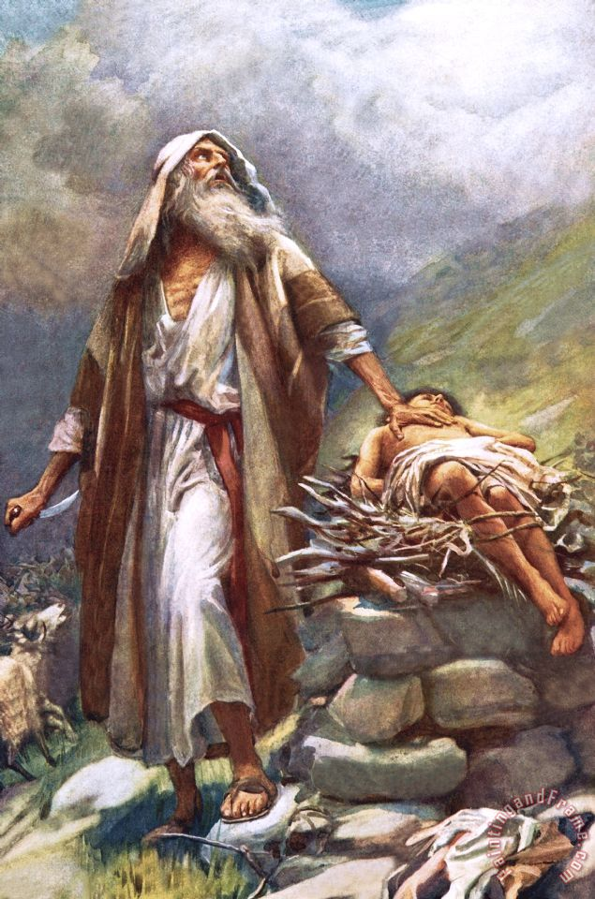
Isaac sees the wood, the firestone, and the knife but no animal for the sacrifice, so he calls out to his father Abraham, and Abraham answers the son of his heart, “Hineni – Here am I” 22:7
And as Abraham stretched forth his hand to kill Isaac with the knife, the Angel of the Lord call out to him from heaven…. “Abraham, Abraham”
And Abraham answered
“Hineni- Here am I”

Slide 8
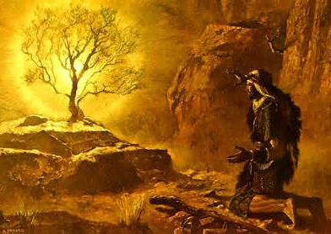
Exodus 3:4 “And when the Lord saw that Moses turned aside to see, God called to him out of the midst of the burning bush, and said , ‘Moses, Moses,’ and he said, HERE AM I.”

Slide 9
Hannah Cried Out in Prayer to the Lord for A Son
1 Samuel 1:11
“O Lord, if You will indeed look
on the affliction of your maidservant and remember me,
& forget not your maidservant, but will give me a son;
then I will give him to You all the days of his life”
When She took a step towards God ….. God took the next step
He gave her Samuel, a son with the supernatural Call of God on his life

Slide 10
The Priesthood was corrupt because of Eli’s sons – Hophni and Phineas. The Word of the Lord was precious in those days - there was no open vision! Eli was old and blind and little Samuel was being trained by Eli to serve the Lord
The Lord called ‘Samuel” and he answered Here am I ” And he ran to Eli and said “Here am I: for you called me. And Samuel said,” I did not call – lie down. Yet the Lord called again Samuel and again Samuel went to Eli and said,” Here am I: for you called me.” After the 3rd time, Eli said, “if He calls you again, you say “Speak, your servant hears You.” 1 Samuel Chapter 3

Slide 11
The Call of God is Poured out on ordinary people
For Extraordinary Work For His Kingdom!

Slide 12
Remember that Saul persecuted the Church…Acts 9
And on the Road to Damascus, everything changed…
Some people
are blind before they can see!

Slide 13
And there was a certain disciple at Damascus, named Ananias; and to him said the Lord in a vision, Ananias. And he said, Behold, I am here, Lord.
Acts 9:10-18
Ananias doesn’t want to go anywhere near Saul, let alone heal him. Saul is persecuting the Church, but the Lord calls Ananias for a special work
And Ananias went his way and entered the house and put his hands on him and said, brother Saul, the Lord, even Jesus that appeared to you in the way as you came, sent me to you, that you may receive your sight, and be filled with the Holy Ghost”

Slide 14
When we respond to God and say
“ HINENI – Here am I “
God’s supernatural power is operating
in our lives
Ordinary people like you and me will do extraordinary feats For Him

Slide 15
But even more amazing than that –
When we say “Here Am I”
God then says “ Here am I”

Slide 16
“Then shall you call,
and the LORD shall answer;
you shall cry,
And He shall say, Here I am.” Isaiah 58:9

Slide 17
Because you have set your love upon Me, there fore will I deliver you.
I will set you on high, because you have known My Name
You shall call upon Me, and I will answer you;
I will be with you in trouble: I will deliver you and honor you.
With long life will I satisfy you, and show you My salvation. Ps 91

Slide 18
Homework
Hineni – Complete Surrender
Call to Action
Find an opportunity this week to say Hineni!

