Slide 1
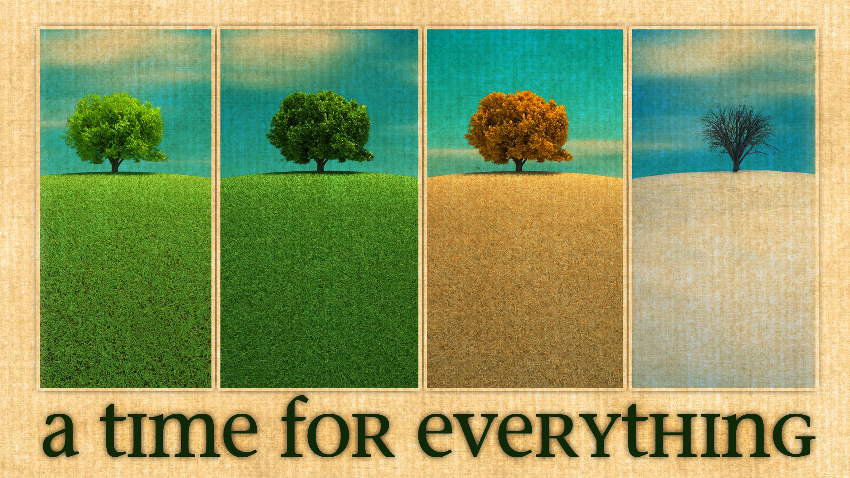

Slide 2
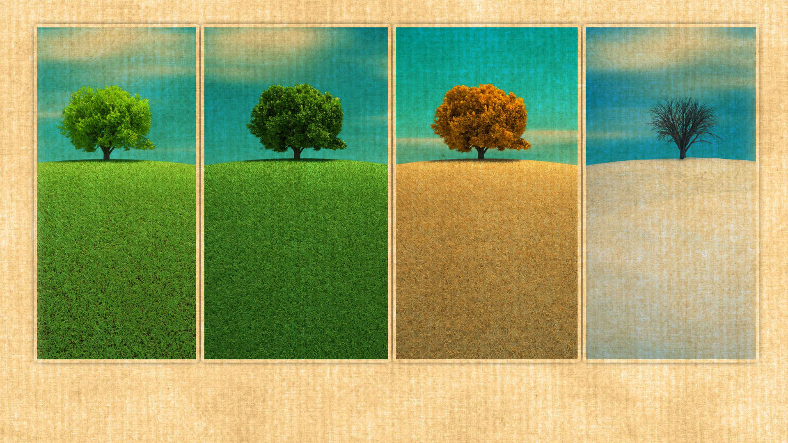
Embracing New Seasons with Faith

Slide 3

Ecclesiastes 3:1-13
1There is a time for everything,
and a season for every activity under the heavens:
² a time to be born and a time to die,
a time to plant and a time to uproot,
³ a time to kill and a time to heal,
a time to tear down and a time to build,
⁴ a time to weep and a time to laugh,
a time to mourn and a time to dance,
⁵ a time to scatter stones and a time to gather them,
a time to embrace and a time to refrain from embracing,
⁶ a time to search and a time to give up,
a time to keep and a time to throw away,
⁷ a time to tear and a time to mend,
a time to be silent and a time to speak,
⁸ a time to love and a time to hate,
a time for war and a time for peace.
⁹ What do workers gain from their toil? ¹⁰ I have seen the burden God has laid on the human race. ¹¹ He has made everything beautiful in its time. He has also set eternity in the human heart; yet^{[a]} no one can fathom what God has done from beginning to end. ¹² I know that there is nothing better for people than to be happy and to do good while they live. ¹³ That each of them may eat and drink, and find satisfaction in all their toil—this is the gift of God.

Slide 4
Quote: Nature is God’s first missionary. Where there is no Bible there are sparkling stars. Where there are no preachers, there are Spring times. If a person has nothing but nature, then nature is enough to reveal something about God. —Max Lucado
Embracing a new season with faith encourages us to not tip-toe but take that leap of faith!

Slide 5
The original Hebrew word for 'season' in Ecclesiastes 3:1 is 'zeman.' This word is used in several other passages in the Old Testament. In Daniel 2:16, Daniel asks for 'zeman' from the king to interpret his dream. In Esther 9:27, the Jews establish a 'zeman' as a time of remembrance. In each of these instances, 'zeman' signifies a divinely appointed time. This understanding of 'zeman' as a divinely appointed time adds depth to our understanding of Ecclesiastes 3:1. It's not just about a time for every purpose, but a divinely appointed time. This brings us to the realization that change, in its various forms, is not random or chaotic. It's part of a divine plan, a plan that is beautiful in its time.

Slide 6
Embracing a New Season
Seasons bring change. Just as the seasons of the year bring change, so do the seasons of our lives. Each season of life brings its own unique beauty and challenges.
Transition. Seasons are not random or meaningless. They are designed to help us grow and mature, to teach us about ourselves and the world, and to bring us closer to God.

Slide 7
Recognize that seasons are part of God's plan. This can be difficult, especially when the new season brings challenges or hardships. But we can take comfort in knowing that God has a purpose for every season of our lives.
Appreciate its unique beauty. If we look closely, we can find beauty in every season of life. We can find joy in the simple things

Slide 8
Homework

Slide 9
Learn from its challenges. This is perhaps the most difficult part of embracing a new season, but it is also the most rewarding. The challenges we face in each season of life are not meant to break us, but to make us stronger.
Trust in God's timing. Let’s be honest, waiting for God to work in our lives can be exhausting, especially when it feels like the season is lasting too long or not long enough. But we can trust that God knows what He is doing.

Slide 10
Appreciating the Beauty of Change
The beauty in change is often overlooked. We're so caught up in the whirlwind of transition that we forget to pause, to breathe, to appreciate the unfolding beauty.
The beauty of change from a different perspective. Change, in its essence, is a process of becoming. It's about shedding the old and embracing the new. It's about growth, transformation, and evolution. When we look at it this way, we see that change is not something to be feared or resisted. Instead, it's something to be welcomed, to be embraced

Slide 11
Understanding God's Appointed Time
Appointed Time. The Hebrew word 'moed' is often translated as 'appointed time' in the Bible. This word carries a sense of divine scheduling, of God's perfect timing. It's not just about a point on a calendar or a tick on a clock. It's about a moment that has been set aside by God for a specific purpose.

Slide 12
God establishes seasons. In the book of Genesis, we see God setting up the celestial bodies to mark out seasons and times. These are not just physical phenomena, but spiritual markers.

Slide 13
Every change is part of God’s plan. This understanding of 'moed' helps us to see that every season in our lives, every change we go through, is part of God's plan. It's not just about the physical changes we can see, but about the spiritual changes that are taking place within us.
As we embrace a new season, we are not just moving from one stage of life to another. We are stepping into a divinely appointed time, a 'moed'. This is a time that God has set aside for us to grow, to learn, to change, and to become more like Him.

Slide 14
C.S. Lewis quote. The respected Christian author, C.S. Lewis, once said, "The great thing, if one can, is to stop regarding all the unpleasant things as interruptions of one's 'own', or 'real' life. The truth is of course that what one calls the interruptions are precisely one's real life -- the life God is sending one day by day."
This reminds us that every moment, every change, every 'interruption' is part of our real life, the life that God has planned for us. It's not an obstacle to our plans, but an opportunity for us to experience God's love, grace, and power.

Slide 15
When we become spiritually flexible, faith acts as our trusty umbrella, shielding us from potential storms, while we remain open to new ideas and experiences that God presents
Every moment, every change has a purpose. And not just any purpose, but a divine purpose.

Slide 16
Embracing a new season is not always easy, but it is always worth it. It is an opportunity to grow, to learn, to appreciate, and to trust. It is an opportunity to see God's hand at work in our lives, and to draw closer to Him. So let's embrace each new season with open hearts and open minds, trusting in God's plan, appreciating the beauty, learning from the challenges, and trusting in His timing.

Slide 17
Homework
As we go about our daily lives this week, let's keep this in mind. Let's look for God's 'moed' in every season, in every change, in every moment. Let's embrace the new season with faith, with hope, and with love. And let's trust in God's perfect timing, knowing that He makes everything beautiful in its time.

