Slide 1
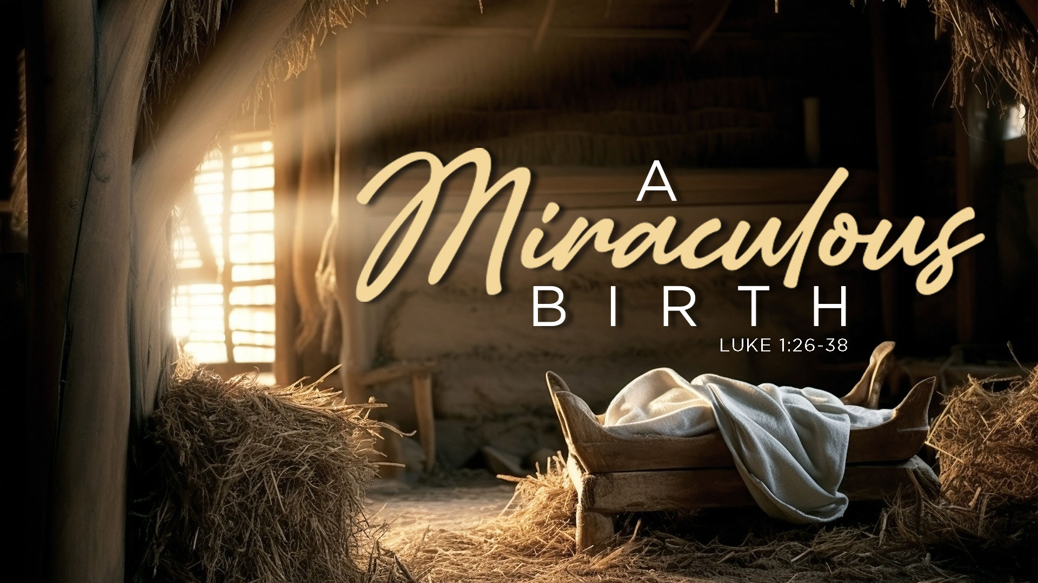
Pastor Richard “Rico” Tubbs

Slide 2
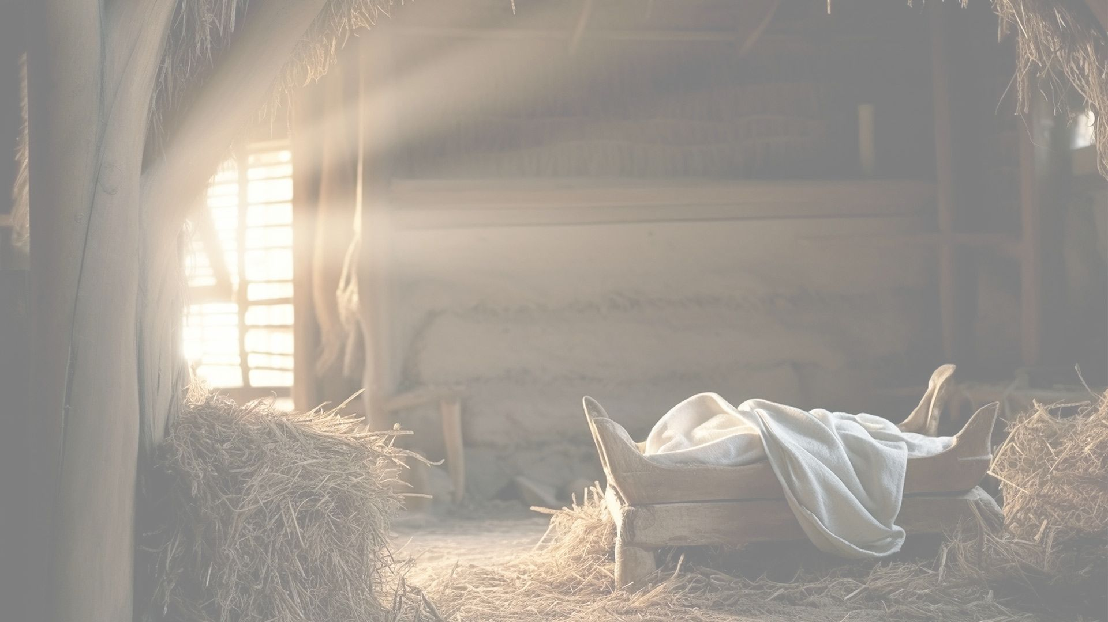
Luke 1:26-38
²⁶ In the sixth month of Elizabeth’s pregnancy, God sent the angel Gabriel to Nazareth, a town in Galilee, ²⁷ to a virgin pledged to be married to a man named Joseph, a descendant of David. The virgin’s name was Mary. ²⁸ The angel went to her and said, “Greetings, you who are highly favored! The Lord is with you.”²⁹ Mary was greatly troubled at his words and wondered what kind of greeting this might be. ³⁰ But the angel said to her, “Do not be afraid, Mary; you have found favor with God. ³¹ You will conceive and give birth to a son, and you are to call him Jesus. ³² He will be great and will be called the Son of the Most High. The Lord God will give him the throne of his father David, ³³ and he will reign over Jacob’s descendants forever; his kingdom will never end.”³⁴ “How will this be,” Mary asked the angel, “since I am a virgin?”³⁵ The angel answered, “The Holy Spirit will come on you, and the power of the Most High will overshadow you. So the holy one to be born will be called^{[a]} the Son of God. ³⁶ Even Elizabeth your relative is going to have a child in her old age, and she who was said to be unable to conceive is in her sixth month. ³⁷ For no word from God will ever fail.”³⁸ “I am the Lord’s servant,” Mary answered. “May your word to me be fulfilled.” Then the angel left her.

Slide 3
The miracle of Christmas is not just that Jesus was born
it is that God came near to rescue, restore, and redeem humanity.

Slide 4
“Looking for the Wrong Miracle”
Many people look for miracles in:
Financial breakthroughs
Physical healing
Sudden answers

Slide 5
But the greatest miracle didn’t come with thunder
It came with a baby’s cry.

Slide 6
Christmas teaches us that God’s greatest miracles often arrive quietly.

Slide 7
THE MIRACLE OF GOD WITH US
“Behold, the virgin shall conceive and bear a Son, and they shall call His name Immanuel.” — Matthew 1:23
“For the Lord Himself will give you a sign…”
— Isaiah 7:14

Slide 8
Immanuel means “God with us,”
not “God far away”
Christmas is God entering our mess, pain, and brokenness
God didn’t shout from heaven
He stepped into humanity

Slide 9
Christmas is God getting down on the floor with humanity.

Slide 10
THE MIRACLE OF A PROMISE KEPT
“But when the fullness of the time had come, God sent forth His Son…”
Galatians 4:4
“Today in the town of David a Savior has been born to you.” Luke 2:11

Slide 11
Christmas didn’t happen randomly
God keeps His promises right on time
Over 300 prophecies pointed to this moment

Slide 12
Like a launch countdown, everything in history was ticking toward Bethlehem.
Christmas proves:
God is never early
God is never late
God is always faithful

Slide 13
THE MIRACLE OF THE HUMBLE ARRIVAL
“And she brought forth her firstborn Son… and laid Him in a manger.”
Luke 2:7
No palace
In poverty
No crown
Among animals
No spotlight
To common people

Slide 14
A king once dressed as a servant to see how his people lived.
They spoke freely around him, never knowing who he really was.
At Christmas, the King of Heaven came disguised as a baby.

Slide 15
THE MIRACLE OF GOOD NEWS FOR ALL PEOPLE
“Behold, I bring you good tidings of great joy which will be to all people.”
Luke 2:10

Slide 16
Christmas is proof
Grace comes before status
God values the overlooked
God didn’t start with the powerful He started with the forgotten.

Slide 17
Christmas reminds us
No one is left out
No one is too far
No one is too small

Slide 18
THE MIRACLE THAT CHANGES EVERYTHING
“For unto us a Child is born, unto us a Son is given.” Isaiah 9:6
“You shall call His name Jesus, for He will save His people from their sins.”
Matthew 1:21

Slide 19
Christmas is the beginning of the rescue mission that leads to
The cross
The empty tomb
The manger points to the cross.

Slide 20
THE MIRACLE STILL AVAILABLE TODAY
Many people admire Christmas, But never receive the gift Himself.

Slide 21
Homework
“Thanks be to God for His indescribable gift!”2 Corinthians 9:15
The miracle of Christmas is not just something to remember
it is something to respond to.
This week and as we prepare for the weeks ahead remember A gift only helps you if it’s opened.

