Slide 1
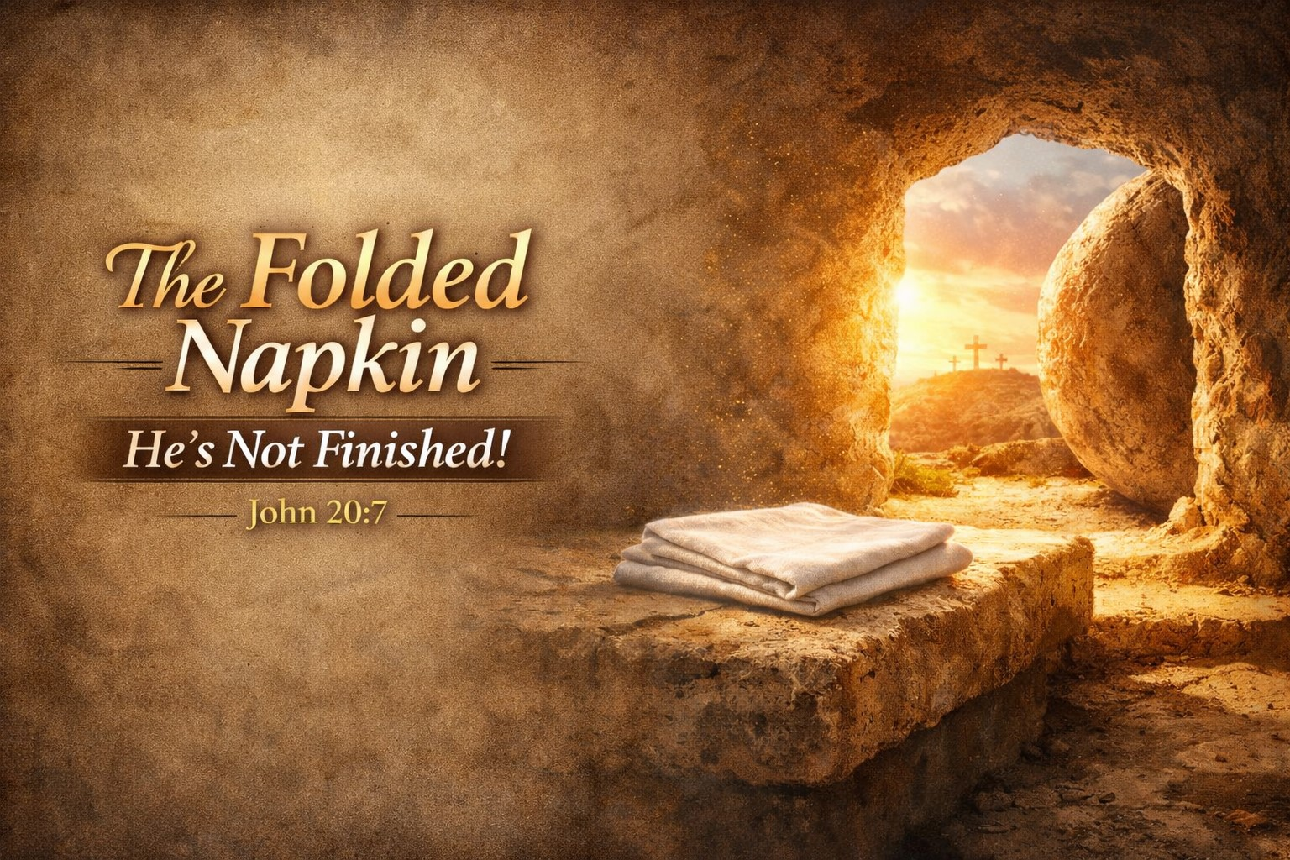
Pastor Richard “ Rico “ Tubbs

Slide 2
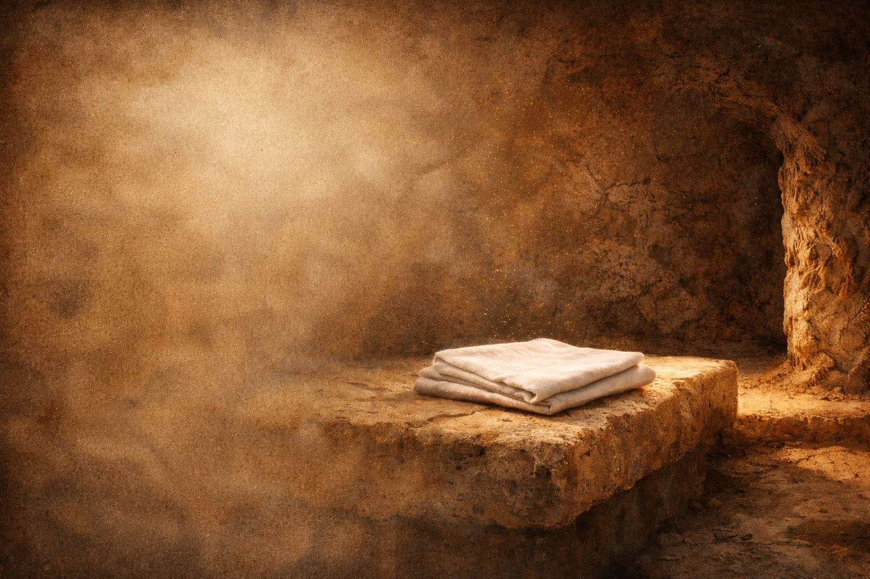
John 20:7
“And the napkin, that was about his head, not lying with the linen clothes, but wrapped together in a place by itself.”

Slide 3
The Detail That Speaks Volumes
At first glance, John 20:7 seems like a small, almost insignificant detail in the resurrection story. The tomb is empty. Jesus is risen. That’s the headline.
But John, under the inspiration of the Holy Spirit, pauses… and zooms in on a napkin.

Slide 4
Not thrown aside.
Not crumpled.
But folded.
Why would that matter?
Because sometimes the smallest details carry the greatest messages

Slide 5
God Is a God of Intentional Details
Nothing in Scripture is accidental.
“All scripture is given by inspiration of God…”
2 Timothy 3:16
John didn’t just say the tomb was empty—he described how it looked. The grave clothes were lying there, but the napkin was separate and folded.

Slide 6
Even in resurrection power, Jesus was intentional.
Even in victory, He was orderly.
Even in leaving the tomb, He left a message.

Slide 7
The Servant’s Napkin
In Jewish culture, when a master was finished eating, he would crumple the napkin and toss it aside. That signaled to the servant:
“I’m done. Clear the table.”
But if the master folded the napkin and placed it neatly…
It meant: “I’m coming back.”
So when Peter and John walked into that tomb, what they saw wasn’t just absence…
It was a promise.

Slide 8
The Folded Napkin Means He’s Not Finished
“Being confident of this very thing, that he which hath begun a good work in you will perform it…” Philippians 1:6
Jesus wasn’t finished!
Not with His mission.
Not with the world.
Not with His disciples.

Slide 9
And hear this clearly today!
The cross wasn’t the end.
The tomb wasn’t the end.
The story wasn’t over.
If Jesus isn’t finished… then your story isn’t finished either.

Slide 10
There was a man who lost everything his business collapsed, his health failed, and relationships fell apart. He said, “I thought my life was over.”
But years later, he looked back and said:
“What I thought was the end was actually God folding the napkin.”
It wasn’t over. It was a transition.

Slide 11
When It Looks Over, God Is Still Working
“Weeping may endure for a night, but joy cometh in the morning.” Psalm 30:5
The disciples thought it was over.
They saw Him die.
They saw Him buried.
They were hiding in fear.
But God was working behind the scenes.
The tomb was silent… but heaven was active.

Slide 12
A caterpillar goes into a cocoon. To the outside world, it looks like nothing is happening.
Still. Silent. Dead.
But inside, transformation is taking place.
What looks like an ending… is actually preparation.
And when it emerges—it’s something completely new.

Slide 13
The Folded Napkin Is a Promise of Return
“I will come again, and receive you unto myself…” John 14:3
Jesus didn’t just rise He left a signal.
The folded napkin whispers across time:
“I’m coming back.”
Not just metaphorically.
Not just spiritually.
But literally.

Slide 14
What Does This Mean for You?
Your situation is not final
That diagnosis… that loss… that failure…
God is not finished.
You may feel buried—but you’re not done.
Your purpose is still alive
Live with expectation, not defeat
Your Savior is returning

Slide 15
A reader once complained to an author halfway through a novel:
“This story is terrible—nothing makes sense!”
The author replied:
“You’re only in chapter 5.”
Some of you are judging your life too early.
God hasn’t finished writing.

Slide 16
Homework
Look at the Napkin
When you feel like it’s over…
When hope seems buried…
When life doesn’t make sense…
The stone is rolled away.
The grave is empty.
And the napkin is folded.
He’s not finished.
Go back to the tomb.
Look again.
He wasn’t finished then.
And He’s not finished now.

Slide 17
If you’ve been feeling like your life is over, your purpose is gone, or your situation is final…
Remember this:
The folded napkin is your sign.
The resurrection is your proof.
And the promise is still alive.
He’s not finished with the world, and He’s not finished with you.

