Slide 1


Slide 2
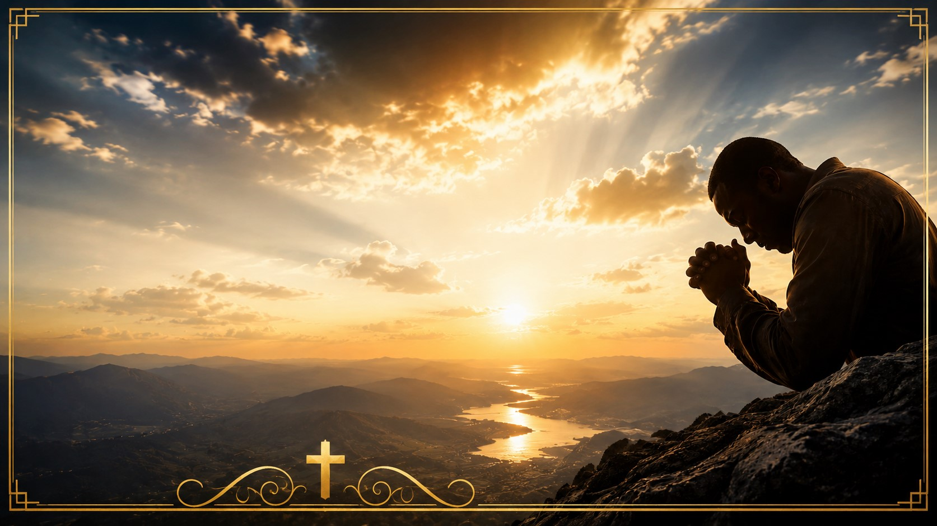
Romans 8:26-27
"In the same way, the Spirit helps us in our weakness. We do not know what we ought to pray for, but the Spirit himself intercedes for us through wordless groans. And He who searches our hearts knows the mind of the Spirit, because the Spirit intercedes for God's people in accordance with the will of God."
Heaven Understands the Language of Your Tears

Slide 3
There are moments in life when words fail us.
There are pains too deep to explain.
Heartbreak too overwhelming to describe.
Questions too heavy to ask.
Sometimes the strongest prayer you'll ever pray is the one you never speak.

Slide 4
You kneel...
You cry...
You sigh...
And nothing comes out.
Yet Heaven hears every silent prayer.
God hears what your lips cannot say.

Slide 5
God Understands the Language of Tears
Psalm 56:8
"You keep track of all my sorrows. You have collected all my tears in Your bottle."
Notice...
God doesn't merely SEE your tears...
He SAVES them…Every tear has a story…Every tear is a prayer.
Every tear says something your mouth couldn't.

Slide 6
Imagine a mother whose newborn cannot speak.
The baby simply cries.
The father hears crying.
The neighbors hear noise.
But Mama knows exactly what the cry means.
She knows whether it's hunger...
Pain...Fear...
Or exhaustion.
Because love understands what words cannot express.
That's exactly how our Heavenly Father responds.
Before you explain...
Before you organize your thoughts...
Before you finish crying...
God already knows.
Why?

Slide 7
The Story of Hannah 1 Samuel 1
1 There was a certain man from Ramathaim, a Zuphite^{[a]} from the hill country of Ephraim, whose name was Elkanah son of Jeroham, the son of Elihu, the son of Tohu, the son of Zuph, an Ephraimite. ² He had two wives; one was called Hannah and the other Peninnah. Peninnah had children, but Hannah had none.
³ Year after year this man went up from his town to worship and sacrifice to the Lord Almighty at Shiloh, where Hophni and Phinehas, the two sons of Eli, were priests of the Lord. ⁴ Whenever the day came for Elkanah to sacrifice, he would give portions of the meat to his wife Peninnah and to all her sons and daughters. ⁵ But to Hannah he gave a double portion because he loved her, and the Lord had closed her womb. ⁶ Because the Lord had closed Hannah’s womb, her rival kept provoking her in order to irritate her. ⁷ This went on year after year. Whenever Hannah went up to the house of the Lord, her rival provoked her till she wept and would not eat. ⁸ Her husband Elkanah would say to her, “Hannah, why are you weeping? Why don’t you eat? Why are you downhearted? Don’t I mean more to you than ten sons?”
⁹ Once when they had finished eating and drinking in Shiloh, Hannah stood up. Now Eli the priest was sitting on his chair by the doorpost of the Lord’s house. ¹⁰ In her deep anguish Hannah prayed to the Lord, weeping bitterly. ¹¹ And she made a vow, saying, “Lord Almighty, if you will only look on your servant’s misery and remember me, and not forget your servant but give her a son, then I will give him to the Lord for all the days of his life, and no razor will ever be used on his head.”
¹² As she kept on praying to the Lord, Eli observed her mouth. ¹³ Hannah was praying in her heart, and her lips were moving but her voice was not heard. Eli thought she was drunk ¹⁴ and said to her, “How long are you going to stay drunk? Put away your wine.”

Slide 8
Yet God heard every word that never left her mouth.
The silent prayer became Samuel.
The tears became testimony.
The broken woman became the mother of one of Israel's greatest prophets.
Your silent prayer may be carrying tomorrow's miracle.

Slide 9
Jesus Heard the Prayer Bartimaeus Never Finished
Mark 10:46-52
⁴⁶ Then they came to Jericho. As Jesus and his disciples, together with a large crowd, were leaving the city, a blind man, Bartimaeus (which means “son of Timaeus”), was sitting by the roadside begging. ⁴⁷ When he heard that it was Jesus of Nazareth, he began to shout, “Jesus, Son of David, have mercy on me!”
⁴⁸ Many rebuked him and told him to be quiet, but he shouted all the more, “Son of David, have mercy on me!”
⁴⁹ Jesus stopped and said, “Call him.”
So they called to the blind man, “Cheer up! On your feet! He’s calling you.” ⁵⁰ Throwing his cloak aside, he jumped to his feet and came to Jesus.
⁵¹ “What do you want me to do for you?” Jesus asked him.
The blind man said, “Rabbi, I want to see.”
⁵² “Go,” said Jesus, “your faith has healed you.” Immediately he received his sight and followed Jesus along the road.

Slide 10
They tried to silence his voice.
But Jesus heard something deeper.
He heard faith.
Sometimes people hear your volume.
God hears your heart.

Slide 11
Imagine being trapped under collapsed concrete after an earthquake.
You have no strength to scream.
No energy left.
But rescue workers have sensitive equipment that detects even the faintest heartbeat.
They don't rescue noise.
They rescue life.
God doesn't respond because your prayer is loud.
He responds because your heart is alive.

Slide 12
God Heard Hagar's Cry in the Wilderness
Genesis 21:1-17
Now the Lord was gracious to Sarah as he had said, and the Lord did for Sarah what he had promised. ² Sarah became pregnant and bore a son to Abraham in his old age, at the very time God had promised him. ³ Abraham gave the name Isaac^{[a]} to the son Sarah bore him. ⁴ When his son Isaac was eight days old, Abraham circumcised him, as God commanded him. ⁵ Abraham was a hundred years old when his son Isaac was born to him.
⁶ Sarah said, “God has brought me laughter, and everyone who hears about this will laugh with me.” ⁷ And she added, “Who would have said to Abraham that Sarah would nurse children? Yet I have borne him a son in his old age.”
⁸ The child grew and was weaned, and on the day Isaac was weaned Abraham held a great feast. ⁹ But Sarah saw that the son whom Hagar the Egyptian had borne to Abraham was mocking, ¹⁰ and she said to Abraham, “Get rid of that slave woman and her son, for that woman’s son will never share in the inheritance with my son Isaac.”
¹¹ The matter distressed Abraham greatly because it concerned his son. ¹² But God said to him, “Do not be so distressed about the boy and your slave woman. Listen to whatever Sarah tells you, because it is through Isaac that your offspring^{[b]} will be reckoned. ¹³ I will make the son of the slave into a nation also, because he is your offspring.”
¹⁴ Early the next morning Abraham took some food and a skin of water and gave them to Hagar. He set them on her shoulders and then sent her off with the boy. She went on her way and wandered in the Desert of Beersheba.
¹⁵ When the water in the skin was gone, she put the boy under one of the bushes. ¹⁶ Then she went off and sat down about a bowshot away, for she thought, “I cannot watch the boy die.” And as she sat there, she^{[c]} began to sob.
¹⁷ God heard the boy crying, and the angel of God called to Hagar from heaven and said to her, “What is the matter, Hagar? Do not be afraid; God has heard the boy crying as he lies there. ¹⁸ Lift the boy up and take him by the hand, for I will make him into a great nation.”

Slide 13
Years ago, a firefighter shared the story of responding to a devastating house fire.
Inside the smoke-filled home was a frightened little girl.
She couldn't call for help because the smoke had overcome her.
She never shouted.
She never screamed.
But through the thick smoke, rescuers heard a faint cough.
That tiny sound guided them directly to her.
Later the firefighter said,
"It wasn't her words that saved her. It was simply knowing she was still alive."

Slide 14
Sometimes God answers prayers you never knew you prayed.
Some of you don't have enough strength left to shout.
But Heaven hears the faint cough of your faith.

Slide 15
Jesus Wept Before Lazarus Walked
John 11:35
Have you ever watched someone sit beside a grieving friend?
Sometimes they say nothing.
No advice…No sermon…No explanation…Just presence.
Sometimes presence speaks louder than words.
That's exactly what Emmanuel means...
God with us.

Slide 16
Jesus Understood the Silent Prayer of Gethsemane
Luke 22:44
Jesus prayed until His sweat became drops of blood.
He didn't give a long public prayer.
He agonized.
He groaned.
He surrendered.
The Father understood every emotion.
If Jesus experienced moments beyond words...
So will we.

Slide 17
Romans 8
²⁶ In the same way, the Spirit helps us in our weakness. We do not know what we ought to pray for, but the Spirit himself intercedes for us through wordless groans. ²⁷ And he who searches our hearts knows the mind of the Spirit, because the Spirit intercedes for God’s people in accordance with the will of God.
Paul tells us...
The Holy Spirit translates every sigh.
Every groan.
Every broken whisper.
Every tear.
Into perfect prayers before the throne of God.
Even when you don't know what to ask...
He already knows.

Slide 18
A pastor once visited a woman who had lost both her husband and her son within a few months.
He expected to pray with her.
Instead...
She simply cried.
For nearly twenty minutes.
Not one sentence.
When she finally spoke, she whispered,
"Pastor... I couldn't find the words... but somehow I knew God already heard everything."
Years later she testified,
"That season became the strongest my faith had ever been—not because I had answers, but because I discovered God's presence doesn't depend on my ability to explain my pain."

Slide 19
The Greatest Illustration
The Cross
Isaiah 53
Jesus hung upon the Cross.
He spoke seven sayings.
But there were also moments of silence.
His suffering spoke louder than words.
His blood cried mercy.
His sacrifice declared love.
His wounds spoke forgiveness.
Even when Jesus was silent...
He was speaking salvation.

Slide 20
There is an old story about a little boy flying a kite.
The clouds became so thick that no one could see the kite anymore.
A man asked,
"How do you know it's still there?"
The little boy smiled.
"I can't see it...But every now and then...
I feel the tug."
Church...
You may not hear God today…You may not see Him today.
You may not understand Him today…But if you're still feeling the tug
He's still holding the other end.

Slide 21
Homework
Some of you came carrying prayers you have never spoken aloud.
Some have hidden tears behind smiles.
Some have buried grief beneath busy schedules.
Some are fighting battles no one knows about.
This week Hear the promise of God's Word:
He heard Hannah.
He heard Hagar.
He heard Bartimaeus.
He heard Jesus in Gethsemane.
And today...
He hears you.
Not just your words...Your heart.
Not just your voice...Your tears.
Not just your prayer...Your silence.
Psalm 34:18
"The Lord is close to the brokenhearted and saves those who are crushed in spirit."
Because...
God Heard What you and I Couldn't Say.

Slide 22
Heavenly Father,
Thank You that You know every burden we carry, every tear we have cried, and every prayer we have been unable to put into words. When our hearts are overwhelmed and our voices fall silent, remind us that Your Spirit intercedes for us and that nothing escapes Your loving attention.
Lord, for those who are grieving, bring comfort. For those who are waiting, bring hope. For those who are weary, bring renewed strength. For those who feel forgotten, let them know they are deeply seen, deeply loved, and never alone.
Teach us to trust that You are working even when we cannot see it, speaking even when You seem silent, and answering prayers that only You can fully understand.
Today we surrender our unspoken fears, hidden wounds, and silent cries into Your hands, believing that You hear what we cannot say and that Your perfect will is always at work for our good and Your glory.
In the mighty name of Jesus Christ we pray,
Amen.

