Slide 1

Pastor Richard “ Rico” Tubbs

Slide 2
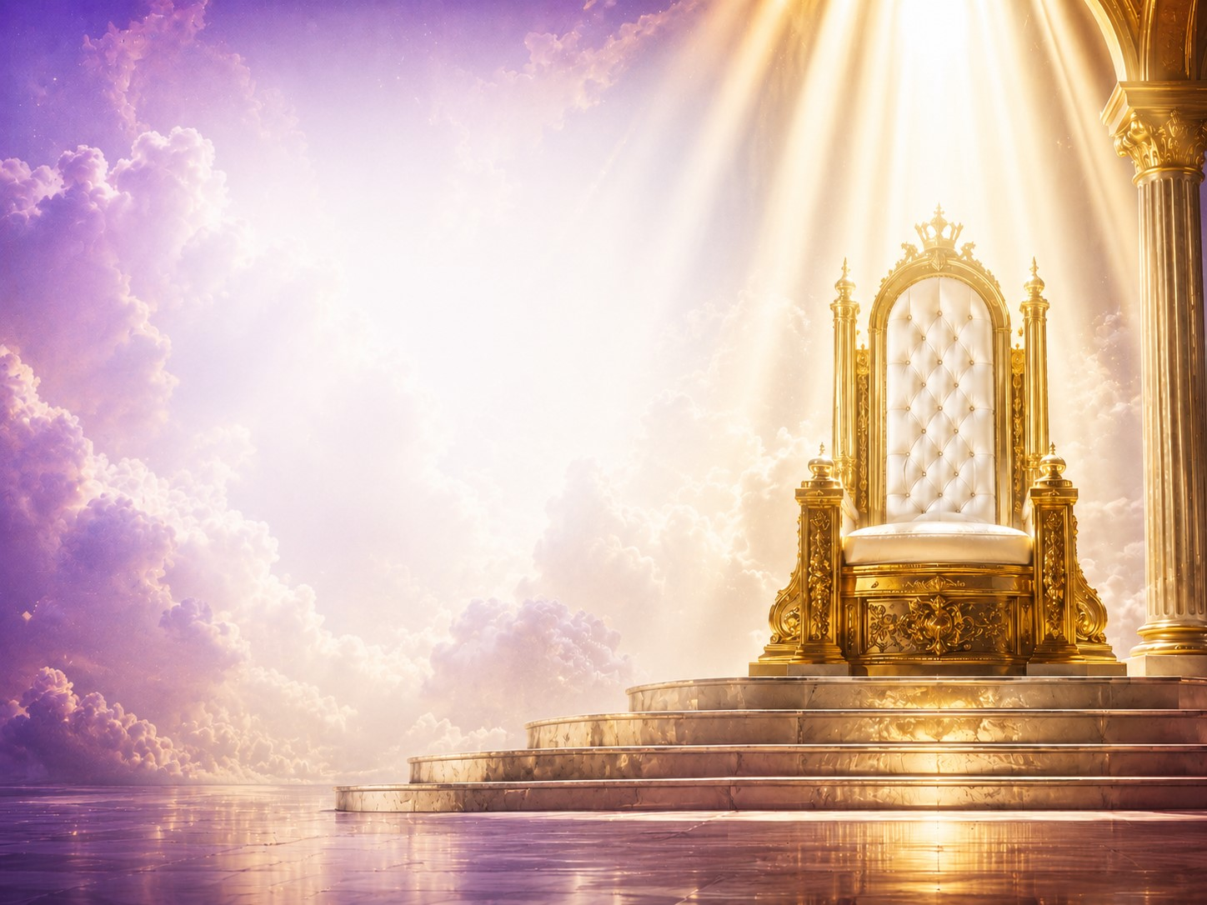
"From Anxiety to Assurance, From Burden to Breakthrough"
Hebrews 4:16
"Let us therefore come boldly unto the throne of grace, that we may obtain mercy, and find grace to help in time of need."

Slide 3
Notice the scripture doesn't say:
"Come to the throne when you've got it all together."
It doesn't say:
"Come after you've fixed yourself."
It doesn't say:
"Come when you've become strong."

Slide 4
It says:
Come boldly.
Why?
Because the throne we approach is not a throne of judgment for believers.
It is a throne of grace.

Slide 5
Every person in this room is carrying something.
Some are carrying financial burdens.
Some are carrying family problems.
Some are carrying sickness.
Some are carrying grief.
Some are carrying disappointments that nobody knows about.
The question is not, "Do you have burdens?“
The question is, "What are you doing with them?"

Slide 6
God Invites Us to Bring Everything
1 Peter 5:7
"Casting all your care upon Him; for He careth for you."
Not some.
Not the spiritual cares only.
Not just the church problems.
Not just the emergencies.
ALL!

Slide 7
Bring Me your fears.
God says:
Bring Me your financial troubles.
Bring Me your stress.
Bring Me your marriage struggles.
Bring Me your broken heart.
Bring Me your children.
Bring Me your future.
Why?
Because He cares for you.

Slide 8
A young student was carrying an overloaded backpack.
Books.
Laptops.
Supplies.
His father pulled up beside him and said:
"Get in the truck."
The son climbed into the truck—but kept the backpack on.
The father asked:
"Why are you still carrying that?"
The son replied:
"I didn't want to burden the truck."
Many Christians do exactly that.
They've climbed into God's salvation.
They're riding in God's grace.
Yet they're still carrying burdens Jesus already paid for.
God says:
"Put the backpack down."

Slide 9
The Throne of Grace Is Higher Than Your Problem
Psalm 103:19
"The Lord hath prepared his throne in the heavens; and his kingdom ruleth over all."

Slide 10
Over all means:
Over cancer.
Over bankruptcy.
Over addiction.
Over depression.
Over prodigal children.
Over impossible situations.

Slide 11
But above every voice is another voice.
The voice from the Throne.
Isaiah saw it.
John saw it.
Ezekiel saw it.
A throne high and lifted up.
Every problem has a voice.
Fear says:
"You won't make it."
Depression says:
"You'll never recover."
Debt says:
"You'll never get ahead."
The doctor says:
"It doesn't look good."
The enemy says:
"It's over."
The throne has never been shaken by what shakes us.
God has never had an emergency meeting.
God has never been nervous.
God has never said, "I didn't see that coming."

Slide 12
Mark 4 records the disciples crossing the Sea of Galilee.
Suddenly a violent storm erupted.
The disciples were panicking.
Water was filling the boat.
Yet Jesus was sleeping.
The disciples cried:
"Master, carest thou not that we perish?"

Slide 13
Isn't that what we often ask?
"God, do You see this?"
"God, do You care?"
"God, where are You?"

Slide 14
Jesus stood up and spoke three words:
"Peace, be still."
The storm that terrified experienced fishermen obeyed the voice of Jesus.
The lesson:
The disciples were focused on the storm.
Jesus was focused on the throne.
The storm wasn't bigger than the Savior.
Neither is yours.

Slide 15
Worry Is Carrying Tomorrow's Burdens With Today's Strength
Philippians 4:6-7
"Be careful for nothing; but in every thing by prayer and supplication with thanksgiving let your requests be made known unto God."
Then comes the promise:
"And the peace of God, which passeth all understanding, shall keep your hearts and minds through Christ Jesus."

Slide 16
Prayer doesn't always change the situation immediately.
But it changes the person in the situation.
Jesus taught repeatedly against worry.
Worry never fixes anything.
It drains strength.
Steals joy…Destroys peace…Robbs faith
Worry says: "What if He doesn't?"
Faith says:"God can."

Slide 17
Worry is like a rocking chair.
It gives you something to do.
But it doesn't take you anywhere.
Some people have spent years rocking.
God says:
Step out of the chair! Come to the throne.

Slide 18
The Throne of Grace Is Where Exchange Happens
Isaiah 40:31
"But they that wait upon the Lord shall renew their strength."
The throne is not merely a place of prayer.
It is a place of divine exchange.

Slide 19
At the throne:
You bring fear.
God gives peace.
You bring anxiety.
God gives assurance.
You bring weakness.
God gives strength.
You bring brokenness.
God gives healing.
You bring guilt.
God gives forgiveness.

Slide 20
A Christian widow was down to her last few dollars.
Bills piled up.
Food was running low.
The future looked hopeless.
Instead of panicking, she knelt beside her bed.
She prayed:
"Lord, I don't know how You're going to do it, but this burden belongs to You now."
The next day an unexpected check arrived from a source she had completely forgotten.
Years later she said:
"I learned that God may not come when fear demands it, but He always arrives when faith trusts Him."
The miracle wasn't just provision.
The miracle was peace before the provision arrived.

Slide 21
Jesus Opened Access to the Throne
Romans 8:34
"Christ... maketh intercession for us."
While you are worrying...
Jesus is praying.
While you are crying...
Jesus is interceding.
While you are struggling...
Jesus is advocating.
You are not facing your battle alone.

Slide 22
In the Old Testament only the High Priest entered the Holy of Holies.
But when Jesus died on Calvary:
The veil was torn.
The barrier was removed.
Access was granted.
Because of the blood of Jesus we can approach God boldly.
Not arrogantly.
Boldly.
Not because we are worthy. But because Jesus is worthy.

Slide 23
A poor servant once received an invitation from the king.
When he arrived at the palace gates, he hesitated.
He felt unworthy.
Dirty…Broken…Ashamed.
The guards saw the invitation and said:
"The king isn't inviting you because of who you are. He's inviting you because of who he is."
God invites us to the throne not because of our perfection but because of His grace.

Slide 24
Homework
What burden will you carry into this week?
A marriage?
A diagnosis?
A prodigal child?
A financial crisis?
A broken dream?
A hidden pain?
God is asking one question:
Because what you hold onto, God cannot carry for you.
The burden that remains in your hands stays your responsibility.
"Will you keep carrying it, or will you cast it?"
The burden surrendered to God becomes His responsibility.

Slide 25
Psalm 55:22
"Cast thy burden upon the Lord, and he shall sustain thee."
And remember:
You may have walked in carrying your burden—
But you don't have to leave carrying it.
Cast it on the Throne of Grace.
Leave it there.
Trust the King.
And walk out in peace.

Slide 26
