Slide 1
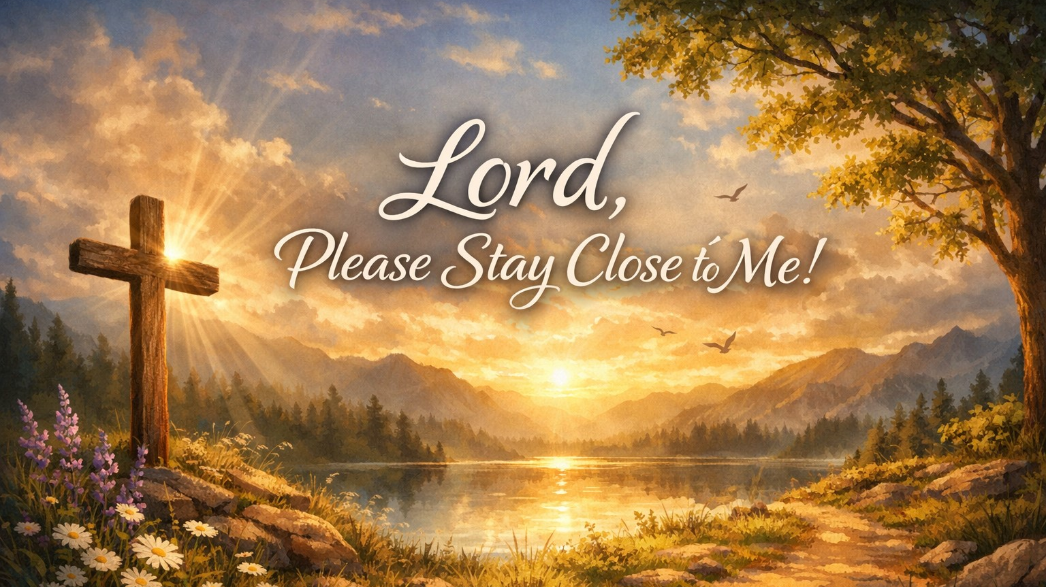
Pastor Richard “ Rico “ Tubbs

Slide 2

Psalm 73:28
“But it is good for me to draw near to God: I have put my trust in the Lord God…”
James 4:8
“Draw near to God, and He will draw near to you.”

Slide 3
There comes a moment in every life not just once, but again and again when the deepest prayer we can pray is simple:
“Lord… please stay close to me.”

Slide 4
Not for blessings.
Not for breakthroughs.
Not even for answers.
Just His presence.
Because when life gets heavy, confusing, or overwhelming, we discover something powerful:
It’s not what God gives that sustains us
it’s how close He is.

Slide 5
Closeness Is Greater Than Control
We often want God to control our situations, fix our problems, remove our storms.
But God’s greatest promise is not control it’s closeness.
Isaiah 41:10
“Fear not, for I am with you…”

Slide 6
A child in a thunderstorm doesn’t ask, “Can you stop the storm?”
They ask, “Can you stay with me?”
And somehow… the storm feels smaller when someone is near.
That’s what we’re really praying:
“God, I can handle the storm…
as long as You’re close.”

Slide 7
Distance From God Is Our Greatest Danger
The enemy’s goal isn’t always to destroy you instantly—it’s to distance you slowly.
A little less prayer
A little less worship
A little more distraction
A little more compromise
Before long, you look up and realize:
“I’m still functioning… but I’m not as close to God as I used to be.”

Slide 8
Because when God is close:
Peace replaces panic
Strength replaces weakness
Direction replaces confusion
Hope replaces despair
The greatest tragedy in life is not trouble… it is distance from God.
The greatest blessing is His presence.

Slide 9
Revelation 2:4
“You have left your first love.”
Think about a campfire.
You don’t have to pour water on a coal to make it go out
just move it away from the fire.
Some people aren’t burned out…
they’re just too far from the flame.

Slide 10
God’s Presence Brings Peace in the Middle of Pressure
Psalm 23:4
“Even though I walk through the valley… I will fear no evil, for You are with me.”
Notice:
The valley didn’t disappear
The danger didn’t vanish
But fear lost its power
Why?
Because God was close.

Slide 11
There was a man going through one of the hardest seasons of his life—loss, stress, uncertainty.
He said, “I kept asking God to change my situation… but instead, He changed my awareness of His presence.”
And he said, “Once I felt God near me… I stopped needing everything else to change.”

Slide 12
When God is close:
Anxiety loses its grip
Fear loses its voice
Confusion loses its control

Slide 13
Staying Close Requires Intentional Pursuit
Jeremiah 29:13
“You will seek Me and find Me when you seek Me with all your heart.”
God isn’t hiding—but He does respond to hunger.
Closeness to God doesn’t happen by accident
it happens by pursuit.

Slide 14
In any relationship, closeness requires time, attention, and priority.
You don’t drift into intimacy
you press into it.
If you want God close:
Talk to Him (prayer)
Listen to Him (Word)
Walk with Him (obedience)

Slide 15
The Power of a Simple Prayer
Sometimes the most powerful prayers are not long or fancy—they’re honest.
“Lord… stay close.”
Luke 24:29
The disciples said to Jesus,
“Stay with us.”
And He did.

Slide 16
Because when God is close:
You can walk through anything
You can face anything
You can endure anything

Slide 17
“Lord, we don’t just want Your hand—we want Your presence.
We don’t just want what You can do—we want You.
Draw us closer.
Remove anything that creates distance.
Let us feel Your nearness in every moment.
Lord… please stay close to us.
And help us stay close to You.
In Jesus’ name… Amen.”

Slide 18
The Greatest Need of the Human Heart
There are many prayers people pray:
“Lord, bless me.”
“Lord, help me.”
“Lord, provide for me.”
But one of the most powerful prayers a believer can pray is simple:
“Lord, please stay close to me.”

Slide 19
The Cry for God’s Presence
Scripture
Exodus 33:15
Moses said to Him,
"If Your Presence does not go with us, do not send us up from here."
Moses had seen miracles.
The Red Sea parted
Pharaoh defeated
Manna from heaven
Water from a rock
Yet Moses said something shocking:
“God, if You’re not going with us, we are not going.”
Moses understood something many people miss:
Miracles are wonderful… but the Presence of God is everything.

Slide 20
Imagine a child walking through a dark forest.
The child doesn’t ask:
“Can you turn the lights on?”
The child asks:
“Daddy, will you walk with me?”
Because when the father is close, fear disappears.
This is the cry of every believer:
“Lord… stay close to me.”

Slide 21
When God Feels Distant
There are seasons when God feels far away.
David experienced this.
Scripture
Psalm 22:1
“My God, my God, why have you forsaken me?”
David wasn't faithless.
He was honest.
Even Jesus quoted this verse on the cross.
There are moments when:
prayers feel unanswered
heaven feels silent
God feels distant
But feelings are not facts.
God never abandoned David.
And He never abandons His people.

Slide 22
Mark 4:35–41
Jesus told the disciples:
“Let us go to the other side.”
Then a storm erupted.
The waves crashed.
The boat filled with water.
And where was Jesus?
Sleeping.
The disciples panicked.
“Teacher, don’t you care if we drown?”
But Jesus stood up and said:
“Peace, be still.”
And the storm stopped instantly.
Here is the lesson:
The storm looked bigger than their faith.
But Jesus was still in the boat.
Sometimes God seems silent…
But He is still with you.

Slide 23
A phone battery slowly dies when disconnected from the charger.
The phone still exists…
but it loses power.
The same thing happens spiritually.
People don’t collapse instantly when they drift from God.
They slowly lose:
joy
peace
clarity
purpose
Which is why the prayer must always be:
“Lord… stay close to me.”

Slide 24
The Prayer God Loves to Hear
David prayed something powerful.
Scripture
Psalm 51:11
“Do not cast me from Your presence or take Your Holy Spirit from me.”
David had lost:
reputation
peace
joy
But he begged God:
“Please don’t take Your presence from me.”
Because David knew:
Without God's presence…
everything else is empty.

Slide 25
A wealthy man once said on his deathbed:
“I spent my life chasing success… but I never chased God.”
At the end of life, money cannot comfort your soul.
But God's presence can.

Slide 26
Jesus Came So God Could Stay Close
Before Jesus, God's presence lived in the Temple.
But after the cross…
everything changed.
Scripture
Matthew 27:51
“The veil of the temple was torn in two.”
That veil separated humanity from God's presence.
When Jesus died…
the barrier was removed.
Now God is not distant.
Scripture
Hebrews 13:5
“I will never leave you nor forsake you.”

Slide 27
A famous pastor once told this story.
A little boy was walking with his father through a crowded street.
At first the father held the boy’s hand.
But the crowd became thick and loud.
The boy suddenly grabbed his father’s hand with both hands and said:
“Daddy, hold me tighter.”
The father asked,
“Why?”
The boy replied,
“Because I might let go… but I know you won’t.”
That is the prayer of every believer.
Not:
“Lord, bless me.”
Not:
“Lord, give me things.”
But:
“Lord… stay close to me.”

Slide 28
Make It Your Daily Cry
Not just in crisis.
Not just on Sundays.
But every single day:
“Lord, please stay close to me.”

Slide 29
Homework
Some people today feel like God has become distant.
Maybe:
life got busy
faith got weak
sin created distance
pain created doubt
But God is still calling!
And this week starting today your prayer can simply be:
“Lord, please stay close to me.”
Not for a moment…
Not for a season…
But for the rest of my life.

