Slide 1


Slide 2
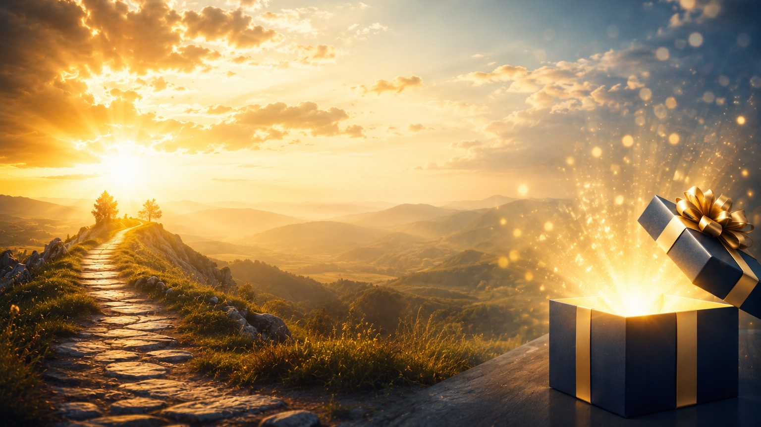
"God Often Wraps His Greatest Blessings in the Most Unlikely Packages"
Romans 8:28
"And we know that all things work together for good to those who love God, to those who are the called according to His purpose."

Slide 3
Isaiah 55:8-9
“For My thoughts are not your thoughts, neither are your ways My ways,” declares the Lord. “As the heavens are higher than the earth, so are My ways higher than your ways and My thoughts than your thoughts.”
Have you ever prayed for one thing, but God answered in a completely different way?

Slide 4
We often picture blessings wrapped in beautiful paper:
A promotion.
A healed body.
A financial breakthrough.
An open door.
But sometimes God’s greatest blessings arrive disguised as:
A delay.
A disappointment.
A closed door.
A difficult season.
Even a painful loss.

Slide 5
Many people miss their blessing because they don’t recognize the package it came in.
The blessing isn’t always what you expected…
Sometimes it’s better than you imagined.

Slide 6
Joseph’s Pit Became His Palace
Genesis 50:20
²⁰ You intended to harm me, but God intended it for good to accomplish what is now being done, the saving of many lives.

Slide 7
Joseph never prayed to be thrown into a pit.
He never asked to be sold into slavery.
He never dreamed of sitting in prison.
Yet every painful chapter was preparing him for the palace.

Slide 8
The pit looked like rejection.
The prison looked like failure.
But heaven saw preparation.
God was positioning Joseph where he could save an entire nation.
Sometimes the blessing isn’t getting out of the pit…
It’s what God develops while you’re in it.

Slide 9
A sculptor was once asked how he created such beautiful statues.
He replied,
“I simply remove everything that doesn’t belong.”
Sometimes God removes comfort…
Removes people…
Removes opportunities…
Not because He is punishing us…
But because He’s shaping us.

Slide 10
Closed Doors Often Protect Greater Blessings
Sometimes we’re angry over doors God refused to open.
We cry because we lost a job…
Lost a relationship…
Lost an opportunity…
Years later we thank God for saying “No.”
Acts 16

Slide 11
The prison wasn’t their destination.
It was somebody else’s miracle.
The earthquake wasn’t just for Paul.
It was for the jailer and his entire family.
Sometimes your prison is somebody else’s blessing.
Paul and Silas weren’t celebrating because everything was going well.
They had been beaten.
Their backs were bleeding.
Their feet were chained.
Yet at midnight…
They praised God.
If God had prevented the prison…
The jailer would never have been saved.
Sometimes your blessing isn’t where you wanted to go…
It’s where God intentionally places you.

Slide 12
The Blind Man Received More Than Sight
John 9:1-3
9 As he went along, he saw a man blind from birth. ² His disciples asked him, “Rabbi, who sinned, this man or his parents, that he was born blind?”³ “Neither this man nor his parents sinned,” said Jesus, “but this happened so that the works of God might be displayed in him.

Slide 13
The disciples asked,
“Who sinned?”
Jesus answered,
“This happened so the works of God might be displayed.”
Everyone else saw a handicap.
Jesus saw a testimony.
People judged the man by his blindness.
Jesus saw the miracle waiting inside him.
Sometimes your greatest blessing comes wrapped in your greatest struggle.

Slide 14
The farmer’s son broke his leg trying to tame one of the horses.
Again the neighbors cried,
“What terrible luck.”
The farmer answered,
“Maybe.”
Soon afterward soldiers came recruiting every healthy young man for war.
Because his son’s leg was broken…
He stayed home.
What first looked like tragedy became salvation.
A Chinese farmer’s horse ran away.
The neighbors said,
“What bad luck.”
The farmer replied,
“Maybe.”
A few days later the horse returned with several wild horses.
The neighbors said,
“What wonderful luck.”
The farmer replied,
“Maybe.”
Sometimes we’re too quick to label what only God fully understands.

Slide 15
Jesus Looked Like a Defeat on Friday
Imagine standing at Calvary.
The disciples thought everything was over.
The crowds walked away.
Hope appeared buried.
Friday looked like failure.
Saturday felt silent.
But Sunday changed history.
The cross looked like defeat…
Yet it became the greatest blessing humanity has ever received.
Never judge God’s work before Sunday arrives.

Slide 16
A businessman spent years building his company.
One recession destroyed everything.
He lost his business…His home…Nearly his marriage.
Broken and desperate, he surrendered his life completely to Christ.
What felt like the end became the beginning.
Years later he started a ministry helping struggling families recover from financial disaster while leading hundreds to Jesus.
He later said,
“If God had answered my first prayer and saved my business, I never would have discovered my true calling.”
Sometimes God doesn’t save what we’re trying to protect…
Because He’s preparing something greater than we ever imagined.

Slide 17
The Emmaus Road
Luke 24:13-35
Two disciples walked away disappointed.
They believed Jesus had failed.
They thought the blessing had died.
But Jesus Himself was walking beside them.
The blessing was closer than they realized.
How many times have we prayed,
“Lord, where are You?”
While He has been walking beside us the entire time?
Sometimes blessings don’t arrive…
They’ve been with us all along.

Slide 18
Three Unexpected Ways God Blesses Us
1. Through Delays
Waiting strengthens faith.
God prepares us while we wait.
Abraham waited.
David waited.
Moses waited.
Jesus waited until the perfect time.
God is never late.
2. Through Difficult People
Some people become our greatest teachers.
They teach patience.
Forgiveness.
Mercy.
Dependence upon God.
Even Judas helped fulfill God’s purpose.
3. Through Disappointments
Every disappointment isn’t a dead end.
Sometimes it’s divine redirection.
God closes doors no man can open…
And opens doors no man can shut.

Slide 19
A little girl was holding a tiny teddy bear.
Jesus stood before her holding an enormous one behind His back.
He said,
“Give Me yours.”
She cried,
“But this is all I have.”
She couldn’t see what Jesus was holding.
Many of us cling tightly to what God is asking us to release.
Not knowing He’s trying to place something much greater into our hands.
Faith lets go because it trusts the One who is asking.

Slide 20
Homework
Never measure God’s goodness by today’s circumstances.
Sometimes blessings come dressed as burdens.
Sometimes miracles arrive wearing work clothes.
Sometimes breakthroughs begin with breakdowns.
Measure His goodness by His promises.
Romans 8:28 reminds us:
“And we know that in all things God works for the good of those who love Him, who have been called according to His
Perhaps you've been questioning God's plan because life has not unfolded the way you expected.
This week, God is inviting you to trust Him even when you cannot see/feel Him.
Bring Him your disappointments.
Bring Him your unanswered prayers.
Bring Him your closed doors.
Bring Him your broken dreams.
Your greatest blessing may already be on its way—it just may not arrive in the package you expected.

Slide 21
Heavenly Father, we thank You that Your ways are higher than our ways and Your thoughts are higher than our thoughts. Teach us to trust You when we cannot understand Your plan. Help us to recognize Your hand even when blessings come disguised as trials, delays, or disappointments. Give us faith to believe that You are working all things together for our good and for Your glory. Transform our struggles into testimonies, our fears into faith, and our waiting into worship. May we leave today with renewed confidence that You are faithful, and that Your greatest blessings often come in ways we never expected. In the mighty name of Jesus we pray, Amen.

