Slide 1
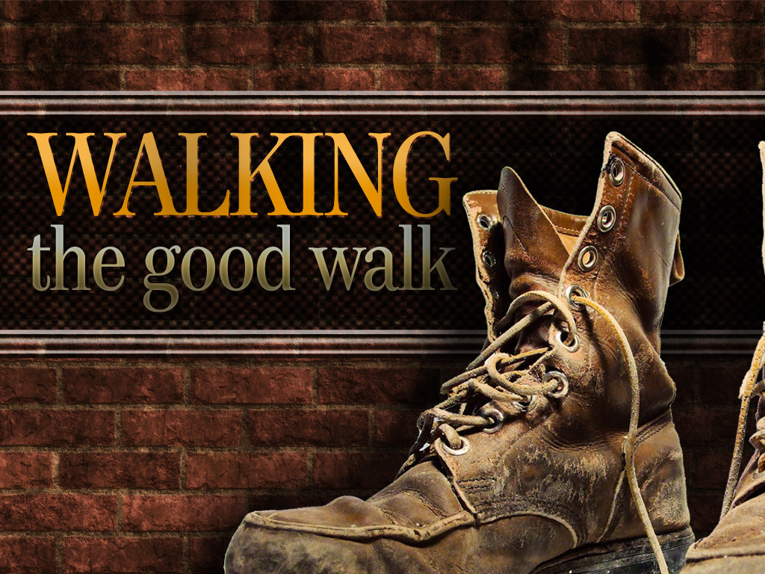
Luke 24:13–35
Pastor Richard “Rico” Tubbs

Slide 2

On the Road to Emmaus Luke 24:13-35
¹³ Now that same day two of them were going to a village called Emmaus, about seven miles^{[a]} from Jerusalem. ¹⁴ They were talking with each other about everything that had happened. ¹⁵ As they talked and discussed these things with each other, Jesus himself came up and walked along with them; ¹⁶ but they were kept from recognizing him.
¹⁷ He asked them, “What are you discussing together as you walk along?”
They stood still, their faces downcast. ¹⁸ One of them, named Cleopas, asked him, “Are you the only one visiting Jerusalem who does not know the things that have happened there in these days?”
¹⁹ “What things?” he asked.
“About Jesus of Nazareth,” they replied. “He was a prophet, powerful in word and deed before God and all the people. ²⁰ The chief priests and our rulers handed him over to be sentenced to death, and they crucified him; ²¹ but we had hoped that he was the one who was going to redeem Israel. And what is more, it is the third day since all this took place. ²² In addition, some of our women amazed us. They went to the tomb early this morning ²³ but didn’t find his body. They came and told us that they had seen a vision of angels, who said he was alive. ²⁴ Then some of our companions went to the tomb and found it just as the women had said, but they did not see Jesus.”
²⁵ He said to them, “How foolish you are, and how slow to believe all that the prophets have spoken! ²⁶ Did not the Messiah have to suffer these things and then enter his glory?” ²⁷ And beginning with Moses and all the Prophets, he explained to them what was said in all the Scriptures concerning himself.
²⁸ As they approached the village to which they were going, Jesus continued on as if he were going farther. ²⁹ But they urged him strongly, “Stay with us, for it is nearly evening; the day is almost over.” So he went in to stay with them.
³⁰ When he was at the table with them, he took bread, gave thanks, broke it and began to give it to them. ³¹ Then their eyes were opened and they recognized him, and he disappeared from their sight. ³² They asked each other, “Were not our hearts burning within us while he talked with us on the road and opened the Scriptures to us?”
³³ They got up and returned at once to Jerusalem. There they found the Eleven and those with them, assembled together ³⁴ and saying, “It is true! The Lord has risen and has appeared to Simon.” ³⁵ Then the two told what had happened on the way, and how Jesus was recognized by them when he broke the bread.

Slide 3
You can be walking with a living Savior… and still feel like everything is dead.
HE WAS WITH ME ALL ALONG!”

Slide 4
THE WALK OF DISAPPOINTMENT
“We had hoped…” (Luke 24:21)
That’s the language of someone who buried a dream.
These men are walking AWAY from Jerusalem, the place of promise because their expectations didn’t match God’s process.

Slide 5
Just because it didn’t happen the way you thought… doesn’t mean God didn’t move!

Slide 6
JESUS SHOWED UP… AND THEY MISSED HIM
“Jesus Himself came up and walked along with them…”
(Luke 24:15)
But they don’t recognize Him.
They’re… discouraged… confused…
And JESUS…
is WALKING RIGHT NEXT TO THEM!

Slide 7
You can be in pain… and still be in His presence.
You can be confused… and still be covered.
You can feel alone… and never be abandoned!

Slide 8
Have you ever been on the phone looking for your phone?
Panicking… searching… stressed…
And it’s BEEN IN YOUR HAND THE WHOLE TIME?!
That’s how some of us are with Jesus!
You’re saying, “God where are You?”
And He’s saying, “I’ve been right here the whole time!”

Slide 9
THE WORD WILL REIGNITE YOUR FIRE
“He explained to them what was said in all the Scriptures…”
(Luke 24:27)

Slide 10
Jesus didn’t just pat them on the back
He opened the Word!
Because when your feelings are unstable…
You need something unchanging!
Feelings will lie…
Circumstances will shift…
But the Word of God will STAND FOREVER!

Slide 11
It’s like having GPS when you’re lost.
You may FEEL like you’re going the wrong way…
But the voice says, “Recalculating…”
And guides you right back on track!
He’s recalculating your route!

Slide 12
SOMETHING STARTED BURNING
“Did not our hearts burn within us…?”
(Luke 24:32)
They didn’t recognize Him with their eyes…
But they felt Him in their spirit!

Slide 13
Before God changes your situation…
He’ll change your HEART!
Before the breakthrough shows up externally…
There’s a fire that starts internally!

Slide 14
THE REVELATION MOMENT
“Then their eyes were opened…”
(Luke 24:31)
One moment with Jesus can fix what confusion messed up for years!
It happened at the table…
In the breaking of bread…
Suddenly—everything made sense!
One revelation can shift your entire perspective!

Slide 15
It’s like turning the lights on in a dark room
Nothing changed in the room…
But now you can SEE clearly!

Slide 16
THE TURNAROUND
“They got up and returned at once to Jerusalem…”
(Luke 24:33)
The SAME road…
The SAME distance…
But now they’re moving in a DIFFERENT DIRECTION!

Slide 17
When you encounter Jesus…
You can’t keep walking the same way!
They went from:
“We had hoped…” → “HE IS RISEN!”
Walking away → Running back!
Defeated → DECLARING!

Slide 18
It’s like your team is down in the 4th quarter… you leave early…
Then you hear they made a comeback and WON!
Now you’re running back to the stadium saying:
“I’ve GOT to see this for myself!”
That’s what happens when revelation hits
You can’t stay where you were!

Slide 19
You may be on an Emmaus road…
But you are NOT alone!
Homework
This week remember
Jesus is closer than you think!
You may feel like you’re walking away from your miracle…
But your miracle is WALKING WITH YOU!
If you’ve been walking in confusion…
If you’ve been saying “I had hoped…”
This week is your turnaround moment.
IS WALKING INTO YOUR SITUATION RIGHT NOW!
Because the same Jesus…
Who walked that road…

Slide 20
“I’m not alone!”
“He’s walking with me!”
“My eyes are opening!”
“My heart is burning!”
“And I’m going back with power!”

