Slide 1
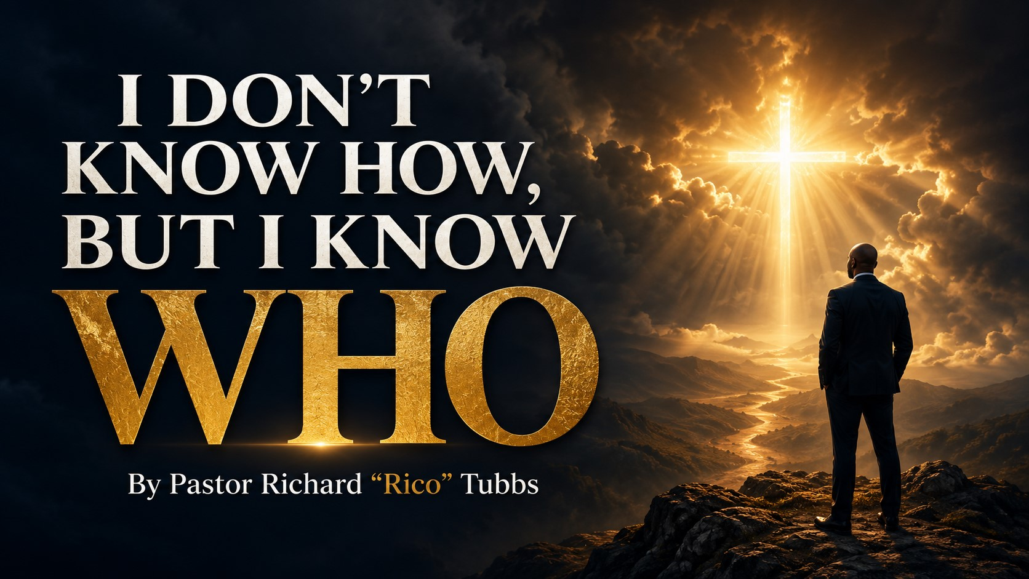

Slide 2
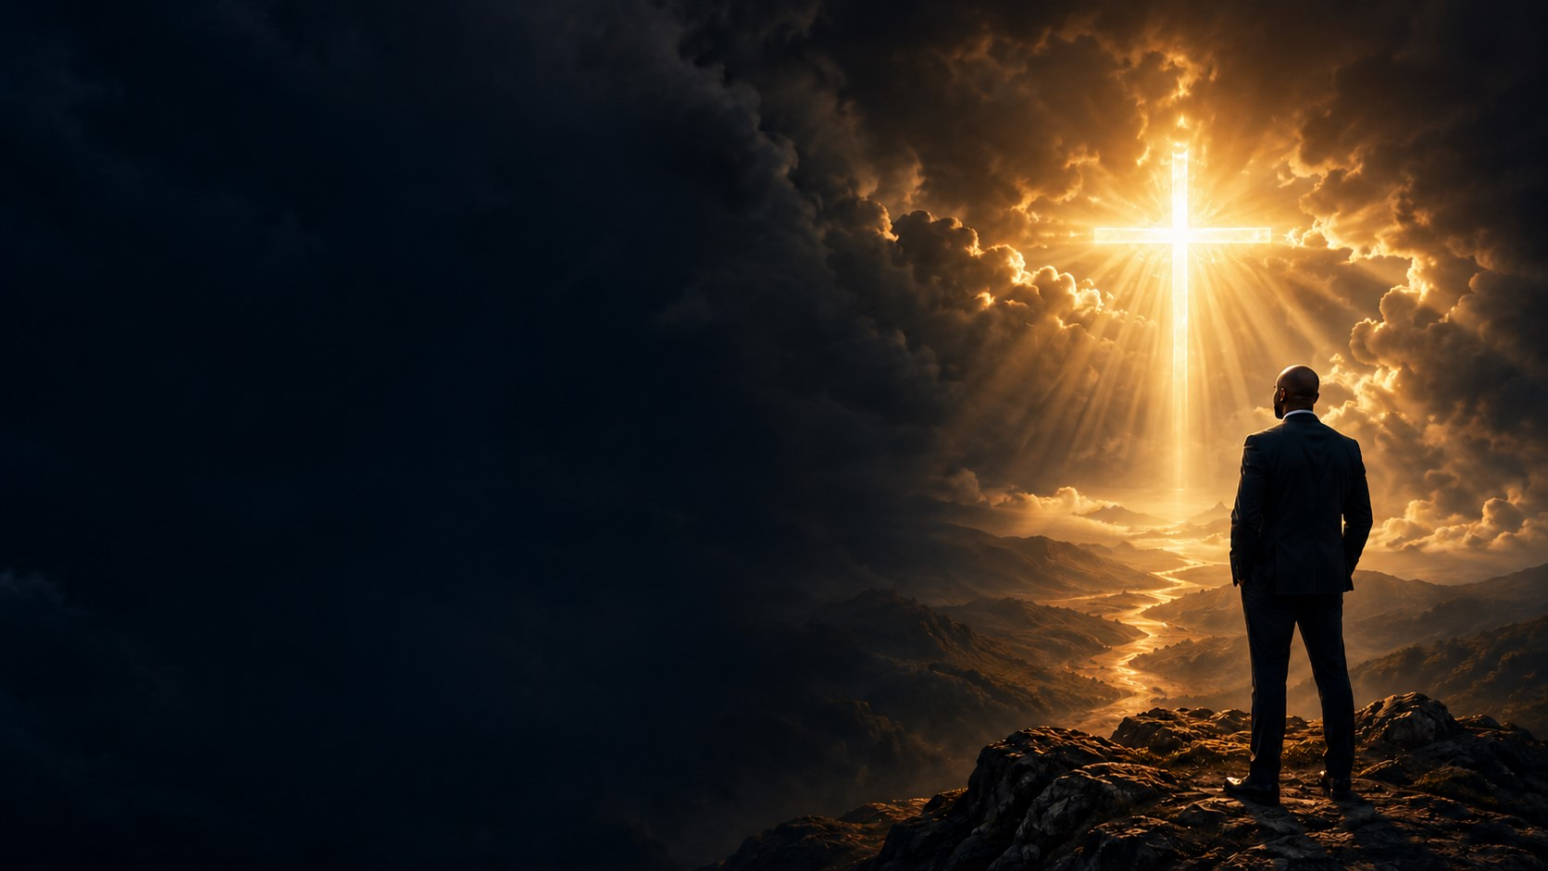
“For the which cause I also suffer these things: nevertheless I am not ashamed: for I know whom I have believed,and am persuaded that He is able to keep that which I have committed unto Him against that day.”
2 Timothy 1:12

Slide 3
“Trust in the Lord with all thine heart; and lean not unto thine own understanding. In all thy ways acknowledge Him, and He shall direct thy paths.”
Proverbs 3:5–6
“Jesus saith unto him, I am the way, the truth, and the life.”
John 14:6

Slide 4
There are moments in life when you can see the answer coming.
You can see the opportunity.
You can see the resources.
You can see the people God is using.
You can see the door beginning to open.

Slide 5
Then there are other seasons when you cannot see anything.
You prayed, but nothing appears to be changing.
You trusted God, but the situation seems to be getting worse.
You believed the promise, but the promise appears farther away than ever.
You looked at the bills and asked, “How?”
You listened to the doctor’s report and asked, “How?”
You looked at your family situation and asked, “How?”
You considered your age, your limitations, your past, and your resources and asked, “How could this ever happen?”

Slide 6
The question “How?” can keep you awake at night.
How will my family recover?
How will I make it?
We want God to give us a detailed schedule.
Sometimes God simply reminds us Who.
How will this relationship be restored?
We want dates, names, addresses, instructions, and guarantees.
How will God bring His promise to pass?
How will I overcome this addiction?
How will my body be healed?
How will this door open?
But God does not always explain how.
How will I survive this loss?

Slide 7
There is a difference between knowing how and knowing Who.
Knowing how gives you information.
Knowing Who gives you confidence.
Knowing how may settle your mind temporarily.
Knowing Who anchors your soul permanently.

Slide 8
I may not know how, but I know Who!
I know the One who opened the Red Sea.
I know the One who brought water out of a rock.
I know the One who fed Israel in the wilderness.
I know the One who kept Daniel in the lions’ den.
I know the One who stood with the Hebrew boys in the fiery furnace.
I know the One who made the sun stand still.
I know the One who used a shepherd boy to defeat a giant.
I know the One who walked on water.
I know the One who opened blinded eyes.
I know the One who called Lazarus out of the grave.
I know the One who died on Friday, remained in the grave on Saturday, and rose with all power on Sunday morning!
I do not know how—but I know Who!

Slide 9
God’s Ways Are Higher Than Our Ways
Isaiah 55:8–9 declares:
“For my thoughts are not your thoughts, neither are your ways my ways, saith the Lord. For as the heavens are higher than the earth, so are my ways higher than your ways, and my thoughts than your thoughts.”

Slide 10
We study the résumé.
God examines the heart.
We look at the clock.
God stands outside of time.
We look at the diagnosis.
God sees the final testimony.
We see an ending.
God sees a new beginning.
We see a grave.
God sees resurrection ground.
God does not think like we think.
God is not limited by what limits us.
We look at what is available.
God looks at what is possible.
We count the money.
God owns the cattle upon a thousand hills.

Slide 11
Sometimes we become frustrated because God is not following the plan we created for Him.
We tell God how He should bless us.
We tell God who He should use.
We tell God when the door should open.
We tell God which road He should take.
Then we become discouraged when He chooses another route.

Slide 12
But God is not obligated to follow our map.
God sees roads that we cannot see.
God knows people we have never met.
God has resources we have never considered.
God can create an answer from something we overlooked.
Stop limiting God to the options you can see.
If God can only work through what you understand, then He would not be God.

Slide 13
Israel at the Red Sea — God Can Create a Way
In Exodus 14, the children of Israel had finally been delivered from Egypt.
For generations, they had prayed for freedom.
God heard their cries.
He sent Moses.
He brought plagues upon Egypt.
Pharaoh finally released them.
They left Egypt carrying the evidence of God’s favor.
But then they arrived at the Red Sea.
The water was in front of them.
Pharaoh’s army was behind them.
Mountains surrounded them.
They were trapped.
They could not go forward.
They could not go backward.
They did not have boats.
They did not have a bridge.
They did not have enough weapons to defeat Pharaoh’s army.
They did not know how—but Moses knew Who!

Slide 14
They did not know how—but Moses knew Who!
The people began to panic. Fear caused them to forget every miracle God had already performed.
Isn’t that what fear does?
Fear will make you forget the doors God already opened.
Fear will make you forget the prayers God already answered.
Fear will make you forget the battles God already won.
Fear will make you look at one difficult chapter and act as if God has never been faithful.
But Moses stood before the people and declared:
“Fear ye not, stand still, and see the salvation of the Lord.”
Exodus 14:13

Slide 15
Then God told Moses:
“Wherefore criest thou unto me? speak unto the children of Israel, that they go forward.”
Exodus 14:15
Go forward?
The sea was still there!
The road had not appeared!
Nothing in the natural had changed!
But when God says go forward, you do not need to see the road. You only need to trust the One giving the instruction.
Moses stretched out his rod, and God divided the water.
Israel walked across on dry ground.

Slide 16
The same water that appeared to be their greatest obstacle became the pathway to their deliverance.
The thing you think is blocking your progress may become the place where God displays His greatest power.
God did not need a bridge.
God moved the water!
God does not need an existing road.
He can create one!
God does not need permission from your circumstances.
He is Lord over your circumstances!
Stop telling God how big your Red Sea is. Start telling your Red Sea how big your God is!

Slide 17
Driving Through the Fog
Imagine driving down an unfamiliar road late at night when heavy fog suddenly moves in.
You cannot see five miles ahead.
You cannot see one mile ahead.
Sometimes you cannot see beyond the next few feet.
The headlights do not reveal the entire journey. They only provide enough light for the next part of the road.
But if you keep moving carefully, the light continues moving with you.
God often guides us the same way.
We want Him to illuminate the entire journey.
God gives enough light for the next step.
We ask, “What will happen next year?”
God says, “Obey Me today.”
We ask, “How will everything come together?”
God says, “Take the next step.”
Psalm 119:105 says:
“Thy word is a lamp unto my feet, and a light unto my path.”
A lamp does not always reveal the entire road. It gives enough light for where your feet need to go next.
You do not have to see the whole journey to keep moving.
You only need to stay close to the Light.

Slide 18
Abraham on Mount Moriah — Provision Is Already Moving
In Genesis 22, God told Abraham to take Isaac, the son of promise, and go to the land of Moriah.
“Behold the fire and the wood: but where is the lamb for a burnt offering?”
Genesis 22:7
Abraham did not know all the details.
He could not explain the entire plan.
But he answered:
“My son, God will provide himself a lamb for a burnt offering.”
Genesis 22:8
This was not just any son.
Isaac represented everything God had promised Abraham.
Isaac was the answer to years of prayer.
Isaac was the miracle Abraham and Sarah had waited for.
Now God was asking Abraham to place the promise back into His hands.

Slide 19
Abraham did not know how, but he knew Who.
He knew God was faithful.
He knew God could not lie.
He knew the same God who gave him the promise was able to preserve the promise.
Hebrews 11:19 tells us Abraham believed that God was able to raise Isaac from the dead if necessary.

Slide 20
Abraham believed that even if he could not understand God’s method, he could still trust God’s character.
When Abraham reached the place of complete obedience, God stopped him. Abraham looked behind him and saw a ram caught in the thicket.
The provision was already on the mountain.
While Abraham was climbing one side, the ram was climbing another.
While Abraham was obeying, God was arranging.
While Abraham was trusting, God was providing.
While Abraham was wondering, God was working.
Somebody needs to hear this: God is working on the other side of your mountain!
You cannot see it yet.
You cannot hear it yet.
You do not know where it is coming from.
But God is already moving the provision into position.
Do not quit halfway up the mountain.
Do not turn around because the climb is difficult.
Do not abandon the promise because you cannot see the provision.
Your ram may already be in the thicket!

Slide 21
The Train in the Tunnel
Imagine sitting on a train that enters a long, dark tunnel.
The sunlight disappears.
The landscape disappears.
For a few moments, you cannot see where the train is going.
But the engineer does not stop the train simply because the passengers cannot see.
The train remains on the track.
The engineer knows the route.
The darkness of the tunnel does not mean the destination has changed.
There are seasons when life feels like a tunnel.
You cannot see what is ahead.
You cannot see how long the darkness will last.
You cannot see how you will come out.
But God has not left the track.
The destination has not changed.
The promise has not expired.
The tunnel is part of the journey, but the tunnel is not the destination.
Keep trusting….Keep believing….Keep moving.
There is still light ahead!

Slide 22
The Back of the Tapestry
A tapestry viewed from the back can look confusing.
You see loose threads.
You see knots.
You see colors crossing one another.
Nothing appears organized.
It can look like a complete mess.
But when the tapestry is turned around, those same threads form a beautiful picture.
We often see life from the back of the tapestry.
We see the knots.
We see the delays.
We see the disappointments.
We see the loose ends.
We see events that do not appear to connect.
But God sees the completed picture.

Slide 23
Romans 8:28 says:
“And we know that all things work together for good to them that love God, to them who are the called according to his purpose.”
The Scripture does not say that all things are good.
It says God works all things together for good.
The pain may not be good.
The betrayal may not be good.
The loss may not be good.
The delay may not feel good.
But God is so powerful that He can take every thread and weave it into His purpose.
Do not judge the tapestry from the back.
God is not finished.

Slide 24
Stop Worshiping the “How”
Sometimes we become so focused on “how” that “how” becomes an idol.
We refuse to believe unless God explains every detail.
We refuse to move unless we can control the outcome.
We refuse to obey unless the instruction makes sense.
But God never asked us to worship the method.
He asked us to trust the Master.

Slide 25
God used a rod in Moses’ hand.
God used a sling in David’s hand.
God used empty jars in the hands of a widow.
God used a jawbone in Samson’s hand.
God used trumpets in the hands of Gideon’s army.
God used mud to open a blind man’s eyes.
God used two fish and five loaves to feed a multitude.
God used a cross to bring salvation.
The method may change, but God’s faithfulness never changes.

Slide 26
Do not become so attached to one method that you miss God moving another way.
You may be looking for God to send a check, while God is preparing an opportunity.
You may be looking for God to remove the mountain, while God is strengthening you to climb it.
You may be asking God to calm the storm, while God is teaching you how to walk on water.
You may be praying for God to change someone else, while God is transforming you.
The answer may not come the way you expected, but God will remain faithful to His purpose.

Slide 27
Three Key Points to Carry Into Next Week
1. Remember Who Is With You
Do not allow the size of your problem to make you forget the greatness of your God.
Before you study the circumstances, remember God’s character.
He is Jehovah Jireh—your Provider.
He is Jehovah Rapha—your Healer.
He is Jehovah Shalom—your Peace.
He is Jehovah Nissi—your Banner.
He is the Good Shepherd.
He is the Way Maker…He is your refuge and strength…He is a very present help in trouble.
Next week, when fear asks, “How will you make it?” answer with Psalm 23:1:
“The Lord is my shepherd; I shall not want.”
When anxiety asks, “What if everything falls apart?” answer with Romans 8:31:
“If God be for us, who can be against us?”
When loneliness says, “Nobody understands,” answer with Hebrews 13:5:
“I will never leave thee, nor forsake thee.”
Your assignment for next week is to replace every fearful “How?” with a declaration about Who God is.

Slide 28
2. Obey the Next Instruction
Moses had to stretch out his rod.
Abraham had to climb the mountain.
Gideon had to reduce his army.
Mary had to surrender to God’s Word.
Peter had to step out of the boat.
The servants at the wedding had to fill the waterpots.
The people at Lazarus’ tomb had to remove the stone.
God may not show you the entire plan, but He will give you the next instruction.
Do not become so focused on the final destination that you miss today’s step.
Make the phone call Submit the application.
Complete the assignment.
Forgive the person…Begin the conversation…Return to prayer…Open your Bible…Ask for help.
Release what God told you to release…Start what God told you to start.
You do not need enough strength for the entire journey today.
You need enough faith for the next step.

Slide 29
3. Praise God Before You See the Answer
Do not wait until the battle is over to praise God.
Praise Him while the army is still approaching.
Praise Him while the sea is still closed.
Praise Him while the tomb is still sealed.
Praise Him while the report has not changed.
Praise Him while the application is still pending.
Praise Him while you are still waiting.
Praise is not denying the problem.
Praise is declaring that the problem is not greater than God.
Your praise says, “Lord, I trust You before I see it.”
Your praise says, “Lord, I believe You before I understand it.”
Your praise says, “I do not know how, but I know Who!”
Begin each morning next week with praise before you begin worrying.
Before you check your messages, thank God.
Before you replay the problem, speak His promises.
Before fear gets the first word, give God the first praise.

Slide 30
A Word for the Person Who Is Tired of Waiting
Maybe you have been trusting God for a long time.
You are not new to prayer…You are not new to faith.
You have been believing, waiting, and holding on.
But if you are honest, you are tired.
You are tired of saying, “God is going to do it,” while watching nothing change.
You are tired of encouraging everyone else while privately fighting discouragement.
You are tired of smiling in public and crying in private.
Hear me today: waiting does not mean God has forgotten you.
Silence does not mean God has rejected you.
Delay does not mean the promise has died.
Habakkuk 2:3 says:
“For the vision is yet for an appointed time… though it tarry, wait for it; because it will surely come.”
God’s promise has an appointed time.
You cannot rush it…The enemy cannot cancel it…People cannot stop it.
When the appointed time arrives, what God has spoken will come to pass.
Keep trusting…Keep praying…Keep serving…Keep believing…Keep praising.
God is doing work in you while you are waiting for Him to work around you.

Slide 31
Homework
Put Who Over How
When your mind asks, “How?” put Who over how.
When fear asks, “How?” put Who over how.
When the doctor’s report asks, “How?” put Who over how.
When your bank account asks, “How?” put Who over how.
When your family situation asks, “How?” put Who over how.
When the dream appears impossible, put Who over how.
I may not know how the door will open, but I know Who holds the key.
I may not know how the mountain will move, but I know Who created the mountain.
I may not know how the storm will stop, but I know Who controls the wind and waves.
I may not know how the provision will come, but I know Jehovah Jireh.
I may not know how healing will take place, but I know Jehovah Rapha.
I may not know how the battle will end, but I know Jehovah Nissi.
I may not know what tomorrow holds, but I know Who holds tomorrow.
Because I know Who, I will keep praying.
Because I know Who, I will keep believing.
Because I know Who, I will keep walking.
Because I know Who, I will keep serving.
Because I know Who, I will keep praising.
Because I know Who, I will not give up!
The enemy wants you to believe that because you do not know how, there is no way.
But Jesus said:“I am the way.”
You do not have to know the way when you know the One who is the Way!

Slide 32
Closing Declaration
I may not know how the door will open, but I know Who holds the key.
I may not know how the mountain will move, but I know Who created the mountain.
I may not know how the storm will stop, but I know Who controls the wind and waves.
I may not know how the provision will come, but I know Jehovah Jireh, the Lord my Provider.
I may not know how healing will take place, but I know Jehovah Rapha, the Lord my Healer.
I may not know how the battle will end, but I know Jehovah Nissi, the Lord my Banner.
I do not know how—but I know Who!
And because I know Who, I will keep praying.
Because I know Who, I will keep believing.
Because I know Who, I will keep walking.
Because I know Who, I will keep praising.
Because I know Who, I will not give up!

