Slide 1

Is Jesus Part of Your Story?
Pastor Richard “ Rico” Tubbs

Slide 2
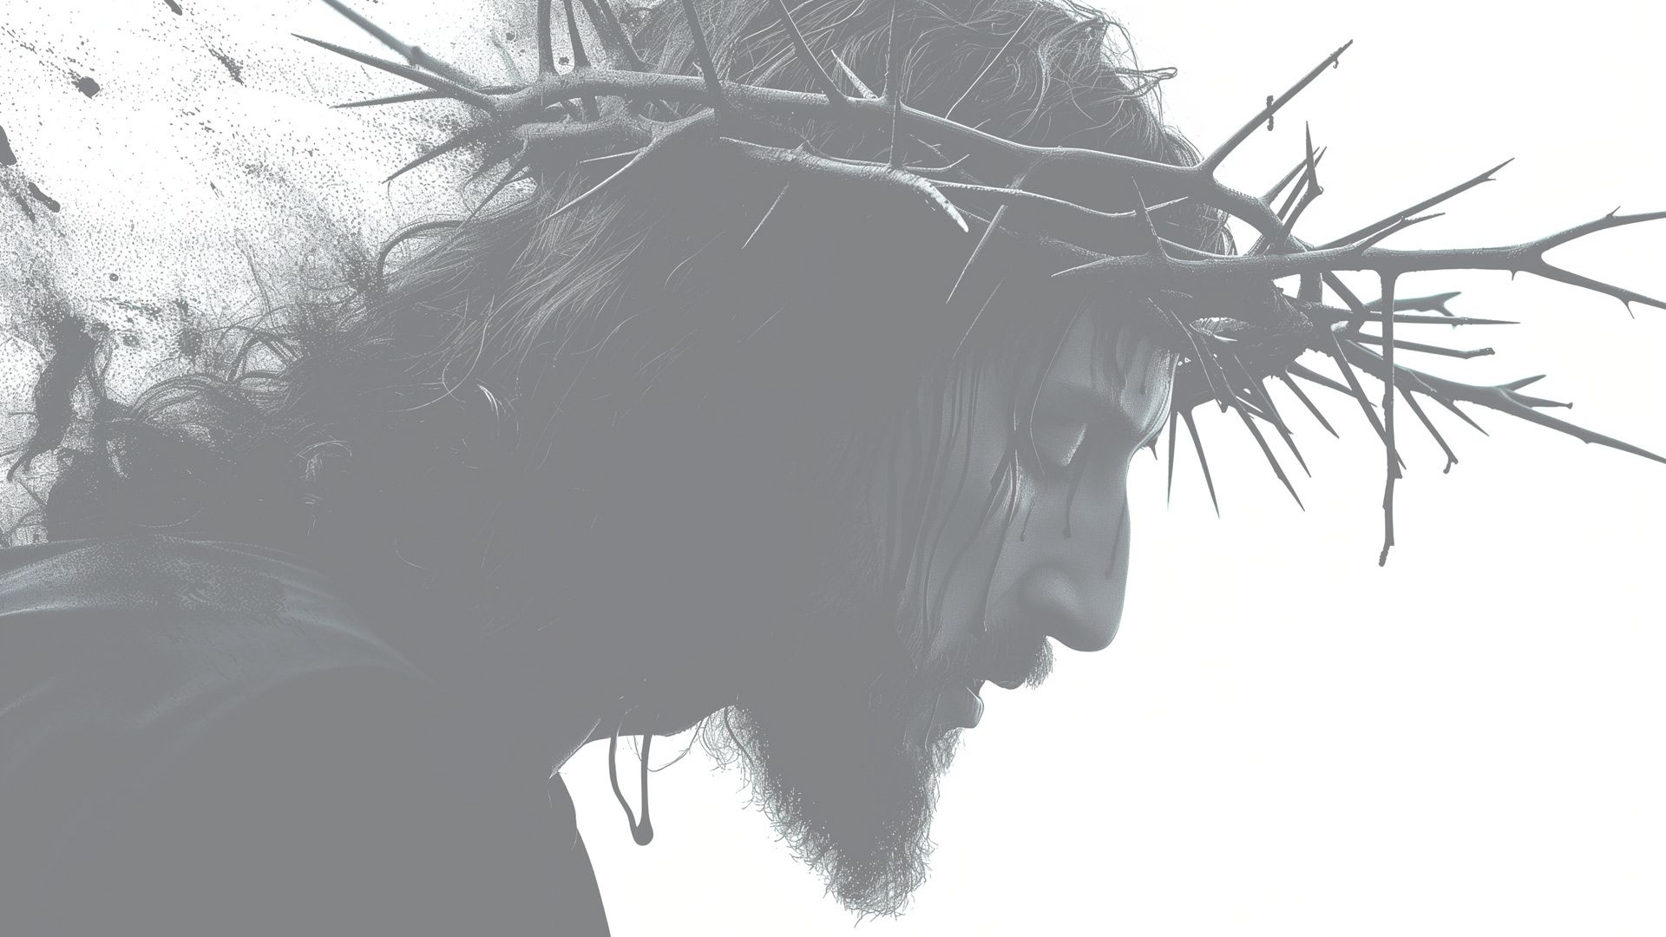
Ephesians 1
1 Paul, an apostle of Christ Jesus by the will of God, To God’s holy people in Ephesus,^{[a]} the faithful in Christ Jesus:² Grace and peace to you from God our Father and the Lord Jesus Christ. ³ Praise be to the God and Father of our Lord Jesus Christ, who has blessed us in the heavenly realms with every spiritual blessing in Christ. ⁴ For he chose us in him before the creation of the world to be holy and blameless in his sight. In love ⁵ he^{[b]} predestined us for adoption to sonship^{[c]} through Jesus Christ, in accordance with his pleasure and will— ⁶ to the praise of his glorious grace, which he has freely given us in the One he loves. ⁷ In him we have redemption through his blood, the forgiveness of sins, in accordance with the riches of God’s grace ⁸ that he lavished on us. With all wisdom and understanding, ⁹ he^{[d]} made known to us the mystery of his will according to his good pleasure, which he purposed in Christ, ¹⁰ to be put into effect when the times reach their fulfillment—to bring unity to all things in heaven and on earth under Christ. ¹¹ In him we were also chosen,^{[e]} having been predestined according to the plan of him who works out everything in conformity with the purpose of his will, ¹² in order that we, who were the first to put our hope in Christ, might be for the praise of his glory. ¹³ And you also were included in Christ when you heard the message of truth, the gospel of your salvation. When you believed, you were marked in him with a seal, the promised Holy Spirit, ¹⁴ who is a deposit guaranteeing our inheritance until the redemption of those who are God’s possession—to the praise of his glory.
⁵ For this reason, ever since I heard about your faith in the Lord Jesus and your love for all God’s people, ¹⁶ I have not stopped giving thanks for you, remembering you in my prayers. ¹⁷ I keep asking that the God of our Lord Jesus Christ, the glorious Father, may give you the Spirit^{[f]} of wisdom and revelation, so that you may know him better. ¹⁸ I pray that the eyes of your heart may be enlightened in order that you may know the hope to which he has called you, the riches of his glorious inheritance in his holy people, ¹⁹ and his incomparably great power for us who believe. That power is the same as the mighty strength ²⁰ he exerted when he raised Christ from the dead and seated him at his right hand in the heavenly realms, ²¹ far above all rule and authority, power and dominion, and every name that is invoked, not only in the present age but also in the one to come. ²² And God placed all things under his feet and appointed him to be head over everything for the church, ²³ which is his body, the fullness of him who fills everything in every way.

Slide 3
Jesus is central to a person's life story if they have faith in him

Slide 4
The narrative of your life is seen as part of a larger story that is both your personal journey and God's redemptive story, which you believe is centered on Jesus Christ

Slide 5
This means Jesus should be considered the main character who gives your individual story its ultimate meaning and purpose, which is often described in terms of creation, fall, redemption, and restoration.

Slide 6
Integrating Jesus into your daily life
Pray regularly
Make prayer a daily habit, communicating with God about your life and asking for His help.
Study scripture
Read the Bible to hear God's word and learn His teachings.

Slide 7
Surrender control
Yield your life to Him, taking your hands off the controls and allowing Him to be in charge.
Live intentionally
Make time for good things like listening to Christian music or reflecting on the day, and identify and eliminate negative habits.

Slide 8
Telling your story
Reflect on your journey: Think about how God has guided you through different experiences, such as hardships or joys, and how His love has helped you.

Slide 9
Share your testimony!
When sharing your story, be authentic and concise. Describe what you were feeling and point to Jesus as the source of your comfort and strength.

Slide 10
Focus on God's faithfulness
Your story's power comes from sharing how God has been faithful in your life, not just from the events themselves.

Slide 11
Apply His teachings
Allow His lessons to change your daily decisions and actions, striving to be more like Him (Christlike).

Slide 12
Be part of a community
Surround yourself with other believers, attend church services, and grow in your faith together.

Slide 13
Serve others
Express your love for God by loving and helping others, especially those in need, reflecting His love and grace to the world

Slide 14
What are some common internal struggles people face when deepening their relationship with Christ ?

Slide 15
Doubt and Unbelief:
Questioning God's existence, goodness, plan, or the validity of one's own salvation are common. These doubts can be a natural part of an evolving faith and may serve as a catalyst for deeper understanding, but they can also be unsettling and lead to a "faith crisis" if not addressed.

Slide 16
The Struggle with Sin:
The "battle between the spirit and the flesh" is a constant challenge. Believers often struggle with letting go of habitual sins, temptations, and self-centered desires that distance them from God's will.

Slide 17
Pride and Self-Sufficiency
A sense of self-importance or a belief in one's own ability to navigate life without God can hinder growth. True spiritual growth requires radical humility and total dependence on God's strength and guidance.

Slide 18
Guilt and Shame
Unconfessed sin or past mistakes can lead to feelings of guilt and unworthiness, creating emotional barriers to intimacy with God.

Slide 19
Lack of Discipline
Maintaining consistent daily practices like prayer, Bible study, and reflection can be difficult amidst a busy and demanding lifestyle.

Slide 20
Fear and Anxiety
Fear of the unknown, failure, rejection, or even fear of fully surrendering control to God can act as significant obstacles.

Slide 21
What are some common external struggles people face when deepening their relationship with Christ ?

Slide 22
Worldly Distractions and Pressures
The demands of work, family, social life, and the pursuit of wealth and comfort can easily distract from spiritual priorities.

Slide 23
Rejection or Misunderstanding from Others:
Family or friends who are not believers may not understand the spiritual journey, leading to feelings of isolation or the temptation to conform to societal expectations.

Slide 24
Suffering and Unanswered Prayers:
When life is difficult, prayers go unanswered, or one experiences pain and loss (such as a loved one's death), it can be challenging to trust in God's goodness and plan.

Slide 25
Negative Experiences with Religious Communities:
Experiences of abuse or hypocrisy within a church can create emotional barriers and make it difficult to trust other believers or religious leaders.

Slide 26
Spiritual Warfare
Many Christians believe in a spiritual battle, where the devil and demonic forces actively seek to undermine faith and test spiritual maturity through various forms of attack or temptation.

Slide 27
Homework
This Week Make Jesus part of your life story, commit to a personal relationship through prayer, scripture, and surrendering control of your life to Him.
You can do this by admitting your need for a savior, believing in Jesus, and receiving Him into your heart, then actively living out His teachings and sharing your story of His faithfulness with others.

