Slide 1
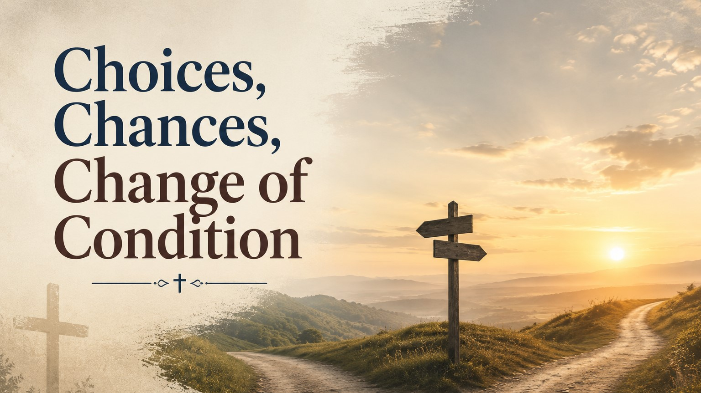
Pastor
Richard “Rico” Tubbs

Slide 2

“I call heaven and earth to record this day against you, that I have set before you life and death, blessing and cursing: therefore choose life…”
Deuteronomy 30:19

Slide 3
Every person in this room is one decision away from a different life.
A choice can open a door.
A chance can change a future.
And a change of condition can become the testimony nobody saw coming.
Some of us are living with the consequences of bad choices.
Some are praying for another chance.
And some are standing on the edge of a change of condition that only God can bring.

Slide 4
The enemy wants you to believe:
“You’ve gone too far.”
“You missed your opportunity.”
“You’ll always be like this.”
The God we serve specializes in turning broken choices into brand new chances and impossible situations into miraculous changes of condition!

Slide 5
Choices Determine Direction
“Choose you this day whom ye will serve…”
Joshua 24:15
Life is built on choices!

Slide 6
We choose:
what we believe
who we follow
what controls us
whether we forgive
whether we obey God
Your destiny is often hidden inside daily decisions.

Slide 7
Imagine driving at night and coming to a fork in the road.
One road is smooth and easy.
The other is narrow and difficult.
One choice may not seem important in the moment…
but miles later you realize you are in completely different places.
Many people ruin their lives one compromise at a time.
But others change their future one obedient decision at a time.

Slide 8
David chose repentance instead of pride.
Peter chose to get out of the boat.
The prodigal son chose to come home.
And these choices changed everything!

Slide 9
A man spent years addicted to drugs and alcohol.
His family had given up on him.
He lost his job, his home, and nearly his life.
One night he walked into a small church because it was raining outside.
He didn’t come looking for Jesus.
He just wanted shelter.
But during the altar call, he made one choice:
He walked forward and surrendered his life to God.
Years later he became a pastor helping thousands overcome addiction.
One choice!
One moment!
One surrender!
Never underestimate the power of a God-led decision.

Slide 10
God Is the God of Another Chance
“Then the word of the Lord came unto Jonah the second time…” Jonah 3:1
“The word of the Lord came unto Jonah THE SECOND TIME!”
Jonah ran from God.
Disobeyed God.
Rebelled against God.
But God still gave him another chance.

Slide 11
Somebody today feels disqualified because of failure.
Failure does not cancel God’s purpose.
Peter denied Jesus three times.
Yet Jesus still used him to preach at Pentecost.
Samson failed morally.
Yet in his final moment, God restored his strength.
The thief on the cross had wasted his entire life
but one moment with Jesus changed his eternity.
God’s grace is bigger than your mistakes.

Slide 12
A student failed an important exam.
Head down.
Ashamed.
Certain he would never recover.
But the teacher said,
“I’m giving you another opportunity.”
That second chance became the turning point of his life.
Grace is heaven’s second chance.
Sometimes God will allow you to hit rock bottom so you can finally discover that He is the Rock at the bottom.

Slide 13
God Can Bring a Change of Condition
“And the Lord turned the captivity of Job…” Job 42:10
A change of condition means:
sorrow turns to joy
weakness turns to strength
lack turns to provision
bondage turns to freedom
sickness turns to healing

Slide 14
The same God who changed Job’s condition…
changed Naomi’s bitterness into joy…
changed Lazarus from dead to alive…
and changed Saul the persecutor into Paul the preacher…
is still changing conditions today.

Slide 15
Joseph went from:
the pit
to slavery
to prison
But overnight his condition changed.
One phone call from Pharaoh…
one divine appointment…
and the prisoner became a prince.
Never judge your future by your present condition.
God can change your situation suddenly.
“Weeping may endure for a night, but joy cometh in the morning.” Psalm 30:5

Slide 16
You may have made bad choices but God still gives chances.
If you take the chance God gives you, He can change your condition.
The woman with the issue of blood took a chance and touched Jesus.
Blind Bartimaeus took a chance and cried out louder.
The paralytic took a chance and let his friends lower him through the roof.
Every one of them left different than they came.

Slide 17
Homework
Your Choices Matter.
God Gives Chances.
And God Changes Conditions.
Somebody today is about to experience:
a spiritual change
a family change
a financial change
an emotional change
a miracle in your condition
You are not trapped by your past.
You are not defined by your failures.
You are not limited by your current condition.
God is still writing your story

Slide 18
Today you have a choice.
You can stay where you are…
or you can choose life.
You can hold onto pain…
or take a chance on God’s grace.
And if you surrender to Him,
He can change your condition forever!
“Therefore if any man be in Christ, he is a new creature: old things are passed away; behold, all things are become new.” 2 Corinthians 5:17

