Slide 1
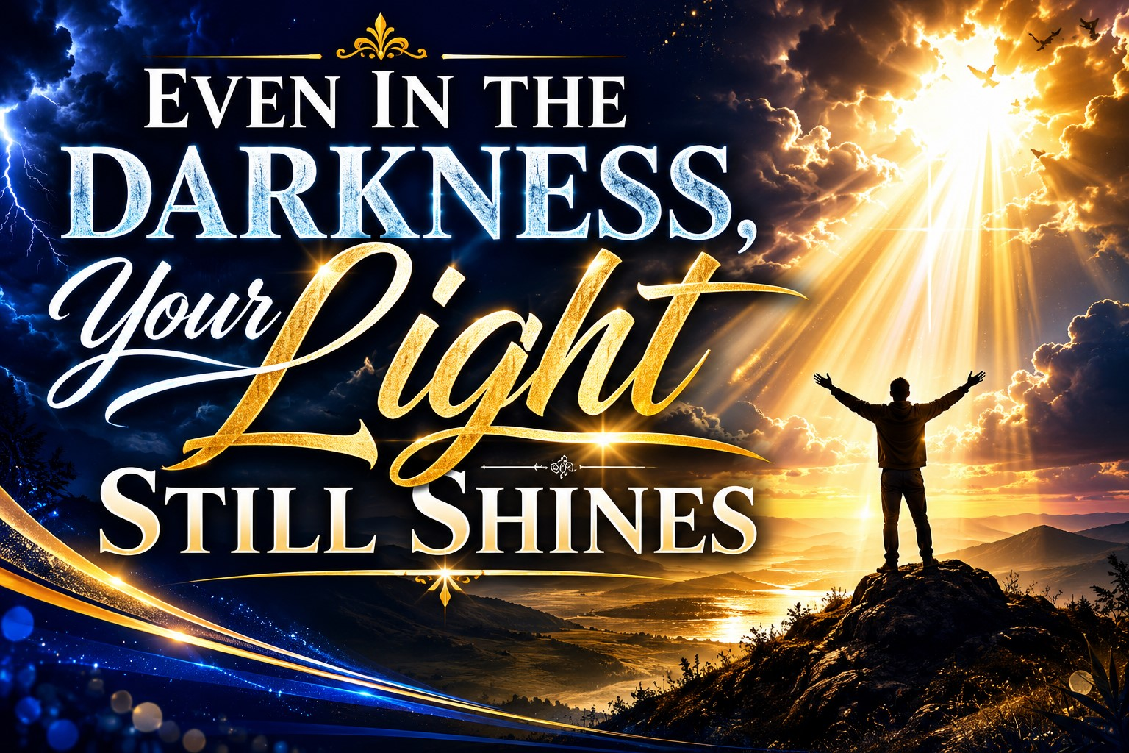
Pastor Richard “ Rico” Tubbs

Slide 2
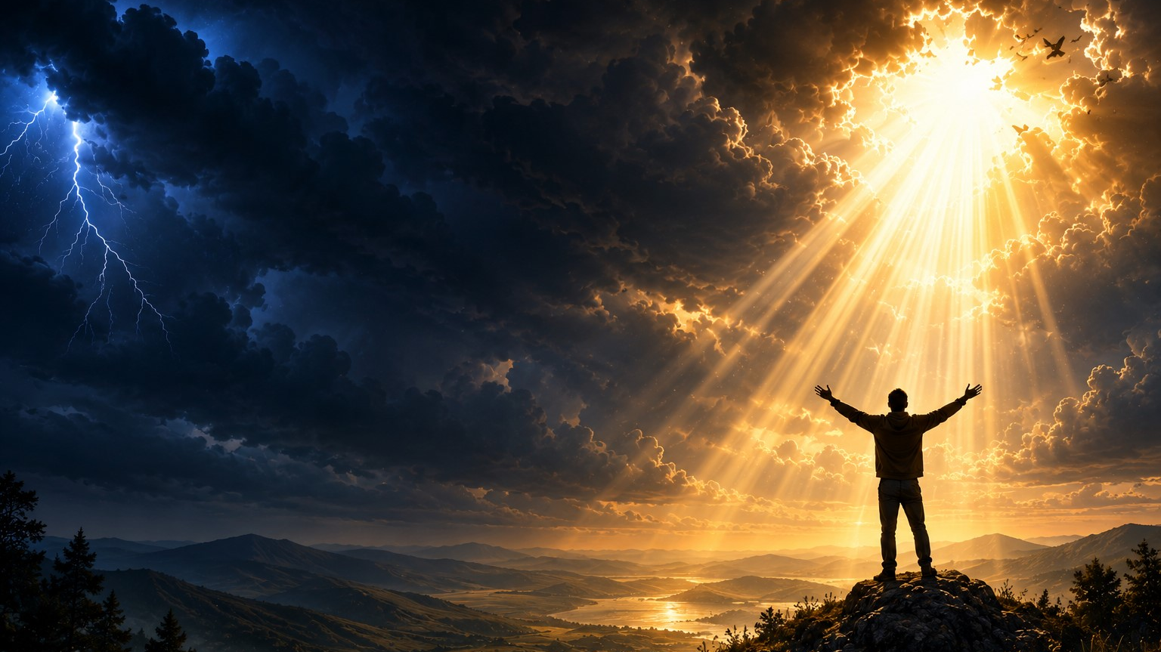
"The light shines in the darkness, and the darkness has not overcome it."
— John 1:5

Slide 3
Darkness Is Not the End of the Story
Everyone experiences darkness.
There are seasons of grief.
Seasons of sickness.
Seasons of financial hardship.
Seasons when prayers seem unanswered.
Seasons when we wonder, "God, where are You?"
The enemy wants us to believe that darkness means God has abandoned us.
Darkness is not evidence of God's absence.
Darkness is often the backdrop where God's light shines the brightest.

Slide 4
A candle is most noticeable in a dark room.
A lighthouse is most valuable during a storm.
And God's glory is often revealed in our darkest moments.

Slide 5
God's Light Is Present Even When You Cannot See It
"Even the darkness will not be dark to You; the night will shine like the day, for darkness is as light to You."
Psalm 139:12

Slide 6
Many people believe if they can't see God working, He must not be working.
But God never stops working!
Just because the sun is hidden behind clouds doesn't mean it has stopped shining.

Slide 7
Pilots often tell of flying through terrible storms.
Passengers are terrified.
Lightning flashes.
Thunder roars.
Rain pounds the aircraft.
But after climbing through the clouds, something amazing happens:
The sky is bright and beautiful.
The sun never stopped shining.
The storm was below them.
Likewise, God's light never stops shining above the storms of life.
Your perspective may be clouded, but His presence has never left.

Slide 8
God Often Does His Greatest Work in the Dark
"Weeping may endure for a night, but joy comes in the morning."
Psalm 30:5

Slide 9
Nobody likes the night season.
Yet throughout Scripture, God performed miracles in dark places.
Joseph's prison became his pathway to the palace.
David's wilderness became preparation for kingship.
Daniel's lion's den became a testimony of God's power.
Paul's prison became a platform for worship.

Slide 10
When you see nothing happening, God may be strengthening roots that will support blessings you cannot yet imagine.
Your darkness may actually be your preparation season.

Slide 11
The Light of Christ Cannot Be Extinguished
"I am the light of the world. Whoever follows Me will never walk in darkness."
John 8:12

Slide 12
The world tried to extinguish Jesus.
They mocked Him.
They beat Him.
They nailed Him to a cross.
The sky turned dark.
Hope seemed lost.
The disciples believed it was over.
But what looked like defeat was actually victory.
Three days later the tomb was empty.
The Light could not be extinguished.

Slide 13
During violent storms, sailors search for one thing:
The lighthouse.
The waves may rise.
The wind may howl.
Visibility may disappear.
But as long as they can see the light, they know they can make it safely home.
Jesus is our lighthouse.
Your circumstances may be chaotic, but His light remains steady.
He has never lost a single soul who trusted Him.

Slide 14
Your Darkness Can Become Someone Else's Hope
"Let your light shine before others, that they may see your good deeds and glorify your Father in heaven."
Matthew 5:16

Slide 15
Many people think their trials are meaningless.
But God often uses our pain to help someone else survive theirs.
The comfort you received becomes the comfort you give.
The strength you found becomes strength for another.
The testimony you carry becomes proof that God still works miracles.

Slide 16
Years ago, a man walked a dark mountain road carrying a lantern.
Another traveler asked him,
"Why are you carrying that light? You already know the path."
The man replied,
"I carry it not for me, but for those coming behind me."
Somebody is watching how you walk through your darkness.
Your faith may be lighting the way for someone else.

Slide 17
The Darkest Hour Often Comes Before the Breakthrough
"The people walking in darkness have seen a great light."
Isaiah 9:2

Slide 18
The enemy specializes in convincing people to quit right before God moves.
Just before dawn, the night is at its darkest.
Just before resurrection, there was a cross.
Just before freedom, there was a prison.
Just before promotion, there was a pit.

Slide 19
A miner spent months digging for gold.
Day after day he found nothing.
Discouraged, he quit and sold the land.
The new owner continued digging only three feet farther and discovered one of the richest gold veins in the region.
How many blessings are missed because people stop three feet too soon?
Don't quit.
Don't give up.
Don't walk away from God's promises.
Your breakthrough may be closer than you think.

Slide 20
The darkest day in history was Good Friday.
The Son of God was crucified.
Hope seemed dead.
The sky grew dark.
The earth shook.
The disciples scattered.
But God was working in the darkness.
The cross was not the end.
The tomb was not the end.
Death was not the end.
Sunday morning proved that God's light always has the final word.

Slide 21
"The light shines in the darkness, and the darkness has not overcome it."
John 1:5
Notice what the verse does not say.
It doesn't say darkness challenged the light.
It doesn't say darkness weakened the light.
It says darkness could not overcome it.
The same is true for every believer.
The darkness you're facing cannot overcome the light of Christ within you.

Slide 22
Homework
Maybe this week
Your marriage feels dark.
Your health feels dark.
Your finances feel dark.
Your family situation feels dark.
Your future feels uncertain.
Remember this:
Encourage someone this week!
The storm will pass.
The night will end.
Morning is coming.
And even in the darkness, His light still shines.
"Arise, shine, for your light has come, and the glory of the Lord rises upon you."
Isaiah 60:1
Darkness is temporary.
God's light is eternal.

Slide 23
Declaration
Say this aloud:
"Even when I cannot see Him, God is working."
"Even when I feel alone, God is with me."
"Even when darkness surrounds me, His light still shines."
"I will not quit."
"I will not lose hope."
"I will trust the God who turns graves into gardens, trials into testimonies, and darkness into light."
Because even in the darkness, His light still shines.

