Slide 1
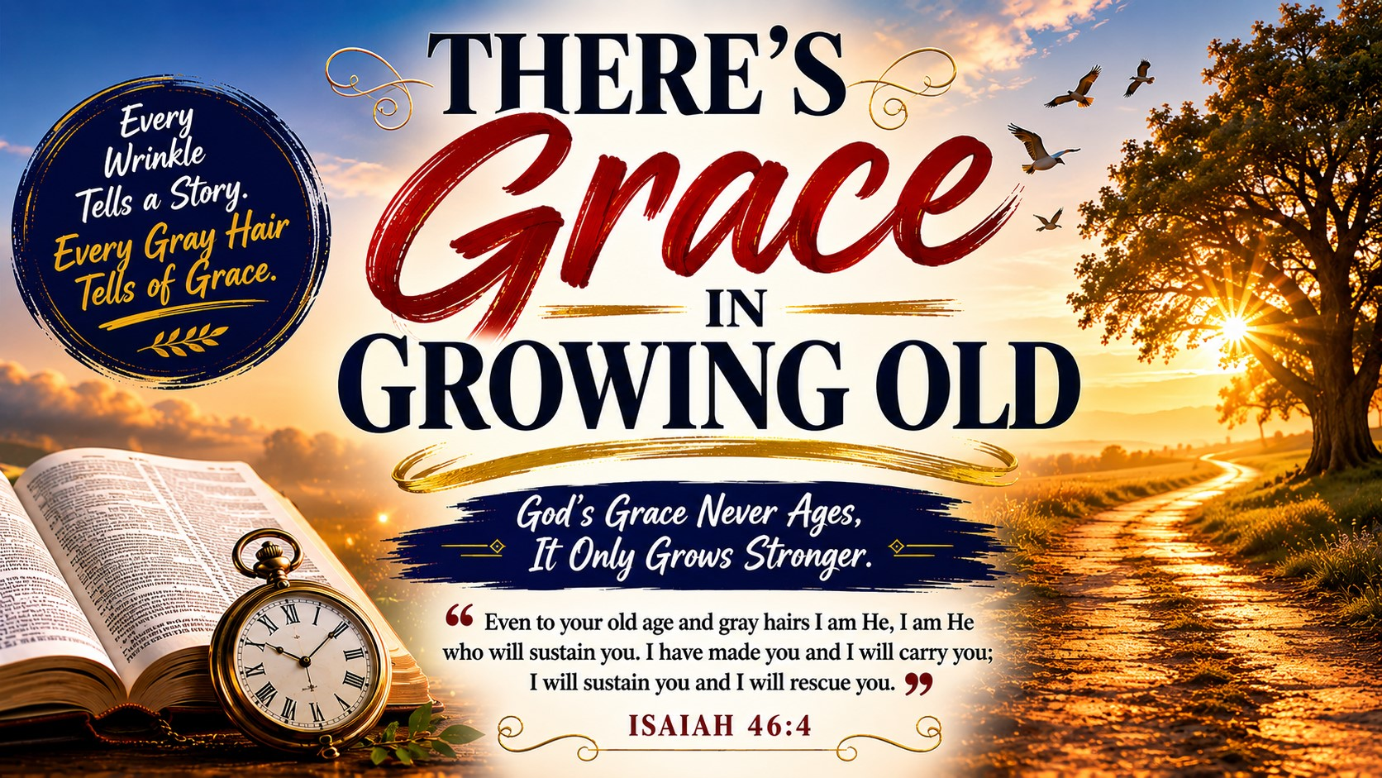
Pastor Richard “ Rico” Tubbs

Slide 2

Isaiah 46:4
“Even to your old age and gray hairs I am He, I am He who will sustain you. I have made you and I will carry you; I will sustain you and I will rescue you.”

Slide 3
The Blessing Many Never Receive
We live in a culture that celebrates youth but often overlooks the beauty of growing older.
Television promotes youth.
Advertisements sell youth.
Society chases youth.
But God honors age.

Slide 4
Every wrinkle tells a story.
Every gray hair carries a testimony.
Every scar reveals a battle survived.
While the world may see aging as decline, God sees it as development.

Slide 5
The Bible never teaches us to fear growing old. Instead, it teaches us that there is grace for every season of life.
There is grace for childhood.
There is grace for adulthood.
And there is grace in growing old.

Slide 6
Growing Old Is a Gift, Not a Curse
Psalm 92:14
“They will still bear fruit in old age, they will stay fresh and green.”
The world measures value by productivity.
God measures value by faithfulness.

Slide 7
A young man once visited an orchard and saw a giant old apple tree.
Its trunk was twisted.
Its bark was worn.
Its branches looked weathered.
The young man thought the tree should be cut down.
The farmer smiled and said:
"That old tree produces more fruit than all the younger trees combined."
What looked worn out was actually most valuable.
The same is true with God's people.
The devil wants seniors to believe:
"Your best days are behind you."
But God says:
"You still have fruit to produce."

Slide 8
God Doesn't Retire His Servants
Caleb Was 85
Joshua 14:10-11
“I am still as strong today as the day Moses sent me out.”
At 85 years old Caleb was asking for mountains.
Most people his age were looking for rocking chairs.
Caleb was looking for giants to conquer.
Moses Was 80
When God called Moses at the burning bush, Moses wasn't a young man.
He was eighty years old.
Most people would have considered him finished.
God considered him ready.
Abraham Was 100
When Isaac was born, Abraham was 100 years old.
The promise arrived when human strength had faded.

Slide 9
The kingdom of God has no retirement plan.
God may change your assignment.
But He never stops using willing vessels.

Slide 10
There Is Wisdom in the Winter Season
Proverbs 16:31
“Gray hair is a crown of splendor; it is attained in the way of righteousness.”
It means:
"I survived."
"I endured."
"I stayed faithful."
"I learned some things."
Gray hair isn't something to hide.
According to Scripture, it is a crown.
A crown speaks of victory.

Slide 11
The Lighthouse
A tourist once asked why an old lighthouse was still standing when newer technology existed.
The guide replied:
"Because during the storms, ships still trust the lighthouse."
Older believers are spiritual lighthouses.
They have weathered storms.
They have survived tragedies.
They have buried loved ones.
They have endured heartbreak.
And because they stayed standing, others can find their way home.
Young believers need the wisdom of seasoned saints.

Slide 12
God Carries Us Through Every Season
Isaiah 46:4
“Even to your old age and gray hairs I am He... I will carry you.”
God didn't say:
"I'll carry you until you reach retirement."
He said:
"I'll carry you through old age."

Slide 13
The same God who held your hand as a child will hold your hand as a senior.
The same God who provided in your twenties provides in your eighties.
The same God who healed yesterday still heals today.
The same God who opened doors then still opens doors now.

Slide 14
Footprints in the Sand
An elderly Christian woman nearing the end of her life reflected on all she had endured.
The loss of a spouse.
Financial struggles.
Health battles.
Heartaches.
She said:
"When I look back, I realize there were many times I thought I was carrying myself."
Then she smiled and said:
"But now I know He was carrying me all along."
That is grace.

Slide 15
Growing Older Means Growing Closer
2 Corinthians 4:16
“Though outwardly we are wasting away, yet inwardly we are being renewed day by day.”

Slide 16
The body may weaken.
But the spirit can grow stronger.
The eyesight may dim.
But spiritual vision can become clearer.
The steps may become slower.
But faith can become deeper.

Slide 17
The Eagle
An eagle's strongest flights often occur later in life.
After years of experience, it learns how to ride winds younger birds fight against.
Older believers have learned something younger believers are still discovering:
How to trust God when answers don't come quickly.
How to praise Him in the storm.
How to stand when others fall.
How to wait on the Lord.

Slide 18
Your Legacy May Be Your Greatest Ministry
Psalm 71:18
“Even when I am old and gray, do not forsake me, my God, till I declare your power to the next generation.”
The Psalmist understood something powerful.
His greatest purpose wasn't behind him.
It was passing truth to the next generation.

Slide 19
The Praying Grandmother
History tells of many great preachers and leaders whose ministries were shaped by praying grandmothers.
Long after their voices became weak, their prayers remained powerful.
Some of the greatest sermons ever preached were first prayed into existence by elderly saints kneeling beside a bed.
A senior saint may never stand behind a pulpit.
But their prayers can move heaven.
Their wisdom can guide families.
Their testimony can change generations.

Slide 20
Heaven Gets Closer Every Day
Philippians 1:21
“For to me, to live is Christ and to die is gain.”
For the believer, growing old isn't moving away from something.
It's moving toward Someone.

Slide 21
Every passing year brings us one step closer to seeing Jesus face to face.
No more pain.
No more sickness.
No more walkers.
No more wheelchairs.
No more hospitals.
No more funerals.
Only joy.
Only peace.
Only glory.
The child of God does not fear growing older because every step brings us closer to home.

Slide 22
There Is Grace in Growing Old
The devil says:
"You're too old."
God says:
"You're still fruitful."
The devil says:
"Your usefulness is over."
God says:
"I still have purpose for you."
The devil says:
"Your strength is gone."
God says:
"My strength is made perfect in weakness."
The devil says:
"You're nearing the end."
God says:
"You're nearing Heaven."

Slide 23
There is grace in growing old.
Grace to endure.
Grace to teach.
Grace to pray.
Grace to inspire.
Grace to finish well.

Slide 24
An elderly violinist stepped onto a stage carrying a worn, scratched violin.
Many wondered if the instrument had any value.
But when he placed the bow upon the strings, beautiful music filled the room.
The violin wasn't valuable because it was new.
It was valuable because it remained in the Master's hands.

Slide 25
You may feel worn.
You may feel weathered.
You may feel like time has left its mark upon you.
Homework
But when your life remains in the Master's hands, He can still make beautiful music through you.
There is grace in growing old because the older we become, the more we discover that God has been faithful every step of the way.
And if He has carried us this far
He will carry us all the way home.

