Slide 1
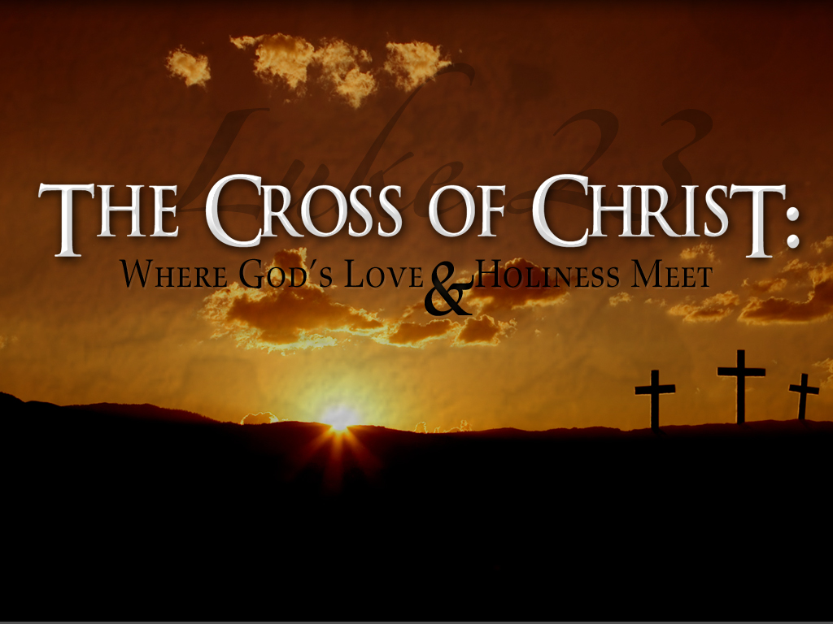

Slide 2
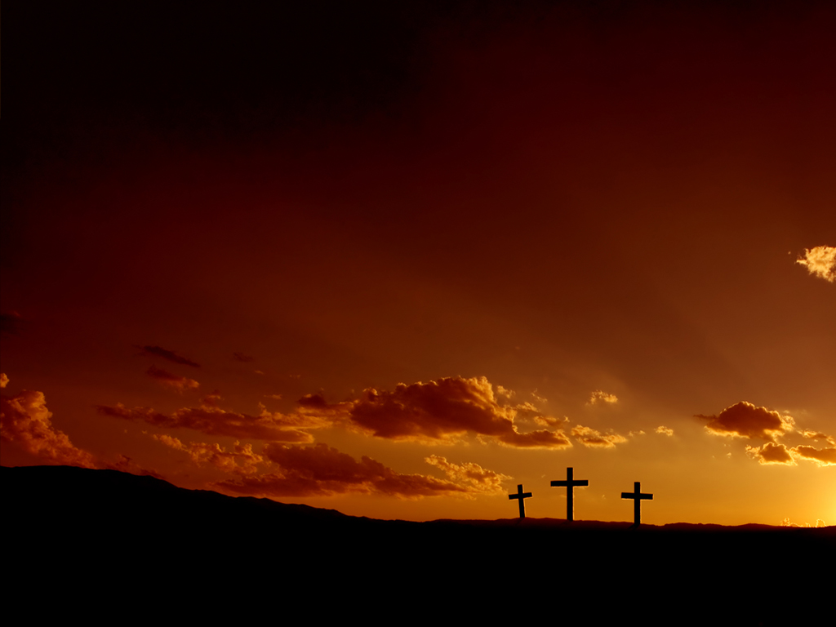
“WHAT DO YOU SEE WHEN YOU LOOK AT THE CROSS?”
Pastor Richard “Rico”Tubbs

Slide 3
Luke 23:33-49
³³ When they came to the place called the Skull, they crucified him there, along with the criminals—one on his right, the other on his left. ³⁴ Jesus said, “Father, forgive them, for they do not know what they are doing.”^{[a]} And they divided up his clothes by casting lots. ³⁵ The people stood watching, and the rulers even sneered at him. They said, “He saved others; let him save himself if he is God’s Messiah, the Chosen One.” ³⁶ The soldiers also came up and mocked him. They offered him wine vinegar ³⁷ and said, “If you are the king of the Jews, save yourself.” ³⁸ There was a written notice above him, which read: this is the king of the jews. ³⁹ One of the criminals who hung there hurled insults at him: “Aren’t you the Messiah? Save yourself and us!” ⁴⁰ But the other criminal rebuked him. “Don’t you fear God,” he said, “since you are under the same sentence? ⁴¹ We are punished justly, for we are getting what our deeds deserve. But this man has done nothing wrong.” ⁴² Then he said, “Jesus, remember me when you come into your kingdom.^{[b]}” ⁴³ Jesus answered him, “Truly I tell you, today you will be with me in paradise.” ⁴⁴ It was now about noon, and darkness came over the whole land until three in the afternoon, ⁴⁵ for the sun stopped shining. And the curtain of the temple was torn in two. ⁴⁶ Jesus called out with a loud voice, “Father, into your hands I commit my spirit.”^{[c]} When he had said this, he breathed his last. ⁴⁷ The centurion, seeing what had happened, praised God and said, “Surely this was a righteous man.” ⁴⁸ When all the people who had gathered to witness this sight saw what took place, they beat their breasts and went away. ⁴⁹ But all those who knew him, including the women who had followed him from Galilee, stood at a distance, watching these things.

Slide 4
WHEN I LOOK AT THE CROSS, I SEE THE DEPTH OF GOD’S LOVE
Romans 5:8 — “God demonstrates His own love for us in this: while we were still sinners, Christ died for us.”

Slide 5
The cross is not merely proof that Jesus died
it is proof that God loves.
He didn’t wait for us to improve.
He didn’t demand that we fix ourselves.
He loved first. He loved fully. He loved freely.

Slide 6
At the cross, love is not a feeling — it is a sacrifice.

Slide 7
A parent who jumps in front of danger to save their child doesn’t stop to calculate the cost. Love moves. Love acts.
That is the cross. The Son of God stepped between humanity and judgment — willingly, knowingly.

Slide 8
When you look at the cross, you should hear God saying: “This is how much I love you.”

Slide 9
WHEN I LOOK AT THE CROSS, I SEE THE COST OF MY SIN
Isaiah 53:5 — “He was pierced for our transgressions… crushed for our iniquities.”

Slide 10
The cross reveals something uncomfortable but essential: sin is not small. Sin destroys. Sin kills.
The cross reminds us that forgiveness is free to us, but it was not cheap.
My lies nailed Him there.
My pride nailed Him there.
My rebellion nailed Him there.

Slide 11
We cannot look at the battered, bleeding body of Jesus and still say, “Sin doesn’t matter.”
At the cross, we realize: We are more sinful than we dared believe — yet more loved than we dared hope.

Slide 12
WHEN I LOOK AT THE CROSS, I SEE THE POWER OF FORGIVENESS
“Father, forgive them…” (Luke 23:34)
To forgive while bleeding… To forgive while mocked… To forgive those who caused the pain…

Slide 13
At the cross, the debt we could never pay was cancelled.
Your past cannot condemn you. Satan cannot accuse you. Shame cannot define you.
Because the cross has the final word.
Forgiveness is not a theory; it was signed in blood.

Slide 14
WHEN I LOOK AT THE CROSS, I SEE VICTORY WHERE THE WORLD SAW DEFEAT!
Colossians 2:15 — “He disarmed the powers and authorities… triumphing over them by the cross.”

Slide 15
Rome saw a criminal.
Satan saw an opportunity.
The disciples saw tragedy.
But Heaven saw war — and Heaven saw victory.

Slide 16
Death was defeated
At the cross:
Hell was disarmed
Satan was crushed
The curse was broken
The veil was torn

Slide 17
The cross is not a monument to death — it is the doorway to resurrection.
What looked like the end was actually the beginning of every new beginning God would ever give you.

Slide 18
WHEN I LOOK AT THE CROSS, I SEE MY CALLING
“If anyone wants to follow Me, let him deny himself, take up his cross, and follow Me.” — Matthew 16:24

Slide 19
The cross is not only something Jesus carried — it is something we are invited to carry.
The cross calls us to:
Surrender
Obedience
Sacrificial love!
Dying to self so that Christ may live in us.

Slide 20
The cross is not where we merely receive salvation — it is where we learn how to live.
When I look at the cross, I hear Jesus saying: “Follow Me this way.”

Slide 21
WHEN I LOOK AT THE CROSS, I SEE THE GREAT EXCHANGE
2 Corinthians 5:21 — “God made Him who knew no sin to be sin for us…”

Slide 22
The cross is the place where everything changes.
At the cross:
He took our shame → we receive His acceptance.
He took our sin → we receive His righteousness.
He took our death → we receive His life.
He was rejected → we are adopted.

Slide 23
This is the great exchange. This is the gospel.
This is why the cross is not just a symbol — it is salvation.

Slide 24
Homework
But the most important question is not what you see — it’s what you will do with what you see.
This week, look again at the cross — not casually, not distantly — but personally.
And hear the voice of the Savior saying: “This was for you.”

