Slide 1


Slide 2
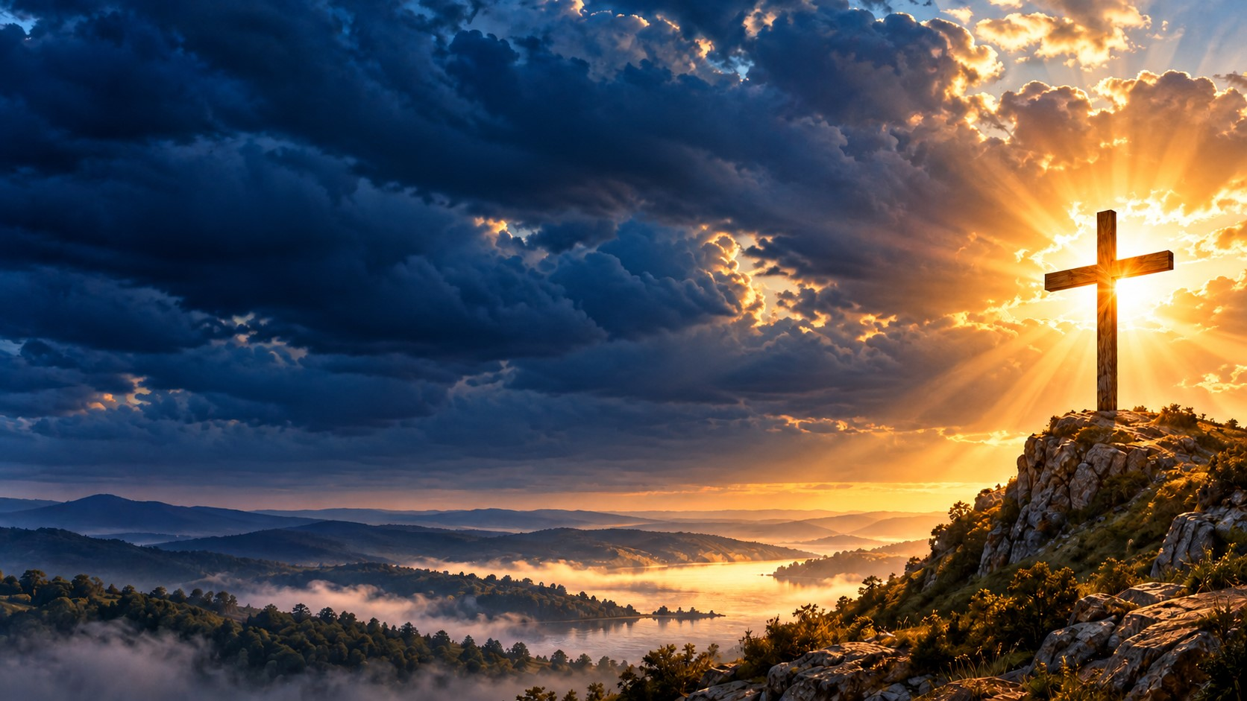
Ephesians 1:3-14
³ Praise be to the God and Father of our Lord Jesus Christ, who has blessed us in the heavenly realms with every spiritual blessing in Christ. ⁴ For he chose us in him before the creation of the world to be holy and blameless in his sight. In love ⁵ he^{[a]} predestined us for adoption to sonship^{[b]} through Jesus Christ, in accordance with his pleasure and will— ⁶ to the praise of his glorious grace, which he has freely given us in the One he loves. ⁷ In him we have redemption through his blood, the forgiveness of sins, in accordance with the riches of God’s grace ⁸ that he lavished on us. With all wisdom and understanding, ⁹ he^{[c]} made known to us the mystery of his will according to his good pleasure, which he purposed in Christ, ¹⁰ to be put into effect when the times reach their fulfillment—to bring unity to all things in heaven and on earth under Christ.¹¹ In him we were also chosen,^{[d]} having been predestined according to the plan of him who works out everything in conformity with the purpose of his will, ¹² in order that we, who were the first to put our hope in Christ, might be for the praise of his glory. ¹³ And you also were included in Christ when you heard the message of truth, the gospel of your salvation. When you believed, you were marked in him with a seal, the promised Holy Spirit, ¹⁴ who is a deposit guaranteeing our inheritance until the redemption of those who are God’s possession—to the praise of his glory.

Slide 3
When everything around me is uncertain, Jesus gives me a sure foundation.
“I may not know what tomorrow holds, but I know Who holds me.”
Blessed assurance is more than a beautiful song we sing when everything is going well. It is a confession we can carry into the hospital room, into the funeral service, into the financial struggle, and into the season we never expected.
“Blessed assurance, Jesus is mine!”

Slide 4
We need to understand that biblical hope is stronger than wishful thinking. It is a confident expectation rooted in God’s character.
Assurance is the settled confidence that His promises are trustworthy.
My circumstances may be unsettled, but my foundation can still be secure.

Slide 5
YOUR ASSURANCE BEGINS WITH WHAT JESUS HAS DONE
Ephesians 1 tells us what we have in Christ: adoption, redemption, forgiveness, an inheritance, and the promised Holy Spirit.
Paul does not begin by telling believers to prove they are impressive. He begins by showing them the grace God has given them in Jesus.
Ephesians 1:7 says:
“In whom we have redemption through his blood, the forgiveness of sins, according to the riches of his grace;”
Redemption means our freedom came at a cost.

Slide 6
Our salvation was purchased through the blood of Jesus Christ. We cannot work hard enough to make the cross unnecessary. We cannot become good enough to outgrow our need for grace.
Imagine someone paying a debt you could never repay. You stand there staring at the bill, wondering how many years it will take to clear it. Then you learn the payment has already been made.
You do not honor the payment by pretending you made it. You receive it with gratitude—and begin living in the freedom it provides.
That is why we can have assurance.
Jesus did what we could never do for ourselves.

Slide 7
Hebrews 10:19 speaks of our confidence to enter God’s presence through the blood of Jesus. Verse 22 invites us to draw near with a true heart in full assurance of faith.
Because of Jesus, you can come to the Father.
You can come with tears in your eyes.
You can come admitting you need help.
You can come confessing sin and asking for mercy.
The cross gives us a reason to draw near.
And when we say, “Jesus is mine,” we are also confessing something precious:
“I belong to Him.”
Jesus is our Lord. We do not control Him or command Him. We trust Him, follow Him, and rest in His love.

Slide 8
GOD’S FAITHFULNESS IS GREATER THAN YOUR CHANGING FEELINGS
Some mornings you wake up ready to praise.
Other mornings you have to fight just to get out of bed.
Some days you feel strong in faith. Other days your prayer sounds like the father in
Mark 9:24:
“Lord, I believe; help thou mine unbelief.”
That is an honest prayer.

Slide 9
Jesus does not require you to hide your struggle before you come to Him. Bring your struggle into His presence.
Picture a child holding a parent’s hand while crossing a busy street. The child gets distracted. Their little fingers loosen. But the parent keeps holding on.
The child’s safety does not depend entirely on the strength of those little fingers.
There is a stronger hand involved.
John 10:27–28 tells us that Jesus knows His sheep, they follow Him, and no one can snatch them from His hand.

Slide 10
Our confidence belongs there in the Shepherd who knows us and calls us to follow.
So when your emotions become loud, return to what God has said.
You may feel alone, but you can call upon Him.
You may feel ashamed, but you can confess and receive forgiveness.
You may feel weak, but you can ask for strength.
Feelings deserve attention. They can tell us that we need rest, support, care, or a conversation with someone we trust. But they cannot overturn the faithfulness of God.
You can be honest about how you feel and still hold fast to what He promised.

Slide 11
CONVICTION CALLS YOU HOME; CONDEMNATION TELLS YOU TO HIDE
The enemy attacks assurance through accusation.
“You failed again.”
“You should know better.”
“God must be finished with you.”
Romans 8:1 declares:
“There is therefore now no condemnation to them which are in Christ Jesus…”
We must distinguish conviction from condemnation.
Conviction identifies sin and calls us to repentance. It moves us toward confession, change, and restored fellowship with God.
Condemnation tells us there is no hope—that we are beyond mercy and should stay away.

Slide 12
God takes sin seriously. Grace is never permission to keep doing what harms us and others. Grace opens the way for us to turn around.
Look at Peter.
He told Jesus he was ready to die with Him. Then, under pressure, he denied knowing Him three times.
Luke tells us that Peter went out and wept bitterly.
His failure was real. His grief was real.
But after the resurrection, Jesus met him again.
In John 21, Jesus asked Peter about his love and entrusted him with the care of His sheep.
“Feed my sheep.”
Jesus brought Peter into a conversation that confronted his failure and renewed his responsibility.
Peter still had a calling to live out.

Slide 13
Someone listening today needs that hope.
You cannot change yesterday. You can repent today.
You can tell the truth.
You can make amends where possible.
You can receive help.
You can take the next obedient step.
Your failure is something you must face. It does not have to become the place where you stop following Jesus.

Slide 14
THE HOLY SPIRIT REMINDS YOU THAT YOU BELONG
Ephesians 1:13–14 describes believers as sealed with the promised Holy Spirit, who is the earnest the pledge of our inheritance.
A seal communicates ownership and authenticity. The Spirit’s presence tells us that God’s promise reaches beyond this present moment.
Romans 8:15 speaks of the Spirit of adoption, by whom we cry:
“Abba, Father.”

Slide 15
Think about the difference between standing outside a house hoping someone will let you in and coming home knowing you are part of the family.
Through Christ, God brings us into His family.
We learn to call Him Father.
That relationship shapes how we pray.
“Father, I need wisdom.”
“Father, I have sinned.”
“Father, I am afraid.”
“Father, help me trust You.”
You do not need an impressive speech. You need an honest heart.
And as the Spirit works within us, He leads us toward the character of Jesustoward love, obedience, repentance, and faith.
Blessed assurance becomes more than words on our lips. It begins shaping our lives.
Because I belong to Jesus, I want to walk with Jesus.

Slide 16
YOU CAN REACH FOR JESUS WITH AN UNFINISHED STORY
Mark 5 tells us about a woman who had suffered from bleeding for twelve years.
She had sought treatment, spent what she had, and grown worse.
Then she heard about Jesus.
She reached through the crowd and touched His garment.
Jesus stopped and addressed her:
“Daughter, thy faith hath made thee whole; go in peace…”
What a tender word: Daughter.
She came carrying suffering, and Jesus addressed her personally.

Slide 17
Her story encourages us to bring our needs to Him. It does not mean every person who prays will receive the same immediate outcome. Faith is not a formula that allows us to dictate the answer.
Faith brings us to Jesus and trusts His care.
You can reach for Him while receiving medical treatment.
You can reach for Him while sitting with a counselor.
You can reach for Him while asking your church family for support.
You can reach for Him when you have no words beyond, “Help me.”
And sometimes your testimony begins quietly:
“I prayed again today.”
“I accepted help.”
“I got through the hardest hour.”
“I am still grieving, but I am learning to breathe.”
“I have not seen the whole answer, but I am still walking with Jesus.”
An unfinished story can still bear witness to a faithful God.

Slide 18
NOTHING CAN SEPARATE US FROM THE LOVE OF GOD IN CHRIST
Romans 8 does not ignore suffering. It names it.
Tribulation. Distress. Persecution. Famine. Nakedness. Peril. Sword.
Paul knew that following Jesus could be costly.
Yet he asks:
“Who shall separate us from the love of Christ?”
Then he declares in verse 37:
“Nay, in all these things we are more than conquerors through him that loved us.”
Notice: “in all these things.”
God’s love remains present in the hardship.
Paul reaches his great conclusion in Romans 8:38–39: neither death nor life, neither things present nor things to come, nor any other creature can separate us from the love of God in Christ Jesus our Lord.
That is a foundation strong enough to carry us into an uncertain week.
We do not know every diagnosis.
We do not know every phone call.
We do not know every change that may come.
We know the love of God revealed in Jesus Christ.

Slide 19
Even death cannot defeat the hope we have in Him.
That is why Job could declare in the middle of suffering:
“For I know that my redeemer liveth…”
He had questions. He had pain. He had things he could not explain.
And he still confessed that his Redeemer lived.
Faith can speak from the middle of unanswered questions.
“I do not understand everything, but I know my Redeemer lives.”

Slide 20
Homework
THREE THINGS TO CARRY INTO NEXT WEEK
1. Remember Who you belong to
Before the phone, before the news, before the demands of the day, take a moment to pray:
“Father, through Jesus Christ, I belong to You. Help me walk as Your child today.”
Read Ephesians 1:3–14 during the week. Let God’s grace shape your understanding of yourself.
You are called to live from His love.
2. Rehearse His faithfulness
Psalm 103:2 says:
“Bless the LORD, O my soul, and forget not all his benefits.”
Write down three ways God has sustained you.
Perhaps He answered a prayer. Perhaps someone arrived with help. Perhaps He gave you strength for a difficult conversation.
Remembering His faithfulness gives us courage to trust Him again. The next answer may look different, but His character remains faithful.
Do not let today’s pain erase every remembrance of His care.
3. Reach for Jesus before you react
When pressure rises, pause.
Take a breath.
Pray:
“Jesus, help me respond with wisdom.”
Then take the next faithful step. Make the necessary call. Ask for help. Tell the truth. Seek counsel. Do what is yours to do.
Prayer prepares us to act with trust instead of being ruled by fear.

Slide 21
WHAT ARE YOU RESTING YOUR LIFE ON?
We are grateful for the blessings of life.
We are grateful for work, health, family, provision, and opportunity.
But all of those things can change.
Our deepest assurance must rest in Jesus Christ.
When the bank account changes, He is still Lord.
When the diagnosis comes, He is still Lord.
When grief enters the room, He is still Lord.
When you need forgiveness, He is still Savior.
When you cannot see the road ahead, He is still worthy of your trust.
“I don’t have blessed assurance because I know what tomorrow holds. I have blessed assurance because I know Who holds me.”

Slide 22
Your assurance begins with Him.
When I am afraid—Jesus is mine!
When I am weary—Jesus is mine!
When I need mercy—Jesus is mine!
When I cannot see tomorrow—Jesus is mine!
And because I belong to Him, I can take the next step in faith.

Slide 23
DECLARATION OF BLESSED ASSURANCE
I belong to Jesus Christ.
My confidence rests in His finished work.
I will bring my fears into His presence.
I will confess my sins and receive His mercy.
I will listen to His Word and follow His leading.
I will remember His faithfulness.
I will accept the help He provides.
I will trust Him with the answers I have not received.
God’s grace is greater than my failures.
God’s love will sustain me through my circumstances.
I know my Redeemer lives.
I know His promises are trustworthy.
I may not know what tomorrow holds—
But I know Who holds me!
Blessed assurance—Jesus is mine!
In Jesus’ name, amen!

Slide 24
CLOSING PRAYER
Father, in the name of Jesus, thank You for receiving us through Your Son.
Thank You for the cross. Thank You for the resurrection. Thank You for forgiveness, adoption, and the gift of Your Holy Spirit.
Some of us came today carrying fear. Some came carrying grief. Some came ashamed of a failure. Some are waiting for an answer they desperately need.
Meet us in those places, Lord.
Give us courage to draw near. Give us humility to repent. Give us wisdom to accept help. Give us strength to take the next obedient step.
When our feelings change, keep us rooted in Your Word.
When trouble comes, remind us of Your presence.
When accusation speaks, lead us back to the grace and truth of Jesus Christ.
Help us carry this assurance into our homes, our families, our workplaces, and our struggles.
We do not know everything this week will bring.
We know You are faithful.
Teach us to live as people who belong to You.
In the mighty name of Jesus Christ—Amen.

