Slide 1


Slide 2
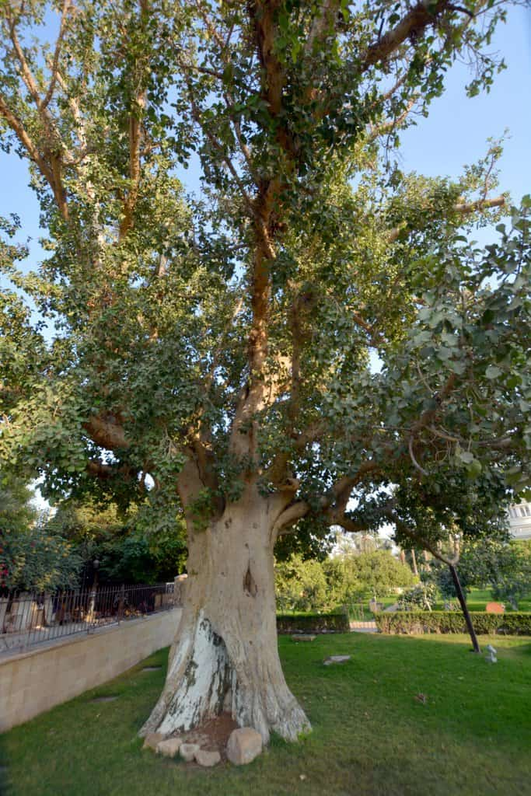
Come Down From Your Sycamore Tree
Luke 19:1-10
Pastor Richard “Rico“ Tubbs
August 4, 2024

Slide 3
Zacchaeus' whole life changed; he completely turned around from a sinful life and thus became a child of God.
God noticed the unnoticed.

Slide 4
1He entered Jericho and was passing through it. 2A man was there named Zacchaeus; he was a chief tax collector and was rich. 3He was trying to see who Jesus was, but on account of the crowd he could not, because he was short in stature. 4So he ran ahead and climbed a sycamore tree to see him, because he was going to pass that way. 5When Jesus came to the place, he looked up and said to him, "Zacchaeus, hurry and come down; for I must stay at your house today." 6So he hurried down and was happy to welcome him. 7All who saw it began to grumble and said, "He has gone to be the guest of one who is a sinner." 8Zacchaeus stood there and said to the Lord, "Look, half of my possessions, Lord, I will give to the poor; and if I have defrauded anyone of anything, I will pay back four times as much." 9Then Jesus said to him, "Today salvation has come to this house, because he too is a son of Abraham. 10For the Son of Man came to seek out and to save the lost."

Slide 5
When was the last time you moved beyond your comfort zone?
While operating within your comfort zone is safe, it does not give you the opportunity to grow. You may be good at what you do, but if you continue to do things in the same way, your life will have a tendency to become very boring. It may no longer offer you a challenge.

Slide 6
As Christians the depth in which we experience the fullness of God’s plans for our lives is often related to our willingness to step beyond our comfort levels

Slide 7
We all have sycamore trees to climb they are a part of our daily lives as a matter of fact—but every once in a while the Lord will instruct us to come down in order for us to enjoy a closer walk with Him.
Maybe the tree you need to climb down from means shutting off the TV; turning the computer off with its Facebook, Instagram, and Twitter; and maybe it is disassociating yourself with people who are standing in the way of your spiritual growth maybe this will aid you in getting out of your comfort zone and spending more time with Jesus

Slide 8
Maybe the tree you need to climb down from means shutting off the TV;
turning the computer off with its Facebook, Instagram, and Twitter;
Maybe it is disassociating yourself with people who are standing in the way of your spiritual growth
Maybe this will aid you in getting out of your comfort zone and spending more time with Jesus

Slide 9
Zacchaeus lived in Jericho where he made his headquarters as the chief tax collector. What’s wrong with being a tax collector in those days? generally tax collectors had a reputation for extortion and dishonesty. Tax collectors are often the most questioned and/or questionable people around
Luke tells us that Zacchaeus was very rich, and the assumption is that he made himself rich off of the backs, the blood, and the sweat of his own people there in Jericho.

Slide 10
1.) He Was Desperate To See Jesus (vs. 3 – 4)
Zacchaeus was not only short in stature but also very sophisticated in his sinning. In his community oppressing people who were already down made him the lowest of the low. The only other profession worse than his was grave robbers but at least their victims couldn’t feel or say anything. They were already dead! He was short in stature. Not just socially or economically but physically. And much worse, spiritually!

Slide 11
Not only was he desperate to see Jesus, he openly showed his desperation for all to see because he was willing to climb out of his comfort zone up a sycamore tree, however uncomfortable the sycamore tree did provide him with a better glimpse of Jesus Christ, it took some effort to climb the tree but once he climbed it he had the perfect view, although, he climbed out of his comfort zone.
It would have been equally uncomfortable for him to stand in the midst of the crowd, for one thing most of them hated him, and even if they didn’t hate him he was just too short in stature and could not get a very good view of Jesus when He passed by. To mingle with the crowd would have most likely been dangerous for him, he would be nudged, kicked, and bruised before it was all over

Slide 12
He was wealthy but he was unhappy. He was lonely; he had absolutely no BFF to confide in and there is no mention of an immediate family, no wife, no children—just him by himself. He had chosen a way or a living that made him an outcast. But somewhere and somehow he heard about Jesus Christ the man who openly welcomed tax collectors and sinners, a man unlike everyone else he knew who despised and hated men such as he, Zacchaeus was reaching after the love of God. Zacchaeus was like many of us today smiling on the outside but crying on the inside. This is why he so desperately wanted to see Jesus

Slide 13
2.) He Received The Invitation of Jesus (vs. 5 – 6)
It is entirely possible that he heard about another tax collector by the name of Matthew—another tax collector just like him who eventually became one of Jesus’ Disciples. He was tired of being the villain of his own people; he knew that he was not living right. Talking about being out of your comfort zone, how about living your entire life out of your comfort zone?

Slide 14
Zacchaeus serves as a perfect example for us today, he was indeed desperate to see Jesus so much so, and he struggled against the odds and found a comfortable place in order to see Jesus. Eventhough this particular place that he found caused him to have to humble and expose himself before the very people who just could not stand him.

Slide 15
Because Zacchaeus diligently sought to see Jesus, Jesus saw him. Not only did Jesus see him, He called Zacchaeus by his name. If a stranger called you by your name it would most definitely get your attention wouldn’t it?
We need to follow Zacchaeus’ example—seek to find a place, a vantage point where can see Jesus even if we have to move out of our comfort zone.

Slide 16
3.) He Repented and His Whole Life Changed (vs. 7 – 10)
And when they saw it, they all murmured…” they murmured, to murmur means to grumble or whine. It is not wrong to complain if correction is needed, but there should be no murmuring. Why does the Word of God mention the act of murmuring so much?
Unfortunately, many Christians are murmurers and complainers. In the home, on the job and in the local church they grumble, murmur and complain. They can see nothing good. To them, everything is bad -- their life is miserable and they want to make it that way for everyone else

Slide 17
Despite all this righteous indignation coming from the crowd Zacchaeus repented just the same. He made an about-face and his whole life changed in an instant, he completely turned around from his sinful life and turned to God and His way of righteousness.
Zacchaeus took steps to show all the community that he was a changed man
He decided to give half of his goods to the poor

Slide 18
The Son of Man came to seek and to save that which was lost. Man has wandered away from God and is lost but through Jesus; man can be saved…Jesus changed Zacchaeus, identity,now he was identified as the son of Abraham, the receiver of blessing and grace from God.

Slide 19
Homework
Bring an example of how to you were moved beyond your comfort zone?

