Slide 1
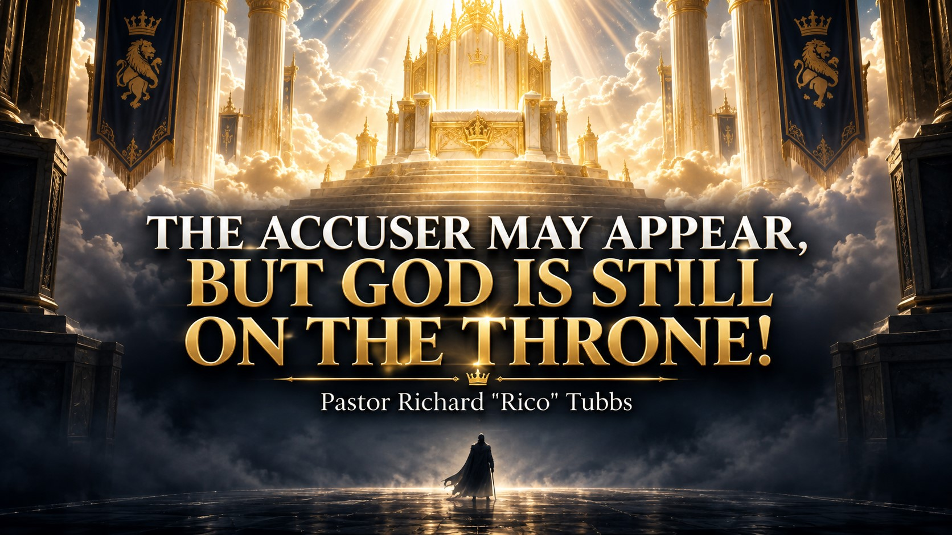

Slide 2
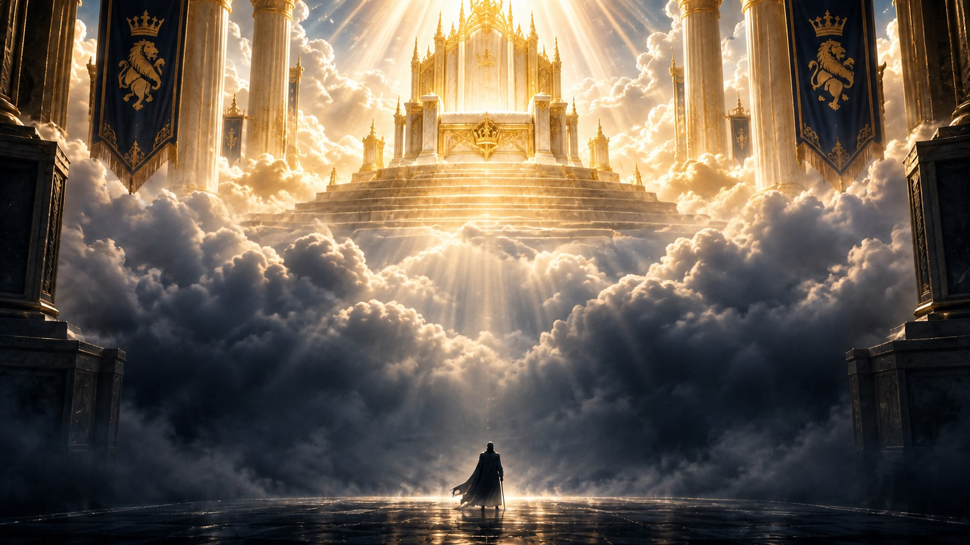
Job 1:6
“Now there was a day when the sons of God came to present themselves before the Lord, and Satan came also among them.”
When Trouble Shows Up Uninvited

Slide 3
The doctor gave you a report you were not expecting.
The job suddenly ended.
The relationship fell apart.
The money became tight.
Someone you trusted betrayed you.
You went to bed with peace, but you woke up in a storm.
Have you ever had trouble show up when you were not expecting it?
You were doing your best.
You were serving God.
You were taking care of your family.
You were trying to live right.
Then, without warning, trouble walked through the door.

Slide 4
That is where we find Job.
Job was not living in rebellion. He was not running from God. The Bible describes him as a man who was blameless, upright, feared God, and turned away from evil.
Yet Job 1:6 says:
“Now there was a day when the sons of God came to present themselves before the Lord, and Satan came also among them.”
The enemy appeared—but he did not appear as the one in charge.
Satan had to present himself before God.
He could not operate independently.
He could not touch Job without divine permission.
He could not go beyond the boundaries God established.
That means the devil may be active, but he is not Almighty.
He may be powerful, but he is not all-powerful.
He may have a plan, but God still has the final word!

Slide 5
THE ENEMY STUDIES YOUR LIFE, BUT GOD ALREADY KNOWS YOUR HEART
God asked Satan:
“Whence comest thou?” Then Satan answered the Lord, and said, “From going to and fro in the earth, and from walking up and down in it.” Job 1:7
1 Peter 5:8 warns us:
“Be sober, be vigilant; because your adversary the devil, as a roaring lion, walketh about, seeking whom he may devour.”

Slide 6
The enemy is looking for openings.
He studies our weaknesses.
He watches for moments of discouragement.
He looks for places where we are wounded, tired, offended, isolated, or afraid.
But while the enemy studies your weaknesses, God knows your heart!

Slide 7
“Hast thou considered my servant Job, that there is none like him in the earth?” — Job 1:8
Notice that God called Job, “My servant.”
Before the trial began, God had already identified Job.
Before Job lost anything, God knew who Job was.
Before people began judging Job, God had already spoken over his life.
The trial did not change Job’s identity.
What Job went through did not cancel what God had said about him.
The enemy may call you a failure, but God calls you His child.
The enemy may call you forgotten, but God calls you chosen.
The enemy may call you defeated, but God calls you more than a conqueror.
The enemy may remind you of your past,
but God reminds you of the blood of Jesus!

Slide 8
The Security Camera
Imagine a thief standing outside a house, looking for an open window. The thief walks around the property studying the doors, the windows, and the locks.
But what the thief does not realize is that the owner is watching him through a security camera.
The thief is looking at the house, but the owner is looking at the thief!
Church, the enemy may be watching for an opening, but God is watching over you.
Psalm 121:4 declares:
“Behold, he that keepeth Israel shall neither slumber nor sleep.”
God is not asleep.
God is not distracted.
God has not lost sight of you.
You may not see the enemy coming, but God sees what is behind you, what is in front of you, and what is waiting around the corner.

Slide 9
THE ENEMY HAS LIMITS GOD DOES NOT
“Doth Job fear God for nought? Hast not thou made an hedge about him, and about his house, and about all that he hath?” Job 1:9–10
Satan accused Job of serving God only because God had blessed him.
Even Satan had to acknowledge that there was a hedge around Job.
There was protection around his life.
There was protection around his family.
There was protection around his possessions.
The enemy could see the hedge, but he could not cross it without permission.

Slide 10
“Behold, all that he hath is in thy power; only upon himself put not forth thine hand.” Job 1:12
God established a boundary.
The enemy could go only so far.
I came to tell somebody: The devil may be allowed to shake some things, but he cannot destroy what God has ordained!
He may attack your peace, but he cannot steal the promise.
He may test your faith, but he cannot cancel your future.
He may cause tears to fall, but he cannot stop God from turning your mourning into dancing.
The enemy is on a leash—and God is holding the leash!

Slide 11
The Dog Behind the Fence
Imagine walking past a yard when a large dog charges toward the fence. The dog barks, growls, and shows its teeth. The noise can frighten you, but the dog cannot go beyond the fence.
The barking is real.
The threat sounds real.
The fear feels real.
But the boundary is real too!
The enemy makes a great deal of noise. He wants you to panic. He wants you to run. He wants you to believe that he has unlimited power.
But he does not!
God has already determined how far the enemy can go.

Slide 12
THE ATTACK DOES NOT ALWAYS MEAN YOU DID SOMETHING WRONG
One of the most dangerous assumptions we can make is that every trial is the result of personal sin.
Job’s friends looked at his suffering and assumed that he must have done something wrong.
They believed that good people were always comfortable and suffering people were always guilty.
But they were wrong.
Sometimes you are under attack because you are moving in the right direction.
Sometimes the enemy is fighting you because your faith is making a difference.
Sometimes opposition is evidence that you are carrying something valuable.

Slide 13
Thieves do not break into empty houses.
The enemy does not fight what he does not fear.
He saw Job’s integrity.
He saw Job’s worship.
He saw Job’s influence over his family.
He saw that Job had something worth attacking.

Slide 14
“Simon, Simon, behold, Satan hath desired to have you, that he may sift you as wheat.” Luke 22:31
But Jesus did not stop there:
“But I have prayed for thee, that thy faith fail not.” Luke 22:32
Jesus did not say, “Peter, you will never be shaken.”
He said, in effect, “Peter, when the shaking comes, your faith will survive.”
You may be shaken, but you will not be separated from God.
You may bend, but you will not break.
You may cry, but you will not quit.
You may stumble, but you will rise again!

Slide 15
YOUR WORSHIP CONFUSES THE ENEMY
In one day, Job lost his livestock, his servants, and his children.
Messenger after messenger arrived with devastating news.
Job did not have time to recover from one report before another report came.
Have you ever been in a season where it felt like one thing after another?
You fixed one problem, and two more appeared.
You survived one disappointment, and another one knocked at the door.
But look at Job’s response:
“Then Job arose, and rent his mantle, and shaved his head, and fell down upon the ground, and worshipped.” Job 1:20
Job grieved, but he worshipped.
He cried, but he worshipped.
His heart was broken, but he worshipped.
Job did not pretend that everything was all right. Faith is not denying your pain. Faith is choosing to trust God in the middle of your pain.

Slide 16
“The Lord gave, and the Lord hath taken away; blessed be the name of the Lord.” Job 1:21
Satan expected Job to curse God, but Job worshipped God!
The enemy said, “If I take the blessing, Job will abandon the Blesser.”
But Job proved that his relationship with God was deeper than his possessions.
Can you worship God when the answer has not come?
Can you praise Him when the door has not opened?
Can you trust Him when you do not understand what He is doing?
Real worship says:
“I may not understand this season, but God is still good.”
“I may not like what happened, but God is still faithful.”
“I may have tears in my eyes, but I still have praise in my heart.”
“I may have lost some things, but I have not lost my God!”

Slide 17
When Paul and Silas were beaten and locked in prison, praise came out.
Acts 16:25 says:
“And at midnight Paul and Silas prayed, and sang praises unto God: and the prisoners heard them.”
Their hands were chained, but their worship was free.
Their feet were bound, but their faith was not bound.
And when they worshipped, God shook the prison!
Do not wait until you come out to praise Him.
Praise Him while you are still in it.
There is power in a midnight praise!
The Crushed Flower
There are flowers and plants that release their strongest fragrance when they are crushed.
The pressure does not create the fragrance. The pressure reveals what was already inside.
Trials do the same thing.
Pressure reveals what is inside us.
When Job was crushed, worship came out.

Slide 18
GOD CAN RESTORE MORE THAN THE ENEMY TOOK
Job’s story did not end in chapter 1.
If you stop reading in the chapter of loss, you will miss the chapter of restoration.
Job 42:10 says:
“Also the Lord gave Job twice as much as he had before.”
God restored Job’s family, health, possessions, relationships, and influence.
Job lived long enough to see the other side of his suffering.
The enemy thought Job’s trial would become his grave, but God turned it into his testimony.
What looked like the end was only a chapter.
Your present condition is not your final conclusion.
God is still writing your story.
Do not put a period where God has placed a comma.
Do not surrender in chapter 1 when God has restoration waiting in chapter 42!

Slide 19
God Is Still in Control
Job 1:6 teaches us that Satan appeared in the heavenly court, but Satan was never sitting on the throne.

Slide 20
Keep praying.
Keep worshipping.
Keep walking.
Your story is not over!
The accuser may have a voice, but he does not have the final word.
The storm may have a voice, but it does not have the final word.
Your sickness may have a voice, but it does not have the final word.
Your past may have a voice, but it does not have the final word.
Jesus Christ has the final word!
And His word over your life is grace.
His word is mercy.
His word is victory.
His word is restoration.
His word is life!
He had to answer God.
He needed permission.
He had boundaries.
And he could not determine Job’s final outcome.
The same God who watched over Job is watching over you.
The same God who sustained Job will sustain you.
The same God who restored Job can restore you.
You may be in Job chapter 1 today.
You may be living through the loss.
You may be asking questions without receiving answers.
You may be worshipping with tears running down your face.

Slide 21
Homework
Three Powerful Truths to Carry Into This Week
1. Remember Who Is on the Throne
The enemy may be moving, but God is still ruling. Nothing can remove God from His throne, and nothing can separate you from His love.
2. Respect the Boundary God Has Established
The trial has limits. The enemy cannot go beyond what God allows, and God will always provide the strength you need to remain faithful.
3. Respond With Worship
When you cannot explain the battle, worship the God who controls the outcome. Your praise declares that your trust in God is greater than your trouble.

Slide 22
Closing Declaration
This week, I will not be controlled by the voice of the accuser.
I will not allow fear to silence my faith.
I will not allow trouble to steal my worship.
I know that God is watching over me.
I know that the enemy has limits.
I know that Jesus is praying for me.
I know that the blood still speaks.
I know that my story is not over.
The accuser may appear, but God is still on the throne!

Slide 23
Heavenly Father, we thank You that You are still on the throne. Thank You for watching over us even when we cannot see what is happening around us. Thank You for placing boundaries around the plans of the enemy.
Lord, strengthen every person who is walking through a Job season. Encourage the brokenhearted. Bring peace to the confused. Give strength to those who are tired and hope to those who feel like giving up.
Silence the voice of the accuser. Remind us that we have been forgiven, redeemed, and covered by the blood of Jesus Christ. Teach us to worship You when we understand and when we do not understand.
Help us remember that the attack is temporary, but Your promises are eternal. What the enemy intended for evil, turn it around for our good and for Your glory.
We declare that no weapon formed against us shall prosper. We declare that we are more than conquerors through Jesus Christ. We declare that our faith will not fail, our worship will not stop, and our story will not end in defeat.
The accuser may have a voice, but Jesus Christ has the final word!
In the mighty, powerful, and victorious name of Jesus Christ, we pray.
Amen!

