Slide 1

Pastor Richard “Rico” Tubbs

Slide 2

Prologue
1 The revelation from Jesus Christ, which God gave him to show his servants what must soon take place. He made it known by sending his angel to his servant John, ² who testifies to everything he saw—that is, the word of God and the testimony of Jesus Christ. ³ Blessed is the one who reads aloud the words of this prophecy, and blessed are those who hear it and take to heart what is written in it, because the time is near.

Slide 3
The bulk of Revelation is prophecy surrounding events that will soon transpire in relation to the church and the Roman Empire.
Before revealing to John these prophecies in a series of visions, Jesus asks John to: write in a book what you see, and send it to the seven churches: to Ephesus and to Smyrna and to Pergamum and to Thyatira and to Sardis and to Philadelphia and to Laodicea (lay.ow.duh.see.uh) (Rev. 1:11).

Slide 4
Revelation 3:15-20
To the Church in Laodicea
¹⁴ “To the angel of the church in Laodicea write:
These are the words of the Amen, the faithful and true witness, the ruler of God’s creation. ¹⁵ I know your deeds, that you are neither cold nor hot. I wish you were either one or the other! ¹⁶ So, because you are lukewarm—neither hot nor cold—I am about to spit you out of my mouth. ¹⁷ You say, ‘I am rich; I have acquired wealth and do not need a thing.’ But you do not realize that you are wretched, pitiful, poor, blind and naked. ¹⁸ I counsel you to buy from me gold refined in the fire, so you can become rich; and white clothes to wear, so you can cover your shameful nakedness; and salve to put on your eyes, so you can see.
¹⁹ Those whom I love I rebuke and discipline. So be earnest and repent. ²⁰ Here I am! I stand at the door and knock. If anyone hears my voice and opens the door, I will come in and eat with that person, and they with me.

Slide 5
Jesus decided to address specific issues (good and bad) within each of these individual congregations.
In writing to the other six churches, Jesus found something good to say, he recognized something positive about the congregation. Not here!

Slide 6
What a powerful and sobering truth! Jesus knows our deeds, both individually and as a church. Jesus knew all about the church at Laodicea
What about us? Does Jesus know our deeds?
Mark 4:22:
For nothing is hidden, except to be revealed; nor has anything been secret, but that it should come to light.

Slide 7
This passage describes the spiritually apathetic church of Laodicea, whose indifference to God's commands leads to Jesus' rejection of them, using the metaphor of lukewarm water from the city's water supply.

Slide 8
The City Laodicea
Wealthy City:
Was a rich ancient Greek city in Asia Minor, now Turkey, on the river Lycus
Wedged between major trade routes Laodicea was a wealthy city known for banking and textiles.

Slide 9
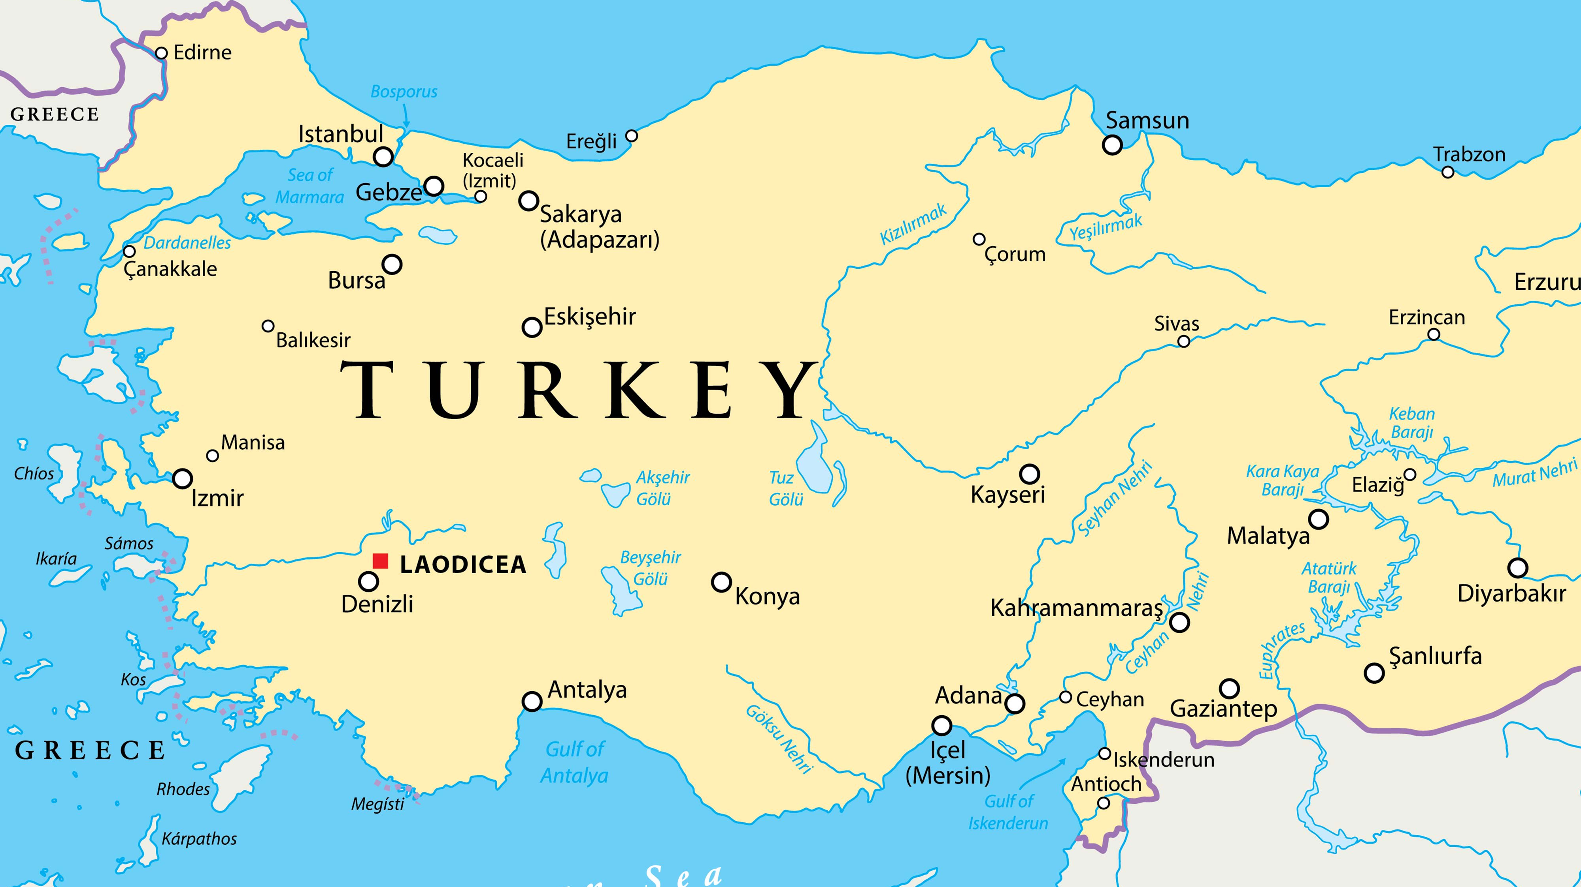

Slide 10
The analogy of hot, cold, and lukewarm water had a powerful, culturally specific meaning for the Laodicean church.
Hot water: Six miles from Laodicea was the city of Hierapolis, known for its hot, medicinal springs used for healing. The hot water was useful and therapeutic.
Cold water: Eleven miles away was the city of Colossae, known for its cold, pure mountain water that was refreshing and life-giving. The cold water was useful and invigorating.

Slide 11
Water Supply:
Its water system brought lukewarm water from hot springs in Hierapolis and cold streams in Colossae. By the time the water reached Laodicea, it was unpalatable and disgusting, incapable of providing refreshing coldness or comforting heat.
Useless

Slide 12
Lukewarm Spirituality:
The church in Laodicea was considered spiritually lukewarm, a state of spiritual indifference and apathy.

Slide 13
Rejection of Indifference:
Jesus preferred a believer to be "hot" (fervent in faith) or "cold" (completely against faith, clear in their conviction) rather than "lukewarm," which was seen as useless and repulsive.

Slide 14
The central message of Revelation 3:15-16 is a warning against spiritual apathy and self-sufficiency.
Jesus desires his followers to be fully and passionately committed, to be spiritually useful to others, and to recognize their total dependence on him for true purpose and meaning.
The threat to "spit you out of my mouth" is a wake-up call to repent and restore their relationship with him.

Slide 15
Consequences:
The threat of being "spat out" or "vomited out" signifies complete rejection and revulsion from Christ due to their spiritual apathy and uselessness to His kingdom.

Slide 16
Jesus's disgust with the church was compounded by their spiritual arrogance. The Laodiceans were a very wealthy people who had rebuilt their city without outside help after an earthquake in AD 60. This material prosperity led to spiritual complacency, with the church believing it was rich and needed nothing.

Slide 17
If we are simply going through the motions, if our heart is not in it, if we are not living and working for Christ everyday of our lives, we are of no benefit to Him!
Useless

Slide 18
Self-deception
He points out their self-deception, as they believe they are rich and in need of nothing, while in reality, they are "wretched, pitiful, poor, blind, and naked".

Slide 19
They had become infected with the love of material things. Perhaps the most dangerous point made here is the fact that they are so “caught-up” in their wealth, they were unaware of their sinful state
Are we the modern day Laodicea?

Slide 20
Something to think about…Ouch!!
This going to sting a little bit
Compare your discretionary spending (spending on things that you could do with out) to what you give the Lord each week.
Ouch!!
Can you get to the point in your life that you have so much and are doing so well that you don’t need God?
Can you get to the point where you have so much and are doing so well that you fail to realize and be thankful for the source of all your blessings?
Can you get to the point where you have so much and are doing so well that you become slaves to your things? Can your priorities change such that you put having things, doing things, in front of God?

Slide 21
Advice for repentance:
Jesus advises them to buy from him "gold refined in the fire" to become truly rich, "white garments" to cover their nakedness, and "salve to anoint your eyes" to see. This is a call to repent and seek spiritual instead of material wealth.

Slide 22
Vs. 18: I advise/counsel you…
If Jesus were to give us advise today, do you think it prudent to follow it?
What was His advise to them and any today who are “dead and don’t know it?”

Slide 23
Jesus at the door:
The passage concludes with a striking metaphor: "Behold, I stand at the door and knock. If anyone hears my voice and opens the door, I will come in to him and eat with him, and he with me".

Slide 24
This is a call for personal, intimate fellowship with believers.
It represents Jesus's desire to have a relationship with them, which is the path to victory

Slide 25
Homework
Vs. 19-20: Those whom I love… repent.
Though blinded by their wealth, love of material things and lukewarmness, Jesus still loves you and provides us an opportunity for repentance.
The same is true for us today. This week He stands at the door and knocks.
This week it’s our responsibility to open it!

