Slide 1


Slide 2
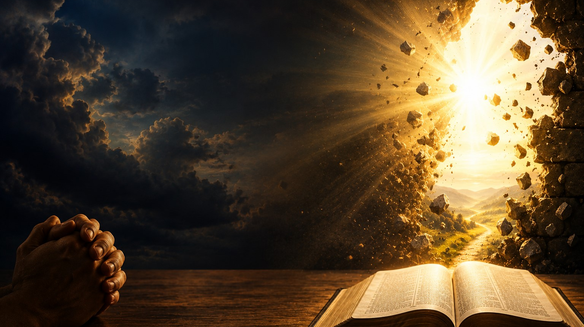
Isaiah 65:24
"Before they call I will answer; while they are still speaking I will hear."

Slide 3
There are prayers you prayed yesterday.
There are prayers you prayed last week.
But then...there are those old prayers.
The prayers you prayed years ago.

Slide 4
The prayers that have become stained with tears.
The prayers you've almost forgotten because life kept moving.
The prayers you've whispered at hospital beds...

Slide 5
You prayed...
You cried...
You fasted...
You believed...
And then...
Nothing.
Or so it seemed.
The enemy whispers,
"God forgot."
People say,
"Move on."
Over broken marriages...
For prodigal children...
For financial miracles...
For healing...
For revival...
For purpose...
For a lost loved one.

Slide 6
But Heaven says...
"I've been working all along."
Sometimes the greatest miracles are not the newest prayers...
They're the oldest ones.

Slide 7
God Never Loses a Prayer
Psalm 56:8
"You keep track of all my sorrows. You have collected all my tears in your bottle."

Slide 8
God doesn't just hear prayers.
He stores them.
Imagine Heaven having shelves filled with prayers.
Not one has been misplaced.
Not one has expired.
Not one has been ignored.
Every tear...
Every whisper...
Every midnight cry...
Is safely kept before God's throne.

Slide 9
Imagine writing a letter to someone deployed overseas.
Weeks pass.
Months pass.
No response.
You assume they never received it.
Then one day they walk through the front door...
Holding every letter.
They read every word.
They treasured every page.
Sometimes Heaven feels silent...
Not because God didn't receive your prayer...
But because He's preparing the right moment to answer.

Slide 10
Delay Does Not Mean Denial
Daniel 10:12-13
¹²Then he continued, “Do not be afraid, Daniel. Since the first day that you set your mind to gain understanding and to humble yourself before your God, your words were heard, and I have come in response to them. ¹³ But the prince of the Persian kingdom resisted me twenty-one days. Then Michael, one of the chief princes, came to help me, because I was detained there with the king of Persia.

Slide 11
The battle happened between Heaven and Earth.
Some breakthroughs aren't delayed because God said "No."
They're delayed because Hell is fighting what Heaven already released.
Someone needs to hear this...
If you're under attack...
Maybe it's because your answer is getting closer.
Daniel prayed.
For twenty-one days...
Nothing.
Then the angel arrived.
"From the first day you prayed...your words were heard."
Not the twenty-first day...
The FIRST day.
The answer left Heaven immediately.

Slide 12
Hannah's Old Prayer Finally Broke Through
1 Samuel 1
Then...
One prayer...
One visit...
One moment...
Everything changed.
Samuel was born.
Notice...
God wasn't simply giving Hannah a son.
God was preparing a prophet to change Israel.
Every year...
She prayed.
Every year...
She cried.
Every year...
People mocked her.
Peninnah laughed.
Eli misunderstood.
Even her husband couldn't fix it.
But Hannah refused to stop praying.

Slide 13
Sometimes your delayed blessing is because God intends for your miracle to bless generations.
An artist spends months painting behind closed doors.
Nobody sees it.
People assume nothing is happening.
Then unveiling day arrives.
Everyone says...
"It happened overnight."
No...
It happened slowly...
Until the right moment.
That's how God works.

Slide 14
The Woman with the Issue of Blood
Mark 5
Twelve years...
Twelve years of doctors.
Twelve years of disappointment.
Twelve years of unanswered prayers.
Imagine all the nights she prayed...
"Lord...
Please heal me."
Nothing changed.
Until one day...
Jesus walked into town.
Her old prayer met a new opportunity.
She touched His garment...
And twelve years ended in one second.
Your miracle can take years to prepare...
But only seconds to arrive.

Slide 15
Corrie ten Boom once wrote that there is no panic in Heaven.
She watched her family imprisoned during World War II.
She lost loved ones.
She suffered unimaginable pain.
Yet later she testified...
Every unanswered prayer had been leading her toward a greater ministry of forgiveness that touched millions worldwide.
Sometimes God answers differently...
Sometimes later...
But always wisely.

Slide 16
God Often Answers Bigger Than You Asked
Ephesians 3:20
"Now unto Him who is able to do exceedingly abundantly above all that we ask or think..."
Sometimes God waits...
Because your prayer is too small.
You prayed for a job…God planned a career.
You prayed for healing….God planned a testimony.
You prayed for provision…God planned abundance.
You prayed for one person…God planned an entire family.

Slide 17
Children often ask for one cookie.
Parents are preparing Thanksgiving dinner.
If they eat too early...
They'll miss the feast.
God sometimes delays cookies...
Because He's preparing banquets.

Slide 18
Your Old Prayer Is About to Meet God's Perfect Timing
Galatians 6:9
"Do not grow weary in doing good..."
George Müller prayed for five friends to come to Christ.
One was saved quickly.
Another years later.
Another after decades.
The last one came to Christ after Müller had already gone to Heaven.
Every single prayer was answered.
Not according to George's timetable...
But according to God's.

Slide 19
Jesus Is Still the God of Breakthrough
Jesus raised Lazarus after four days.
He restored Peter after failure.
He healed blind Bartimaeus after years of darkness.
He delivered the demoniac everyone had given up on.
Nothing is impossible with Him.
The same Jesus...
Still hears old prayers.
Still opens impossible doors.
Still heals.
Still restores.
Still saves.
Still delivers.
Still performs miracles.

Slide 20
Imagine standing beside a dam.
For years...
Water presses against it.
Nothing happens.
Then suddenly...
One tiny crack appears.
Within moments...
The entire dam gives way.
People think,
"The crack caused it."
Years of pressure caused the breakthrough.
No!

Slide 21
Your prayer life has been building holy pressure.
Every prayer...
Every tear...
Every act of faith...
Every moment of obedience...
Has been pressing against the impossible.
When that old prayer finally breaks through...
People will call it luck.
Doctors will call it unexplainable.
Friends will call it coincidence.
But you'll know...
It wasn't luck.
It wasn't chance.
It was years of faithful praying finally meeting God's perfect moment.

Slide 22
Homework
Today God is asking one question:
Have you stopped praying the prayer I never stopped hearing?
Maybe you've buried it.
Maybe you've given up.
Maybe you've convinced yourself it's too late.
But hear the Word of the Lord today:
"Before they call I will answer; while they are still speaking I will hear." (Isaiah 65:24)
This week
Bring that old prayer back to the altar.
Dust it off…Believe again.
Pray again…Trust again.
Because the God who heard it the first time...
Is still working on it today.
Your breakthrough may be closer than you think.

Slide 23
Heavenly Father,
Today we bring before You the prayers we've carried for years—the dreams that seemed forgotten, the promises we've waited to see fulfilled, and the burdens we've wept over in secret. Thank You that You have never forgotten a single prayer or tear.
Lord, renew our faith where disappointment has settled in. Give us strength to keep believing when we cannot yet see the answer. Help us trust Your perfect timing and remember that Your delays are never without purpose.
For every prodigal child, bring them home. For every broken heart, bring healing. For every impossible situation, make a way where there seems to be no way. Let old prayers become fresh testimonies of Your faithfulness.
We declare that breakthrough belongs to You, and we believe that what has been sown in tears will be reaped with songs of joy. May our lives proclaim that You are the God who hears, remembers, and answers.
In the mighty name of Jesus Christ we pray,
Amen.

