Slide 1
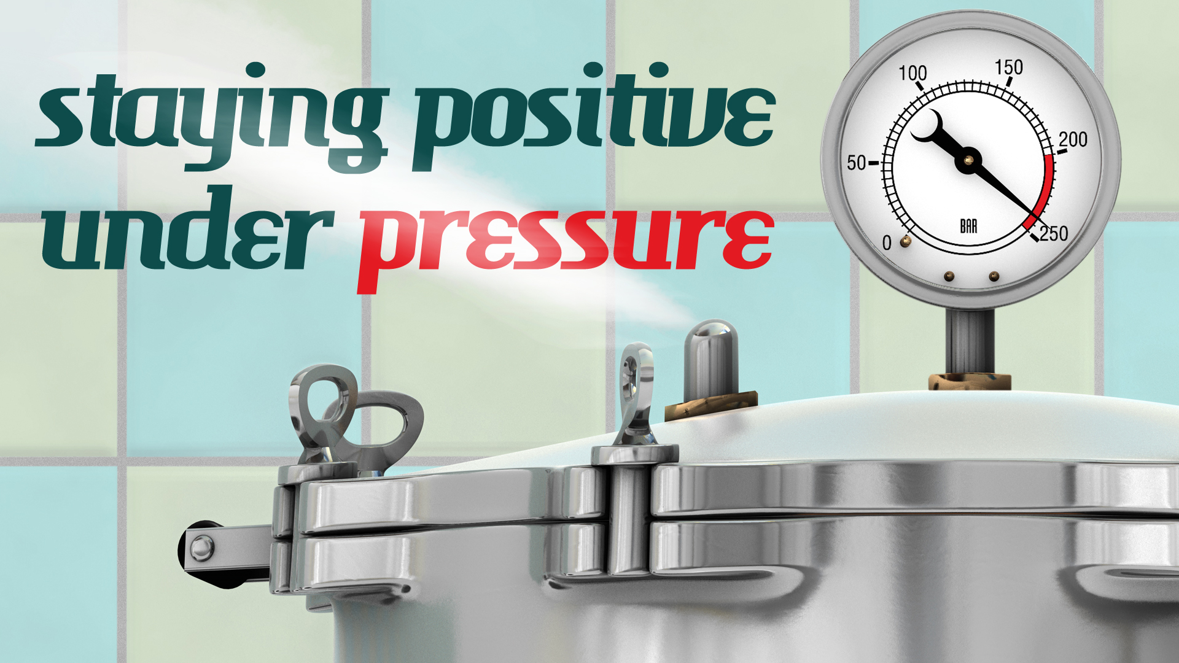
Pastor Richard “Rico” Tubbs

Slide 2

"We are hard pressed on every side, but not crushed; perplexed, but not in despair; persecuted, but not abandoned; struck down, but not destroyed
2 Corinthians 4:8-9

Slide 3
Pressed, but not crushed
"Pressed on every side": The Greek word suggests being hemmed in or crowded from all directions, symbolizing the relentless and overwhelming troubles Paul faced, including physical hardships and persecution.
"But not crushed": This resilience is a testament to God's sustaining power. While the pressure is real, God sets a limit on what a believer must endure, preventing them from being completely defeated. The "clay jar" can be squeezed and cracked, but it will not be shattered by external forces.

Slide 4
Perplexed, but not in despair
"Perplexed": Paul and his companions sometimes felt lost, uncertain of what to do, or unable to find a way out of a confusing situation. This reflects the normal human experience of uncertainty.
"But not in despair": Despite this confusion, Paul's faith kept him from losing all hope. His trust in God provided an anchor in the midst of uncertainty, assuring him that even if he didn't know the way, God did.

Slide 5
Persecuted, but not abandoned
"Persecuted": This refers to the active and often cruel opposition Paul and other early Christians faced for their faith.
"But not abandoned": No matter how many people turned against them or chased them away, Paul was confident that God would never forsake them. The believer is never alone in their suffering.

Slide 6
Struck down, but not destroyed
"Struck down": Paul experienced severe physical abuse during his ministry, being beaten and even left for dead at one point (Acts 14:19). He was knocked down, but it was not the end.
"But not destroyed": With God's help, he always got back up. This shows that while his enemies could inflict physical harm, they could not ultimately destroy him or stop his mission.

Slide 7
2 Corinthians 4:8-9
is a powerful message of hope and resilience for all believers.
God provides the strength and comfort needed to endure, turning human weakness into an opportunity to display God's power.

Slide 8
2 Corinthians 4:7
"But we have this treasure in jars of clay to show that this all-surpassing power is from God and not from us"

Slide 9
In ancient times, clay jars were commonplace, practical, and cheap. They were used for storing all kinds of items, from water and grain to important scrolls, and were often discarded once they broke
The material itself, being fragile and common, is a powerful symbol for human nature.

Slide 10
Commonness:
Like a simple earthenware pot, humanity is not inherently special or magnificent. Paul's point is that God does not choose only the powerful, eloquent, or high-born to carry his message. He uses ordinary people from every station of life.

Slide 11
Fragility:
Clay jars were easily broken. This symbolizes the weakness, vulnerability, and mortality of the human body and spirit. Paul experienced this fragility firsthand through persecution, beatings, and other hardships, as detailed in the verses that follow (2 Corinthians 4:8-9).

Slide 12
Emptiness and dependence:
The jar's primary purpose is not to be admired for its own beauty but to hold something. Likewise, humans are meant to be vessels for God's purposes, not to glorify themselves.
This echoes the Old Testament image of God as the "potter" and humanity as the "clay" (Isaiah 64:8), emphasizing that we are molded and shaped by him.

Slide 13
Glory through brokenness:
When the fragile clay jar is cracked or broken through hardship and suffering, the light of the treasure inside shines out more brightly.
This means that a Christian's trials and weaknesses are not a liability but an opportunity for God's power to be put on display for all to see.

Slide 14
The value of a person does not come from their own inherent strength or impressive qualities, but from the divine glory they have the privilege of carrying.
Don't question the spin.

Slide 15
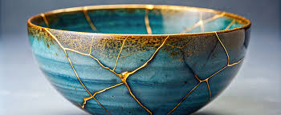
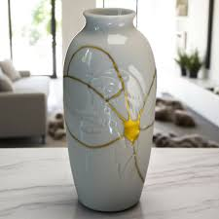
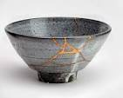
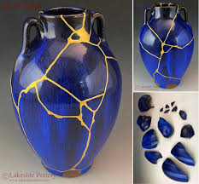
Kintsugi is the Japanese art of repairing broken pottery by mending the areas of breakage with lacquer dusted or mixed with powdered gold, silver, or platinum. This technique, also called Kintsukuroi, treats the break as part of the object's history, making the repaired piece even more beautiful and unique by highlighting, rather than hiding, the damage.

Slide 16
When our lives are shattered by trauma, loss, or personal failings, God doesn't just put us back together; he fills our cracks with his grace, making our story of restoration a testament to his power.

Slide 17
Examples of biblical figures under pressure
Job: Faced immense suffering, loss of family, wealth, and health, yet maintained his faith.
Jesus: Experienced "sorrow to the point of death" in the Garden of Gethsemane, a moment of profound human pressure and the need for prayer and submission to God's will
Apostle Paul: Wrote about being "hard pressed on all sides, but not crushed," and "perplexed, but not in despair" due to persecution, imprisonment, and other hardships.
Moses: Was under pressure from both Pharaoh, who increased the Israelites' workload, and the Israelites themselves, who blamed him for their difficult situation.
King David: Endured stress from political turmoil, enemies, and personal failures, but often turned to God in prayer.
Elijah: After a major confrontation with the priests of Baal, he fell into despair and asked God to take his life

Slide 18
How should we respond
Reliance on God: When their own strength failed, they learned to rely on God's strength and grace, as Paul stated in 2 Corinthians.
Faith and prayer: Many turned to prayer to seek guidance and strength, like Jesus in Gethsemane or David throughout his life.
Finding purpose: Some, like Paul, continued to share God's word even in difficult circumstances, like imprisonment
Submission to God's will:
They often found a way to submit to God's will, even in the face of extreme pressure.

Slide 19
Homework
The contrast between the fragile vessel and the powerful treasure glorifies God alone and provides hope that even broken, ordinary people can be used for extraordinary purposes.
This week recognize a pressure situation and does God allow his light to shine through or do you continue crack under pressure
Let’s ask the Lord to help us and to teach us how to better manage the pressure cooker times in life.

