Slide 1
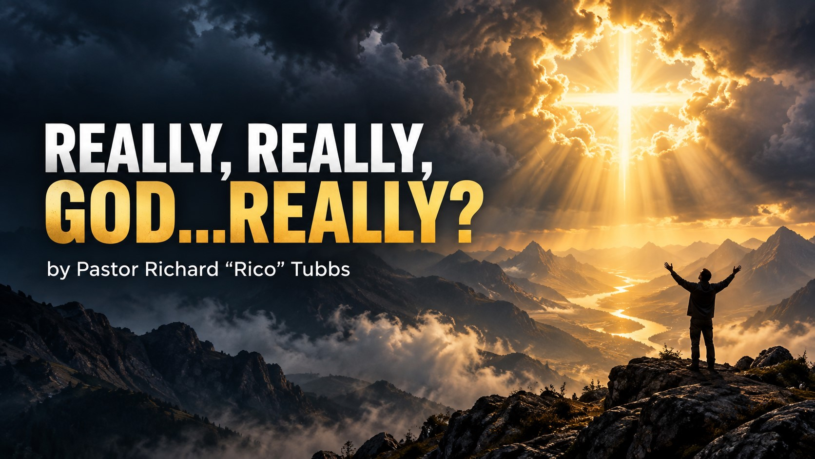

Slide 2
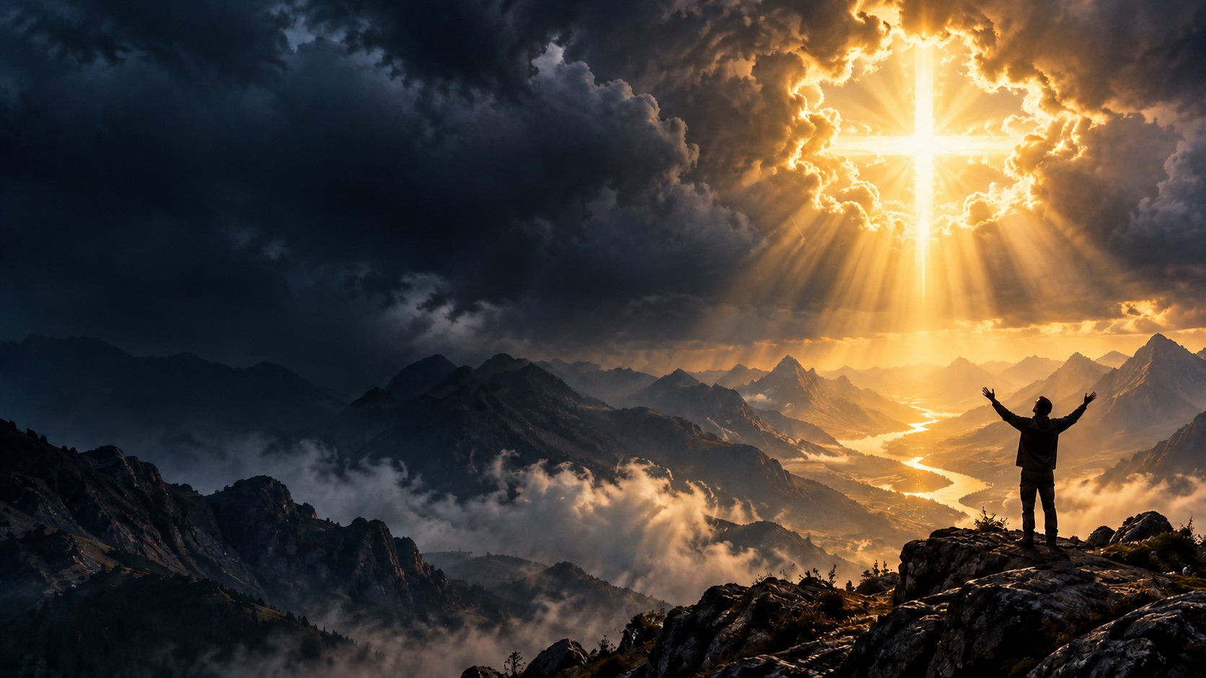
Habakkuk 1:2–5
Habakkuk’s Complaint
² How long, Lord, must I call for help,
but you do not listen?
Or cry out to you, “Violence!”
but you do not save?
³ Why do you make me look at injustice?
Why do you tolerate wrongdoing?
Destruction and violence are before me;
there is strife, and conflict abounds.
⁴ Therefore the law is paralyzed,
and justice never prevails.
The wicked hem in the righteous,
so that justice is perverted.
The Lord’s Answer
⁵ “Look at the nations and watch—
and be utterly amazed.
For I am going to do something in your days
that you would not believe,
even if you were told.

Slide 3
Habakkuk is an Old Testament prophet and the author of the eighth book of the Twelve Minor Prophets in the Hebrew Bible. Operating around 612 BC during the decline of the Southern Kingdom of Judah, he witnessed rapid social decay, widespread injustice, and the rising threat of the Babylonian (Chaldean) Empire.
Habakkuk’s theology profoundly influenced the New Testament, serving as a primary theological bridge from the Old Testament Law to the Christian gospel. While he is a Minor Prophet, New Testament writers rely heavily on his core statement in Habakkuk 2:4: "The righteous shall live by his faith"
1. Romans 1:17 – The Foundation of Justification by Faith
2. Galatians 3:11 – Faith vs. The Mosaic Law
3. Hebrews 10:37–38 – Enduring Faith Through Persecution

Slide 4
Have You Ever Questioned God?
Have you ever looked toward Heaven and said:
“Really, God?”
“After everything I have already been through this too?”
“I prayed.”
“I believed.”
“I trusted You.”
“I tried to do the right thing.”
“And this is what happened?”
Sometimes life hits you so hard that you do not have a polished prayer. You do not have church words. You do not have a praise break. All you have is one honest question:
“Really, God…really?”

Slide 5
Have you ever received bad news while you were still recovering from the last bad news?
Have you ever watched a door close that you were certain God was going to open?
Have you ever prayed for healing, but the sickness became worse?
Have you ever trusted somebody, only to discover that they betrayed you?
Have you ever given your best and still watched everything fall apart?

Slide 6
You were faithful…but still frustrated.
You were praying…but still hurting.
You were believing…but still waiting.
You knew God was able, but you could not understand why He had not done it yet.
And deep inside your heart, you whispered:
“Really, God? Is this really part of Your plan?”

Slide 7
And deep inside your heart, you whispered:
“Really, God? Is this really part of Your plan?”
God is not intimidated by your confusion. He is not offended by your tears. He is not threatened by your honest emotions.
God would rather hear your honest cry than your empty religious words.
Habakkuk Asked God, “How Long?”

Slide 8
Habakkuk looked at the violence, injustice, pain, and confusion surrounding him and cried:
“O Lord, how long shall I cry, and thou wilt not hear!”
—Habakkuk 1:2
Habakkuk was essentially saying:
“God, do You see this?”
“God, do You hear me?”
“God, why are You allowing this?”
“God, when are You going to do something?”

Slide 9
But God answered:
“Behold ye among the heathen, and regard, and wonder marvellously: for I will work a work in your days, which ye will not believe, though it be told you.”
—Habakkuk 1:5
God was saying:
“Habakkuk, I know you cannot see it, but I am already working.”
You may not see God’s hand, but that does not mean He is not moving.
You may not hear God’s voice, but that does not mean He is not speaking.
You may not understand God’s plan, but that does not mean He has abandoned you.

Slide 10
God is working in places you cannot see, through people you do not know, and in ways you do not yet understand.

Slide 11
GOD’S SILENCE DOES NOT MEAN GOD’S ABSENCE
One of the hardest things to endure is the silence of God.
It is hard when you pray and Heaven seems quiet.
It is hard when you ask for direction and receive no immediate answer.
It is hard when God gave you a promise, but your present circumstances look nothing like what He promised.

Slide 12
David cried:
“How long wilt thou forget me, O Lord? for ever? how long wilt thou hide thy face from me?”
Psalm 13:1
David loved God, but David still had questions.
David trusted God, but David still experienced pain.
David worshiped God, but David still had moments when he felt forgotten.
Faith does not mean you never have questions.
Faith means you continue trusting God even when your questions have not been answered.

Slide 13
The Teacher Is Silent During the Test
The teacher knows exactly what the student is facing.
Sometimes God is silent because you are walking through a test based on what He has already taught you.

Slide 14
God has already told you:
“I will never leave thee, nor forsake thee.”
Hebrews 13:5
God has already told you:
“No weapon that is formed against thee shall prosper.”
Isaiah 54:17
God has already told you:
“Weeping may endure for a night, but joy cometh in the morning.”
Psalm 30:5
When Heaven seems silent, stand on what God has already spoken!
God’s silence is not His absence.
God’s delay is not His denial.
God’s quietness is not His abandonment.

Slide 15
GOD MAY NOT COME WHEN YOU WANT HIM, BUT HE IS NEVER LATE

Slide 16
In John 11, Lazarus became sick.
Mary and Martha sent word to Jesus:
“Lord, behold, he whom thou lovest is sick.”
—John 11:3
They did not ask a stranger for help. They called Jesus.
They knew Jesus loved Lazarus.
They knew Jesus had healed the sick.
They knew Jesus had performed miracles.
Surely Jesus would come immediately!
But the Bible says:
“When he had heard therefore that he was sick, he abode two days still in the same place where he was.”
—John 11:6
Jesus waited.
Can you imagine Mary and Martha looking down the road?
“Is Jesus coming?”
“Did He receive the message?”
“Does He know how serious this is?”
“Why has He not arrived?”
Lazarus died.
The funeral took place.
The stone was rolled in front of the tomb.
When Jesus finally arrived, Martha said:
“Lord, if thou hadst been here, my brother had not died.”
—John 11:21
In other words:
“Really, Jesus? Now You come?”

Slide 17
Sometimes God does not answer the way you expect because He is preparing to reveal Himself in a way you have never known Him before.
You knew Him as Provider—but now you are about to know Him as Sustainer.
You knew Him as Healer—but now you are about to know Him as Peace in the middle of pain.
You knew Him as Deliverer—but now you are about to know Him as the One who keeps you while you are still walking through the fire.
God may not come when you want Him, but when He arrives, He is always on time!

Slide 18
THE STORM DOES NOT MEAN YOU MISSED GOD
In Mark 4, Jesus told His disciples:
“Let us pass over unto the other side.”
Mark 4:35
The disciples obeyed Jesus and entered the boat.
Then a violent storm arose.
This is important: They were in the storm because they obeyed Jesus.
We sometimes assume that every storm means we made a wrong decision.

Slide 19
You can obey God and still experience opposition.
You can be walking in God’s will and still face trouble.
You can be doing exactly what God told you to do and still encounter a storm.
The disciples looked at Jesus sleeping in the boat and cried:
“Master, carest thou not that we perish?”
Mark 4:38
They were asking:
“Jesus, do You even care?”
“Do You see what is happening?”
“Are You going to let us die out here?”
Jesus stood and spoke to the storm:
“Peace, be still.”
Mark 4:39
Immediately, the wind stopped and the sea became calm.

Slide 20
Here is the revelation:
The storm was never going to cancel the word Jesus had already spoken.
Jesus said, “Let us pass over unto the other side.”
He did not say, “Let us go halfway and drown.”
If God said you are going to the other side, then the storm cannot change your destination!
The storm may shake your boat.
The storm may frighten your heart.
The storm may make you question everything.
But the storm cannot overthrow the Word of God!

Slide 21
GOD CAN HANDLE YOUR HONEST QUESTIONS
Job lost his wealth, his children, his health, and the support of those around him.
Job did not understand what was happening.
But the Bible says:
“Then Job arose, and rent his mantle, and shaved his head, and fell down upon the ground, and worshipped.”
Job 1:20
Job grieved—but he worshiped.
Job cried—but he worshiped.
Job had questions—but he worshiped.
Job did not pretend that it did not hurt. He simply refused to allow the hurt to steal his worship.

Slide 22
There is a difference between questioning God and quitting on God.
There is a difference between crying in His presence and walking away from His presence.

Slide 23
There are believers who can testify:
“I thought losing that opportunity would destroy me, but God used it to redirect me.”
“I cried when that relationship ended, but later I realized God was protecting me.”
“I did not understand the season of loneliness, but God used it to heal me.”
“I thought the delay was punishment, but God was preparing something better.”
“I thought I had reached the end, but God showed me it was only a turning point.”
What looked like rejection became redirection.
What felt like isolation became preparation.
What appeared to be an ending became a new beginning.
And one day, you will look back at the season that made you ask, “Really, God?” and you will say:
“Now I understand why You did not let me give up.”

Slide 24
The Seed Beneath the Ground
A seed placed beneath the ground is surrounded by darkness.
It is buried…it is covered…It cannot see the sunlight.
If the seed could speak, it might say:
“Really, God?”
“Why am I down here?”
“Why am I surrounded by darkness?”
“Why does it feel like I have been buried?”
But the seed has not been buried to die.
It has been planted to grow!
There are seasons when you feel buried, but God says:
“You are not buried. You are planted!”
The darkness is not your grave.
It is your growing place.
The pressure is breaking open something that has been locked inside you.
Roots are developing where nobody can see them.
Strength is growing underneath the surface.
And at the appointed time, what God placed inside you will break through!

Slide 25
Maybe you entered this season saying:
“Really, God?”
But you are going to leave declaring:
“Even now, I trust You!”
I do not understand it—but I trust You.
I cannot explain it—but I trust You.
I do not know when it will change—but I trust You.
I do not know how the door will open—but I trust You.
I do not know how the mountain will move—but I trust You.
I do not know how the story will end—but I know the Author!
“Trust in the Lord with all thine heart; and lean not unto thine own understanding.”
Proverbs 3:5
Do not lean on what you see.
Do not lean on what you feel.
Do not lean on what people are saying.
Lean on God!
The same God who carried you before will carry you again.
The same God who made a way before will make a way again.
The same God who opened one door can open another.
The same God who healed your heart before can heal it again.
The same God who brought you out of the last storm is already standing with you in this one!

Slide 26
Homework
Three Instructions for the Coming Week
3. PROCEED IN OBEDIENCE
Do not allow confusion to paralyze you.
Do the last thing God told you to do.
Take the next faithful step.
Make the call.
Forgive the person.
Submit the application.
Return to prayer.
Open your Bible.
Get back in position.
You do not need to see the entire staircase. You only need enough faith to take the next step.
Pray honestly. Praise expectantly. Proceed obediently.
1. PRAY HONESTLY
Stop pretending with God.
Tell Him where it hurts.
Tell Him what you fear.
Tell Him what you do not understand.
But after you pour out your questions, declare:
“God, I may not understand Your plan, but I still trust Your heart.”
“Casting all your care upon him; for he careth for you.”
1 Peter 5:7
2. PRAISE BEFORE THE ANSWER COMES
Do not wait until the battle is over to worship.
Praise God while you are waiting.
Praise Him while the door is still closed.
Praise Him while the report still looks bad.
Praise is your declaration that the problem is not greater than your God!
Every morning this week, say:
“This is the day which the Lord hath made; I will rejoice and be glad in it.”

Slide 27
Final Declaration
I may have questions, but I will not quit!
I may be hurting, but I will keep believing!
I may be waiting, but I will keep worshiping!
I may not understand God’s methods, but I trust His motives.
I may not understand His timing, but I trust His wisdom.
I may not understand this chapter, but I trust the One writing my story.
So when life makes me cry:
“Really, really, God…really?”
My faith will answer:
“Yes, really! God is still faithful.”
Really—He is still working!
Really—He is still providing!
Really—He is still healing!
Really—He is still protecting!
Really—He is still making a way!
And really—God is still on the throne!

Slide 28
Closing Prayer
Father, in the mighty name of Jesus, we come before You with our questions, our pain, our disappointment, and our confusion.
Some of us are facing situations we do not understand. We have prayed, waited, cried, and wondered when our answer would come.
Lord, forgive us for the moments when fear became louder than our faith.
Help us trust You when we cannot trace You.
Help us worship while we wait.
Help us remember that Your silence does not mean Your absence and Your delay does not mean Your denial.
Strengthen every tired heart.
Encourage every discouraged believer.
Heal every wounded spirit.
Remind us that the storm cannot cancel Your Word, the pit cannot cancel Your promise, and the grave cannot stop Your power.
Give us the courage to pray honestly, praise expectantly, and proceed obediently.
We declare that our present pain will not destroy our future purpose. You are still working all things together for our good.
We may not understand everything You are doing, but we trust You.
In the mighty, matchless, and powerful name of Jesus Christ, we pray.
Amen!

