Slide 1
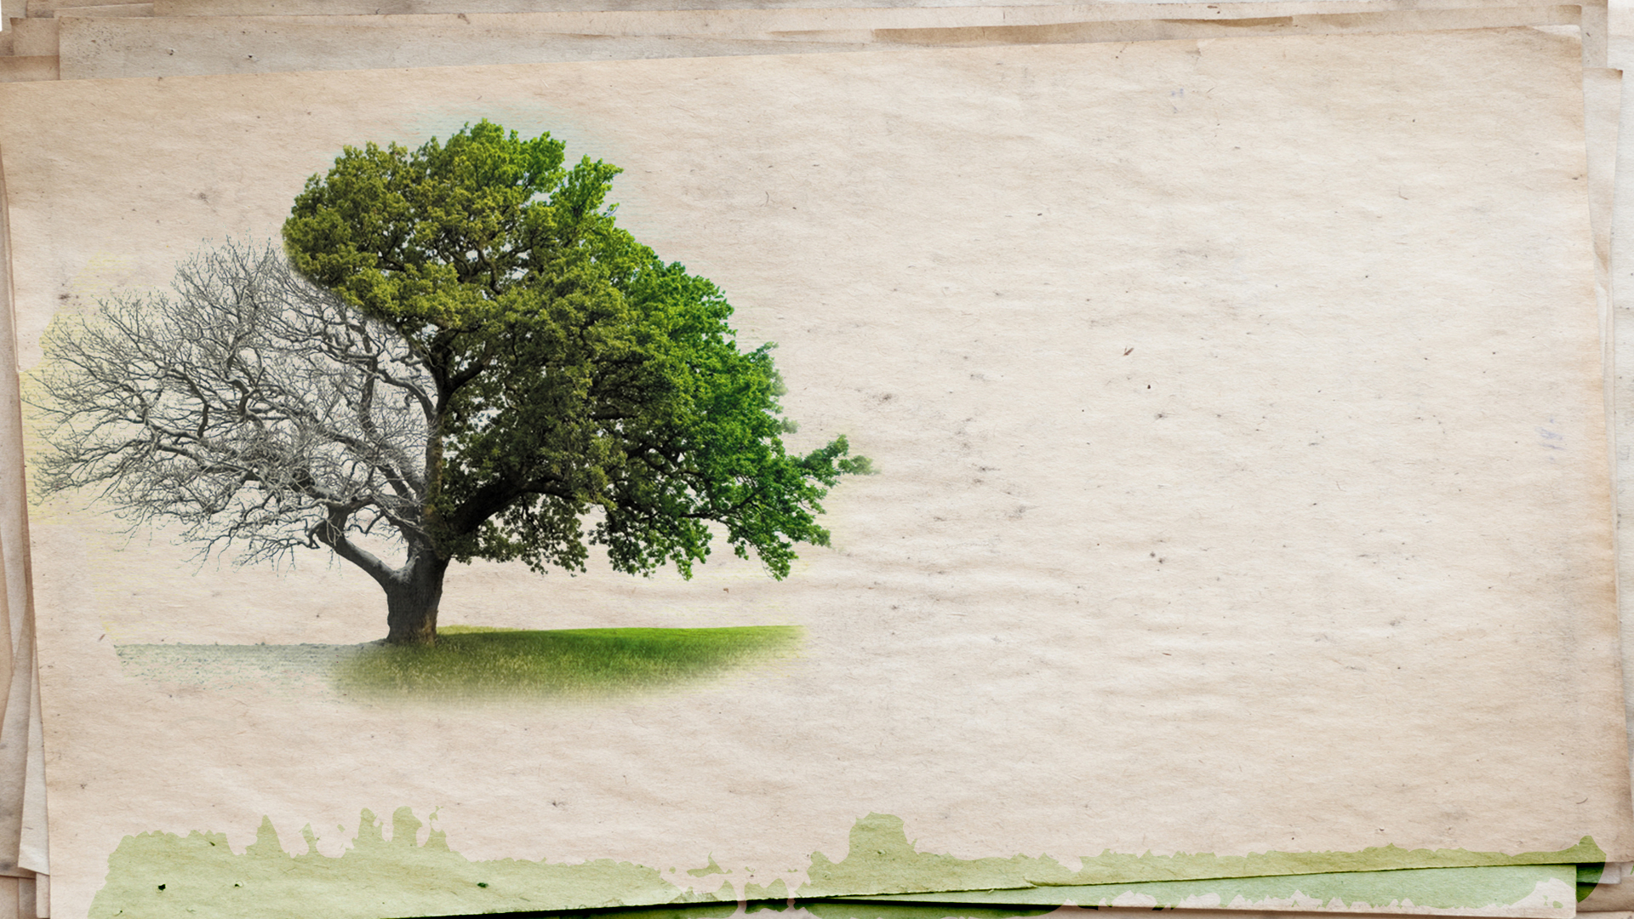
Finding Grace in Setbacks
2 Corinthians 12:9
Pastor Richard “Rico” Tubbs

Slide 2
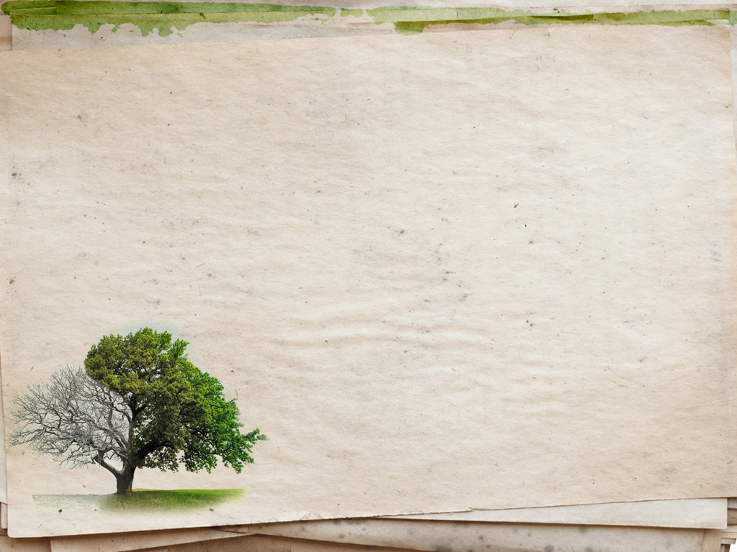
2 Corinthians 12:9 "But he said to me, 'My grace is sufficient for you, for my power is made perfect in weakness.' Therefore I will boast all the more gladly of my weaknesses, so that the power of Christ may rest upon me."
This verse is part of a larger passage where Paul discusses a "thorn in the flesh" and how God's grace sustains him despite his struggles.

Slide 3
What in the world is God trying to teach me in this moment ?
Embrace setbacks as opportunities for growth and witness the miracles that unfold!

Slide 4
Grace Claims us!
1Cor 15:10 But by the grace of God I am what I am:
Grace Saves us!
Eph. 2:8 For by grace are ye saved through faith;

Slide 5
Grace Keeps us!
1 Pet. 1:5 Who are kept by the power of God through faith unto salvation ready to be revealed in the last time.
Grace Helps us!
2 Cor. 12:9 My grace is sufficient for thee:

Slide 6
Setbacks, in that moment, are usually because I’m comparing myself to someone else’s success.
When we start to get in that comparison mindset, we all know that it can go downhill very quickly.

Slide 7
Oftentimes, people outside our faith, use our setbacks, to kind of prove that our our faith isn’t for them.
Oftentimes, people outside our faith want to use setbacks, as a way to discount our faith or to prove that God doesn’t care. But Christians experience setbacks just like everyone else, but the Bible gives us the answers to why we experience setbacks.
It’s God’s way of growing us.

Slide 8
The Bible shows us how to handle setbacks. The New Testament is filled with applications on how to live as a Christian. And Paul in Second Corinthians speaks to how we should view setbacks.
With Jesus we can find strength in weakness. So finding your strength in your weakness in your setback. Second Corinthians 12:9, but he said to me, My grace is sufficient for you. For my power is made perfect in weakness. Therefore, I boast all the more gladly of my weakness, so the power of Christ may rest upon me.
Paul really realizes that Jesus has all the power and can take this thorn in his side, as it’s referred to. Paul understands who Jesus is, his power and authority, as a deity and as God. But Paul also realizes that the pain and the setback of his problem is keeping him humble.

Slide 9
James 4:6
⁶ But he gives us more grace. That is why Scripture says: “God opposes the proud
but shows favor to the humble.”^{[a]}
In the face of setbacks, leaning into humility opens the doorway to grace’s gifts, we make space for God to step in and work miracles

Slide 10
I’ve experienced setbacks myself, and finding strength and perseverance and relying on God’s grace during times of weakness.
Don’t let perfectionism take over. Don’t let this small setback derail what God wants to do in your life

Slide 11
Your perseverance in setback helps to strengthen your faith. And it also allows God to show off and shine. It allows God to flex his muscle on your behalf.
After a setback, when you just allow God to take over, giving him body, soul and spirit and just say, Lord, I know you want this, but I need your strength to do this, He will show up and it allows your faith to grow

Slide 12
You don’t have to do it on your own strength because if God has called you to it, He will see you through it!

Slide 13
Homework
The beauty of setbacks is they don’t disqualify you; rather they define your resilience through grace
This week recognize if you need a little divine redirection and remember its little nudge from Heaven that says “try again.”

