Slide 1
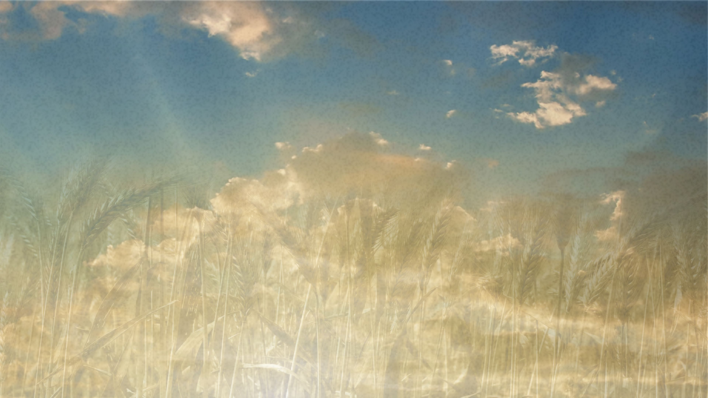
When Holiness Moves Toward You
Pastor Richard “ Rico” Tubbs

Slide 2
Two Touches — Two Outcomes
In Scripture we see a startling contrast.
Uzzah touched the Ark — and died.
A bleeding woman touched Jesus — and lived.
One touch brought judgment.
The other touch brought healing.

Slide 3
What changed?

Slide 4
The Ark represented God’s holy presence under the Law untouchable, guarded, and deadly to the unprepared.

Slide 5
But when Jesus came, holiness put on flesh.
Holiness did not just sit on a mercy seat.
Holiness started walking toward people.

Slide 6
Under the Law, holiness demanded distance.
Under grace, holiness invites us close.

Slide 7
Uzzah and the Weight of Holiness
2 Samuel 6:6–7
“Uzzah reached out and took hold of the ark of God… therefore God’s anger burned against Uzzah… and he died there beside the ark of God.”

Slide 8
Uzzah (meaning "strength") was an Israelite tasked with transporting the Ark of the Covenant during King David’s first attempt to bring it to Jerusalem.
Family and Lineage: Uzzah was the son of Abinadab. The Ark had been kept at his father's house in Kiriath-jearim for approximately 20 years (or up to 70 by some calculations) after its return from the Philistines.

Slide 9
Brother: He worked alongside his brother Ahio to guide the cart carrying the Ark; while Ahio walked in front, Uzzah walked beside it.
Probable Levite Status: While the text does not explicitly label him a Levite in every passage, many scholars and historical accounts (such as Josephus) identify him as one. His family had been entrusted with the Ark's care for a generation, suggesting they were of priestly or Levitical descent.
Familiarity with the Ark: Because the Ark had been in his home since his youth, some commentators suggest Uzzah had developed a "profane familiarity" or lack of awe for the sacred object, leading to his impulsive decision to touch it.

Slide 10
But God had already given clear instructions:
The Ark was never to be touched by human hands.
It was to be carried by consecrated priests with poles.
Uzzah assumed familiarity gave him permission.
He grew comfortable around what should have been revered.
Nearness without covering brought judgment.

Slide 11
A "Mistake" vs. an "Error"
The Bible describes Uzzah’s specific action as an "irreverent act" or "error". While the entire method of transport (using a cart instead of poles) was a communal mistake led by King David, the immediate judgment fell on the individual who broke the specific prohibition against physical contact.

Slide 12
The Woman with the Issue of Blood
Mark 5:25–28
“A woman was there who had been subject to bleeding for twelve years… She thought, ‘If I just touch his clothes, I will be healed.’”

Slide 13
Unclean by the Law Isolated for 12 years
Broke
Unseen
Weak
According to Leviticus, anyone she touched became ceremonially unclean.
She should not have been in the crowd.
She definitely should not have touched a rabbi.

Slide 14
And when she touched Jesus…
Power flowed.
Healing came.
Life returned.
Mark 5:30
“Immediately Jesus realized that power had gone out from him.”
Under the Law, the unclean contaminates the clean.
But with Jesus, the clean overwhelms the unclean.
Instead of her making Jesus unclean…Jesus made her whole.

Slide 15
Under the Law: Holiness separated.
Under grace: Holiness reaches.
Hebrews 4:16
“Let us then approach God’s throne of grace with confidence…”
Approach!
Because now the throne is not just holiness..it is grace.

Slide 16
Think of a sterile operating room.
Before surgery:
No one can enter casually.
You must scrub in. You must be covered. You must be prepared.
Why?
Because contamination can kill.
But what if the surgeon leaves the operating room and walks into the waiting area to heal someone where they are?
That’s what Jesus did.
He stepped out of heaven’s perfection into humanity’s contamination so healing could flow where we are.

Slide 17
The Danger of Casualness vs the Power of Faith
Uzzah had familiarity without reverence.
The woman had desperation mixed with faith.
Uzzah touched casually.
The woman touched intentionally.
One assumed.
One believed.
Crowds pressed around Jesus that day. Many touched Him accidentally.
Only one touched Him by faith.
Mark 5:34
“Daughter, your faith has healed you. Go in peace.”
He didn’t just heal her body. He restored her identity.
Twelve years of isolation ended in one moment of contact.

Slide 18
The Message for Us Today
Some of us still live like Uzzah.
“I’ll be struck down.”
“I’m not clean enough.”
“I’ll be judged.”
Romans 8:1
“There is now no condemnation for those who are in Christ Jesus.”
Jesus already took the judgment.

Slide 19
You don’t approach God through your perfection.
You approach God through Christ’s mediation.
You don’t steady His presence.
His presence steadies you.

Slide 20
The closer you get to Jesus
The less power your past has over you.
Uzzah approached incorrectly and died.
The woman approached in faith and lived.

Slide 21
Homework
You don’t have to live outside the crowd.
You don’t have to stay at a distance anymore.
This week If you reach for Him
You don’t have to watch others get healed.
Shame will break
Not because you are worthy
but because He is willing.
Chains will fall
Healing will flow
Life will return
One touch of religion brings pressure. One touch of Jesus brings life.

Slide 26
Uzzah died because of his error. An error is not a mistake. It is flagrant disobedience to the word of God. The story of Uzzah has challenged human wisdom to understand why God took such a rash action against a seemingly innocent act.
There is no margin for human wisdom to change the word of God. The fact remains the ark was being transported in a manner forbidden by God. It was to be carried on the shoulders of the priests and was not. David became angry because of what happened and then he became afraid. He knew why God killed Uzzah.

Slide 27
A "Mistake" vs. an "Error": The Bible describes Uzzah’s specific action as an "irreverent act" or "error". While the entire method of transport (using a cart instead of poles) was a communal mistake led by King David, the immediate judgment fell on the individual who broke the specific prohibition against physical contact.
The Animals: David offered an ox (symbolizing strength and cost) and a fattened calf (symbolizing joy and celebration), showing a balance of solemn reverence and jubilant worship
n
2 Samuel 6:13
, the text records that after the bearers of the Ark had taken six steps, David sacrificed an ox and a fattened calf

Slide 28
Family and Lineage: Uzzah was the son of Abinadab. The Ark had been kept at his father's house in Kiriath-jearim for approximately 20 years (or up to 70 by some calculations) after its return from the Philistines.
Brother: He worked alongside his brother Ahio to guide the cart carrying the Ark; while Ahio walked in front, Uzzah walked beside it.
Probable Levite Status: While the text does not explicitly label him a Levite in every passage, many scholars and historical accounts (such as Josephus) identify him as one. His family had been entrusted with the Ark's care for a generation, suggesting they were of priestly or Levitical descent.
Familiarity with the Ark: Because the Ark had been in his home since his youth, some commentators suggest Uzzah had developed a "profane familiarity" or lack of awe for the sacred object, leading to his impulsive decision to touch it.

Slide 29
Many years earlier, when the Philistines returned the ark to Israel, they put the ark on a new cart drawn by two milk cows. The cows brought the ark to the field of Joshua of Beth Shemesh. There the wood was used to sacrifice the cows and the Levites came and secured the ark. Because the people looked into the ark of the Lord, more than fifty thousand people were killed by the hand of the Lord. The penalty of their error was to do what God forbade.
Uzzah died because of his error. An error is not a mistake. It is flagrant disobedience to the word of God. The story of Uzzah has challenged human wisdom to understand why God took such a rash action against a seemingly innocent act. What is lost in the story is the purity of God’s word and the expectation of complete obedience to the word of God. There is no margin for human wisdom to change the word of God. The fact remains the ark was being transported in a manner forbidden by God. It was to be carried on the shoulders of the priests and was not. David became angry because of what happened and then he became afraid. He knew why God killed Uzzah.

