Slide 1

Pastor Richard “Rico”Tubbs

Slide 2
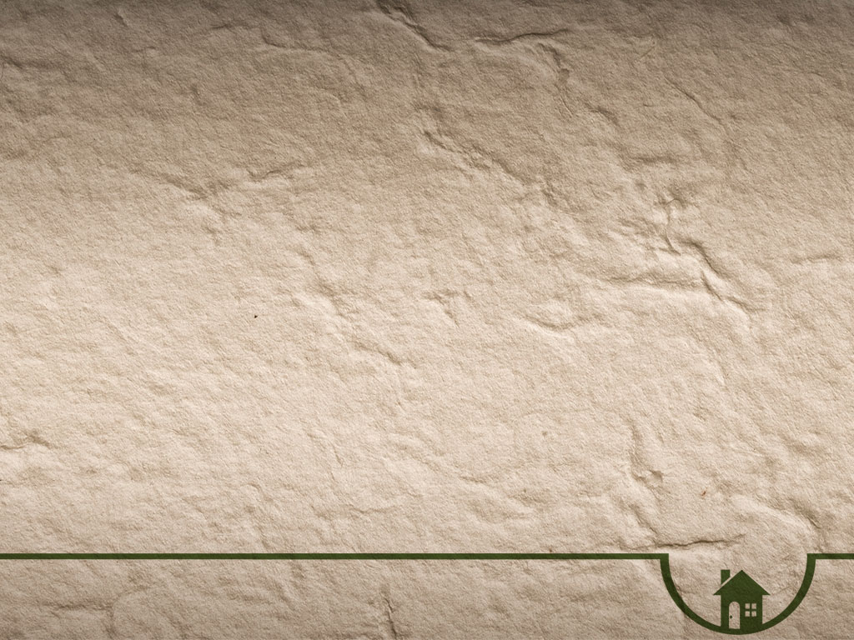
Never Judge someone’s struggle by your strength
Romans 8:18
¹⁸ I consider that our present sufferings are not worth comparing with the glory that will be revealed in us.

Slide 3
The main point is that present difficulties are minor compared to the magnificent future glory awaiting believers.
How many don’t feel that way when your going through a storm?

Slide 4
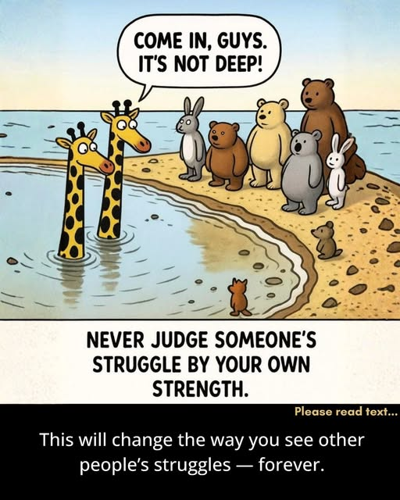

Slide 5
So before you say, “It’s not that bad,”
pause
—
and remember:
you might just be a giraffe talking to a mouse.

Slide 6
Outward appearances can be deceiving, can’t they? A person can appear to look happy or put on such a strong front, but inside there is so much hidden pain.

Slide 7
We judge too easily.
We tell others — “It’s not that hard.” “Just move on.” “Why are you overthinking?”
But the truth is, what feels small to us might be someone else’s storm.

Slide 8
Your calm could be their chaos.
Your comfort could be their breaking point.

Slide 9
Not because they’re weak
—
but because their story runs deeper than you can see.
Their heart carries weights your eyes can’t measure.

Slide 10
We never see the full depth of another’s pain — only the ripples it leaves on the surface.
For the storm you call shallow might be the one someone is fighting to survive in silence.

Slide 11
“We know nothing of the trials, sorrows and temptations of those around us, of pillows wet with sobs, of the life-tragedy that may be hidden behind a smile, of the secret cares, struggles, and worries that shorten life and leave their mark in hair prematurely whitened, and a character changed and almost recreated in a few days. Let us not dare to add to the burden of another the pain of our judgment.” ~ William George Jordan

Slide 12
Our stories may be heartbreaking, We may have to wait a while, and that certainly isn’t easy, but His story of love for us will always give us sufficient grace until that time comes.

Slide 13
The promise of an incomparable and eternal reward reframes the meaning of pain, turning it into a temporary phase on the path to a divine, permanent reality.

Slide 14
A temporary reality:
This perspective reminds believers that their hardships are not permanent. As Paul notes in 2 Corinthians 4:17, "our present troubles are small and won't last very long".

Slide 15
A greater context:
Instead of feeling hopeless, this eternal view allows believers to understand their current pain as part of a larger, divinely orchestrated story that culminates in their complete redemption.

Slide 16
The certainty of God's promises provides an anchor for believers in the midst of turmoil.

Slide 17
A guaranteed future:
Paul emphasizes that future glory "shall" be revealed, indicating that it is a certain and guaranteed future, not merely a wish.

Slide 18
An anticipated reality
The anticipation of this coming glory is what hope is all about. It is the ability to wait with perseverance for what is not yet seen (Romans 8:25). This provides motivation to press on through trials.

Slide 19
Ultimate security:
As Romans 8 concludes, nothing can ever separate a believer from the love of God in Christ Jesus. This promise is the ultimate source of strength and security.

Slide 20
Jesus was intimately familiar with unseen pain
Isaiah 53:3: The prophecy describes the Messiah as "a man of suffering, and familiar with pain. Like one from whom people hide their faces he was despised, and we held him in low esteem". Jesus understood what it was like to carry a deep, internal burden that others could not see or appreciate.
Matthew 26:38: In the Garden of Gethsemane, Jesus confessed, "My soul is overwhelmed with sorrow to the point of death". This reveals the profound anguish Jesus felt in His heart, even before His physical crucifixion, demonstrating the depth of unseen hurt He bore.

Slide 21
The call to compassion for hidden struggles
2 Corinthians 1:3-4: Paul identifies God as the "Father of compassion and the God of all comfort" who comforts believers in their troubles so they can comfort others with the same comfort they have received.
This suggests that personal experience with hidden hurt fosters empathy and the ability to minister to others.

Slide 22
The private heart:
Proverbs 14:10 ¹⁰ Each heart knows its own bitterness, and no one else can share its joy.
This acknowledges that the inner emotional world is deeply personal and ultimately unknowable to others. People can carry silent burdens and private sorrows that are masked by outward appearances, even laughter
Proverbs 14:13
¹³ Even in laughter the heart may ache, and rejoicing may end in grief.

Slide 23
Examples of unseen pain
Hannah: As detailed in 1 Samuel 1, Hannah was barren and was taunted by her husband's other wife. Her grief was so deep and her weeping so bitter that the priest thought she was drunk. Despite her years of private agony, she continued to pray and worship, and God saw her tears and answered her prayer.
Joseph: Joseph experienced the silent pain of betrayal when his brothers sold him into slavery. Even as he rose to power in Egypt, he carried the hidden sorrow of a family ripped apart, only for God to redeem his suffering many years later (Genesis 45:7-8).
Job: Though outwardly successful, Job was tested with immense and mysterious suffering. He wrestled with his agony in private for a time, with friends failing to understand the full depth of his pain.

Slide 24
Response to hidden hurt
Trust in God: We are called to pour out our hearts to God, trusting that he is a refuge for us (Psalm 62:8). He wants us to be transparent with him and not hide our hurt.
Greater compassion for others: The biblical understanding of hidden hurt should inspire compassion. Knowing that every heart has its own bitterness encourages us to be patient and kind with others, as we cannot fully know what they are experiencing (Romans 12:15).
Quiet waiting: The Book of Lamentations teaches that it is good to "sit alone in silence" when suffering, patiently waiting for the Lord to save us, trusting in his unfailing love (Lamentations 3:25-32).

Slide 25
Homework
This week…Speak softly. Act kindly. Pray Earnestly…
True empathy begins where judgment ends.

