Slide 1
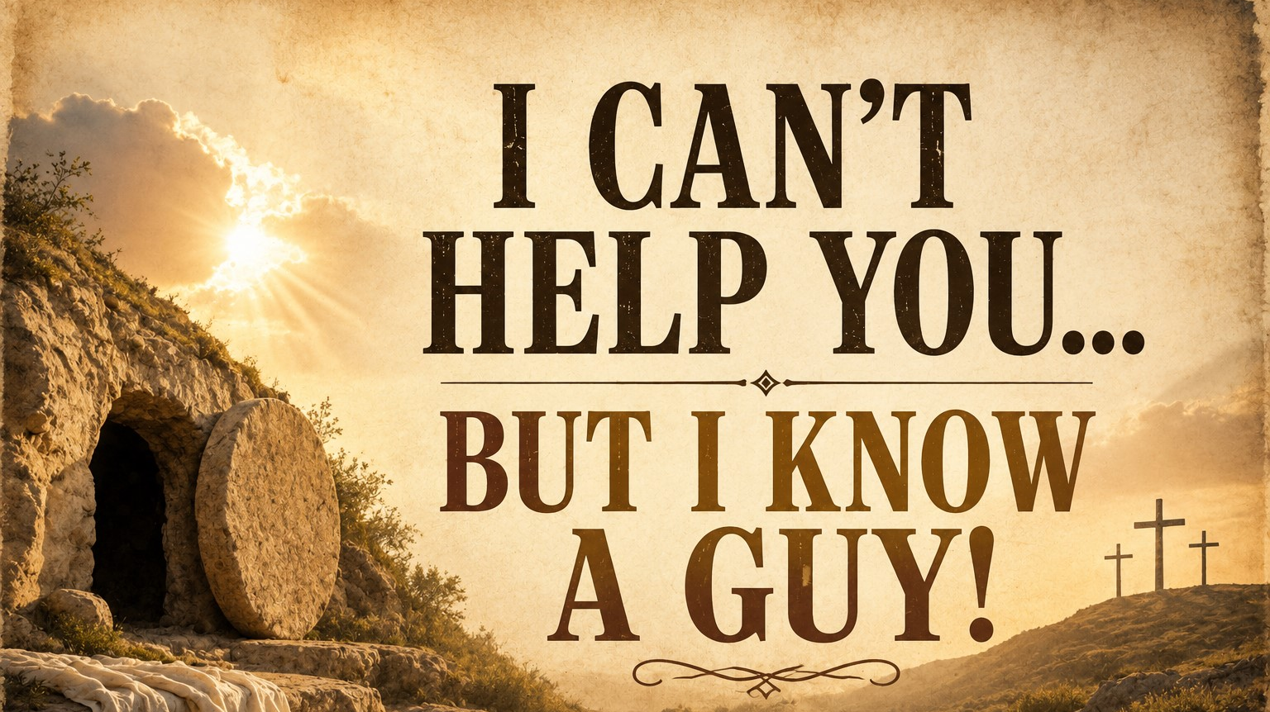
Pastor Richard “ Rico” Tubbs

Slide 2

John 1:40-42
⁴⁰ Andrew, Simon Peter’s brother, was one of the two who heard what John had said and who had followed Jesus. ⁴¹ The first thing Andrew did was to find his brother Simon and tell him, “We have found the Messiah” (that is, the Christ). ⁴² And he brought him to Jesus.
Jesus looked at him and said, “You are Simon son of John. You will be called Cephas” (which, when translated, is Peter^{[a]}).

Slide 3
There comes a moment in all of our lives when we reach the end of our own ability. When the answers run out. When the strength is gone. When the fix isn’t in our hands anymore.

Slide 4
And sometimes the most honest, powerful thing you can say is:
“I can’t help you…
but I know a guy.”

Slide 5
Not just any guy.
Not a consultant, not a connection, not a shortcut
I know Jesus.

Slide 6
The Power of Introducing People to Jesus
John 1:41–42
Andrew finds his brother Simon and says, “We have found the Messiah.” And he brought him to Jesus.

Slide 7
Andrew didn’t preach a sermon.
He didn’t have a theology degree.
He didn’t perform a miracle.
He just said, “I can’t fix everything in your life… but I know someone who can.”

Slide 8
Imagine someone drowning and you can’t swim. You don’t jump in and both perish you throw a lifeline or call for help.
Andrew understood this: my job isn’t to be the Savior… it’s to connect people to Him.

Slide 9
Some of us are stressed because we’re trying to be what only Jesus can be.
You’re trying to fix your family.
You’re trying to save your friends.
You’re trying to carry burdens that don’t belong to you.
You can’t help them
but you know a guy.

Slide 10
Faith That Carries Others
Mark 2:3-5
³ Some men came, bringing to him a paralyzed man, carried by four of them. ⁴ Since they could not get him to Jesus because of the crowd, they made an opening in the roof above Jesus by digging through it and then lowered the mat the man was lying on. ⁵ When Jesus saw their faith, he said to the paralyzed man, “Son, your sins are forgiven.”

Slide 11
They didn’t say, “Sorry, we tried.”
They didn’t say, “The crowd is too big.”
They said, “We can’t heal him… but we know a guy.”
So they got creative.
They got determined.
They got disruptive.
Real friends don’t just sit with you in your struggle they carry you when you can’t walk.

Slide 12
Somebody in your life is spiritually paralyzed:
They can’t move forward
They can’t get up from depression
They can’t break the addiction
And God is saying:
“You may not be their answer, but you are their access point.”
Sometimes your role is not to fix them…
It’s to carry them into the presence of Jesus.

Slide 13
Your Testimony is the Introduction
John 4:28-30
²⁸ Then, leaving her water jar, the woman went back to the town and said to the people, ²⁹ “Come, see a man who told me everything I ever did. Could this be the Messiah?” ³⁰ They came out of the town and made their way toward him.

Slide 14
She didn’t have all the answers.
Her life wasn’t perfectly cleaned up.
But she had an encounter.
And her message was simple
“I can’t explain everything… but I know a guy who changed me.”

Slide 15
A man once battled addiction for years. Rehab failed him. Friends gave up. Family stepped back. One day someone invited him to church. He didn’t understand the sermon—but he felt something.
Afterward, someone shook his hand and said,
“Man, I don’t have all your answers… but I know a Savior who changed my life.”
That man gave his life to Christ—and years later, he now helps others break free.
Your story doesn’t need perfection—just authenticity.
People aren’t looking for polished speeches. They’re looking for real encounters.

Slide 16
Jesus Is Still the Answer
John 14:6
⁶ Jesus answered, “I am the way and the truth and the life. No one comes to the Father except through me.
When you don’t have peace… He is peace
When you don’t have strength… He is strength
When you don’t have answers… He is the answer
Not one of many options.
THE way.

Slide 17
Stop Playing God
“Be still, and know that I am God” (Psalm 46:10).
You were never called to be the Savior.
That job is already taken.

Slide 18
So many people are exhausted because they are carrying responsibilities, fears, and burdens God never asked them to carry. We try to control outcomes, fix people, force doors open, and understand every detail of tomorrow

Slide 19
Peter stepped out of the boat only when he kept his eyes on Jesus, but the moment he focused on the storm, he began to sink (Matthew 14:29-30).

Slide 20
Trying to play God is like sitting in the passenger seat while fighting the driver for the steering wheel—it only creates chaos and fear.

Slide 21
Real peace comes when we surrender control and trust that the One who created the universe is far better at running our lives than we are. God never asked us to be sovereign; He asked us to be faithful.

Slide 22
Trying to fix everyone will exhaust you.
Trying to control outcomes will break you.
But pointing people to Jesus?
That will fulfill you.

Slide 23
A broken-down car sits on the side of the road. People pass by offering advice:
“Check the engine.”
“Kick the tire.”
“Maybe it’ll start.”
But one man pulls over and says,
“I’m not a mechanic… but I know one. Let me call him.”
Moments later, the one who knows how shows up.

Slide 24
Homework
There may be some us here this morning who feels stuck, broken, overwhelmed.
And I’ll tell you plainly:
He heals.
He restores.
He saves.
He transforms.
All you have to do is come to Him.
I can’t fix everything in your life… but I know a guy.
“I can’t help you… but I know a guy!”
And His name is Jesus!

