Slide 1
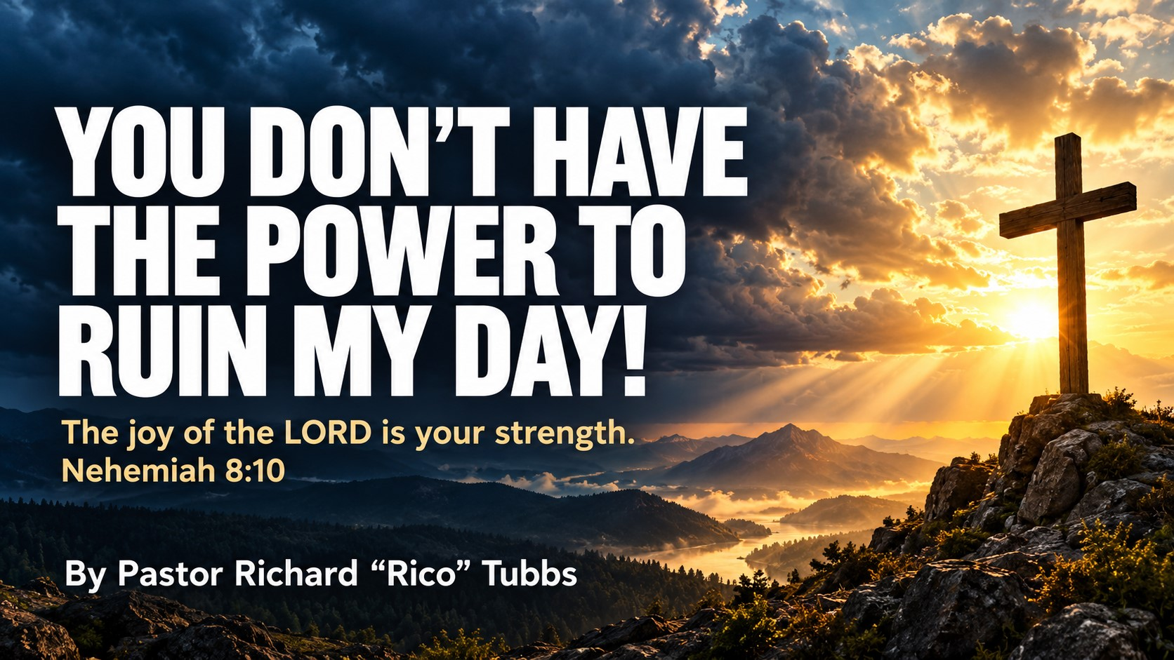

Slide 2

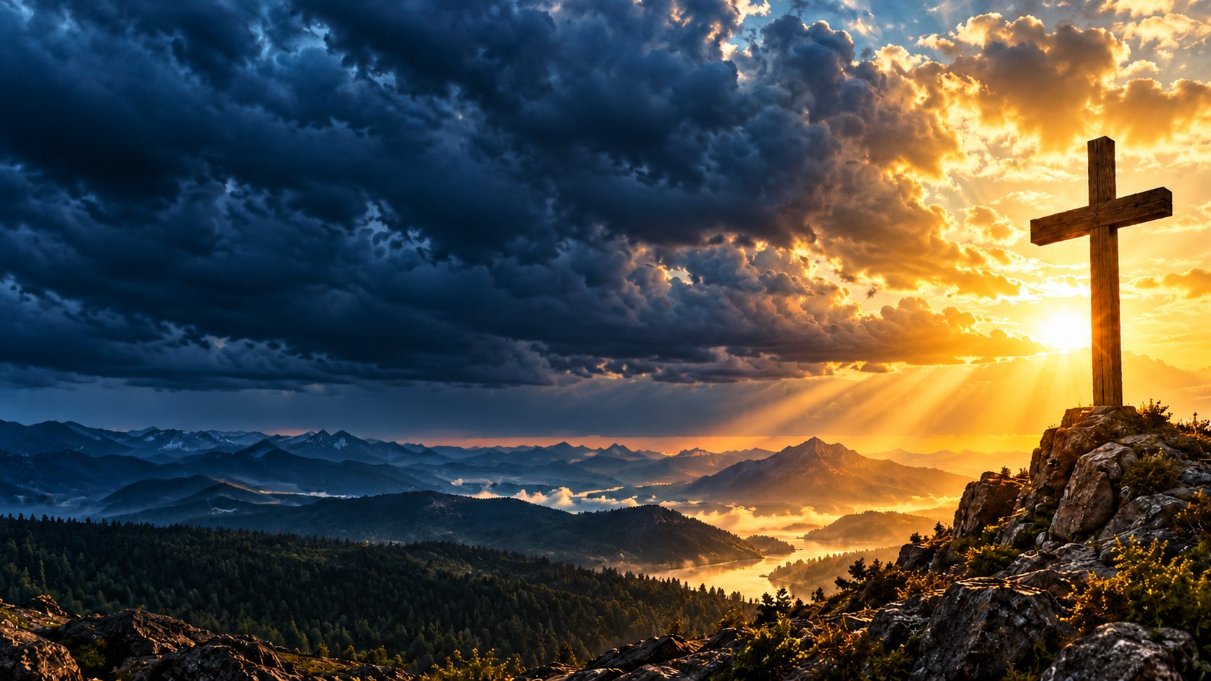
Central message:
I cannot control what people say, what they do, or what circumstances come my way. But with God’s help, I can choose how I respond. My peace is too valuable, my purpose is too important, and my God is too faithful for me to surrender my entire day to somebody else’s attitude!

Slide 3
Have you ever gotten up in the morning feeling good? You prayed your prayer. You thanked God for another day. You got out of bed with a little spring in your step. You were ready to face the world.
And then somebody opened their mouth!
One phone call. One text message. One rude comment. One disrespectful attitude. One person who knows exactly which button to push.
And suddenly, the peace you woke up with is gone!

Slide 4
Everybody who has access to you does not deserve authority over you!
Some people have access to your phone, but they shouldn’t have access to your peace.
Some people have access to your workplace, but they shouldn’t have access to your joy.
Some people have access to your past, but they don’t get to write your future.
And some people know your weaknesses, your struggles, your history, and your mistakes—but they still don’t have the final word over your life!
Why? Because the final word belongs to God!

Slide 5
This sermon is not about pretending that nothing hurts. It’s not about smiling when your heart is breaking, ignoring injustice, or allowing people to mistreat you.
It’s about learning that even when something hurts you, it doesn’t have to own you.
You can acknowledge the pain without surrendering your peace. You can confront the problem without becoming the problem. You can establish boundaries without becoming bitter.
And you can walk away from an argument without losing your dignity!

Slide 6
Because the enemy doesn’t always need to destroy your whole life to distract you. Sometimes all he needs is one angry conversation to steal your focus, disturb your spirit, and cause you to spend the entire day fighting a battle that God never assigned to you.
But today, we’re changing the way we respond!
My peace is not for sale. My joy is not up for negotiation. And my day belongs to God!

Slide 7
Stop giving people a remote control to your emotions
Scripture: Proverbs 4:23
“Keep thy heart with all diligence; for out of it are the issues of life.”
Think about a television remote control. With a push of a button, somebody can change the channel. They can turn the volume up. They can turn the television off.
Now, some of us have handed other people the remote control to our emotions!

Slide 8
If they compliment us, we’re happy. If they criticize us, we’re miserable. If they include us, we feel important. If they leave us out, we feel rejected. If they agree with us, we’re at peace. If they disagree with us, we can’t sleep.
We’ve allowed somebody else’s opinion to become the thermostat for our entire day!
You cannot always control what comes into your life, but through God’s grace, you can learn to control what takes root in your heart.

Slide 9
Galatians 5:22–23 teaches us about the fruit of the Spirit, including love, joy, peace, patience, gentleness, and self-control.
Notice that self-control is part of the fruit!
Sometimes the greatest victory isn’t getting the last word. It’s having the opportunity to say something destructive—and choosing not to say it.
Sometimes the greatest victory isn’t winning the argument. It’s refusing to lose your character while you’re arguing.
Sometimes the greatest victory is looking at a situation and saying, “This may be difficult, but I am not going to let it turn me into somebody I don’t want to be.”
I don’t have to answer every accusation. I don’t have to attend every argument. I don’t have to prove myself to everybody who misunderstands me!
Some things deserve a conversation. Some things require a boundary. And some things need to be placed in God’s hands and left there.

Slide 10
1 Samuel 24.
King Saul was pursuing David, even though David had not committed the crimes Saul imagined. David had an opportunity to strike Saul while Saul was vulnerable inside a cave.
David’s men saw an opportunity for revenge. They could have reasoned that Saul deserved what was coming.
But David refused to take matters into his own hands.
David did not pretend Saul’s behavior was acceptable. He recognized that there was a difference between having an opportunity to retaliate and having the right to do so.
David chose restraint.

Slide 11
David had the opportunity to end the problem with one act of violence. Instead, he walked away with his character intact.
Some of us are asking God to give us peace while we’re still determined to get even.
We’re praying, “Lord, give me peace,” but we’re rehearsing what we’re going to say when we see them.
We’re asking God to heal our hearts while we’re feeding our anger with another conversation about what they did.

Slide 12
You can stand up for yourself without seeking revenge. You can tell the truth without trying to destroy somebody. You can refuse mistreatment without allowing hatred to take up residence in your heart.
You don’t have to become like the person who hurt you to prove that you are strong!

Slide 13
Picture a woman who spends years allowing a difficult coworker to determine how she feels each morning. Every criticism follows her home. Every insult replays in her mind. She loses sleep over conversations that ended hours ago.
One day, she begins a new practice. Before going to work, she prays. When an insult comes, she pauses before responding. She documents serious misconduct appropriately, sets clear boundaries, and refuses to spend her evening replaying every ugly word.
The coworker may not change immediately. But she begins to change.
She discovers that peace isn’t the same as having no problems. Peace is learning how to face problems without allowing them to consume every part of your life.
Church, you don’t need everybody to change before God can begin changing you!

Slide 14
Protect your peace because your purpose is too important
Scripture: Nehemiah 6:3
Nehemiah said:
“So I sent messengers unto them, saying, I am doing a great work, so that I cannot come down.”
Nehemiah was rebuilding the walls of Jerusalem. He had a God-given assignment. But while he was building, people came against him. They mocked him, threatened him, and attempted to distract him.
Eventually, they invited him to meet with them.
Nehemiah understood that the invitation wasn’t going to help him fulfill his assignment. It was a distraction from the work God had placed in his hands.

Slide 15
So he sent a message:
“I am doing a great work, so that I cannot come down!”
I love that!
Nehemiah didn’t say, “I don’t have any enemies.”
He didn’t say, “Everybody understands me.”
He didn’t say, “Nobody has anything negative to say about me.”
He said, in effect, “I have too much work to do to abandon my assignment for every distraction that comes my way!”

Slide 16
You have too much purpose to waste your life responding to every provocation.
You’ve got children who need your love. You’ve got a calling that needs your obedience. You’ve got a future that deserves your attention. You’ve got gifts that need to be developed and people who need what God has placed inside you.
One person’s opinion can occupy your mind for an entire week!
How much time have you lost arguing with somebody who had no intention of understanding you?
How much energy have you spent trying to prove yourself to somebody who had already decided what they wanted to believe?
How many nights have you lost sleep because somebody else couldn’t recognize your value?
Your assignment is too important!
Don’t come down from what God called you to build just because somebody wants to pull you into what they are trying to destroy.

Slide 17
The construction site
Imagine a construction crew building a beautiful house.
The workers have plans. They have materials. They have a deadline. They know what they’re building, and they understand what it will take to finish.
But every time somebody walking past the construction site shouts an insult, the entire crew stops working.
One person says, “They don’t like the color of the bricks!”
Another says, “They don’t think we’re qualified!”
Another says, “Let’s go outside and show them who’s right!”
And before long, nobody is building the house.
The workers have become so occupied with responding to the critics that they have abandoned the very work they were hired to complete.
That is what happens when you let every critic interrupt your calling.
You stop building your future because you’re too busy defending your past.
You stop investing in your family because you’re too busy fighting with strangers.
You stop growing spiritually because you’re too busy keeping score.
You stop moving forward because you’re trying to convince everybody behind you that you’re going in the right direction.

Slide 18
Proverbs 16:3
“Commit thy works unto the LORD, and thy thoughts shall be established.”
Give God your work. Give Him your plans. Give Him your future.
And when distraction comes, remember what you’re building!
Luke 4:28–30, describing Jesus being rejected in His hometown of Nazareth.
The people became furious after Jesus reminded them that God had shown mercy to outsiders through Elijah and Elisha. Their anger escalated until they drove Him toward a cliff but “he walked right through the crowd and went on his way.”
Scripture does not explain exactly how He passed through them. The clear outcome is that their attempt to kill Him failed, and Jesus continued His mission.

Slide 19
And throughout His ministry, He continued to face rejection, accusations, and misunderstanding. Yet He remained committed to the Father’s will.
If Jesus had stopped every time somebody misunderstood Him, where would we be?
If He had abandoned His mission every time somebody rejected Him, where would we be?
If He had surrendered to every critic, the cross would never have been reached.
But Jesus kept going!

Slide 20
If you’re going to fulfill what God has called you to do, you must learn the difference between a genuine problem that requires your attention and a distraction that demands your reaction.
Not every battle is your battle.
Not every comment deserves a response.
Not every closed door requires you to kick it down.
Sometimes God is calling you to stand. Sometimes He’s calling you to speak. And sometimes He’s calling you to keep building!
Your future is too valuable to mortgage it to somebody else’s negativity.

Slide 21
Consider a person who has been trying to rebuild life after a painful setback. They have made mistakes, faced criticism, and heard people say they will never succeed.
For a while, those words become a soundtrack in their mind.
But slowly, they begin to measure progress differently. Instead of asking, “What are people saying about me?” they begin asking, “Am I being faithful to what God has placed before me?”
They seek wise counsel, make better choices, take responsibility for what they can change, and keep moving forward.
The critics may continue talking. But the person is no longer organizing their life around the critics.

Slide 22
Somebody needs to stop waiting for an apology before they move forward.
Somebody needs to stop waiting for recognition before they serve.
Somebody needs to stop waiting for everybody to agree before they obey God.
Keep building! Keep praying! Keep believing! Keep walking!
And when the enemy tries to pull you down into another argument, remind yourself:
“I’m doing a great work. I cannot come down!”

Slide 23
Let God have the final word over your life
Romans 8:31
“What shall we then say to these things? If God be for us, who can be against us?”
People may criticize you, but they cannot cancel God’s purpose for your life simply by having an opinion.
People may reject you, but rejection does not erase your worth.
People may remind you of your past, but your past does not have to determine your future.
People may tell lies about you, but you don’t have to spend every waking moment trying to manage every lie.
And people may try to make you feel small, but they cannot measure the greatness of what God can accomplish through a surrendered life!

Slide 24
The author and the critic
Imagine a writer sitting at a desk, working on a book that means everything to them.
A critic walks into the room and says, “That story is terrible. Nobody will ever read it. You should quit.”
Now, the writer has a choice.
They can throw the entire manuscript away because one person disapproved of it.
Or they can listen carefully, learn whatever is useful, make improvements where necessary, and continue writing.
The critic can offer an opinion. The critic cannot take over the writer’s responsibility to finish the book.
In the same way, not every criticism should be dismissed. Sometimes God uses correction to help us grow. Sometimes we need to apologize, make amends, or change our behavior.
But we must never confuse constructive correction with the idea that we are worthless.
Learn from what is true. Correct what needs correcting. Leave what is false in God’s hands.
And keep walking!

Slide 25
Declaration 1: You will not control my heart.
“I will guard my heart, watch my words, and choose my response. I can be hurt without becoming hateful. I can be disappointed without becoming defeated.”
Scripture: Proverbs 4:23; Galatians 5:22–23.
Declaration 2: You will not distract me from my purpose.
“I have a life to live, a calling to fulfill, and work to do. I will not abandon my assignment to answer every accusation.”
Scripture: Nehemiah 6:3; Philippians 3:13–14.
Declaration 3: You will not steal my expectation of God’s goodness.
“I will not let one bad moment convince me that God has abandoned me. I will trust Him in the middle of the struggle and keep believing that He can lead me forward.”
Scripture: Romans 8:28; Psalm 27:13–14.

Slide 26
Your practical faith Homework Assignment for the coming seven days
Next week, we’re not just going to shout about having peace. We’re going to practice it!
1. Monday and Tuesday: Guard your peace
Your challenge: Pause before you react.
Before you answer that text, respond to that comment, or enter that argument, take a breath and pray.
Ask yourself three questions:
Does this need a response?
Will my response help or make things worse?
Can I respond in a way that honors God and protects my peace?
Scripture: Philippians 4:6–7.
Daily declaration: “I will not let somebody else’s bad moment become the definition of my entire day.”

Slide 27
2. Wednesday and Thursday: Stay focused on your assignment
Your challenge: Build something instead of feeding a distraction.
Identify one thing God has placed in front of you that deserves your attention.
Maybe it’s your marriage. Maybe it’s your children. Maybe it’s your ministry, your work, your health, your finances, or your relationship with God.
Take one meaningful step toward that responsibility instead of spending that energy on unnecessary conflict.
Scripture: Nehemiah 6:3.
Daily declaration: “I have too much purpose to waste my energy on every distraction.”

Slide 28
3. Friday through Sunday: Release the hurt and walk in freedom
Your challenge: Stop carrying what God is calling you to surrender.
Pray for the strength to release bitterness. Make amends where you need to. Establish appropriate boundaries where necessary. Talk to a trusted person if the wound is deep.
You don’t have to pretend the hurt never happened. You simply have to stop allowing it to dictate every step you take.
Scripture: Ephesians 4:31–32.
Daily declaration: “I release revenge, I pursue healing, and I trust God with what I cannot control.”

Slide 29
The next time somebody wakes up on the wrong side of the bed and tries to make it your problem, remember who you are.
The next time somebody misunderstands your intentions, remember who you serve.
The next time somebody says something cruel, remember that you don’t have to return cruelty for cruelty.
And the next time life throws something at you that you didn’t expect, remember that God has not lost His power!

Slide 30
You might have to deal with a difficult person today, but you don’t have to become a difficult person.
You might have to walk through a painful situation today, but you don’t have to surrender every ounce of hope.
You might have to face an unexpected setback today, but you don’t have to conclude that your entire future is falling apart.
And you might have to cry today, but tears do not mean that your faith has failed!
Sometimes the strongest thing you can say is, “Lord, this hurts, but I’m trusting You.”
Sometimes the most powerful response is silence.
Sometimes the most spiritual decision is to walk away.
And sometimes the greatest evidence of God’s work in your life is not that you defeated your enemy, but that you refused to let your enemy turn you into someone you were never called to be.
I’m not giving you permission to disrespect me. I’m not giving you permission to mistreat me. But I’m also not giving you permission to control the condition of my heart!

Slide 31
You can have your opinion.
You can have your attitude.
You can have your criticism.
But by the grace of God, I am choosing my response!
You don’t have the power to take away the love God has shown me.
You don’t have the power to erase the promises I find in His Word.
You don’t have the power to make me stop praying.
You don’t have the power to make me stop believing.
And you don’t have the power to convince me that one difficult day means God has stopped working in my life!
Because my joy is rooted deeper than my circumstances.
My hope is anchored deeper than somebody else’s opinion.
And my faith rests in a God who is faithful even when life is difficult!

Slide 32
Closing prayer: Lord, protect my peace
Heavenly Father, in the mighty name of Jesus, thank You for the gift of another day.
Lord, teach us to guard our hearts, control our tongues, and respond with wisdom when life becomes difficult.
Give us strength when people disappoint us, patience when we are provoked, and discernment to know when to speak, when to stand, and when to walk away.
Heal the wounds we have carried for too long. Break the hold of bitterness, resentment, and the desire for revenge. Help us forgive without excusing wrongdoing and establish boundaries without losing our love.
Father, remind us that our worth is not determined by people’s opinions and our future is not limited by yesterday’s disappointments.
When we face criticism, help us remain humble. When we face injustice, give us courage. When we face uncertainty, strengthen our faith. And when we feel overwhelmed, remind us that we are never beyond the reach of Your grace.
Bless our homes, our families, our work, and our ministries. As we enter the coming week, help us guard our peace, stay focused on our purpose, and trust You with what we cannot control.
Let our lives reflect Your love, even when others fail to show us theirs.
We declare that we will not surrender our joy to every difficult circumstance. We will keep praying, keep believing, keep growing, and keep moving forward with You.
In the mighty and matchless name of Jesus, we pray.
Amen!

