Slide 1
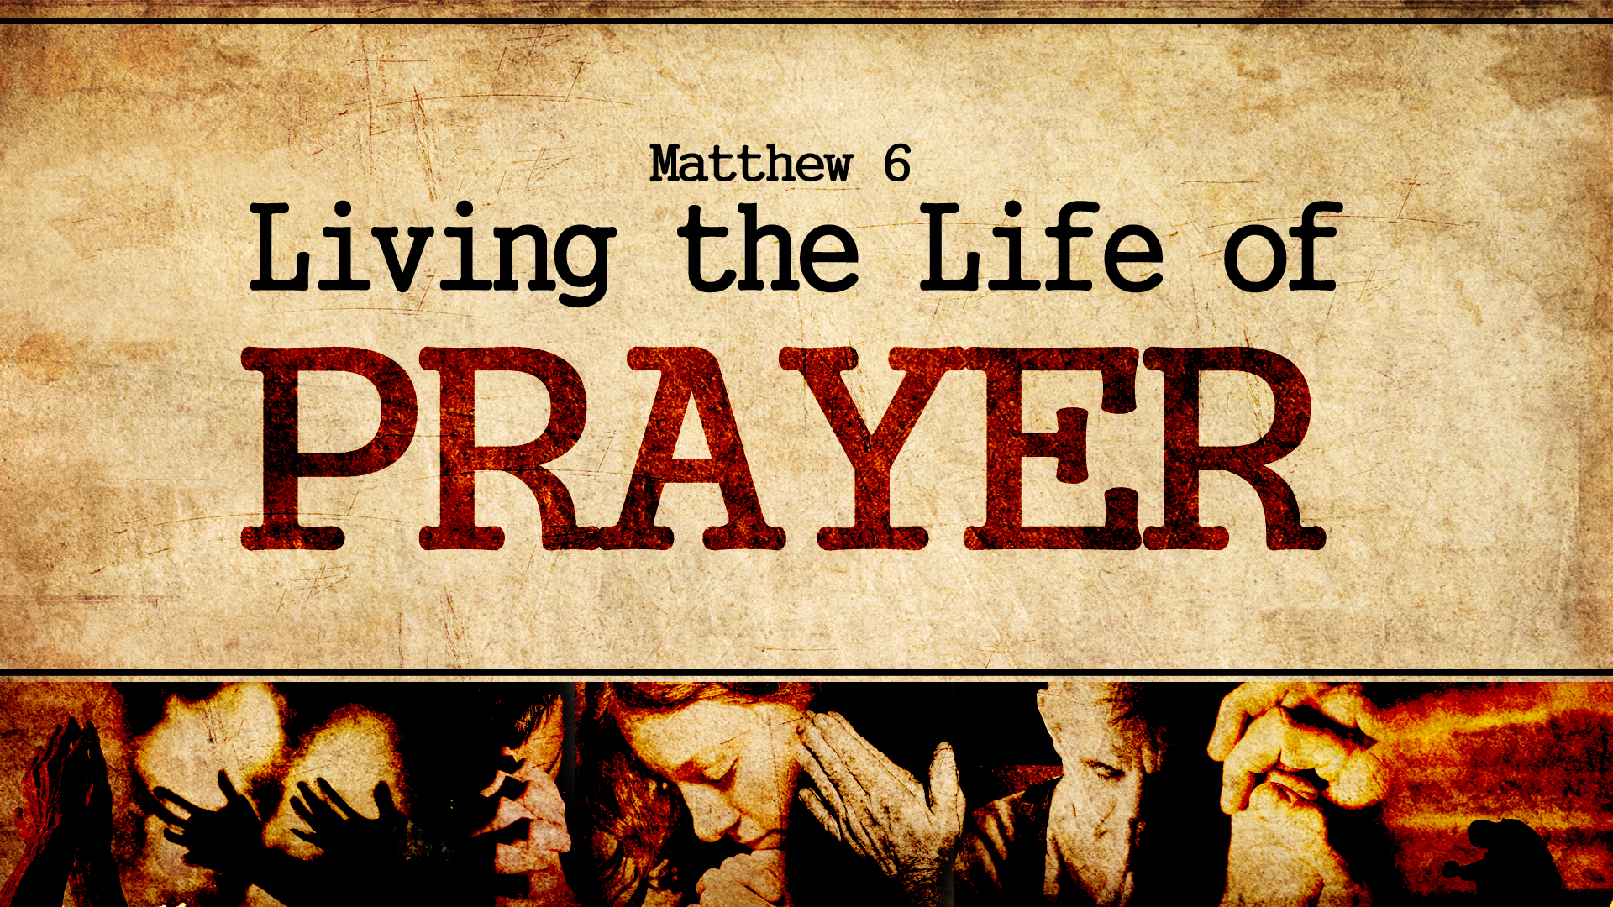

Slide 2

A season of prayer!
Romans 12:1-12
Pastor Richard “Rico” Tubbs

Slide 3

Romans 12:1-12
12 Therefore, I urge you, brothers and sisters, in view of God’s mercy, to offer your bodies as a living sacrifice, holy and pleasing to God—this is your true and proper worship. ² Do not conform to the pattern of this world, but be transformed by the renewing of your mind. Then you will be able to test and approve what God’s will is—his good, pleasing and perfect will.³ For by the grace given me I say to every one of you: Do not think of yourself more highly than you ought, but rather think of yourself with sober judgment, in accordance with the faith God has distributed to each of you. ⁴ For just as each of us has one body with many members, and these members do not all have the same function, ⁵ so in Christ we, though many, form one body, and each member belongs to all the others. ⁶ We have different gifts, according to the grace given to each of us. If your gift is prophesying, then prophesy in accordance with your^{[a]} faith; ⁷ if it is serving, then serve; if it is teaching, then teach; ⁸ if it is to encourage, then give encouragement; if it is giving, then give generously; if it is to lead,^{[b]} do it diligently; if it is to show mercy, do it cheerfully.⁹ Love must be sincere. Hate what is evil; cling to what is good. ¹⁰ Be devoted to one another in love. Honor one another above yourselves. ¹¹ Never be lacking in zeal, but keep your spiritual fervor, serving the Lord. ¹² Be joyful in hope, patient in affliction, faithful in prayer.

Slide 4
The first time prayer is mentioned is in Genesis 4:26: “Seth also had a son, and he named him Enosh. At that time people began to call on the name of the Lord.” Before this passage, all dialogues with God were initiated by Him.
While the New International Version of the Bible doesn’t directly mention the word “prayer”, the passage mentions “people calling on the name of the Lord,” which usually denotes praying.

Slide 5
The word "prayer" and its variations like "prayers," "pray," "prayed," and "praying" is mentioned over 650 times in the Bible.
Additionally, the New Testament records 450 answers to prayer.

Slide 6
Isaiah 56:7 for mine house shall be called an house of prayer
He Promised in II Chronicles 7:14, If my people who are called by my name shall humble themselves and pray….and pray….and pray.
Mark 9
28 And when he was come into the house, his disciples asked him privately, Why could not we cast him out?
29 And he said unto them, This kind can come forth by nothing, but by prayer and fasting.
· If you can’t get victory. If you can’t stay faithful. If you can’t overcome your sinful habits it is only because these things only goeth by fasting and prayer.

Slide 7
Matthew 21
22 And all things, whatsoever ye shall ask in prayer, believing, ye shall receive.
Philemon 1
4 I thank my God, making mention of thee always in my prayers,
Ephesians 6
18 Praying always with all prayer and supplication in the Spirit, and watching thereunto with all perseverance and supplication for all saints;
Philippians 4
6 Be careful for nothing; but in every thing by prayer and supplication with thanksgiving let your requests be made known unto God.
James 5
15 And the prayer of faith shall save the sick, and the Lord shall raise him up; and if he have committed sins, they shall be forgiven him. 16 Confess your faults one to another, and pray one for another, that ye may be healed. The effectual fervent prayer of a righteous man availeth much.
1 Peter 3
12 For the eyes of the Lord are over the righteous, and his ears are open unto their prayers: but the face of the Lord is against them that do evil.

Slide 8
It is the experience of the Presence of God
It is a divine experience. It should be one of awesomeness. It is not a time to be rushed. We sometimes fall into the trap of being too "chummy" with God. We lose our respect for Him. We really need to watch out for this. He is an awesome God.
Prayer is that ACCESS to ABUNDANT LIFE in CHRIST JESUS.

Slide 9
Thanksgiving Prayer
It’s Crucial to take a moment to express Gratitude for all the blessings we’ve received
Thanksgiving Prayers invite us to recognize God’s hand in every detail of our lives

Slide 10
Petitionary Prayer
A cry for help a fancy way of saying “Help me Jesus!”
Dear Lord I’m in hot mess right now ;please help me figure this life thing out!

Slide 11
Intercessory Prayer
This is where we step outside of our own wants and needs and lift others up
It’s a chance to pray on behalf of others

Slide 12
Meditative Prayer
This prayer is all about stillness and focus
This prayer encourages us to silence our minds, listen to God’s whisper, and simply enjoy His presence

Slide 13
Praise Prayer
When we lift our voice in praise, we’re not only exalting God for who He is, but we’re also shaking off the weight of our worries and letting joy burst forth
Your joyful praise is part of your offering

Slide 14
Homework
Whether your thanking God, asking for help, interceding for friends, meditating in His presence or praising Him
This week during this season of prayer explore the various types of prayer and how they are applied to your life….write them down when you pray and see if you could identify each one

