Slide 1
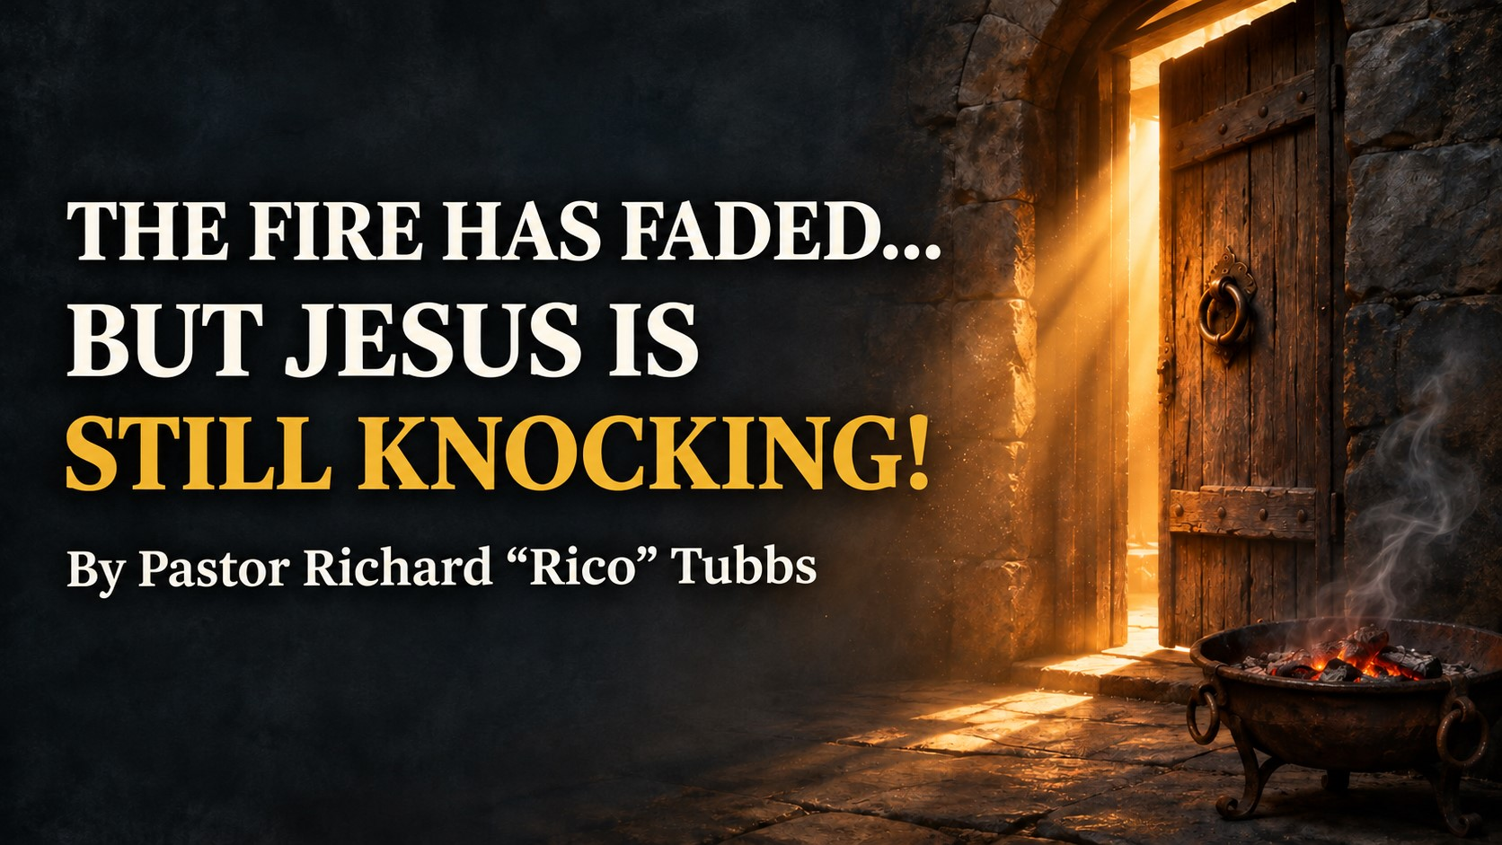

Slide 2
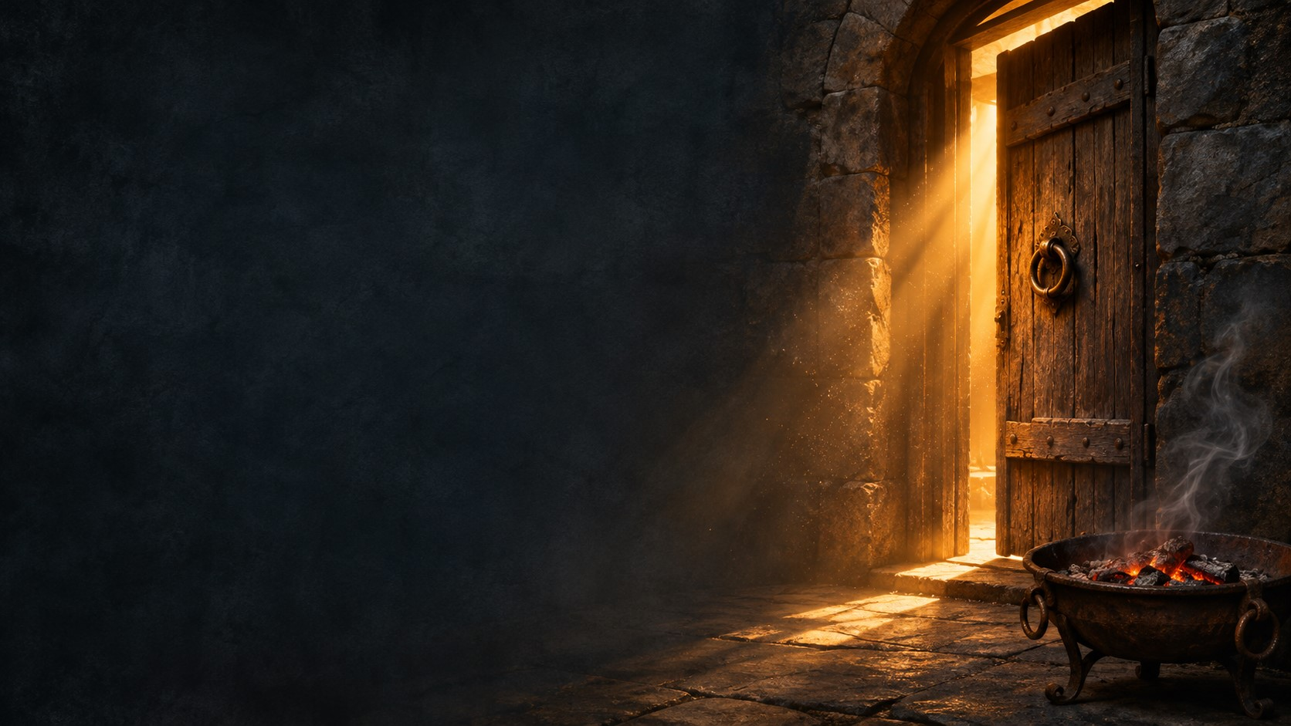
Revelation 3:14-22 To the Church in Laodicea
¹⁴ “To the angel of the church in Laodicea write: These are the words of the Amen, the faithful and true witness, the ruler of God’s creation. ¹⁵ I know your deeds, that you are neither cold nor hot. I wish you were either one or the other! ¹⁶ So, because you are lukewarm—neither hot nor cold—I am about to spit you out of my mouth. ¹⁷ You say, ‘I am rich; I have acquired wealth and do not need a thing.’ But you do not realize that you are wretched, pitiful, poor, blind and naked. ¹⁸ I counsel you to buy from me gold refined in the fire, so you can become rich; and white clothes to wear, so you can cover your shameful nakedness; and salve to put on your eyes, so you can see.¹⁹ Those whom I love I rebuke and discipline. So be earnest and repent. ²⁰ Here I am! I stand at the door and knock. If anyone hears my voice and opens the door, I will come in and eat with that person, and they with me.²¹ To the one who is victorious, I will give the right to sit with me on my throne, just as I was victorious and sat down with my Father on his throne. ²² Whoever has ears, let them hear what the Spirit says to the churches.”

Slide 3
Some of us have learned how to quiet the very thing God is using to get our attention. A scripture challenges us, and we scroll past it. A friend tells us the truth, and we avoid their calls. We feel the need to pray, but we fill the silence with something else. After a while, what once troubled us barely gets our attention.
And then we say, “I’m at peace.”
Have we made peace with something Jesus is asking us to change?

Slide 4
What might that look like in an ordinary week?
Prayer becomes rare or mechanical. You can say all the right words without telling God what’s actually going on.
Scripture becomes optional. You open it when you need comfort, but you rush past the parts that challenge how you live.
Faith stays private. People hear what you believe on Sunday, but the person you live with is still waiting to see how it changes the way you handle anger.
Sin becomes easier to excuse. The first time, it bothered you. Now you’ve told yourself “that’s just how I am” so often that you’ve stopped bringing it to God.
God becomes your emergency contact. You know how to call on Him when the diagnosis comes or the money runs short. What does your conversation with Him sound like when life is going well?
To the person who’s grieving or exhausted and can barely get a prayer out, bring Jesus the words you have. “Lord, I need You” is a prayer.
Laodicea’s problem was that it had become convinced it didn’t need anything.

Slide 5
Jesus used the word lukewarm to describe the church at Laodicea. What makes this passage so unsettling is that the people thought they were doing fine. They said, “I am rich, and increased with goods, and have need of nothing” (Revelation 3:17, KJV).
How long can our faith sit unattended before we notice what’s changed?
You can still believe in God, still know the songs, still show up on Sunday, and grow so comfortable that conviction rarely changes what you do on Monday.

Slide 6
The same Jesus who tells the church the truth says, “As many as I love, I rebuke and chasten” (verse 19, KJV). Then He stands at the door and knocks.
Jesus cares enough to tell us where we’ve drifted, and He wants us close again.
Laodicea said, “I have need of nothing.” That’s the false security of lukewarm faith. You look around and see things going well, so you assume your soul is doing well, too.

Slide 7
Let Jesus tell you how your heart is doing
Revelation 3:17–19
Laodicea’s most revealing words were, “I have need of nothing.” You can be competent, generous, busy serving, and so accustomed to managing everything that you rarely stop to ask, “Lord, what do You want from me today?”
Spiritual drift often shows up in ordinary moments. You used to pray before you answered when you were angry. Now you send the message and justify it afterward. You used to ask God what to do with an offense. Now you rehearse it until bitterness feels reasonable. You used to sit with Scripture long enough to let it question you. Now you read just far enough to find a verse that agrees with you.

Slide 8
Repair the altar before you ask for fire
1 Kings 18:30–39
On Mount Carmel, the people of Israel had divided loyalties. Elijah called them near, and while everybody was waiting to see what would happen, he began repairing the altar of the Lord.
Picture him bending down, picking up a stone, setting it in place, and going back for another. The people could see exactly what had fallen into ruin. Then Elijah prayed that they would know the Lord and see that God was turning their hearts back to Him. When the fire fell, the people cried, “The LORD, he is the God” (verse 39, KJV).

Slide 9
What’s the first stone you need to pick up?
Maybe you’ve been asking God for peace in your home while putting off an apology. Maybe you’ve been asking Him to help you pray while giving every spare minute to your phone. Maybe you’ve promised yourself you’ll deal with a private habit, and today the first step is telling someone you trust.
Repentance gets specific. It sounds like, “Lord, I’ve been making excuses for this. I’m turning back to You, and here’s the step I’m taking today.”
God says in Malachi 3:7, “Return unto me, and I will return unto you” (KJV). Some of us have been asking God for a fresh fire when the clearest thing we can do today is pick up the stone that’s already at our feet.

Slide 10
Open the door and invite Jesus to stay
Revelation 3:20 · Luke 24:13–35
Jesus says, “Behold, I stand at the door, and knock” (Revelation 3:20, KJV). He’s speaking to a church. And when the door opens, what does He offer? A meal. He wants to sit at the table with them.
Think about the two disciples walking to Emmaus. They were disappointed and confused after the crucifixion. The risen Jesus walked beside them, listened to their sorrow, and opened the Scriptures to them. They still didn’t recognize Him when they asked, “Abide with us” (Luke 24:29, KJV).
Later, at the table, their eyes were opened. Looking back, they asked each other, “Did not our heart burn within us, while he talked with us by the way?” (verse 32, KJV).
They invited Him to stay before they understood what was happening in their hearts.

Slide 11
You can do that this week.
Open your Bible even on a morning when you don’t feel like it. Tell Jesus what’s been weighing on you. Ask Him to renew your hunger for His Word. Then make room for Him in the next decision you have to make.
If you’re wondering today if there was any way back to the closeness you used to have with God. Hear what Jesus says to the church that had drifted
He’s at the door. Open it.

Slide 12
Bring Jesus to the place where you failed
John 18:17–18, 25–27 · John 21:9–19
Peter stood beside a charcoal fire and denied knowing Jesus. Three times he had the opportunity to say, “Yes, I’m with Him.” Three times he denied it.
After the resurrection, Peter comes ashore and finds Jesus beside another charcoal fire. And what does Jesus have waiting for him?
Breakfast!
Picture Peter stepping out of that boat and smelling the charcoal. The last time we saw him beside a fire like this, he was trying to save himself by pretending he had never known Jesus. Now the very One he denied is inviting him to come and eat.

Slide 13
After breakfast, Jesus asks Peter three times, “Lovest thou me?” And He gives Peter people to care for: “Feed my sheep” (John 21:17, KJV).
Some of us have one memory we keep using as a reason to stay away from God. We say, “Lord, I knew better. I promised I wouldn’t do it again.” Peter knew what he had said by that first fire. Jesus knew it, too. And Jesus still made him breakfast.
What if the place you’re most ashamed to talk about is the very place Jesus wants to meet you?
Tell Him the truth about what happened. Then listen for what He’s asking of you today. Peter came to shore carrying the memory of his denial. He left with sheep to feed.

Slide 14
Let your faith show up where nobody’s clapping
James 2:14-17
¹⁴ What good is it, my brothers and sisters, if someone claims to have faith but has no deeds? Can such faith save them? ¹⁵ Suppose a brother or a sister is without clothes and daily food. ¹⁶ If one of you says to them, “Go in peace; keep warm and well fed,” but does nothing about their physical needs, what good is it? ¹⁷ In the same way, faith by itself, if it is not accompanied by action, is dead.
James asks us to picture someone who needs clothes and food. We tell them to go in peace, stay warm, and eat well. Then we send them away without anything to wear or eat.
We can say something that sounds like faith and walk right past the opportunity to live it.

Slide 15
Imagine a neighbor whose porch light is always on. One evening you knock because your car won’t start and you need a ride. The light lets you see the steps. What gets you where you need to go is the neighbor who opens the door, grabs the keys, and says, “Come on. I’ll take you.”
Jesus says to let our light shine so people can see our good works and glorify our Father in heaven. Sometimes that light looks like a ride. Sometimes it looks like taking a meal to a family without waiting to be asked. Sometimes it looks like telling the truth at work when it costs you something, or going back to your child and saying, “I was wrong for the way I spoke to you.”

Slide 16
Who will experience the love of Jesus this week because you followed through on something He put on your heart?
This week, let’s answer the knock.
Get honest today
“Lord, show me.”
Before you leave, name one place where you’ve grown comfortable ignoring God. You don’t have to say it out loud. Say it plainly to Him. If you’re struggling to find the words, begin with Psalm 139:23–24: “Search me, O God, and know my heart.”
2. Turn back this week “Lord, I’ll take the step.”
Choose one act of obedience and put it on your calendar. Make the call. Offer the apology. Ask for help. Set aside the distraction that keeps swallowing your time with God. If you already know the step, take it this week.
3. Make room every day “Jesus, stay with me.”
For the next seven days, give Jesus ten unhurried minutes before the day gets away from you. Read a few verses. Tell Him what’s really going on. Ask, “What would it look like to obey You today?”
“Let somebody feel the warmth of the fire you’ve been asking God to rekindle.”

Slide 17
Father, thank You for loving us enough to tell us the truth. Show us where we’ve grown comfortable with distance from You. Give us courage to confess what we’ve excused and to take the step we’ve delayed. Jesus, we open the door to You. Meet the weary, restore the wandering, and give us a fresh hunger for Your Word. Let what begins here reach our homes, our conversations, and the choices we make when nobody is watching. In Jesus’ name, amen.

