Slide 1
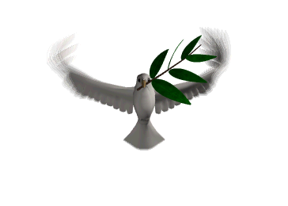
Welcome
Grace Tabernacle of Peace
December 10, 2023

Slide 2
“Let the Dog Die and The Dove Fly"
Revelation 22:14-15
¹⁴ “Blessed are those who wash their robes, that they may have the right to the tree of life and may go through the gates into the city. ¹⁵ Outside are the dogs, those who practice magic arts, the sexually immoral, the murderers, the idolaters and everyone who loves and practices falsehood.
1. Inside every believer there is a flesh nature and his spirit nature's battling for position
2. You have to feed the nature you want to live and starve the nature you want to die starve it!!!!!
3. Psalm 74:19 ¹⁹ Do not hand over the life of your dove to wild beasts; do not forget the lives of your afflicted people forever.

Slide 3
2 Sam 8:6 He put garrisons in the Aramean kingdom of Damascus, and the Arameans became subject to him and brought tribute. The Lord gave David victory wherever he went.
Get out of the bed and back on the battlefield
God Does not Tempt anyone
James 1:13-14
¹³ When tempted, no one should say, “God is tempting me.” For God cannot be tempted by evil, nor does he tempt anyone; ¹⁴ but each person is tempted when they are dragged away by their own evil desire and enticed.
When you were saved God does not take away your appetite He allows you to put it under Control
A lust is an appetite that has gone out of control

Slide 4
Galatians 5:16-25
¹⁶ So I say, walk by the Spirit, and you will not gratify the desires of the flesh. ¹⁷ For the flesh desires what is contrary to the Spirit, and the Spirit what is contrary to the flesh. They are in conflict with each other, so that you are not to do whatever^{[a]} you want. ¹⁸ But if you are led by the Spirit, you are not under the law.
What Feeds the Dog/Beast
¹⁹ The acts of the flesh are obvious: sexual immorality, impurity and debauchery; ²⁰ idolatry and witchcraft; hatred, discord, jealousy, fits of rage, selfish ambition, dissensions, factions ²¹ and envy; drunkenness, orgies, and the like. I warn you, as I did before, that those who live like this will not inherit the kingdom of God.
What Feeds the Dove
²² But the fruit of the Spirit is love, joy, peace, forbearance, kindness, goodness, faithfulness, ²³ gentleness and self-control. Against such things there is no law. ²⁴ Those who belong to Christ Jesus have crucified the flesh with its passions and desires. ²⁵ Since we live by the Spirit, let us keep in step with the Spirit.

Slide 5
Welcome
Grace Tabernacle of Peace
December 10, 2023

