Slide 1
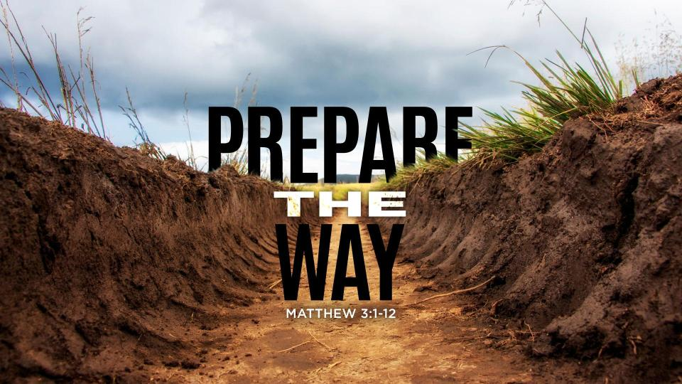

Slide 2

I’m Preparing You for myself!
Ephesians 2:1-10
Pastor Richard “Rico” Tubbs

Slide 3
Ephesians 2
2 As for you, you were dead in your transgressions and sins, ² in which you used to live when you followed the ways of this world and of the ruler of the kingdom of the air, the spirit who is now at work in those who are disobedient. ³ All of us also lived among them at one time, gratifying the cravings of our flesh^{[a]} and following its desires and thoughts. Like the rest, we were by nature deserving of wrath. ⁴ But because of his great love for us, God, who is rich in mercy, ⁵ made us alive with Christ even when we were dead in transgressions—it is by grace you have been saved. ⁶ And God raised us up with Christ and seated us with him in the heavenly realms in Christ Jesus, ⁷ in order that in the coming ages he might show the incomparable riches of his grace, expressed in his kindness to us in Christ Jesus. ⁸ For it is by grace you have been saved, through faith—and this is not from yourselves, it is the gift of God— ⁹ not by works, so that no one can boast. ¹⁰ For we are God’s handiwork, created in Christ Jesus to do good works, which God prepared in advance for us to do.

Slide 4
God is actively working in an individual's life to shape them for a closer relationship with Him and to fulfill a specific purpose.

Slide 5
What are some ways people experience God's preparation?
Difficulties, trials, and suffering
These experiences can feel overwhelming, but God can use them to refine character, build resilience, increase reliance on Him, and teach valuable lessons.

Slide 6
Periods of uncertainty or delay can be used by God to deepen faith, cultivate patience, and increase desire for Him, according to Medium.
Waiting seasons:
Setbacks or changes in circumstances can be God's way of redirecting individuals toward His preferred path.
Closed doors and new opportunities:
Being mindful and open to God's presence in ordinary activities can transform them into spiritual experiences
Everyday routines and mundane tasks:

Slide 8
It is a process that can lead to a deeper understanding of God and a more fulfilling life.

Slide 9
Purposeful Preparation
The belief is that God has a plan for each individual's life, and the challenges and experiences encountered are not random but are part of a deliberate process of preparation.

Slide 10
Spiritual Growth
This preparation often involves spiritual growth, including developing virtues like patience, resilience, and faith, which are seen as necessary for a closer relationship with God.

Slide 11
Alignment with God's Will
The goal is to align one's life with God's will and purpose, which may involve embracing a specific calling or living a life that reflects God's values.

Slide 12
Trials and Refinement:
The preparation process may involve trials and difficult experiences that serve to refine character and build spiritual strength.

Slide 13
Active Participation
While God is seen as the primary force in this preparation, individuals are also expected to actively participate by seeking God, learning from experiences, and striving to live according to His teachings.

Slide 14
Not Always Easy
The process of being prepared for God can be challenging and may not always be understood or appreciated in the moment, but it is ultimately seen as a pathway to a more meaningful and fulfilling life.

Slide 15
Deepening relationship with His Word
God might increase your desire to study Scripture, pray, and spend time in worship, strengthening your spiritual foundation.

Slide 16
Biblical examples illustrating this preparation include
Joseph: His journey from slavery to prominence demonstrated God's providential hand in preparing him to save many lives.
Moses: He spent forty years in the desert before being called to lead the Israelites, a period of preparation for his demanding role.
David: His experiences as a shepherd and in Saul's service equipped him for his future as king.

Slide 17
Transformation and growth in Christlikeness
Equipping for service and divine purpose
God's preparation also aims to equip us for the specific assignments and purposes He has for our lives

Slide 18
What's the end goal of God preparing someone for Himself?
1. Deeper relationship and communion
The ultimate aim is to draw closer to God and experience a deeper, more intimate relationship with Him.
2. Intimacy and Abiding:
Learning to live in close fellowship with Him, experiencing His presence, and allowing His desires to shape our thoughts and actions.
Finding ultimate satisfaction and purpose in Him
3. Joy and Fulfillment:

Slide 19
Readiness for Christ's return and eternity
The ultimate end goal of God's preparation includes being ready for eternity

Slide 20
It's important to remember that this preparation is a continuous process that unfolds over our lives, involving both active participation on our part and reliance on God's transforming power

Slide 21
Homework
It's a deeply personal journey, and God interacts with each individual in unique and meaningful ways.
This Week try to recognize and respond to these promptings and experiences.
Let this lead to deeper intimacy with God and alignment with His purposes.

