Slide 1
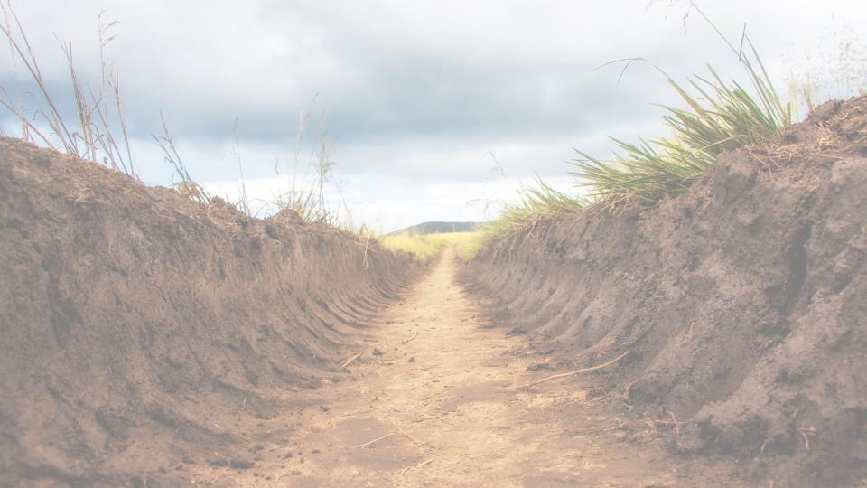
“I Couldn’t See What He Was Preparing for Me!”
Pastor Richard “ Rico” Tubbs

Slide 2
Isaiah 64:4 "Since ancient times no one has heard, no ear has perceived, no eye has seen any God besides you, who acts on behalf of those who wait for him."

Slide 3
God Is Working Even When You Cannot See It
Isaiah 64:4 (NIV) "Since ancient times no one has heard, no ear has perceived, no eye has seen any God besides you, who acts on behalf of those who wait for him."
God is always working behind the scenes.
We often think God has stopped moving when we cannot see progress. But heaven never stops working on behalf of God’s people.

Slide 4
Have you ever driven past a construction site covered by fences and barriers?
You cannot see what is happening inside. But weeks later you drive by and suddenly there is a new building standing there.
Just because you couldn't see the work, does not mean no work was happening.
God often hides the process until the moment of the reveal.

Slide 5
Joseph Couldn’t See What God Was Preparing
Genesis 50:20 "You intended to harm me, but God intended it for good to accomplish what is now being done, the saving of many lives."

Slide 6
Joseph went through things that made no sense:
Betrayed by his brothers
Thrown into a pit
Sold into slavery
Falsely accused
Thrown into prison
At every stage Joseph could have said:
“God, I don’t understand this.”

Slide 7
Joseph could not see that God was preparing him to become Prime Minister of Egypt.
The pit was preparation.
The prison was preparation.
The delay was preparation.
Sometimes God hides the destination so you will trust Him in the process.

Slide 8
Delays Are Often Divine Preparation
Habakkuk 2:3 "For the revelation awaits an appointed time; it speaks of the end and will not prove false. Though it linger, wait for it; it will certainly come and will not delay."
Sometimes we think God is late. But God is never late.
He is strategic.

Slide 9
The Chinese bamboo tree is planted in the ground and watered.
Year 1 — nothing happens. Year 2 — nothing happens. Year 3 — nothing happens. Year 4 — nothing happens.
But in year five, it grows 90 feet in six weeks.
The question is:
Did it grow in six weeks?
No.
It spent five years building roots underground.

Slide 10
God is often building things in you that nobody else can see.
You may think nothing is happening.
But heaven is preparing something strong enough to hold what God is about to release.

Slide 11
Even Your Pain May Be Preparation
Romans 8:28 "And we know that in all things God works for the good of those who love him, who have been called according to his purpose."
Notice what scripture says. It doesn't say some things work together for good. It says all things.
heartbreak
failures
seasons of waiting
mistakes
closed doors
God wastes nothing. He recycles pain into purpose.

Slide 12
The Disciples Couldn’t See What God Was Preparing
1 Corinthians 2:9 (NIV) "What no eye has seen, what no ear has heard, and what no human mind has conceived—the things God has prepared for those who love him."
When Jesus went to the cross, the disciples thought everything was over.
But what they thought was the end was actually the greatest beginning in history.

Slide 13
They couldn’t see that:
The cross would lead to the resurrection
The resurrection would lead to salvation
Salvation would change the world forever
What looked like defeat was actually divine preparation.

Slide 14
Sometimes God Hides the Preparation So We Don’t Quit
Psalm 119:105 "Your word is a lamp for my feet, a light on my path."
So God reveals His plan one step at a time.
Notice it says lamp for my feet, not stadium lights for the whole road.
God gives enough light for the next step, not the whole journey

Slide 15
Homework
Some of us are in a season where we cannot see what God is doing.
Jeremiah 29:11 (NIV) "For I know the plans I have for you,” declares the LORD, “plans to prosper you and not to harm you, plans to give you hope and a future."
You’re asking:
“Why is this taking so long?”
“Why did this door close?”
This week recognize and understand that God already sees the future you cannot see.
Your job is not to understand everything.
“Why did this relationship end?”
But heaven is whispering:
“You can’t see it yet… but I am preparing something for you.”
“Why did this opportunity disappear?”
Your job is to trust the One who is preparing it.

Slide 16
One day you will look back and say:
“I cried about it… I questioned it… I almost gave up…”
But now I see…
God was preparing something I couldn’t see.

