Slide 1
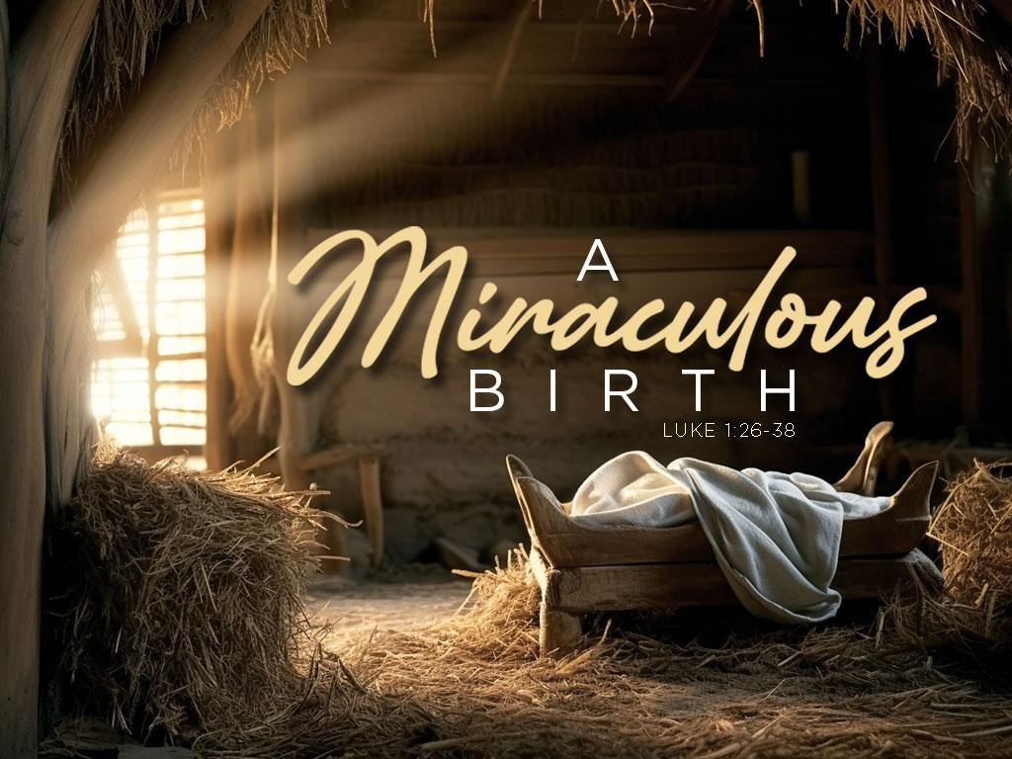
Pastor Richard “ Rico” Tubbs
December 24, 2023

Slide 2
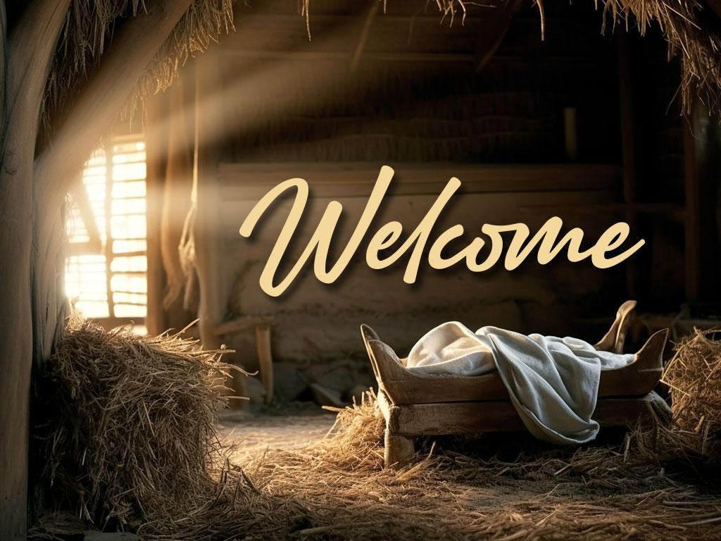

Slide 3
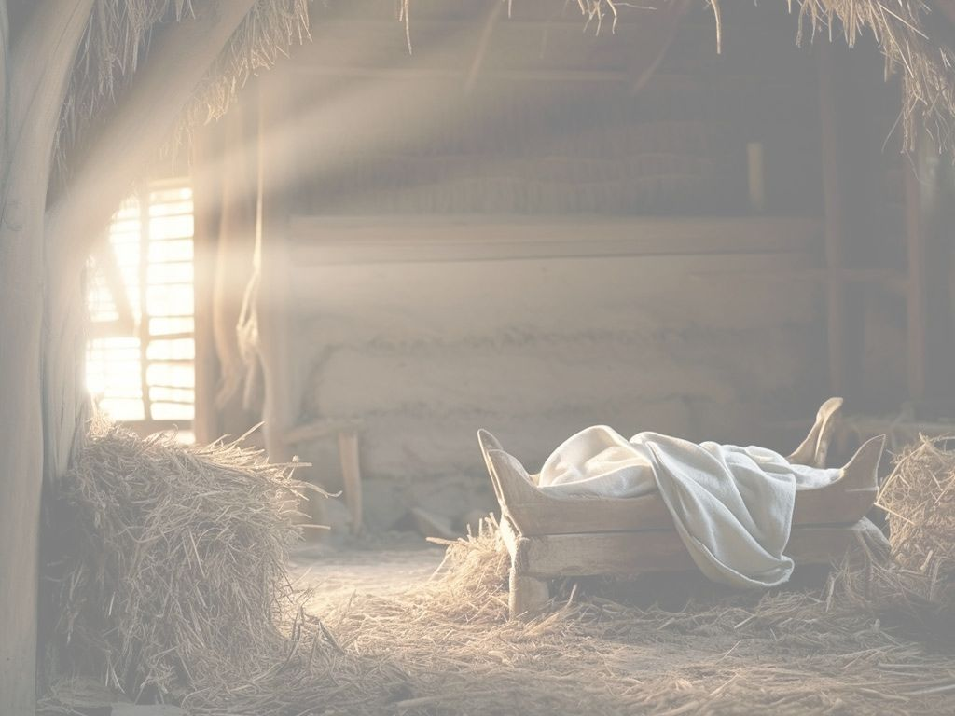
Luke 1:26-38
²⁶ In the sixth month of Elizabeth’s pregnancy, God sent the angel Gabriel to Nazareth, a town in Galilee, ²⁷ to a virgin pledged to be married to a man named Joseph, a descendant of David. The virgin’s name was Mary. ²⁸ The angel went to her and said, “Greetings, you who are highly favored! The Lord is with you.”
²⁹ Mary was greatly troubled at his words and wondered what kind of greeting this might be. ³⁰ But the angel said to her, “Do not be afraid, Mary; you have found favor with God. ³¹ You will conceive and give birth to a son, and you are to call him Jesus. ³² He will be great and will be called the Son of the Most High. The Lord God will give him the throne of his father David, ³³ and he will reign over Jacob’s descendants forever; his kingdom will never end.”
³⁴ “How will this be,” Mary asked the angel, “since I am a virgin?”
³⁵ The angel answered, “The Holy Spirit will come on you, and the power of the Most High will overshadow you. So the holy one to be born will be called^{[a]} the Son of God. ³⁶ Even Elizabeth your relative is going to have a child in her old age, and she who was said to be unable to conceive is in her sixth month. ³⁷ For no word from God will ever fail.”
³⁸ “I am the Lord’s servant,” Mary answered. “May your word to me be fulfilled.” Then the angel left her.

Slide 4
The Obstacle of Unworthiness.
    She was poor. To many at that time, poverty was a sign of God’s disfavor.
    2. She was young. Lacking in experience and wisdom. No one would believe her or take her seriously.
    3. She lived in Nazareth. A city with a bad reputation. Wouldn’t God do his work in Jerusalem?

Slide 5
“Many of us miss God’s blessings because we don’t think we are worthy.”

Slide 6
The overwhelming message of the Bible.
God wants to give you, the water of life, and form Christ in you!
That’s Grace!
God wants to overshadow you with his Holy Spirit, and bring his life to birth in you. He wants to form Christ in you.
John 1:11-13;
“He came to that which was his own, but his own did not receive him. Yet to all who received him, to those who believed in his name, he gave the right to become children of God—children born not of natural descent, nor of human decision or a husband’s will, but born of God.”

Slide 7
The Obstacle of Unbelief.
“Nothing is impossible with God”.
Many of us miss God’s blessings because we don’t think it’s possible.
My problems are too big for even God to handle.
I don’t believe God does miracles anymore.
I’ve been stuck in this rut for too long.
A leopard can’t change its spots

Slide 8
The Obstacle of Unwillingness.
“Nothing is impossible with God”.
It’s not unworthiness, or unbelief, that is the problem for most of us—it’s our stubborn will. We have to say “Yes” to God.
Many of us miss God’s blessings on our lives because we won’t say “Yes” to God and allow it to happen.
To be chosen by God, to be “highly favored” by Him, is indeed a fearful and awesome thing.

Slide 9
The world thinks that God’s favor is in ease and pleasure and prosperity
God’s supreme favor is revealed in things that are desperately hard.
It is the people who have been given something great to do, or some great suffering to bear, even though they are scarred and bruised along the way, who have truly known the favor of God.

Slide 10
Quote from The work of Christmas by Howard Thurman:
Although the Christmas miracle signals the possibility and beginning of redemption, much of the "holy work" of redemption here on earth is placed within our frail, human hands. The miracles we experience and may help to foster are typically not as magnificent as the birth of the son of God to a virgin. No, the miracles we shape and that shape us are usually much more boring on the surface, take far longer than we would like to manifest, and often go unnoticed.
Offering and being offered grace is a miracle. Letting go of anger, resentment, or fear (even if for a moment) is a miracle. Listening to another and being heard by another is a miracle. Recognizing our own limitations and lack of control is a miracle.
Dear God- Open our eyes, hearts, and hands to miracles that are "the work of Christmas."

Slide 11
