Slide 1


Slide 2
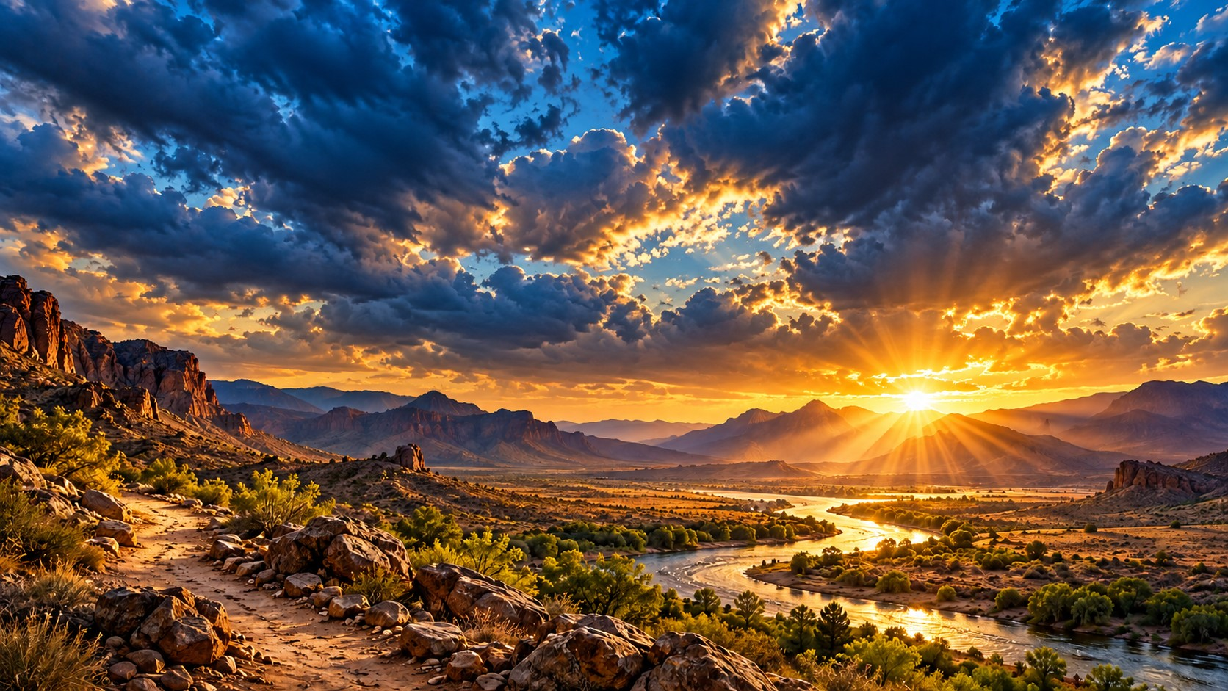
Isaiah 43:19 (KJV)
“Behold, I will do a new thing; now it shall spring forth; shall ye not know it? I will even make a way in the wilderness, and rivers in the desert.”
You have a reason to get up in the morning with expectation! You have a reason to smile before you know all the answers. You have a reason to praise God before you see the finished product.
Why? Because our God is not limited to what we experienced yesterday, what we see today, or what we can imagine for tomorrow!

Slide 3
Most of us have lived through enough to know that life can change in a moment. One phone call can change your plans. One opportunity can open a new door. One conversation can introduce you to a new possibility. One act of obedience can put you on a different path.
And throughout Scripture, we see a God who continually invites His people to trust Him for what comes next. Isaiah 43:19 declares, “Behold, I will do a new thing!” Notice the language: a new thing! Not just the same old routine.

Slide 4
Not just the same old thinking. Not just the same old expectations. God was speaking to His people about His power to bring redemption and a future where they could not see one.
Caution: We must not turn that promise into a guarantee that every dream we have will come true exactly as we imagine it.
We can live confidently knowing that God is able to work in new ways, give us fresh wisdom, open opportunities, and lead us into His purposes.

Slide 5
Don’t walk into a new day expecting nothing simply because yesterday did not go according to plan. You serve a God who can bring new purpose, new understanding, new opportunities, and renewed joy into your life!
Declare: “I’M READY FOR WHAT GOD HAS NEXT!”
I’m ready to grow!
I’m ready to serve! I’m ready to love! I’m ready to walk by faith! I’m ready to stop living in yesterday! And I’m ready to make the most of the day God has given me!

Slide 6
The sunrise
Have you ever watched a sunrise? The night can seem long. The sky can look completely dark. But eventually, the horizon begins to change. First, you see a little light. Then the clouds begin to glow. Then the sun rises, and suddenly the landscape looks different. The hills were there all along. The trees were there all along. The road was there all along. But the light helps you see what was already there. Sometimes a fresh move of God begins with a fresh perspective

Slide 7
The circumstances may not change overnight, but God can change how we see them, how we respond, and how faithfully we move forward. Don’t miss the possibilities of a new day because you are still thinking about yesterday’s darkness!
“I’m expecting God to do something good!”

Slide 8
EXPECT GREAT THINGS FROM A GREAT GOD
Genesis 12:1–4 and Genesis 21:1–7. God called Abraham to leave what was familiar and trust Him with a future he could not fully see. Later, God promised Abraham and Sarah a son. The promise seemed impossible as they grew older, and their circumstances gave them plenty of reasons to wonder how it could happen. Yet Isaac was born, just as God had promised. Their story reminds us that God’s purposes are not limited by what human beings consider possible.

Slide 9
Abraham’s story was not an invitation to demand whatever we want from God. It was an invitation to trust God’s faithfulness and follow His direction. Sometimes faith means stepping into something new. Sometimes it means patiently waiting. Sometimes it means allowing God to reshape our expectations. In every season, we can keep our eyes on Him.

Slide 10
The Unopened Gift
Imagine somebody gives you a beautifully wrapped present. It has a ribbon, a bow, and a card with your name on it. You carry it around the house. You put it on the table. You tell people how beautiful it looks. But you never open it! You never discover what’s inside because you are satisfied with looking at the wrapping.
Many people do something similar with the opportunities in front of them. They pray for wisdom but never seek it. They pray for a better future but refuse to learn something new. They ask God to use them but never volunteer. They want deeper relationships but never take the first step toward reconciliation.
Faith is not merely expecting something good to happen. Faith also calls us to respond to God’s leading. Expectation opens your heart; obedience moves your feet!

Slide 11
Think about the testimony of someone who felt called to serve their community but believed they had nothing meaningful to offer. They had no large platform, no big budget, and no special recognition. But they began by helping one neighbor, encouraging one discouraged person, or serving one family in need. Over time, those small acts of service grew into a meaningful ministry of encouragement. The lesson is not that every small effort will become a large organization.
The lesson is that a life of service can begin with one willing heart. Never underestimate what God can do through ordinary faithfulness.
Declaration:“I’m not going to limit my future to what I have already experienced. I’m going to trust God, follow His direction, and be ready to say yes when He opens the way!”

Slide 12
YOUR NEXT CHAPTER CAN BE BETTER THAN YOUR LAST
Philippians 3:13–14 (KJV)
“Forgetting those things which are behind, and reaching forth unto those things which are before, I press toward the mark…
Paul understood something powerful: you cannot move forward effectively while constantly turning around to relive the past. He had a past. He had regrets. He had things he would never have chosen to repeat. But he refused to let yesterday become the boundary of tomorrow. Church, there is a difference between learning from your past and living in your past. Learn from it.

Slide 13
Thank God for what it taught you. Make things right wherever you can. Celebrate the good memories. But don’t let yesterday keep you from embracing the responsibilities and opportunities of today. Maybe you made a mistake in business. Learn from it. Maybe a relationship ended. Give yourself room to heal and grow. Maybe a dream did not work out the way you planned. Ask God for wisdom about what comes next. Maybe you spent years believing you were too old to begin something new.
Remember that God can still give your life purpose at every age and stage. You don’t have to be who you were five years ago. You can keep growing into the person God is calling you to become.

Slide 14
Consider someone who returns to education later in life after years of believing the opportunity has passed them by. They may feel embarrassed at first. They may struggle to balance family, work, and study. They may wonder whether they are capable of succeeding. But they begin with one class, then another, gradually building confidence and skills. Their testimony is not that the journey was easy. It is that they refused to assume that the past had closed every door to future growth.
There are new things to learn, new people to encourage, new ways to serve, and new ways to grow. You are never too old to become more loving. Never too experienced to become more humble. Never too successful to learn something new. And never too broken to seek restoration.
Declaration: “My past is part of my testimony, but it does not have to be the limit of my future!”

Slide 15
LIVE WITH JOY, BECAUSE GOD HAS GIVEN YOU PURPOSE TODAY
Scripture: Psalm 118:24 (KJV)
“This is the day which the LORD hath made; we will rejoice and be glad in it.
Joy is not the same thing as pretending that life is perfect. Biblical joy is rooted in God, not in the illusion that we control every circumstance. You can have joy while waiting for an answer. You can have gratitude while working through a challenge.

Slide 16
You can experience laughter even after seasons of tears. You can appreciate today’s blessings without having every desire fulfilled. And one of the greatest mistakes we make is postponing our joy until some future event. “I’ll be happy when I get the promotion.” “I’ll be grateful when I have more money.” “I’ll enjoy life when everything settles down.” But what if, while waiting for the next season, you miss the blessings sitting in front of you today? What if you overlook the friend who cares about you?
What if you forget to enjoy the laughter of your children or grandchildren? What if you become so focused on tomorrow’s problems that you never thank God for today’s provision?
Don’t wait until your entire life is perfect before you learn to recognize the goodness of God.

Slide 17
The gratitude challenge
Imagine two people waking up on the same morning. Both have responsibilities. Both have challenges. Both have things they would like to change. One person spends the entire morning thinking about everything that is wrong. The other acknowledges the difficulties but also thanks God for a new day, a chance to make things right, a person who cares, and an opportunity to help someone else. Neither person has a perfect life. But their focus shapes how they approach the day. Gratitude does not erase our problems.
It helps keep our problems from becoming the only things we can see.

Slide 18
A real biblical testimony of gratitude
In Luke 17:11–19, Jesus healed ten men who had leprosy. One returned to give thanks. All ten received healing, but only one is specifically described as returning to thank Jesus. His response challenges us to become people who notice God’s goodness and express our gratitude. Don’t become so focused on what you are still waiting for that you forget to thank God for what you have already received. Thank Him for His mercy. Thank Him for the people who stand beside you. Thank Him for the strength to begin again.
Thank Him for the opportunity to love somebody today. And when life is difficult, remember that you can seek help, ask for prayer, and still find reasons to hold on to hope.
Declaration: “I will not postpone my joy until tomorrow. Today is a gift from God, and I will live it with gratitude, faith, and purpose!”

Slide 19
Homework:
Take this into next week!
1. EXPECT GOD TO LEAD YOU INTO NEW POSSIBILITIES
Isaiah 43:19 Start each morning with prayer and an open heart. Don’t assume that yesterday’s experience tells you everything about tomorrow. Ask God to show you where you can grow, serve, and take a faithful step.
Say it: “Lord, open my eyes to the opportunities You have placed before me!”
2. STOP LIVING BACKWARD
Philippians 3:13–14 Learn from your past, receive God’s grace, and move forward. Take one practical step toward the person you want to become. Don’t allow regret to rob you of the opportunity to grow today.
Say it: “I will learn from yesterday, live faithfully today, and trust God with tomorrow!”
3. MAKE SOMEBODY ELSE’S DAY BETTER
Psalm 118:24 Encourage someone. Forgive where you can. Call a person who may be lonely. Thank somebody who has helped you. Let your faith become visible through the way you love people.
Say it: “God has given me this day, and I will use it to spread hope!”

Slide 20
Your challenge for the coming week
Don’t just hear the message. Live the message!
Monday: Start the day by thanking God for five blessings
Tuesday: Take one step toward a goal you have been putting off.
Wednesday: Encourage somebody who needs a little hope.
Thursday: Let go of one unnecessary regret and focus on what you can do differently.
Friday: Find a way to serve somebody without expecting anything in return.
Saturday: Spend time with the people who matter most.
Sunday: Come ready to testify about one thing you learned, one step you took, or one blessing you recognized.

Slide 21
I want you to leave today with your head lifted, your heart encouraged, and your faith renewed! You are not required to know every detail of tomorrow to live with hope today. You do not have to repeat the mistakes of yesterday. You do not have to wait for a perfect season to find reasons to rejoice. You can grow. You can serve. You can love more deeply. You can forgive. You can learn. You can begin again. And you can trust God to lead you, even when the next step is not completely clear.

Slide 22
Closing prayer
Heavenly Father, thank You for the gift of a new day and the hope we have in You. Renew our joy. Strengthen our faith. Open our eyes to opportunities to grow, to serve, and to love others. Help us release the regrets we cannot change and take responsibility for the things we can. Give us courage to take the next step, wisdom to recognize Your direction, and grateful hearts that see Your goodness in everyday life.
Let our homes be filled with encouragement, our churches be filled with compassion, and our lives be living testimonies of Your grace. May we leave this place with expectation, walk into this week with purpose, and encourage somebody along the way. In the mighty name of Jesus, amen!
Don’t just get ready for another week. Get ready to live it with faith, walk in it with purpose, and fill it with joy. Yesterday has passed, today is a gift, and tomorrow belongs in God’s hands. Now go out there and let your life be a testimony!”

