Slide 1
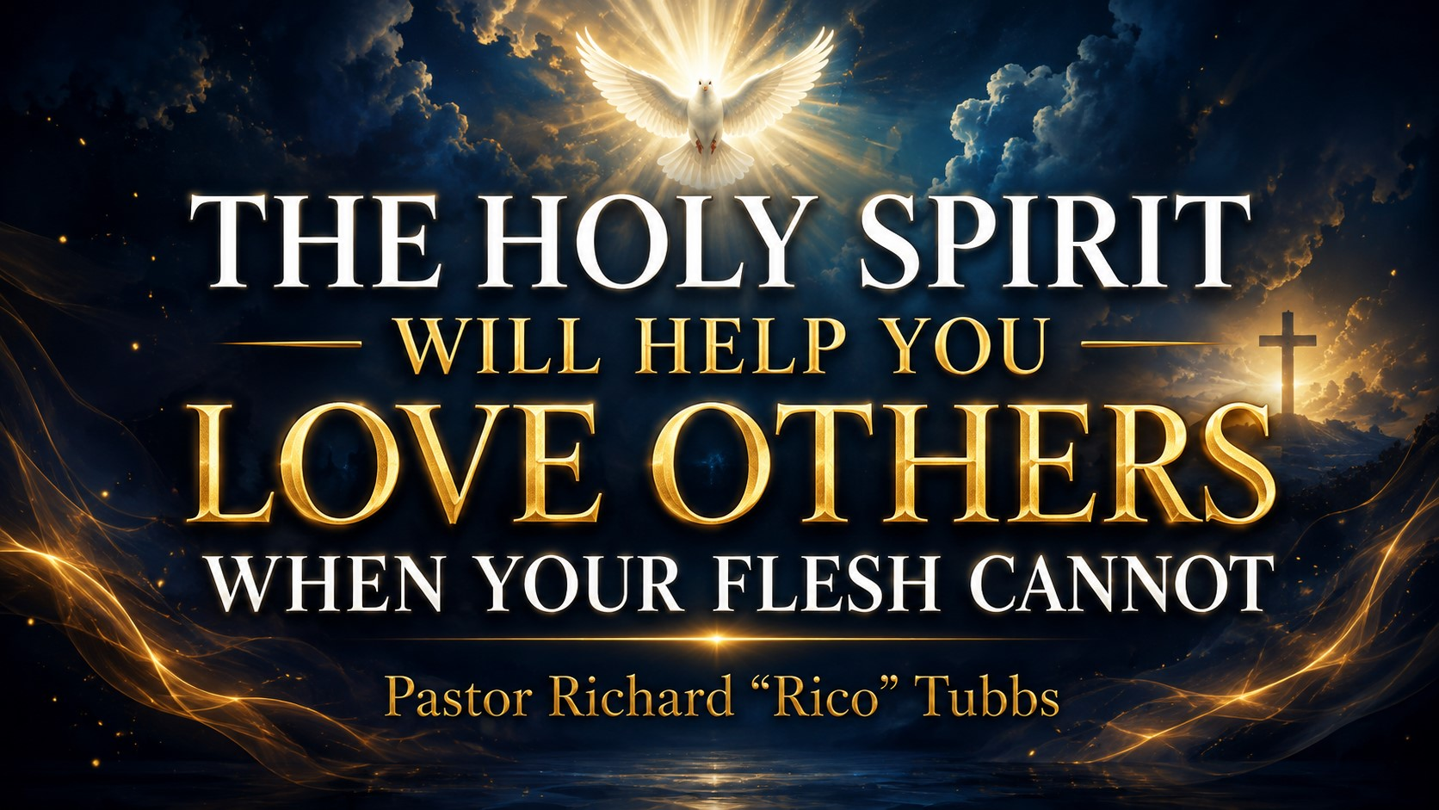

Slide 2
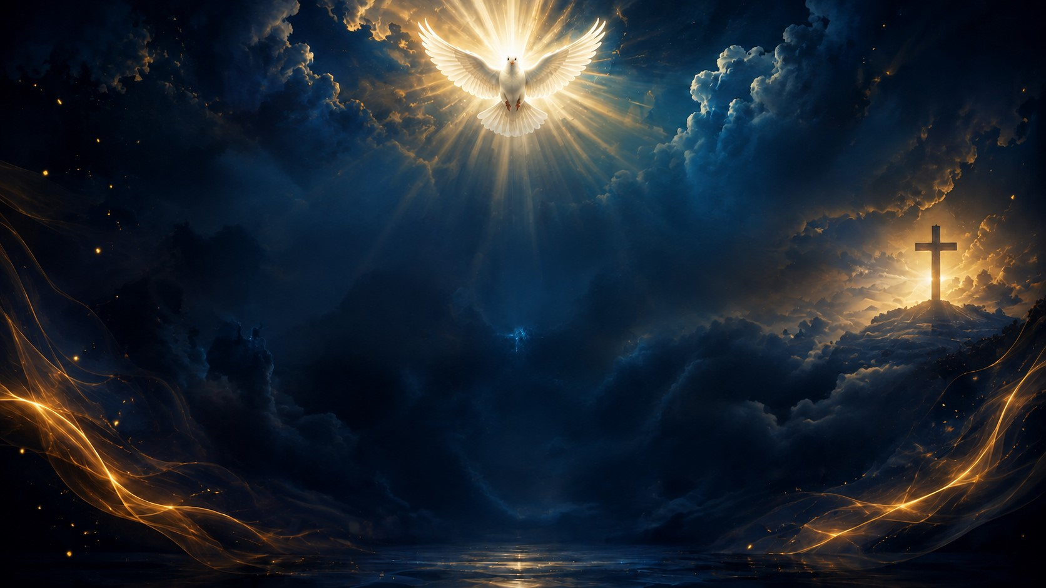
“But the fruit of the Spirit is love, joy, peace, longsuffering, gentleness, goodness, faith, meekness, temperance.”
Galatians 5:22–23
There are some people who are easy to love.
They love you back. They encourage you. They respect you. They celebrate your victories and stand beside you during your struggles.

Slide 3
The ones who hurt you.
The ones who lied about you.
The ones who betrayed your trust.
The ones who talked about you behind your back.
The ones who keep pushing the same button and reopening the same wound.
When you encounter those people, your flesh starts talking.
When you encounter those people, your flesh starts talking.
Your flesh says, “I’m done!”
Your flesh says, “I don’t have to forgive them.”
Your flesh says, “Treat them exactly the way they treated you.”
Your flesh says, “Make them feel the pain they made you feel.”

Slide 4
But then, in the middle of your anger, the Holy Spirit whispers:
“Love them anyway.”
That is where the battle begins.
Sometimes God will call us to love people whom our flesh does not even like.
He will ask us to demonstrate patience toward someone who has tested our patience.
He will ask us to show kindness to someone who has been unkind.
He will ask us to forgive someone who has never apologized.

Slide 5
That kind of love is not natural. It is supernatural.
The evidence that the Holy Spirit is working in our lives is not merely how loudly we can shout, how beautifully we can sing or how many Scriptures we can quote.
Sometimes the greatest evidence of the Holy Spirit is how we respond when someone gives us every reason to react in the flesh.

Slide 6
Your Flesh Wants Revenge, but the Spirit Produces Love
Paul tells us:
“For the flesh lusteth against the Spirit, and the Spirit against the flesh.”
Galatians 5:17
There is a battle taking place inside every believer.
Your flesh says, “Get even.”
The Spirit says, “Forgive.”
Your flesh says, “Cut them down.”
The Spirit says, “Pray for them.”
Your flesh says, “They do not deserve your kindness.”
The Spirit reminds you, “Neither did you deserve Mine.”

Slide 7
Your flesh wants to win the argument.
The Holy Spirit wants to win the person.
Your flesh wants to protect your pride.
The Holy Spirit wants to protect your heart.
Your flesh wants immediate satisfaction,
but the Holy Spirit is producing eternal transformation.

Slide 8
The Two Dogs
There is an old illustration about two dogs fighting inside a person. One represents anger, bitterness, pride and revenge. The other represents love, forgiveness, humility and grace.
“The one you feed.”
If you continually feed your anger, rehearse the offense and tell the story of how badly you were treated, resentment will become stronger.

Slide 9
If you keep checking their social media, replaying the conversation and imagining what you should have said, your flesh will continue to grow.
But when you feed your spirit with God’s Word, prayer, worship and obedience, the Holy Spirit begins changing your response.

Slide 10
We must stop asking, “How do I feel about them?”
We must start asking, “Holy Spirit, how do You want me to respond to them?”
You do not have to respond to every accusation.
You do not have to attend every argument you are invited to.
You do not have to send every message you type.

Slide 11
Sometimes the most Spirit-filled thing you can do is pause, pray and remain silent.
Before you answer, ask yourself, “Will my response reveal my anger, or will it reveal Jesus?”

Slide 12
Jesus Showed Us How to Love People Who Do Not Love Us
“Love your enemies, bless them that curse you, do good to them that hate you, and pray for them which despitefully use you.”
Matthew 5:44
Anyone can love someone who loves them. Anyone can be kind to someone who is kind to them. Anyone can speak well of someone who speaks well of them.
But it takes the power of God to love someone who has wounded you.

Slide 13
The Cross Is Our Greatest Example
Think about Jesus hanging on the cross.
They had beaten Him.
They had mocked Him.
They had spit upon Him.
They placed a crown of thorns upon His head and drove nails through His hands and feet.
Yet, while hanging between heaven and earth, Jesus prayed:
“Father, forgive them; for they know not what they do.”
Luke 23:34

Slide 14
If Jesus could forgive while hanging on a cross, the Holy Spirit can help us forgive while sitting in church!
God saw the betrayal.
God heard the lie.
God witnessed the abuse.
God collected every tear.

Slide 15
Forgiveness does not mean that what they did was acceptable.
Forgiveness does not mean that you must trust them again.
Forgiveness does not mean removing necessary boundaries.
Forgiveness means, “I will not allow what you did to control what God is doing within me.”
Forgiveness means, “You may have wounded me, but you will not determine who I become.”
Forgiveness means, “I refuse to drink the poison of bitterness while waiting for you to suffer.”

Slide 16
You can forgive someone and still establish boundaries.
You can forgive someone and still walk away from an unhealthy situation.
You can forgive someone without pretending that nothing happened.
Forgiveness releases that person from your judgment and releases your heart from their control.

Slide 17
Do not confuse forgiveness with reconciliation. Forgiveness requires one willing heart. Reconciliation requires repentance, honesty and rebuilding from both people.
God may not be asking you to reopen the door. He may simply be asking you to remove the bitterness from your heart.

Slide 18
Imagine picking up a burning coal with your bare hand because you intend to throw it at someone who hurt you.
You stand there waiting for the perfect opportunity. You keep holding it, thinking about what they did and imagining how good it will feel when you finally throw it.
But while you are waiting to hurt them, the coal is burning you.
That is what unforgiveness does.
We hold on to anger because we think it punishes the other person. Meanwhile, they may be sleeping peacefully while we are awake rehearsing the offense.
They may have moved on while we remain emotionally chained to the moment they hurt us.
Bitterness says, “I will hold on to this until they pay.”
The Holy Spirit says, “Let it go before it destroys you.”
Forgiveness is not saying they were right.
Forgiveness is dropping the burning coal.
It is saying, “I refuse to keep hurting myself because of what someone else did to me.”
You cannot receive everything God wants to place into your hands while your hands are still gripping yesterday’s pain.
Drop the coal!
Release the offense. Open your hands and let God begin the healing.

Slide 19
The Holy Spirit Gives You Power to Love Beyond Your Ability
Romans 5:5 says:
“The love of God is shed abroad in our hearts by the Holy Ghost which is given unto us.”
The Bible does not say that we must manufacture this kind of love by ourselves. It says that the love of God is poured into our hearts through the Holy Spirit.

Slide 20
There will be moments when you do not have enough love within yourself
but God has enough love within Him.
There will be moments when your patience runs out, your kindness runs dry and your strength reaches its limit.

Slide 21
That is when you pray:
“Holy Spirit, love them through me.”
“Give me the words I do not have.”
“Give me the patience I cannot produce.”
“Give me the strength to forgive.”
“Help me respond in a way that looks like Jesus.”

Slide 22
In Acts 7, Stephen was falsely accused and attacked because of his faith. An angry crowd dragged him outside the city and began throwing stones at him.
Stephen could have cursed them.
He could have prayed for God to destroy them.
He could have asked God to make them suffer.
Instead, as the stones were striking his body, Stephen prayed:
“Lord, lay not this sin to their charge.”
Acts 7:60

Slide 23
Where did that kind of love come from?
One of the men standing nearby was Saul. Saul later encountered Jesus, became the Apostle Paul and carried the gospel throughout the known world.
Stephen prayed for someone who was participating in his death, and that man later became one of the greatest voices of the early church.

Slide 24
Sometimes the person you are tempted to hate today may be someone God intends to transform tomorrow.
Do not let your anger write the ending to somebody else’s story.
You do not know what God may do in their life.
You do not know what conviction God may bring.
You do not know what testimony may emerge from their transformation.
Your responsibility is not to change them. Your responsibility is to obey God and keep your heart clean.

Slide 25
When You Cannot Love Them, Love God Enough to Obey Him
Sometimes we make forgiveness too emotional.
We say, “I do not feel like forgiving them.”
You may not feel like it. But obedience is not always based on feelings.
Sometimes you must say:
“God, I do not feel love toward this person right now, but I love You enough to obey You.”

Slide 26
You do not forgive because they deserve forgiveness. You forgive because God has forgiven you.
You do not show kindness because they earned it. You show kindness because Christ showed kindness to you.
You do not pray for them because they treated you well. You pray because Jesus instructed you to pray.

Slide 27
Your feelings may follow your obedience, but your obedience cannot always wait for your feelings.
Love is not pretending that the pain is not real. Love is choosing to let God have the final word over your pain.

Slide 28
The Mirror
Imagine walking into a room while you are angry with someone. You look into a mirror and begin thinking about everything that person did.
You say, “I cannot stand them!”
But the mirror is not showing you their face. It is showing you yours.
Sometimes we spend so much time examining what someone else did that we forget to examine what their behavior is producing inside us.
Is their offense making you bitter?
Is their behavior making you angry?
Is their betrayal stealing your peace?
Is their rejection changing your personality?
Are you becoming suspicious of everyone because of what one person did?
They may have hurt you once, but bitterness can make you hurt yourself every day.

Slide 29
The Cup That Was Bumped
Imagine someone walking through a crowded room carrying a cup filled to the top. Another person accidentally bumps into them, and everything inside the cup spills out.
If the cup contained coffee, coffee would spill out.
If it contained water, water would spill out.
If it contained something bitter, bitterness would spill out.
Why did it spill?
Someone may answer, “Because another person bumped the cup.”
Life will bump you.
But the deeper answer is this: It spilled because that was what the cup contained.
People will disappoint you.
Someone will speak disrespectfully to you. Someone will betray your confidence. Someone will challenge your patience.
When life bumps you, whatever has been filling your heart will come spilling out.
If your heart is filled with bitterness, bitterness will come out.
If your heart is filled with anger, anger will come out.
But if you have been filled with the Holy Spirit, love, patience and grace can come out—even when somebody bumps you the wrong way.
Stop blaming the bump for everything that spills out of you. Sometimes the bump simply reveals what was already inside.
That is why we must continually pray:
“Holy Spirit, fill me until there is no room left for bitterness. Fill me until love comes out when life bumps me!”

Slide 30
The Snakebite
Imagine being bitten by a poisonous snake while walking through the woods.
The snake strikes, releases its poison and disappears.
You now have two choices.
You can chase the snake through the woods, trying to understand why it bit you and attempting to make it pay.
Or you can immediately seek treatment and get the poison out of your body.
If you spend all your time chasing the snake, the poison will spread.
Some people have been emotionally bitten, and instead of seeking healing, they have spent years chasing the person who hurt them.
They keep reliving the conversation.
They keep searching for an apology.
They keep trying to make the person understand the damage they caused.
But while they are chasing the person, the poison is spreading through their hearts.
Do not spend your life chasing the snake. Let the Holy Spirit remove the poison.
God may never give you the apology you wanted, but He can still give you the healing you need.
Your healing is too important to be dependent upon someone else’s apology.

Slide 31
Homework
Three Key Points to Remember This Week
1. Pause, Pray and Let the Holy Spirit Lead Your Response
Before you answer, pause.
Before you react, pray.
Before you send that text, ask:
“Holy Spirit, is this how You want me to respond?”
Do not let a temporary emotion create a permanent consequence.
This week, remember: I will not respond from my flesh. I will respond from the Spirit.
2. Forgiveness Does Not Say They Were Right; It Says God Is Still Lord of Your Heart
Forgiveness does not excuse the offense. It removes the offense from the throne of your heart.
You can forgive and establish boundaries. You can forgive and move forward. You can forgive without returning to the same unhealthy situation.
This week, remember: What they did will not control what God is doing within me.
3. When Your Love Runs Out, Ask God for His
There may be someone whom you cannot love through human strength alone.
Be honest with God and pray:“Lord, I do not have the strength to love this person, but You do. Holy Spirit, love them through me.”
What you cannot accomplish naturally, God can empower you to accomplish supernaturally.
This week, remember: I do not have to love people through my strength. The Holy Spirit will love them through me.

Slide 32
Final Declaration
Holy Spirit, help me love when I do not feel like loving.
Help me forgive when I do not feel like forgiving.
Help me bless when my flesh wants to curse.
Help me pray when my flesh wants revenge.
Help me pause before I react and pray before I respond.
Heal every wound that has produced anger, bitterness or resentment within me.
Give me wisdom to establish healthy boundaries without carrying hatred in my heart.
I release every person who has hurt me. I place them into Your hands, and I trust You to handle what I cannot fix.
Lord, I refuse to become what hurt me.
Let the fruit of Your Spirit grow within my life. Let Your love be seen in my words, my attitude, my choices and my response to difficult people.
Not my will…Not my feelings…Not my pride…Not my flesh.
But Your Holy Spirit working through me.
In the mighty name of Jesus Christ, Amen.

