Slide 1
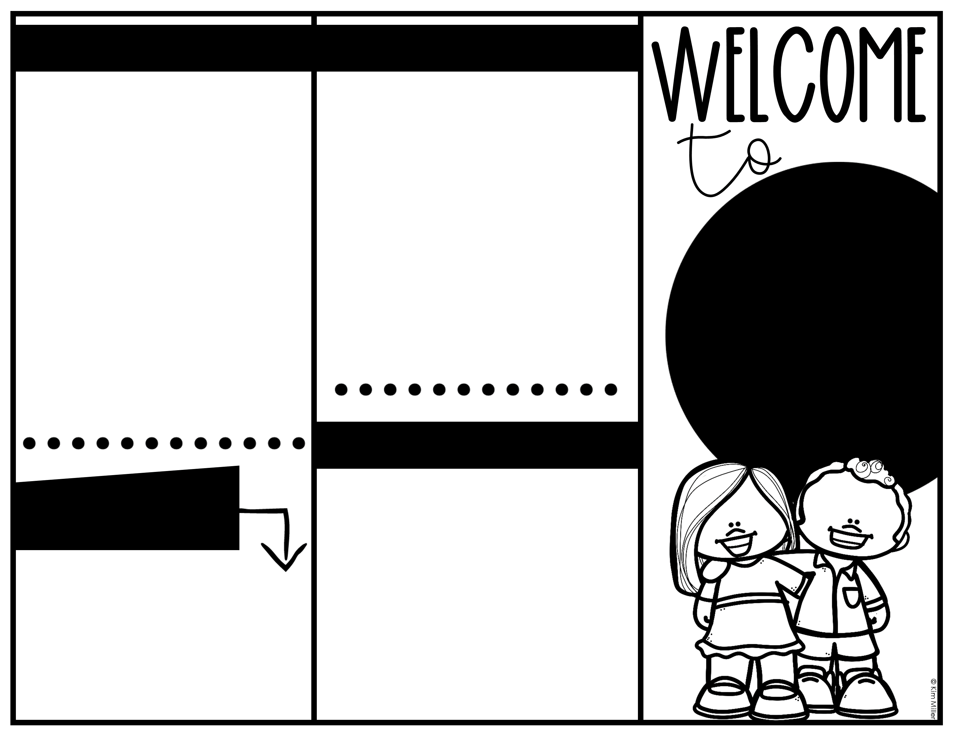
Daily Routines:
Positive Behavior Classroom
Items needed every day:
Dressed in uniform
Full water bottle (closable & Spillproof)
Backpack (no wheels)
Communication Binder
Our Classroom is a positive behavior classroom. This means we focus on the positive things we do individually and as a class, or “family.” Everyday, we strive to live by the “SHARKS” expectations. These expectations guide us to be SUPER SHARKS throughout our day.
Seek Solution
Have Grit
Act with Integrity
Reach for Extra
Know that Kindness Matter
Stay Optimistic
Be on the look out for:
- Weekly Emails
- Daily Posts on the Facebook Group
- Calendar in Communication Binder
- Remind Messages
- Connect Ed phone calls and emails from administration
Mr. Bernaert’s
KINDERGARTEN
CLASS
WISH LIST
CONTACT info
Check out our Amazon Wishlist. We appreciate all donations!
As we need items, I add them to the wish list. I will include the link in our weekly email.
Mr. Cory Bernaert, Room 144
Barbara A. Harvey Elementary School
8610 115th Avenue East
Parrish, FL 34219
bernaertc@manateeschools.net
School: (941)803-9340 Ext. 75911
Cell: (574) 329-4710
mrbteaches.com

Slide 2
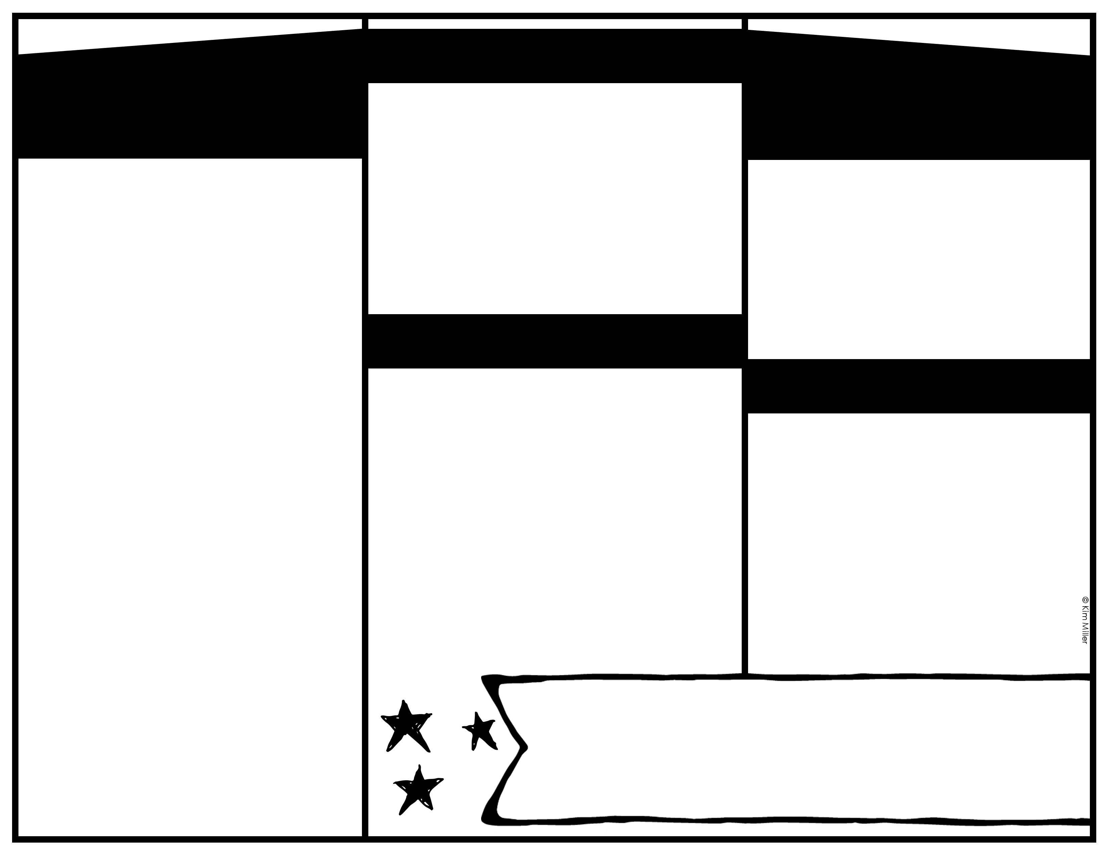
I’m so hungry!
Transportation
Daily Pictures
SNACK TIME
All families will need to use the PikMyKid App to delegate/change transportation information.
Info on our website:
https://www.manateeschools.net/Page/9934
Early pick up- text/email me so I can have your child ready.
Dismissal Changes– Must be made in PikMyKid before 2 PM. Please text or email me as well.
Color Coded Bands by Dismissal Type:
Keep color bands on backpacks as long as possible – wrist bands for 1-2 weeks.
Snack Time
At the beginning of each month families are asked to donate 1 class snack to feed 20 children unless you are sending a snack with your child each day.
SNACK IDEAS-must be individually wrapped:
-Cheez-Its
-Pretzels
-Gold Fish
-Veggie Straws
-Pringles
-Protein Bars
Use the Amazon Wishlist if you’d like to purchase from there. It will ship directly to school. The Wishlist will be shared in my weekly emails and a QR code is here.
WATER BOTTLES
Please send a full, closable, spill proof, labeled water bottle every day. Students will have access to their water bottle throughout the day and will be able to refill as needed.
Join our PRIVATE Facebook Group
Mr. Bernaert’s Kindergarten 24/25
I post daily pictures and videos! These are great conversation starters for you to talk about school with you child! Only legal guardians are allowed in the group.
Helping Hands
We always welcome helping hands in our classroom! There will be various opportunities for you to volunteer in our classroom and school this year.
ALL Volunteers MUST complete a series of required steps through our main office to volunteer. Please see our wonderful office staff for more information.
Be on the lookout for information on volunteer opportunities!
Birthday Celebrations
We love to celebrate birthdays!
You are welcome to send in a special treat for your child’s special day. All items MUST be store bought. Please include plates/napkins/utensils.
All summer birthdays will have a special day before end of the year.
About Mr. Bernaert
I love being active and outdoors as much as possible. I enjoy the beach, paddleboarding, and riding my bike. However, I also love sitting in my chair watching TV! Coffee, sparkling water, salty snacks, and going to local restaurants are a few of my favorite things!

