Slide 1

Welcome to our
March FRN Meeting
March 18, 2025
Roane FSC 12:00

Slide 2

Review of Minutes
*Those viewing this presentation
on their personal device can expand
minutes and virtually flip pages using
icons located at the bottom of the
page.

Slide 3
Review of Financial Report
*Those viewing this presentation
on their personal device can scroll
document here.

Slide 4
DoHS Updates/News
  Roane FRN has submitted Q2 reporting forms and is still awaiting feedback from DoHS.
  Reports for Q3 will be due on April 30, 2025.
  FY DoHS Grant Window is expected to open April/May 2025. This will ensure funding for FRNs for next fiscal year. We anticipate having documentation ready to submit early.
  FRN will also be assisting FSC in submitting their annual grant request as their fiscal agent.

Slide 5
FRN Active Grant Projects

Slide 6

Monetary Support for Backpack Program
Funding Source: Parkersburg Area Community Foundation
Grant Cycle: Fall 2024
Grant Award Amount: $10,000
Collaborating Partnerships: The Backpack Program, Spencer MMC
Point of Contact: Phillip McNemar
Purpose: To provide continued support of Backpack Program to supplement meals for Roane County youth in need and expand services to fixed-income seniors.
February Update:
Following the loss of our friend Phil, the Backpack Program will undergo new fiscal management. Director will provide update from meeting held on 3/13/2025. Continued support of the backpack program is encouraged in memoriam of Phil.

Slide 7

Community Baby Shower
Funding Source: TeamWV Partners in Prevention
Grant Cycle: FY 2024-2025
Grant Award Amount: $7,500 (two installments)
Collaborating Partnerships: TeamWV Partners in Prevention
Point of Contact: Jessica Dianellos
Purpose: To re-establish a Roane County Community Baby Shower that provides education, support, and resources to new and expecting families in our region.
February Update:
Registration for both participants and vendors is open. We currently have 22 participants registered. Heritage Park is booked for April 26, 2025. Planning Committee met virtually on 3/13.
Catering is provided by RGH and Shannon and TC has purchased decor. Corie purchased mom gifts. Vendors and photographer are booked. New parent info packed is in development.

Slide 8



Slide 9

Geary Elementary/Middle
Resource Closet
Funding Source: Hope Gas Foundation
Grant Cycle: Fall 2024 Donation
Grant Award Amount: $5,000
Collaborating Partnerships: Hope Gas Foundation, Geary Elementary Middle School, Communities in Schools
Point of Contact: Erin O’Donnell (Hope Gas), Lorra Tanner (GEMS), Frederick Hammack (GEMS Communities in Schools)
Purpose: To establish a student resource closet with clothing, toiletries, personal hygiene items, and non-perishable food items for GEMS students in need.
February Update:
Shelving has been purchased and installed. CIS and Geary PTO will stock pantry after bingo event on 3/14. Pics of finished project will be available in April.

Slide 10
Trainings/Information Sharing

Slide 11

In March, FRN made focused information sharing on two targeted topics:
  Nutrition/Balanced Diet/ Understanding Food Labels (in correlation with National Nutrition Month)
  Developmental Disabilities Month (focus on challenging stigma, inclusive behaviors, and using person-first language)
  We also recognized International Women’s Day and Read Across America Day
Examples of Social Media Posts on Next Slide

Slide 12
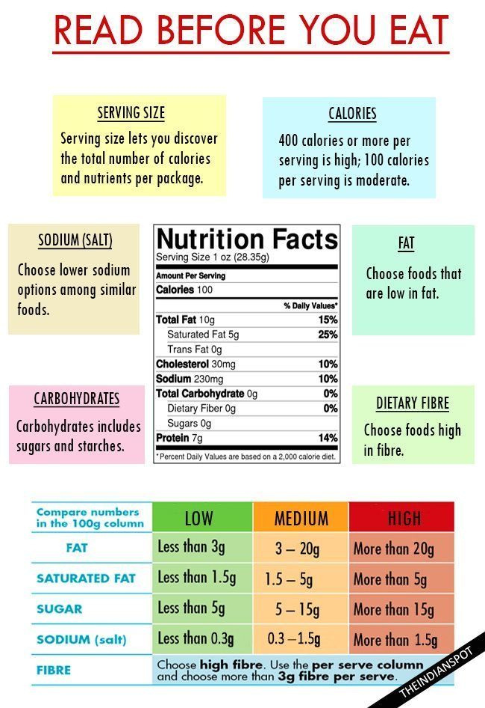
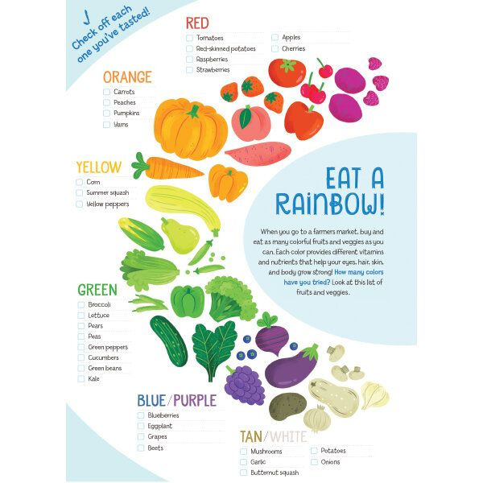

Slide 13
FSC Updates

Slide 14
Guest Speaker:
Tausha Burton
WV JobCorps

Slide 15


Next Meeting:
March 18, 2025
12:00 p.m.
Roane FSC and Zoom

