Slide 1







ROANE COUNTY FAMILY RESOURCE NETWORK
2024 NEEDS ASSESSMENT
SURVEY REVIEW

Slide 2


WHAT IS THE DATA FOR?
Needs Assessment Surveys help us accomplish a few things:
Provides a snapshot of what Roane citizens perceive as service gaps/unmet needs
Data and feedback can guide helping agencies like FRN in addressing problems that matter most to citizens
Provides Roane FRN key data to justify grant-seeking and advocate for needs of county to grantees
Establishes a baseline to measure effectiveness of services and programs made in response to needs

Slide 3

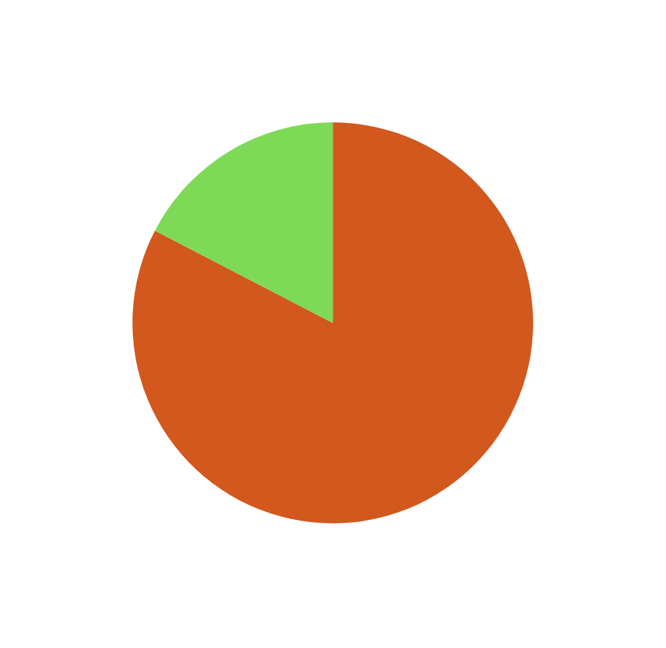
WHO TOOK THE SURVEY?
Survey Respondent Data Breakdown
Of the 23 respondents to the survey, 19 indicated they were Roane County residents.
Of those who designated they were out of county residents, many noted they were employed within the county or provide services to Roane County residents.

Slide 4
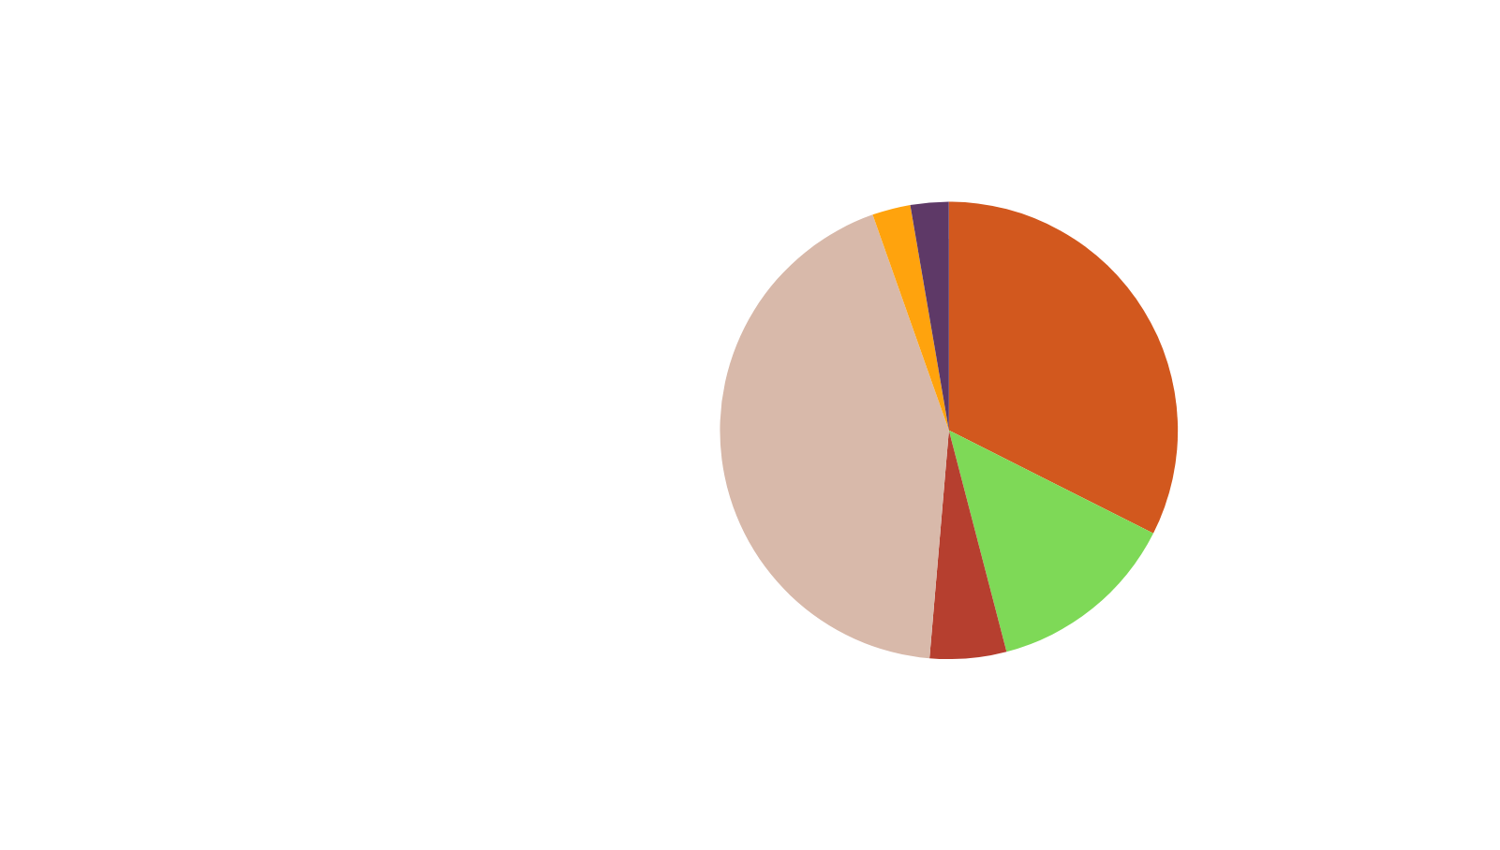
WHO TOOK THE SURVEY?
Survey Respondent Data Breakdown
Respondents were asked to select as many identifiers as applied to them. This data helps identify what manner of stakeholder feedback is being collected.
Many respondents selected multiple relevant identifiers, with the largest population represented being Parents, Grandparents, or Other Legal Guardians.

Slide 5





THE ISSUES:
  For the next portion of the survey, we asked respondents to rate the severity of multiple key issues in Roane County.
  Additionally, repondents were asked if they were aware of services addressing each issue and if they would feel confident they would know how to access said services.
  There are not the only issues facing Roane County citizens. However, these topics are often highlighted in prevention and social service programmatic planning. These service gaps are good foundations for expanded outreach.

Slide 6
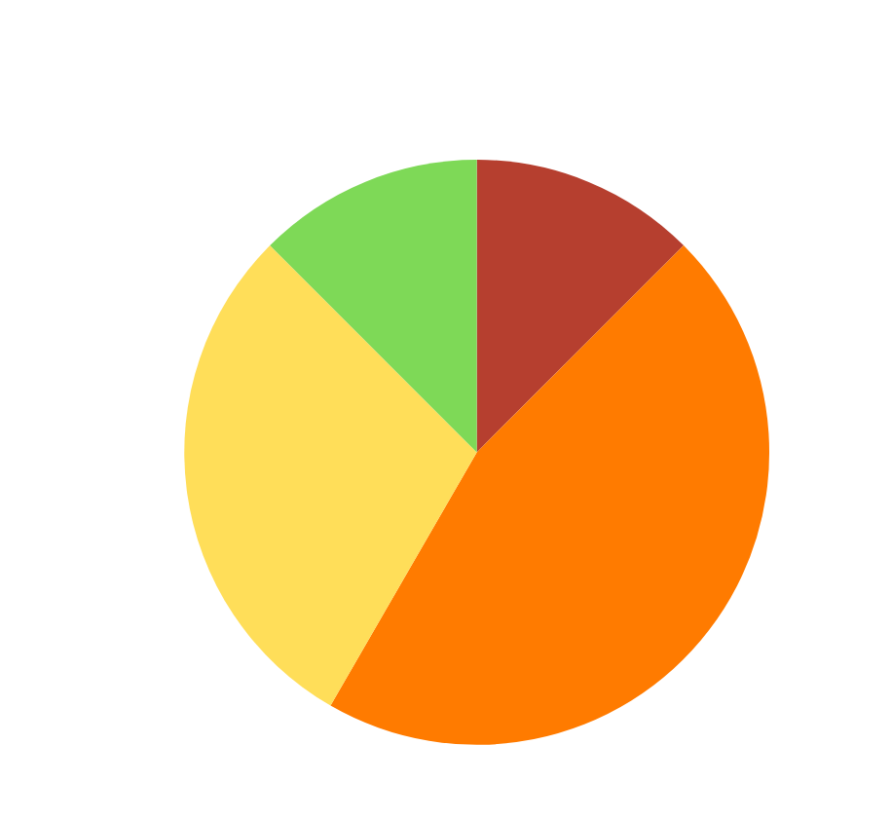
HUNGER
Q: On a scale of one to five, how severe of a problem do you perceive hunger/food insecurity (ex. 1= not a problem, 5= a severe problem/crisis) to be in Roane County?
Data suggest that the majority of respondents view hunger/food insecurity as a severe/crisis-level concern in Roane County.
None of those who responded indicated that they believed hunger/food insecurity was NOT an issue in Roane County.

Slide 7
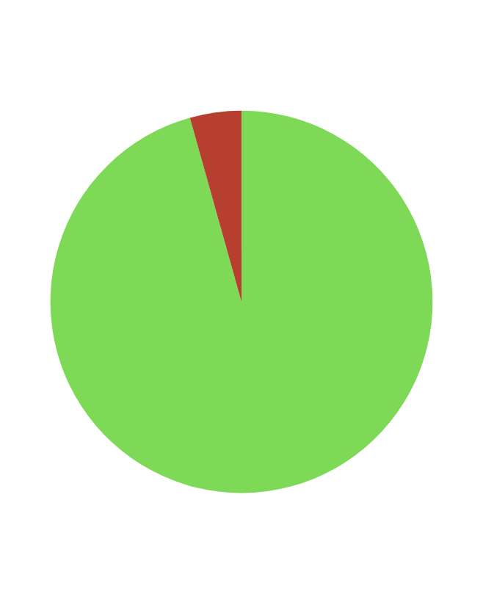
HUNGER
Q:Are you currently aware of programs/supports within our community designed to assist those experiencing hunger/food insecurity?
Data suggests that nearly all respondents were aware of programs currently in place to assist those experiencing hunger/food insecurity.
This data is meant to measure awareness, not efficacy, of pre-existing programs.

Slide 8
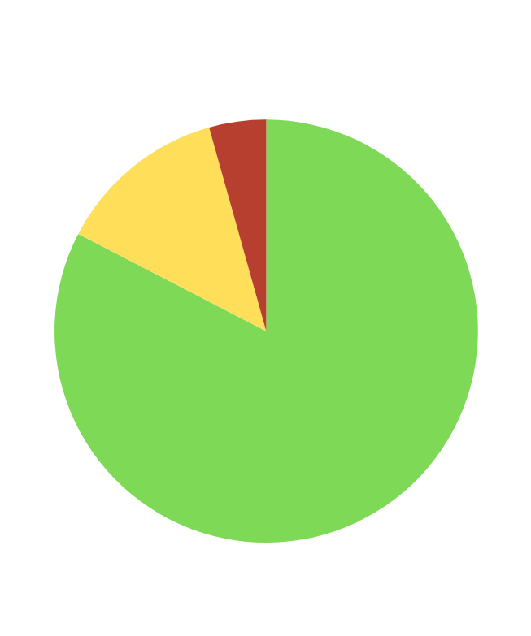
HUNGER
Q: If necessary, would you know how to access programs/supports within our community designed to assist those experiencing hunger/food insecurity?
Data suggests there may be some discrepancy between being aware of existing programs concerning hunger, and how to access them or make referrals.
Bridging the gap between awareness and access may service providers in addressing this area of concern.

Slide 9
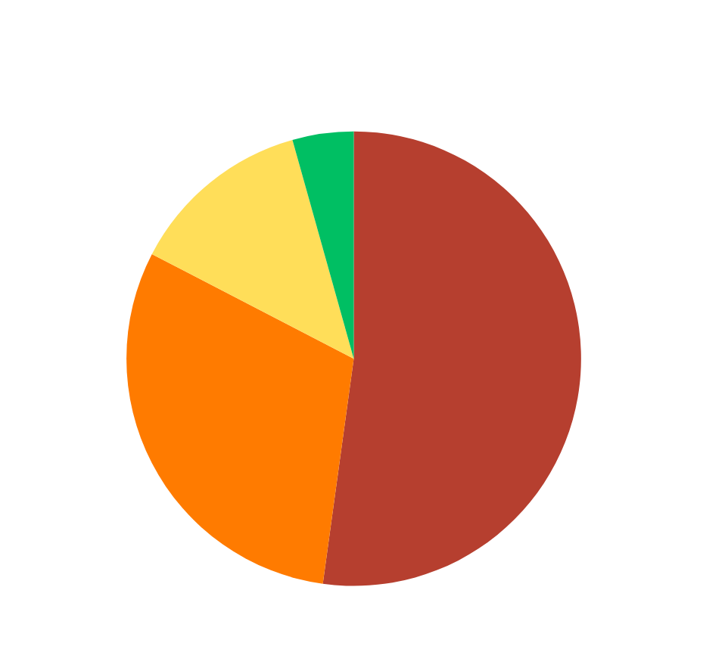
SUBSTANCE ABUSE
Q: On a scale of one to five, how severe of a problem do you perceive addiction/substance abuse disorder (ex. 1= not a problem, 5= a severe problem/crisis) to be in Roane County?
Data suggest that over half of respondents perceive Roane County as having a severe/crisis-level issue with addiction/substance abuse disorder.
Around 96% percent of respondents indicated this issue to be a point of concern for Roane County/

Slide 10
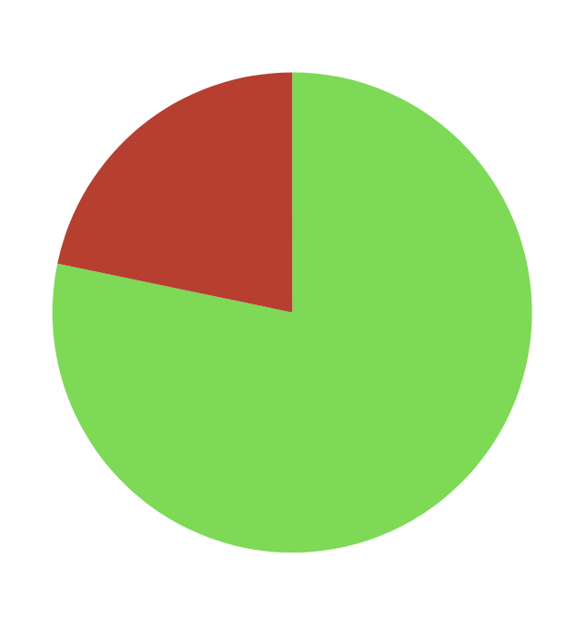
SUBSTANCE ABUSE
Q: Are you currently aware of programs/supports within our community designed to assist those experiencing addiction/substance abuse disorder?
Data suggests that over one third of respondents were aware of programs currently in place to assist those experiencing addiction/substance abuse disorder.
This data is meant to measure awareness, not efficacy, of pre-existing programs.

Slide 11
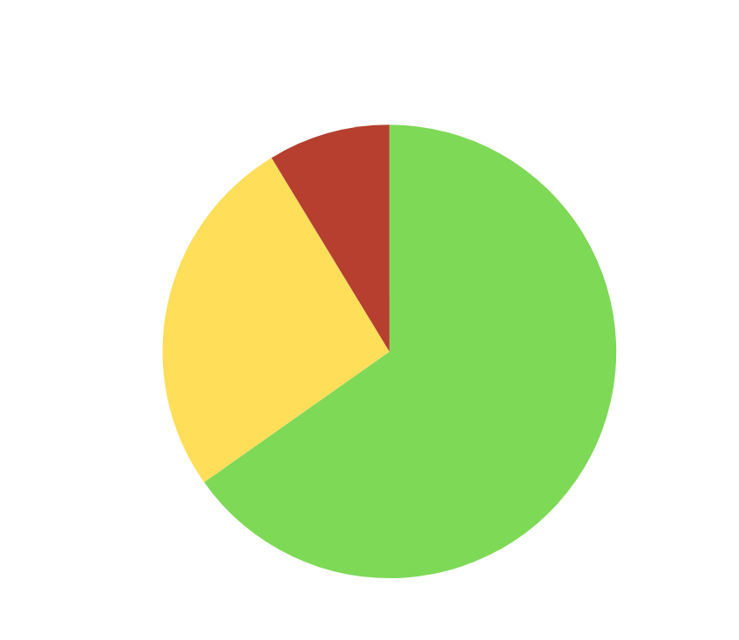
SUBSTANCE ABUSE
Q: If necessary, would you know how to access programs/supports within our community designed to assist those experiencing addiction/ substance abuse disorder in working toward recovery?
Data once again suggests there may be some discrepancy between being aware of existing programs and how to access them/ make referrals.
Bridging the gap between awareness and access may service providers in addressing this area of concern.

Slide 12
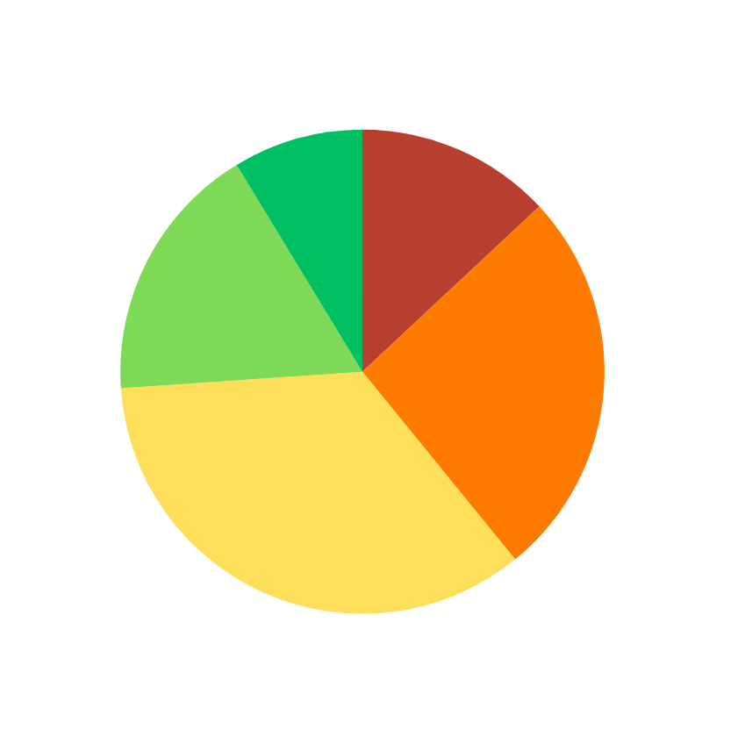
MENTAL HEALTH
Q: On a scale of one to five, how adequate do you perceive mental health support access (ex. 1= not a problem, 5= a severe problem/crisis) to be in Roane County?
Data suggests that most repondents perceive the ability to access mental health services in Roane County favorably.
This data is concerned solely with ease of access and not efficacy of the programs themselves.

Slide 13
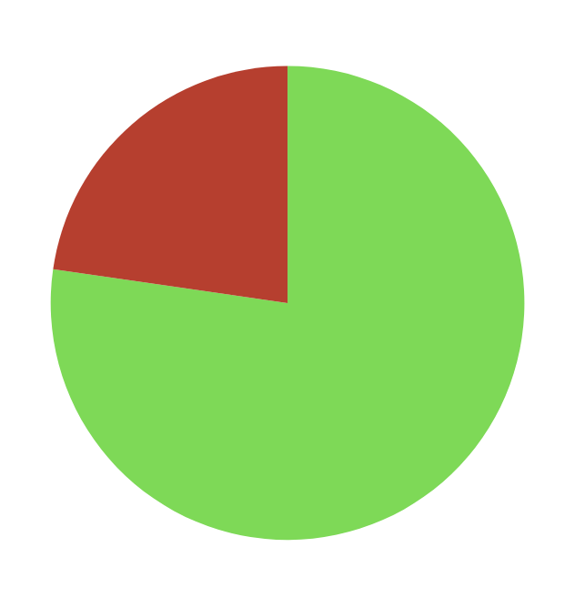
MENTAL HEALTH
Q: Are you currently aware of programs/supports within our community designed to assist those experiencing negative mental health symptoms/crisis?
Data once again suggests that most respondents are aware of existing mental health services.
This information is encouraging, as it indicates there may be some shift in mentality concerning the stigma of discussing mental health.

Slide 14
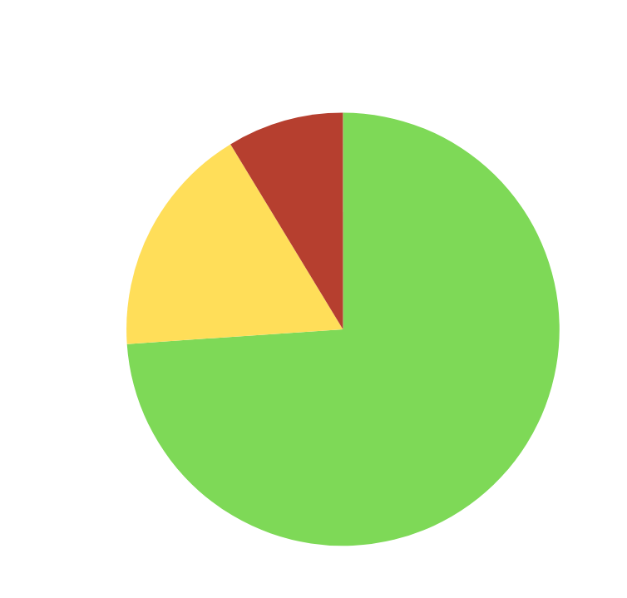
MENTAL HEALTH
Q: If necessary, would you know how to access programs/supports within our community designed to assist those experiencing negative mental health symptoms/crisis?
Data suggests that awareness of and confidence in accessing mental health services are pretty closely aligned.
This may be indicative of positive communication concerning mental health and visibility of mental health agencies in Roane County.

Slide 15
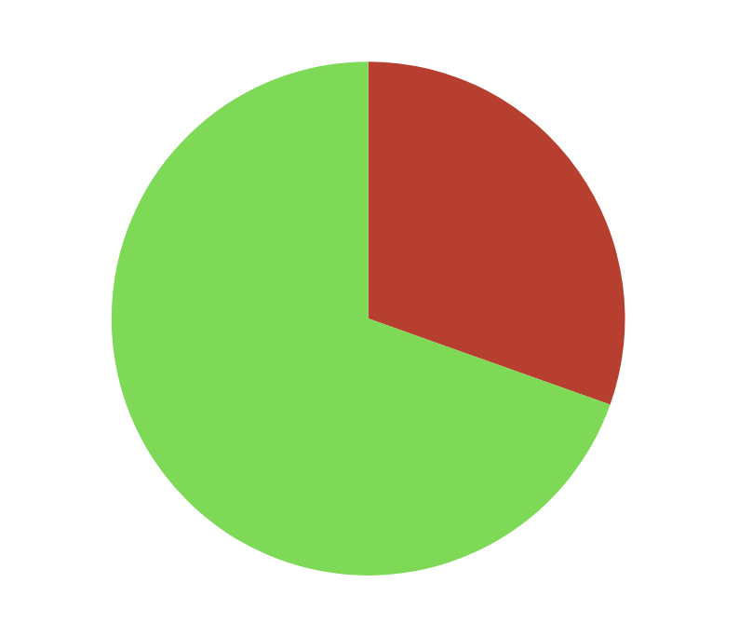
PARENTING
Q: Are you currently aware of programs/supports within our community designed to support parents, foster parents, expecting parents, or families?
Data suggests that while a majority of respondents are aware of parenting supports for family, there is still a statistically significant population who is not in Roane County.
This may indicate an underserved population emerging.

Slide 16
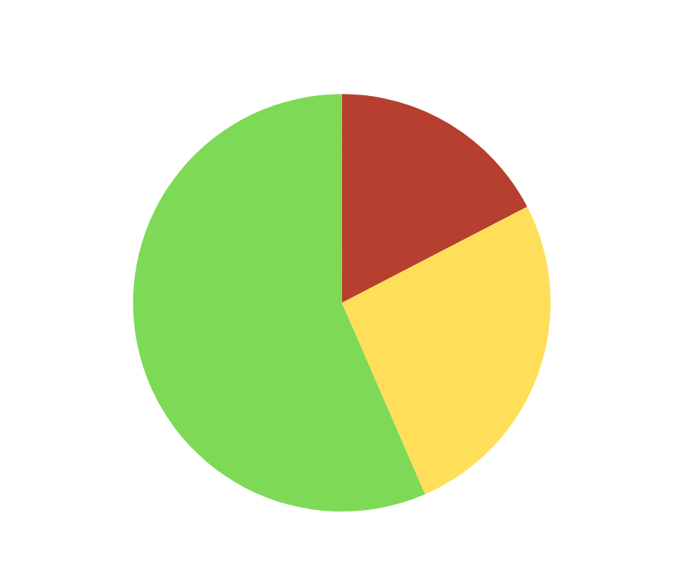
PARENTING
Q: If necessary, would you know how to access programs/supports within our community designed to support parents, foster parents, expecting parents, or families?
Data suggests a significant difference in awareness of supports versus confidence in ability to access them.
This may suggest more information concerning program access may aid in addressing this service gap.

Slide 17
EDUCATION
Q: Are there any trainings, classes, or programs you would like Roane FRN to consider bringing to Roane County? (ex. parenting, anger management, life skills, etc.)
  Life Skills
  School Technology Support
  Grandparent Support
  Programs for Single Mothers
  Healthy Cooking
  CPR/ Child CPR
  First Aid
  Food Handlers
  Resume Writing
  Computer Skills Refresher
  Parenting Skills
  Anger Management Skills
  Tax Support
  Self-Defense Classes
  Healthy Cooking Classes
  Sewing, Mending, Hemming
  Mental Health Classes/Supports
  Budgeting/ Budget Shopping

Slide 18
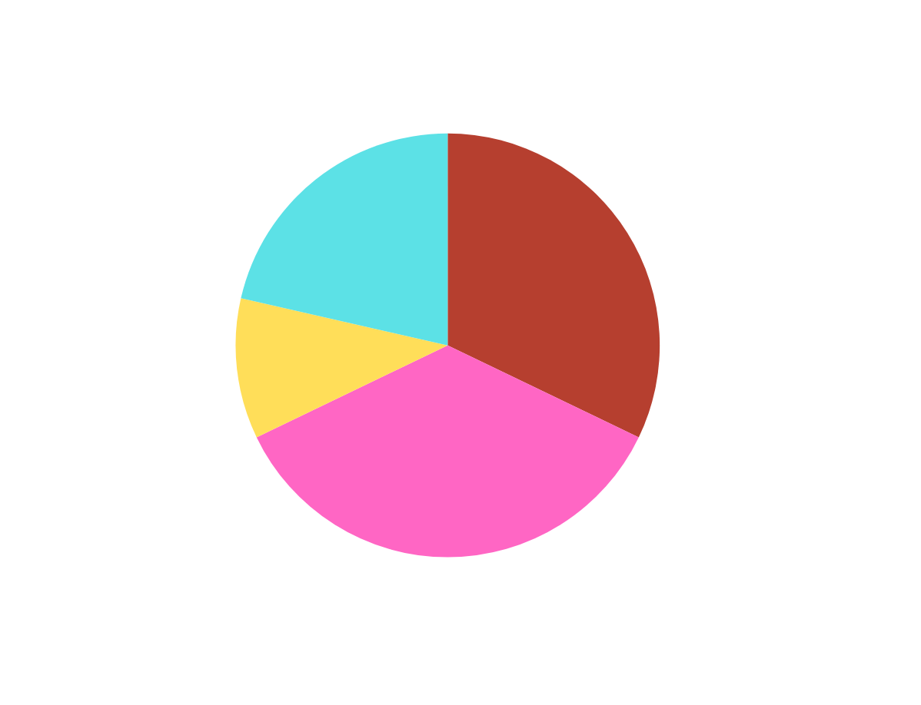
EDUCATION
Q: What is your preferred method to receive information, data, and training from Roane FRN?
(Check all that apply)
This data is already being implemented to increase efficiency of FRN communication with Roane County citizens.

Slide 19
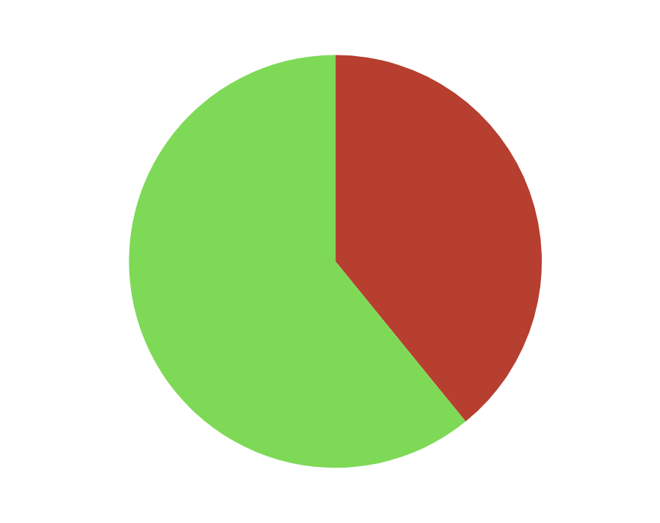
CULTURE
Q: CULTURE: Do you perceive Roane County as being a supportive and inclusive community for all citizens?
Data suggests that over half of respondents perceive Roane County as being inclusive. This data also suggests some work may be necessary in creating a welcoming, inclusive, and supportive community for all citizens.

Slide 20
CULTURE
Q: CULTURE: Are there any programs, initiatives, or projects you would like Roane FRN to consider implementing to improve county culture in the coming year?
  Highlighting accomplishments of marginalized groups in community
  Emphasis on support for homeless population
  Create volunteerism opportunities for community/teens
  Single parent support group
  Community Bonding Activities
  Grief Support Groups
  More engagement for youth/teens
  Outreach in rural parts of county
  Celebration of Appalachian culture
  Inclusivity trainings
  More opportunity to interact positively with LEOs
  Multi-Cultural celebrations
  Family Nights

Slide 21



KEY TAKE-AWAYS
Of sample surveyed, most are aware of community supports, but are not always confident in their knowledge of HOW these supports can be accessed.
Of sample surveyed, many perceive the common service gaps identified as being severe or crisis-level issues. Of the issues, it can be assumed mental health is the topic most citizens feel confident in our ability to address within the county.
Based on participant feedback, Roane County citizens are notice a lack of inclusivity and are favorable to increased support groups for marginalized communities and celebration of our individual and collective cultures.
Many respondents indicated interest in increased recreational opportunities and learning life skills that make day-to-day life easier and more affordable.

Slide 22

QUESTIONS?

Slide 23
THANK YOU TO ALL PARTICIPANTS!

