Slide 1

Welcome to our
February FRN Meeting
February 25, 2025
Roane FSC 12:00

Slide 2


Review of Minutes
*Those viewing this presentation
on their personal device can expand
minutes and virtually flip pages using
icons located at the bottom of the
page.

Slide 3


Review of Financial Report
*Those viewing this presentation
on their personal device can scroll
document here.

Slide 4

DoHS Updates/News
  Roane FRN has submitted Q2 reporting forms and is still awaiting feedback from DoHS.
  DoHS emailed in February to inform FRNs that our reporting forms will change in Q3 and Q4. The primary changes indicated were the elimination of collaboration requirements with state agencies that no longer exist following change in administration, primarily the Governor’s Interagency Task Force and GIS mapping. This should streamline our reports. Additionally, there is now a Google Form option for reporting numbers of families worked with that will make data tracking more efficient.
  Roane FRN attended FY 25-26 grantee planning and informational session. We were able to get a better sense of how reporting will look in the coming fiscal year and how DoHS plans to work collaboratively with FRNs to ensure accountable use of funds and encourage programmatic growth.
  We were notified that the annual FRN summer conference will not continue this year. DoHS is experiencing change in administration and staffing that do not make this event feasible this year.

Slide 5
FRN Active Grant Projects

Slide 6

Monetary Support for Backpack Program
Funding Source: Parkersburg Area Community Foundation
Grant Cycle: Fall 2024
Grant Award Amount: $10,000
Collaborating Partnerships: The Backpack Program, Spencer MMC
Point of Contact: Phillip McNemar
Purpose: To provide continued support of Backpack Program to supplement meals for Roane County youth in need and expand services to fixed-income seniors.
February Update:
Through our collaboration with Operation Warm, Roane FRN and The Backpack Program were able to use PACF funds to purchase 120 coats of various sizes to distribute to Roane County students in need. As registered Operation Warm partners, we able to secure $2,640 worth of coats for only $360! See next slide for image of our shipment arriving.

Slide 7
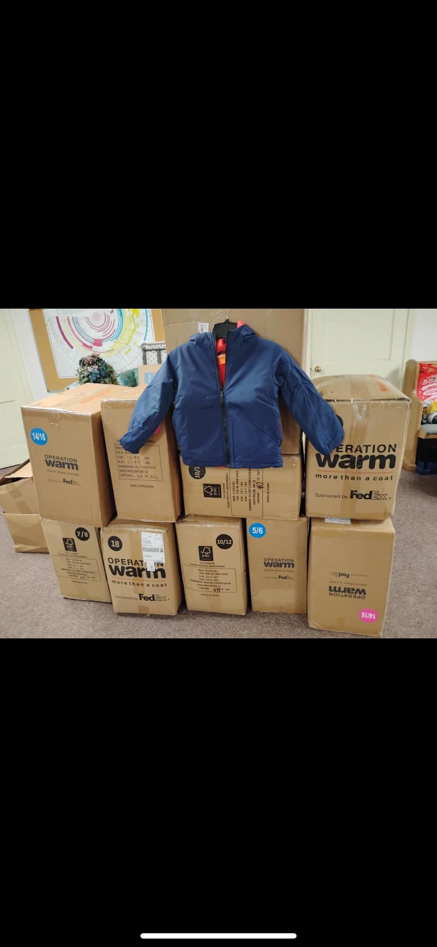

Slide 8

Community Baby Shower
Funding Source: TeamWV Partners in Prevention
Grant Cycle: FY 2024-2025
Grant Award Amount: $7,500 (two installments)
Collaborating Partnerships: TeamWV Partners in Prevention
Point of Contact: Jessica Dianellos
Purpose: To re-establish a Roane County Community Baby Shower that provides education, support, and resources to new and expecting families in our region.
February Update:
Registration for both participants and vendors is open. We currently have 16 participants registered. Heritage Park is booked for April 26, 2025. Planning Committee met virtually on 2/12.
Roane General is sending catering menus and sample brunch options. Amazon list has been made for those wishing to sponsor items for gift bags and giveaways. Will meet again in March.

Slide 9



Slide 10

Geary Elementary/Middle
Resource Closet
Funding Source: Hope Gas Foundation
Grant Cycle: Fall 2024 Donation
Grant Award Amount: $5,000
Collaborating Partnerships: Hope Gas Foundation, Geary Elementary Middle School, Communities in Schools
Point of Contact: Erin O’Donnell (Hope Gas), Lorra Tanner (GEMS), Frederick Hammack (GEMS Communities in Schools)
Purpose: To establish a student resource closet with clothing, toiletries, personal hygiene items, and non-perishable food items for GEMS students in need.
February Update:
Payment for this project was received the first week of February. GEMS is clearing their closet space and has ordered shelving. Grade levels are submitting items their students need most to CIS. Purchasing and intallation will be completed in early March.

Slide 11
FRN Pending Grant Projects
*Pending projects are those that have funding applications submitted, but have not had funding announced yet.

Slide 12

Family Connection Toolkits
Funding Source: Partners in Prevention Good Beginnings Mini Grant
Grant Cycle: Spring 2025
Grant Award Amount: $2,500
Collaborating Partnerships: TeamWV Partners in Prevention
Point of Contact: Jessica Dianellos
Purpose: To provide Roane County families education, resources, and tools to foster an increase sense of family connectedness and reinforce protective factors against child abuse and neglect.
February Update:
Due to the limited funds available and competitive nature of grant cycle, our project was not selected to be funded. Other funding avenues will be pursued.

Slide 13
Back to School Bash Backpacks
Funding Source: Sister’s Health Foundation
Grant Cycle: Spring 2025
Grant Award Amount: TBD
Collaborating Partnerships: Roane County Prevention Coalition
Point of Contact: TBD
Purpose: To provide Roane County students and families quality backpacks filled with school supplies, local resource information, and other resources necessary to a successful academic year.
February Update:
Due to the limited funds available and competitive nature of grant cycle, our project was not selected to be funded. Other funding avenues will be pursued. If other avenues are not secured, Partners in Prevention funding can be utilized.

Slide 14
Trainings/Information Sharing

Slide 15


In February, FRN made focused information sharing on two targeted topics:
  Inter-partner Violence/ Healthy vs. Unhealthy Relationships (in correlation with Valentine’s Day)
  Disaster Preparedness/Inclement Weather Prep (in response to weather-related emergencies in region)
Examples of Social Media Posts on Next Slide

Slide 16



Slide 17
FSC Updates

Slide 18


Next Meeting:
March 18, 2025
12:00 p.m.
Roane FSC and Zoom

