Slide 1
Young People's Perspectives on the Social Media Age Delay
September, 2026

Slide 2

Acknowledgement of Country
We pay our respects to Elders past and living, and acknowledge their continuing connection to Country, community and culture.
We acknowledge that this Country has always been, and continues to be, a place of learning, relationship, ceremony, care and belonging. We recognise the deep knowledge systems and enduring cultural practices that have sustained First Nations peoples for over 3,000 generations, and we honour the wisdom held in Country, kinship, story, community and the responsibility to care for one another.

Slide 3
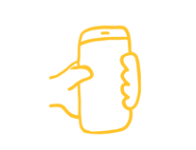
Australia's Social Media Age Delay
Introduced by the Australian Government.
Regulated by the eSafety Commissioner.
Applies to people under 16.
Places responsibility on social media platforms.
Intended to reduce exposure to online harms and provide more time for young people to develop digital literacy, resilience and maturity.

Slide 4
Where did we hear from young people?
Youth-led focus groups:
56 secondary school students (Y7-Y10)
7 Victorian schools
Metropolitan and regional communities
Government, independent and alternative settings
Discussions took place through a youth advocacy program

Slide 5
Theme 1: "Young people can and do circumvent age gates"
“we need to be a certain age, but it doesn’t stop us"
"Kids will find a way to get around it anyway"
"Alternative accounts are for people to forge being an older person so they don’t get banned"

Slide 6
Theme 2: "People doing harmful things on the internet will still do harmful things on the internet"
"Cyber bullying and harmful content... they should just prevent it from happening on the platforms”
“Roblox isn't banned, thank God, but it has so much cyberbullying… people highly dox and hack… people blocking you from your own account and taking your information and sharing it in chats”
“On a lot of platforms people ask for really personal information so it takes away your right to privacy and data protection.”

Slide 7
Theme 3: Unequal and harmful social consequences
"[Social media] supports with friends and school work”
"[Social media] serves as a lifeline"
“With the social media delay, how will people be able to connect if they are regional or remote?"
“Doesn't the social media ban take away the right to access and connectivity and to participation and expression?”

Slide 8
Theme 4: “I think it can be positive and negative. [If you] don’t have the option you can find something else, like playing a sport or reading”
“The rate of people playing sports might go up”.
“More activities when they implement the ban. They need to provide us with activities to replace it"

Slide 9
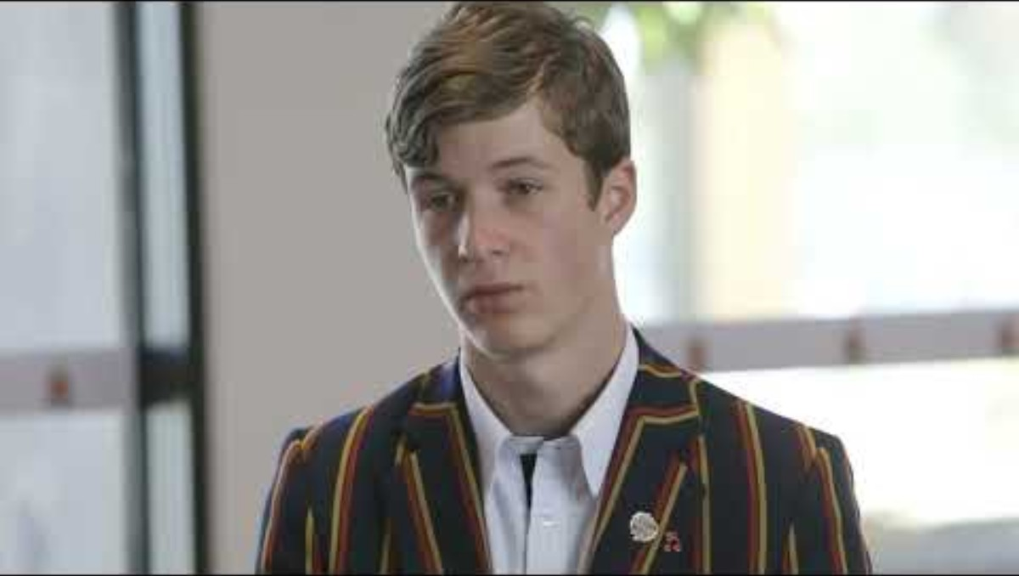
Notes:
Video to be embedded: https://youtu.be/DfH0B0ZFqhw

Slide 10
Now what?
Age delay implemented in December 2025
4.7 million under-16 accounts removed (eSafety)
Ongoing engagement with young people
Currently co-designing a podcast with metropolitan and rural schools exploring young people's experiences after implementation

Slide 11
What happened following the delay?
“My accounts didn't get banned so not much changed for me"
"Before the ban everyone was worried - talking about whats going to happen. Then after, asking 'whats going to happen now it didn't work' and relief and anticipation"
"My whole life I use social media, other than going to school that's how I communicate. After the ban nothing changed - our accounts have fake ages, so I can still chat to friends + other ways to chat like text etc"

Slide 12
What happened following the delay?
"Other people's accounts [got delayed] - it was nearly summer holidays so I only spoke to them for a short period of time before people lost their accounts"
"We finished school on the day of the social media ban, people had to wait months to reconnect with their friends"
"People that live further away, when they lost SM, they live an hour away from school and only connect with people at school, so they had to wait."
"Most teens were able to bypass the ban by lying about their age (using their parents license or straight up lying about it)"

Slide 13
"[The Social Media Delay was] ineffective in protecting teen from the dangers of social media"
"Social media is often used in a way that harms people, its a tool that is sometimes used for bad purposes. Doesn't mean social media itself is not good for teens"
"Adults think banning us from social media will fix our problems but this isn't the reality. the problem isn't that we're on it, it's the people using it for bad choice - the system needs to find the bad actors and ban them, not everyone who is just trying to use to connect with others"

Slide 14
Young people's asks for decision makers
“Policymakers - involve teens - Young people should have a meaningful role in shaping policies that directly affect them"
"Gov. & Ministers - create opportunities- invest in spaces for youth (both metro and rural) where teens can build real connections (maybe reform/amend the legislation)"
"Support through change: if the social media landscape changes, teens need guidance and support rather than simply being left to adapt alone"

Slide 15
“Money should be expended on making it [social media]
a safer space”

Slide 16
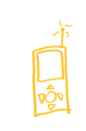
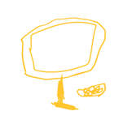


Q & A

