Slide 1
Input without influence: Multistakeholder legitimacy and corporate power in global
AI governance
Wendy Lam,
auDA Internet Governance Fellow

Slide 2
Research aim
This research asks whether a multistakeholder model can balance corporate influence against state sovereignty and the public interest in AI governance. It argues that Big Tech’s influence has created structural barriers to the model’s legitimacy, but that multistakeholderism can still offer a pathway of equal footing through deliberate design for inclusion.

Slide 3
The multistakeholder premise
Governments
Industry
Civil society
Technical community

Slide 4
Why AI intensifies this problem
Institutional fragmentation
Geopolitical concentration
No shared
North Star

Slide 5
AI needs robust governance yet we cannot agree on what that is meant to achieve: “we are left asking whether AI is primarily an engine of economic growth, a tool for scientific discovery, a weapon for strategic dominance, or a commercial platform.”
Konstantinos Komaitis, ‘The Internet Had a North Star. The UN’s Global Dialogue Made Clear AI Doesn’t’, Tech Policy Press (July 2026)

Slide 6
Big Tech’s playbook
Firms position themselves as indispensable providers of essential services, making regulation look too costly for states constrained by their own market interests. Big Tech further exercises normative influence by presenting themselves as neutral intermediaries and responsible experts, empowering them to shape reform agendas to their desires..

Slide 7
Assessing legitimacy
Input
=
Participation
Throughput
=
Deliberation
Output
=
Implementation

Slide 8
The path forward
Governance mechanisms should build on existing structures, adopt an inclusive approach, and avoid process proliferation.
Australia has a critical opportunity to advocate for structural reform by collaborating with other middle powers and prioritising responsible AI development

Slide 9
Recommendations
Advocating for power-balancing and accountability as a design feature of AI governance bodies
Funding independent technical and evaluation capacity
Resourcing underrepresented stakeholders
Applying the São Paulo Multistakeholder Guidelines as a benchmark for accessible, transparent and accountable policy processes
Advocating for the PNAI to be institutionalised as a permanent track within the IGF, including piloting the proposed Regional Leads Model for the Indo-Pacific
Strengthening coordination and capacity among existing institutions
Pursuing regional convergence rather than global consensus upfront

Slide 10
Thank you!
E.: wendy.lam01@outlook.com
LI: https://www.linkedin.com/in/wendynlam/

Slide 11
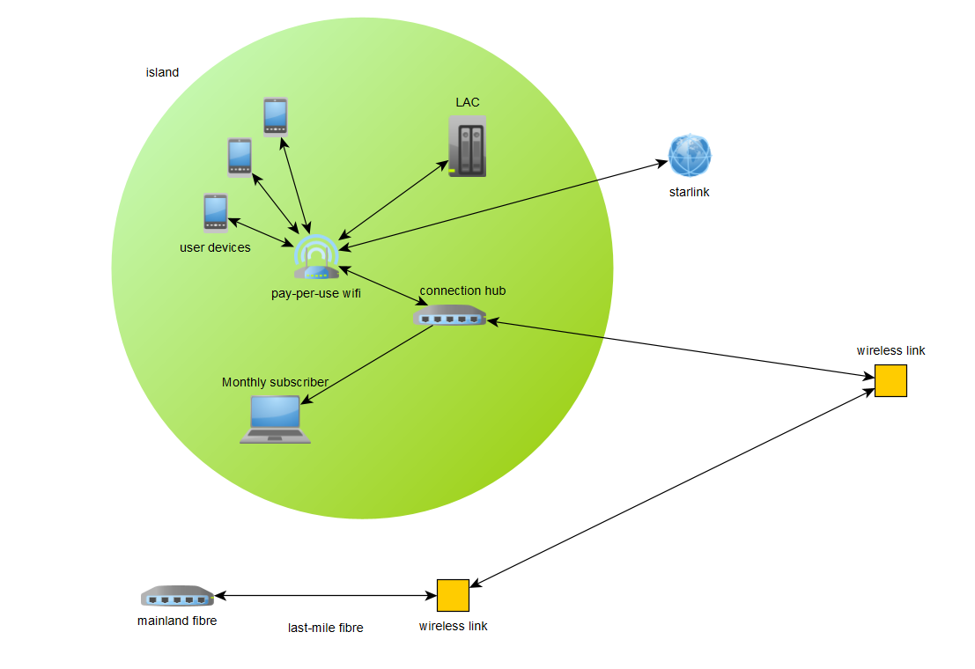
Notes:
This is called an acyclic graph because your next move is never to yourself. The position of a packet can change, but if it stays still that would not be a network. You would be talking to yourself. It is DIRECTED

Slide 12


1
1
2000
1
6
1
3
2
1
1
2
Notes:
You can assign numbers to show how many connections each node has, and this helps us know which links are most vulnerable, e.g. what if a boat blocks this link or a typhoon takes out the wireless link

