Slide 1
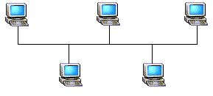
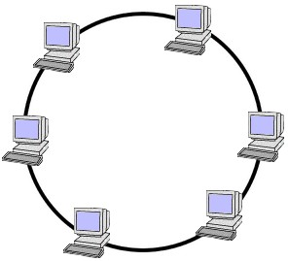
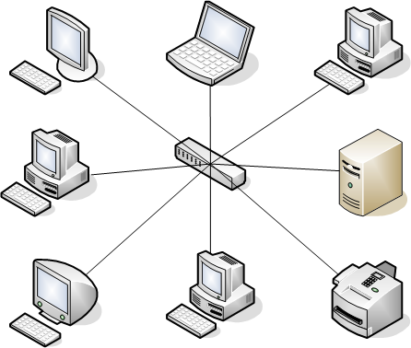
NETWORKS : COMPUTING REVISION
What is a Computer Network :
“Two or more computers that are connected in some way (Cabled or Wireless) in order to communicate and share resources, usually a Local Area Network [LAN] or a Wide Area Network [WAN]”
Examples, School Network = LAN The Internet = WAN
A home network = LAN The Banking System = WAN
The Bus Topology
Inexpensive and easy to add new computers
Has to be kept small because of Data Collisions
If main cable breaks the whole network is down
The Ring Topology
Data only travels in one direction so no data collisions
It Can be very large
If 1 computer is down the whole network is down
If cable breaks the whole network is down
Faults can be difficult to find
The Star Topology
It Can be very large
If 1 computer is down the network is unaffected
Extra Cabling makes it e3xpensive
Very Efficient and robust
The choice for many offices and schools

Slide 2
Threats to a Network
Internal Threats
External Threats
Power Failure
Hardware Failure
USB drives
laptops and netbooks
wireless access points
miscellaneous USB devices (digital cameras, MP3 players, etc.)
employees borrowing others’ machines or devices
lack of employee alertness
smartphones
e-mail
The Trojan Human (People who visit buildings disguised as employee personnel or contractors)
Malware : (Viruses, Trojans,Worms,Keyloggers,Spyware)
Unauthorised access to the network (Hackers or Identity theft)

