Slide 1
THE COMPUTER OPERATING SYSTEM
How important is It ?
What does it actually do ?

Slide 2
Learning Objectives
Learn about the different operating systems
Understand the importance of the operating system
Investigate the range of tasks performed by the operating system

Slide 3
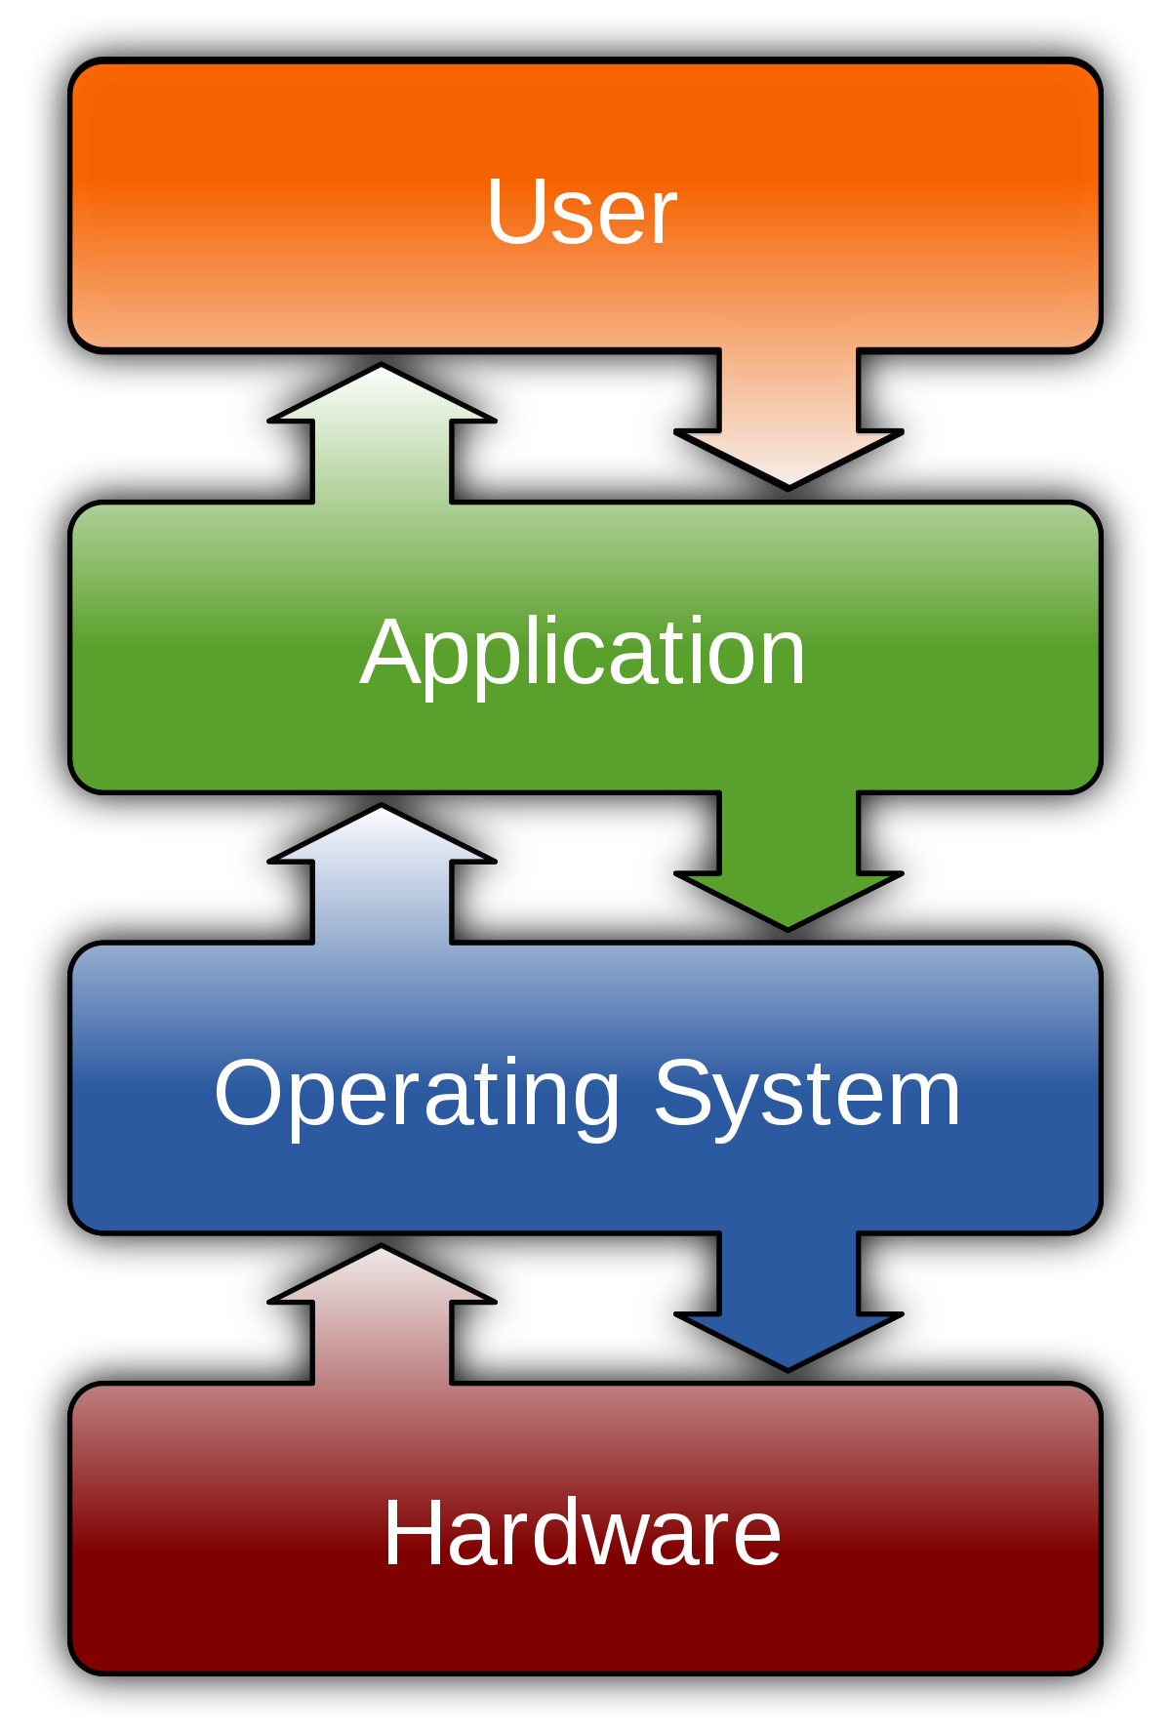
THE COMPUTER OPERATING SYSTEM

Slide 4
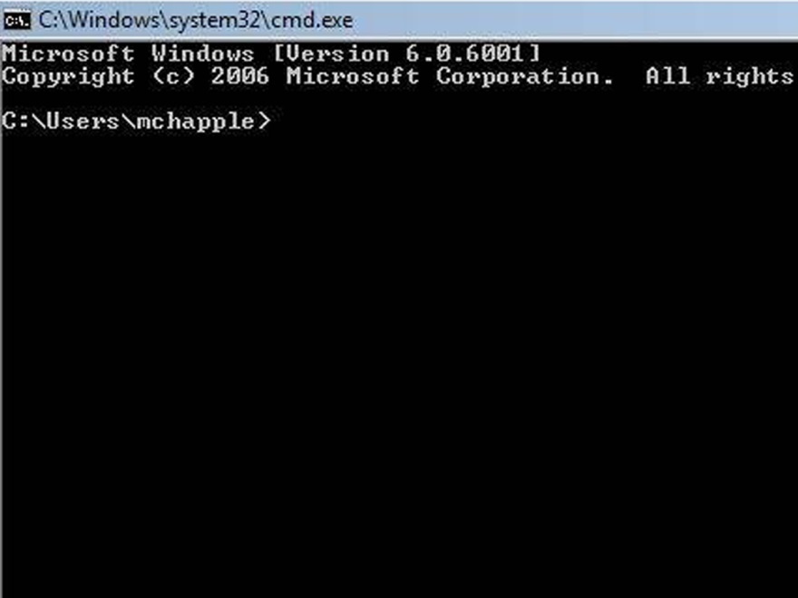
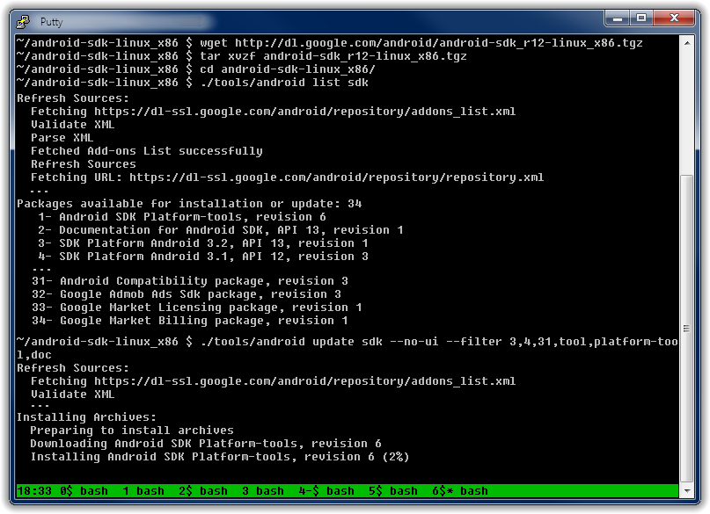
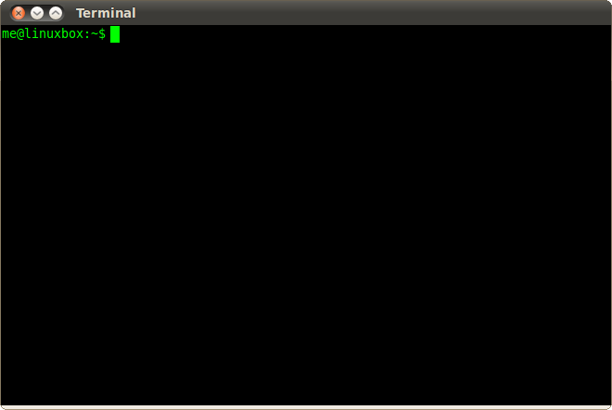
THE COMMAND LINE
INTERFACE [ CLI ]

Slide 5
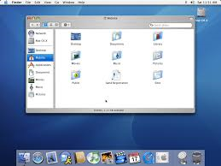
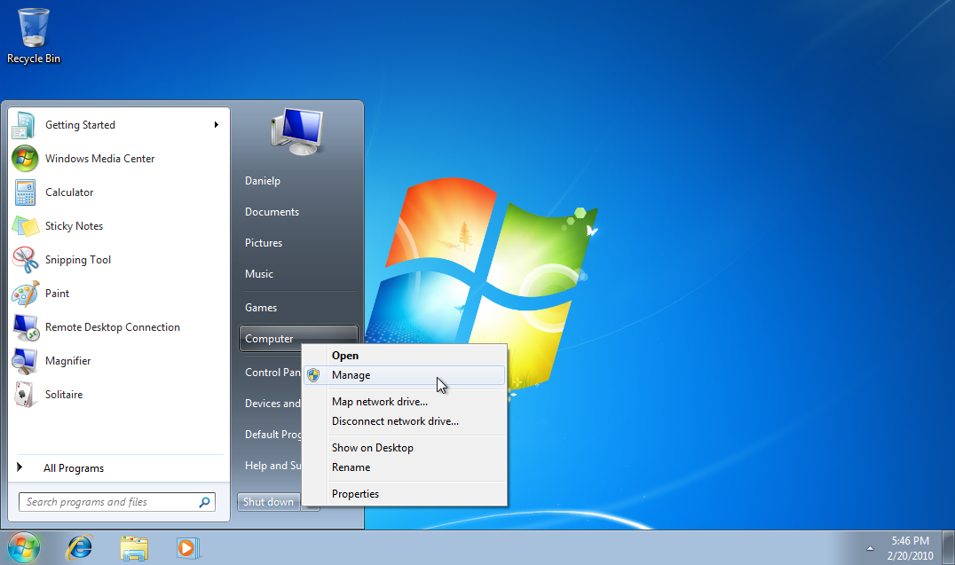
The Graphical User Interface [GUI]
Always Think WIMP : Windows, Icons, Menus, Pointer !

Slide 6
THE COMPUTER OPERATING SYSTEM
Explain one reason why multi-tasking is needed in an operating system
State three other functions of an operating system
1)
2)
3)

