Slide 1
What Do These Communities Have in Common ?
The Sami People
The Hadza
The Khalkha
The Imazighen
The Nenets
The Tlingit

Slide 2
Conclusions
What can we say with some confidence about access to Digital Services for the communites that you have looked at ?
How Can we talk about The World Wide Web
Where are the gaps in our own modern affluent community ?
What are are our Ethical Challenges as we go forward ?

Slide 3
Lesson objectives
Understand how the digital divide creates a gap in access to Digital Services
Understand How The Digital Divide affects Communities?
Review how it affects Education, Money, Social structures and culture

Slide 4
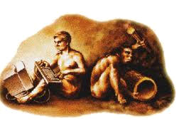
How can it affect us?
When you think about the it most people think it looks like this

Slide 5
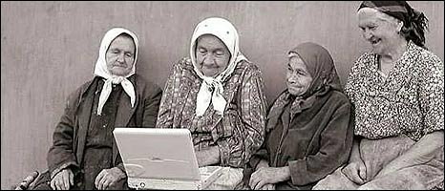
How can it affect us?
Or this

Slide 6
That is not the case
There are many factors for the big gap between those with technology and those without..
Lets review the following link – digital divide

Slide 7
Money
Some people simply can not afford to keep up with technology
As technology changes it can get more expensive to keep up
In some countries a price of expensive computer is a whole years wage!!
Think about if you didn’t have that?

Slide 8
School
Using technology in school allows students to work, learn in different ways
Using the internet to search for information has made it a lot easier
Computer networks allows us to use computers and save our information to our own area?
Virtual learning environments – what does that allow us to do?
Think about if you didn’t have that?

Slide 9
Work
Technology to communicate with people, at work or across the globe – how can this be achieved?
Using software to store information, make websites, create graphs
Use of the internet to speak to people, share information or collaborate on projects
Work from Home

Slide 10
Social Change
Staying in touch with friends is so much easier with technology – how?
Home Entertainment changes? How?
The types of activities you do with your mates that might involve using technology
Think about if you didn’t have that?

Slide 11
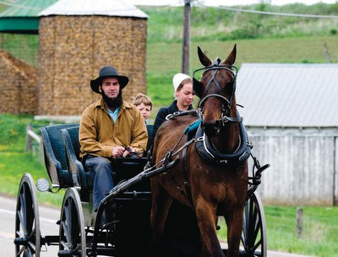
Culture
Some cultures chose to lead the technology race
Can you think of some?
Other cultures prefer not too, some tribes in India live as they would do 3000 years ago
The Amish community do not use technology

Slide 12
Exam question
What is the digital divide and how can it affect people? (8 Marks)
How would you answer?
Mark | Detail
1-2 marks | Simple discussion on what it is and how it effects people generally
3-5 marks | Good written discussion covering work, culture and social aspects
5-8 marks | Well writtten discussion covering all aspects of work, culture, school and social Correct punctuation and language is used

Slide 13
Or complete a presentation
You will be creating a presentation highlighting the following points
What is the digital divide?
You need to discuss how it effects people at:
Work
School
Socially
Write down what happens if you don’t have that?
You should aim your presentation for year 9 students

Slide 14
Content? Are all points covered?
Culture
Socially
Work
School

