Slide 1
PINELLAS WATCHDOGS
“Taking back our Party one county at a time”.

Slide 2
The Florida America First
Playbook Snapshot of Playbook follows…
As the first Florida Watchdogs leading the way, Pinellas Watchdogs adheres to principles based on …

Slide 3
What is America First?

Slide 4
America First Republicans’ issues and policies include:
Protect gun rights and the right to defend yourself
Protect Property Rights
Limit government
Lower Taxes
Protecting our Children; from the Leftist “wokeism”
Protect American Citizens through legal immigration
Support Strong Border protection
Support Legal Immigration
MADE IN AMERICA - Support producing goods and materials Americans consume back to the U.S.
Self reliance on oil production

Slide 5
“America First” is centered on protecting American Citizens’ rights, property and freedom.

Slide 6
What are the principles of the Republican Party?

Slide 7
Principles of the Republican Party:
Protect gun rights—no red flag laws
Protect Property Rights
Limit government
Lower Taxes
Protect American Citizens through legal immigration
Support Strong Border protection
Produce what Americans consume
Bring manufacturing back to the US
Self reliance on oil production

Slide 8
Where did ”America First” come from?
The Republican Party Hierarchy: Understanding the Organization
County: Republican Executive Committee (REC)
State: The Republican Party of Florida (RPOF)
National: Republican National Committee (RNC)

Slide 9
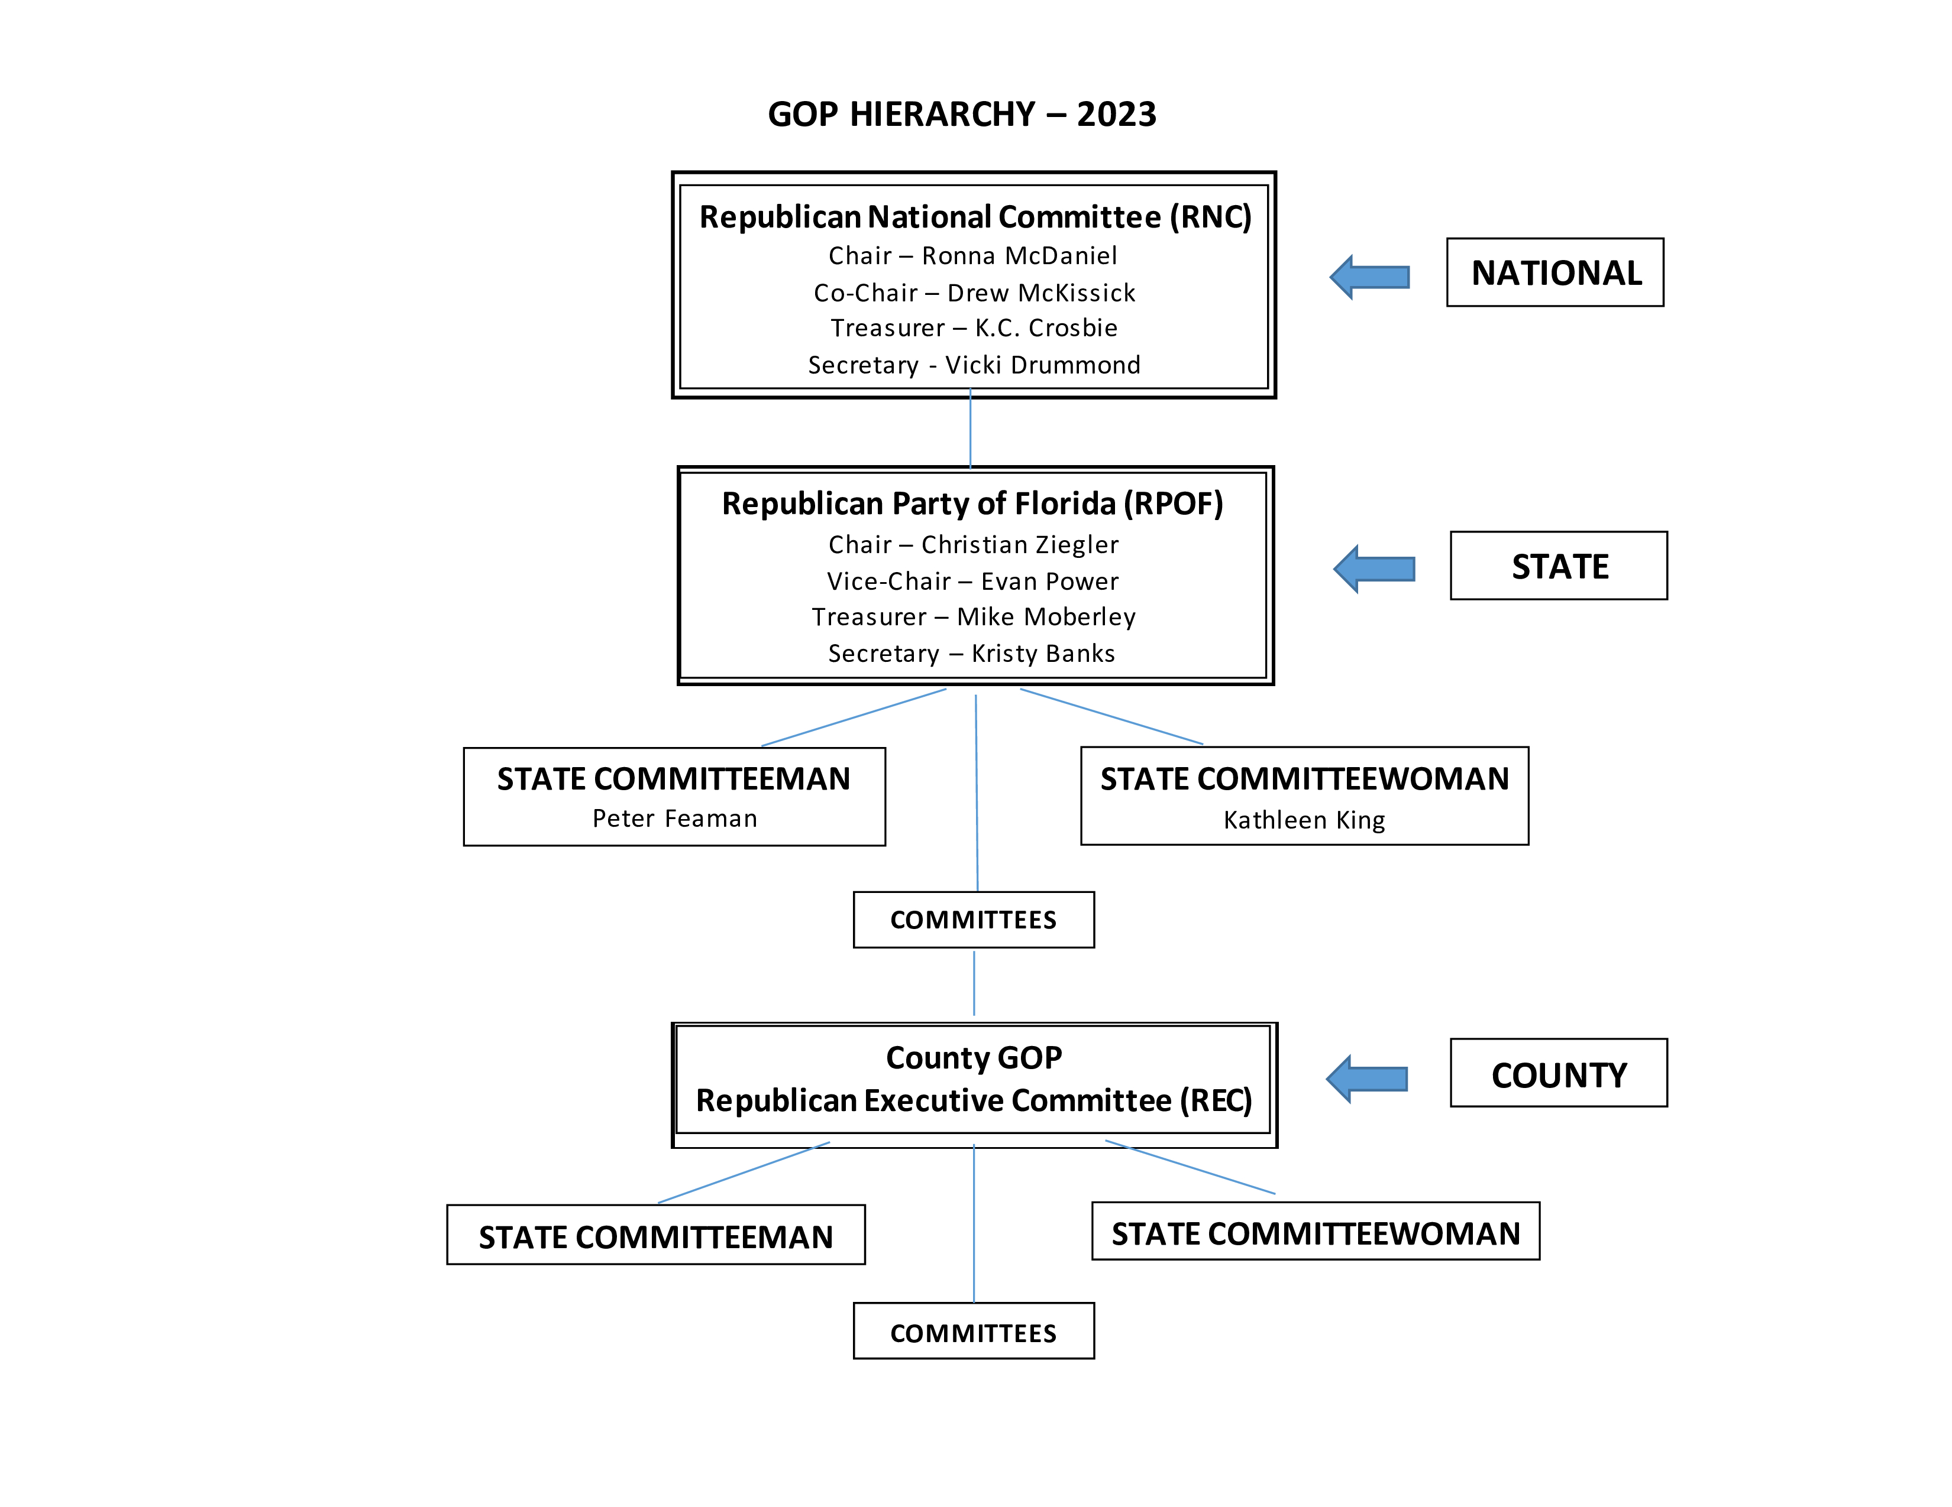

Slide 10
REC - Republican Executive Committee
Six meetings per year; designed to maintain contact with Republican voters via “Precincts.”
Precinct committee men and women are elected by the REC membership, their election is recorded and submitted to the Supervisor of Elections. It is a political office. You are assigned a precinct to manage.
The original intent of the REC was to engage the Republican voters in their precinct to vote. That engagement would be for both the Republican Primary which is always held in August and the General Election in November.

Slide 11
Florida RECs:
Where did it go so wrong?

Slide 12
In the marketplace of ideas, America First wins.
Against the Republican Establishment,
America First mostly loses..

Slide 13
The Florida Republican Establishment doesn’t want you talking about:
Trump
Election integrity
The border
Inflation

Slide 14
That’s why we must do it.

Slide 15
Gather your People: form a working group of likeminded America First Republican REC members

Slide 16
Start Training
Even if you think you are the smartest person in the room, you need training. It is far more complicated than you think.

Slide 17
Documents
Roberts Rules
RPOF Rules
Procedures
Model Constitution
Florida GOP Playbook

Slide 18
REC Political Treachery

Slide 19
Be aware of your own personal weaknesses. The Establishment will exploit you with these tactics.
The larger your impact, the more the Republican Establishment will try to co-opt you. It’s predictable.

Slide 20
Florida Watchdogs The solution to taking back our Party… …one county at a time.

Slide 21
Your County Could be Here
ORGANIZATIONAL CHART

Slide 22
PINELLAS WATCHDOGS
(Adheres to the Florida Watchdogs Mission Statement)
Mission Statement
Pinellas Watchdogs is a grassroots countywide organization designed to educate members on the rules and procedures of the local GOP as well as the Republican Party of Florida (RPOF).
Our mission is to empower members of the county Republican Executive Committee/Pinellas County GOP with the knowledge and tools needed to ensure adherence to the guidelines as set forth in the RPOF Constitution and all amendments passed by Pinellas County.
When the Pinellas County rules are not being enforced, the Pinellas Watchdogs will serve as an oversight committee to ensure that all State and County statutes are being followed as well as the Constitutions of both the RPOF and the Pinellas GOP.

Slide 23
Key Resources:
Robert’s Rules of Order
RPOF RULES AND PROCEDURES
RPOF County Model Constitution
Florida GOP Playbook
DECEMBER REC OFFICERS ELECTION

Slide 24
For help setting up your county
Watchdogs organization…
Email:
PinellasWatchdogs@protonmail.com

Slide 25
For information about Florida America First Coalition and to sign up for their training course, contact Mollie Ewing:
Molliefafc@gmail.com

