Slide 1
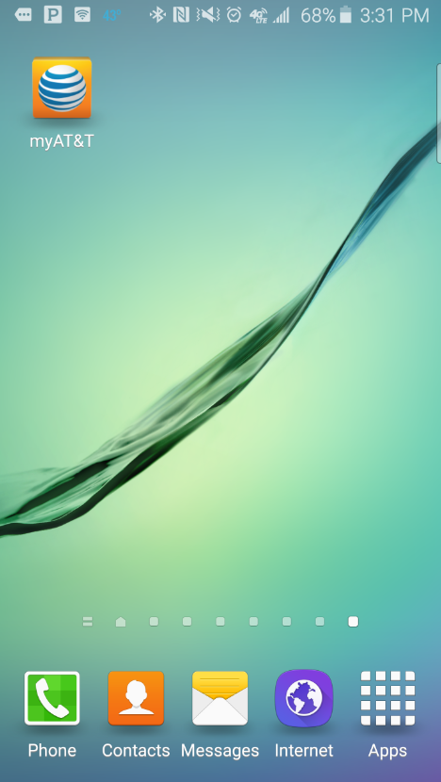
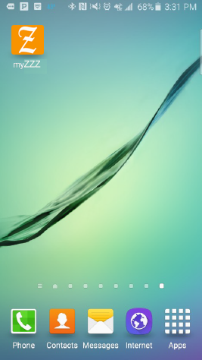
Editing a Scheduled Payment Arrangement
Tap the myZZZ app
IMPORTANT: This simulation contains audio.
Script:
Customers can use the myZZZ app to make payments, schedule payments, or select a new payment date. In this simulation, you’ll learn how to edit a scheduled payment arrangement.
In this example, you have a payment arrangement already set up for 2/8. You want to change the payment date to 2/6.
Note: If the customer chooses a date that is after their due date they may incur a late payment fee.
Start by tapping the myZZZ app.

Slide 2
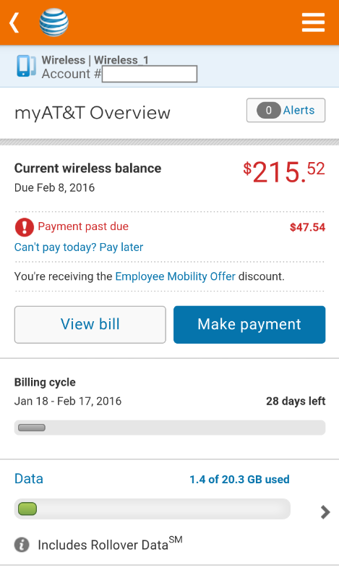
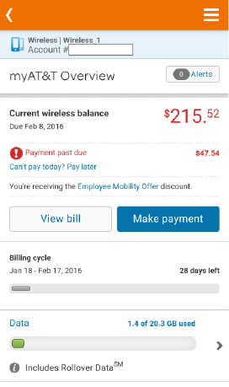
Editing a Scheduled Payment Arrangement
Tap anywhere to continue.
Script:
If you wanted to make an immediate payment, you would tap the Make payment button.
Tap anywhere to continue.

Slide 3
Editing a Scheduled Payment Arrangement
Tap Can’t pay today? Pay later.
Script:
You want to edit a scheduled payment date so tap Can’t pay today? Pay later.

Slide 4
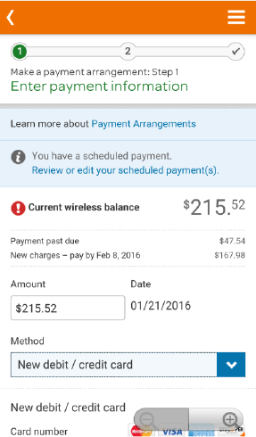
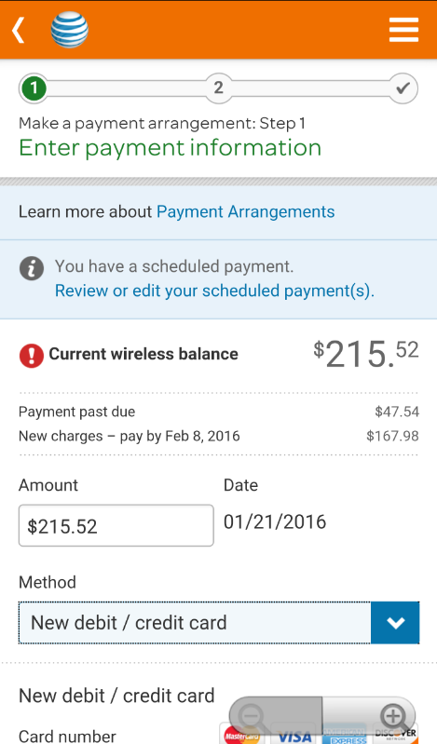
Editing a Scheduled Payment Arrangement
Tap Review or edit your scheduled payment(s).
Script:
Tap Review or edit your scheduled payment(s).

Slide 5
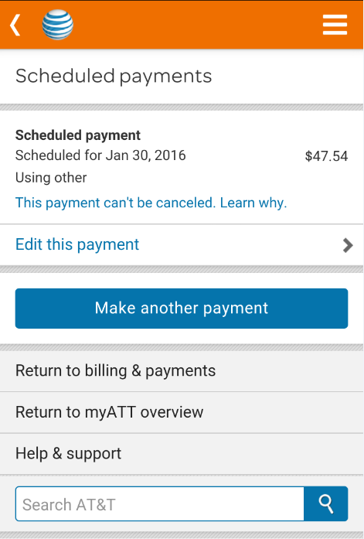
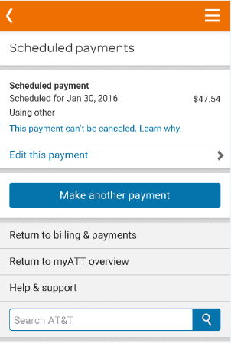
Editing a Scheduled Payment Arrangement
Tap, Edit this payment.
Script:
The Scheduled payments screen appears showing the details of your current payment schedule. You want to change the payment date. Tap Edit this payment.

Slide 6
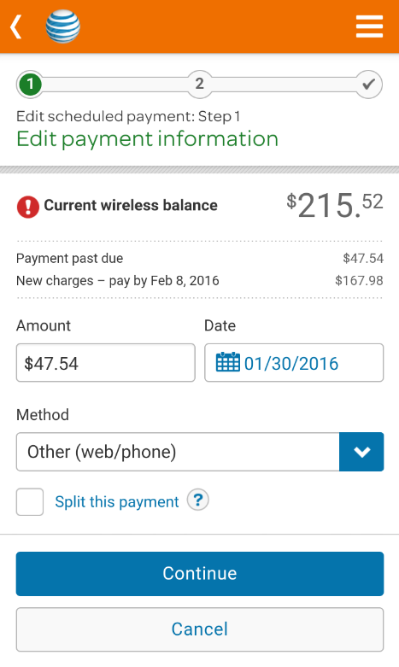
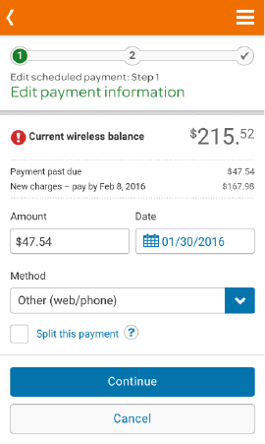
Editing a Scheduled Payment Arrangement
Tap the calendar icon.
Script:
The Edit payment information screen appears displaying the current payment arrangement information. You may edit these fields as necessary.
You want to change the date to 2/6. Tap the calendar icon to select a new payment arrangement date.

Slide 7
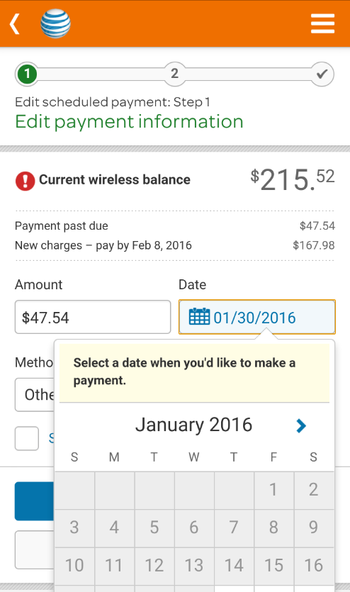
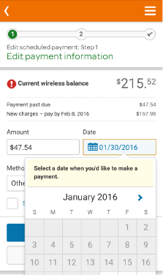
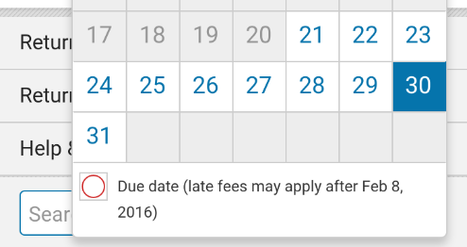
Editing a Scheduled Payment Arrangement
Tap the blue arrow to see the next month.
Script:
The calendar appears. Tap the blue arrow to see the next month.

Slide 8
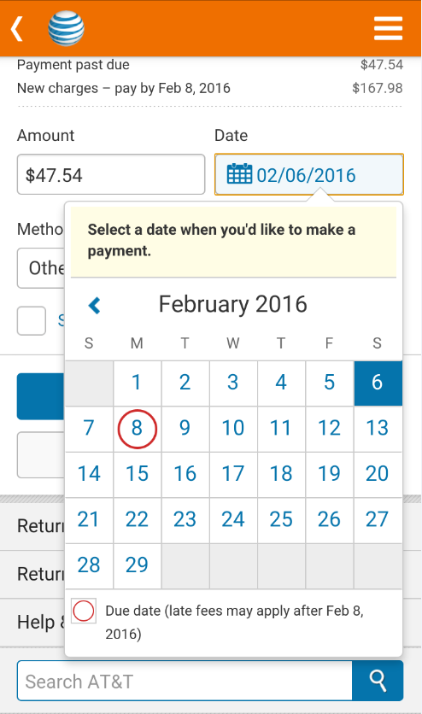
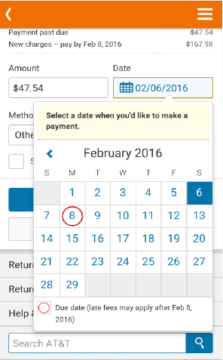
Editing a Scheduled Payment Arrangement
Tap the 6th of February.
Script:
Choose a date from the calendar. For this example, choose 2/6.
Note: If the customer chooses a date that is after the scheduled due date they may incur a late payment fee. If the date selected is too far in the future the customer will receive an error message explaining to pick another date.

Slide 9
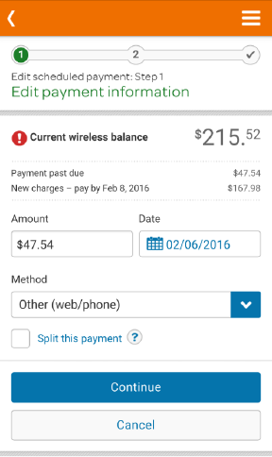

Editing a Scheduled Payment Arrangement
Tap Continue.
Script:
You can change how you will pay by tapping the drop down arrow to select the method of payment, which includes any saved payment profiles. You may select a payment that will automatically draft on the day selected or create a payment arrangement.
You will leave this as “Other” and tap Continue.

Slide 10
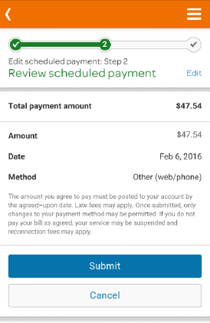
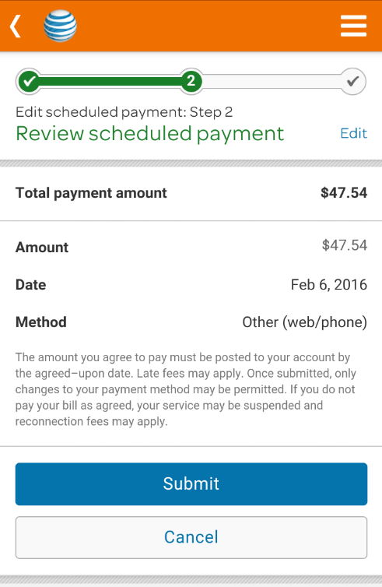
Editing a Scheduled Payment Arrangement
Tap Submit.
Script:
Review the arrangement details, including the amount, date, and method. If correct, tap Submit.

Slide 11
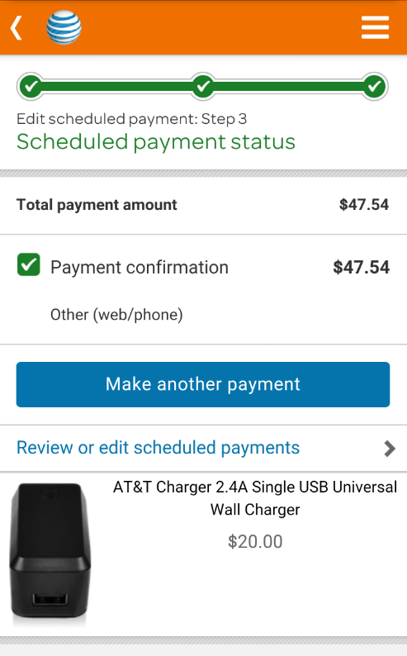
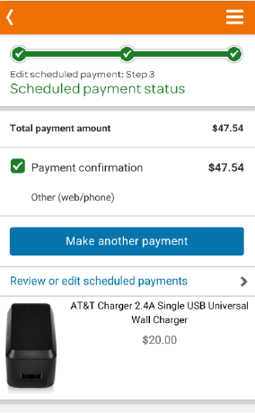
Editing a Scheduled Payment Arrangement
-End of simulation for Editing a Payment Arrangement
Script:
The confirmation screen will show if the payment arrangement was successful and the customer will receive a text message with the details.

Slide 12
Setting up a
Payment Arrangement
Tap the myZZZ app
Script:
Customers can use the myZZZ app to make payments, schedule payments, or select a new payment date. In this simulation, you’ll learn how to set up a payment arrangement.
In this example, today's date is 6/21. You want to set up a payment arrangement so the scheduled payment date is 2/6.
Note: If the customer chooses a date that is after their due date they may incur a late payment fee.
Start by tapping the myZZZ app.

Slide 13
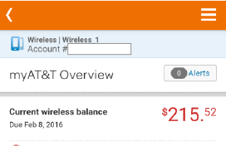

Setting up a
Payment Arrangement
Tap anywhere to continue.
Script:
If you wanted to make an immediate payment, you would tap the Make payment button.
Tap anywhere to continue.
$124.⁵²

Slide 14
Setting up a
Payment Arrangement
Tap Can’t pay today? Pay later.
Script:
You want to set up a scheduled payment date so tap Can’t pay today? Pay later.
$124.⁵²

Slide 15
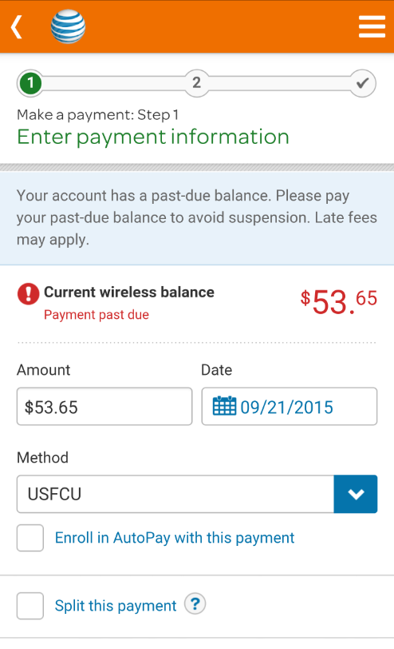
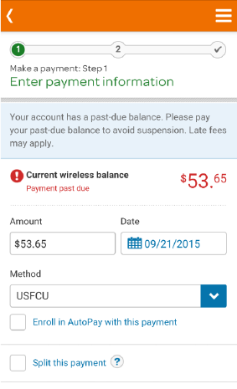


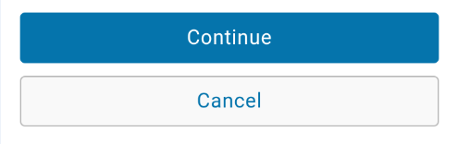
Setting up a
Payment Arrangement
Tap the Calendar icon.
Script:
The Make a Payment screen appears displaying the past due amount and the current payment arrangement. In this example, we will leave the amount as $124.53, but you want to set up a payment arrangement for 2/6. Tap the calendar icon to open the calendar.
$124.⁵²
$124.52
1/21/2016

Slide 16
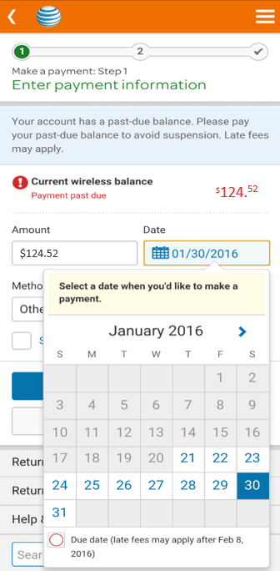
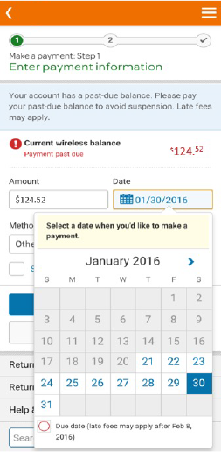
Setting up a
Payment Arrangement
Tap the blue arrow to see the next month.
Script:
The calendar appears. Tap the blue arrow to see the next month.
01/21/2016
30

Slide 17

Setting up a
Payment Arrangement
Tap the 6th of February.
Script:
Choose a date from the calendar. For this example, choose 2/6.
Note: If the customer chooses a date that is after the scheduled due date they may incur a late payment fee. If the date selected is too far in the future the customer will receive an error message explaining to pick another date.
$124.52
$124.52

Slide 18


Setting up a
Payment Arrangement
Tap Continue.
Script:
You can change how you will pay by tapping the drop down arrow to select the method of payment, which includes any saved payment profiles. You may select a payment that will automatically draft on the day selected or create a payment arrangement.
You will leave this as “Other” and tap Continue.
$124.⁵²
$124.52

Slide 19
Setting up a
Payment Arrangement
Tap Submit.
Script:
Review the arrangement details, including the amount, date, and method. If correct, tap Submit.
$124.52
$124.52

Slide 20
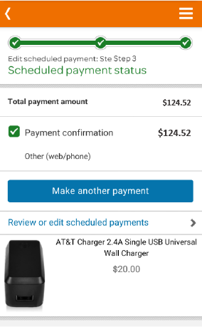
Setting up a
Payment Arrangement
-End of simulation for Editing a Payment Arrangement
Script:
A confirmation screen appears, which includes the confirmation number. Also a confirmation text is automatically sent with the details of the new arrangement.
$124.52
$124.52

