Slide 1
DOCTRINE #6
God the Father

Slide 2
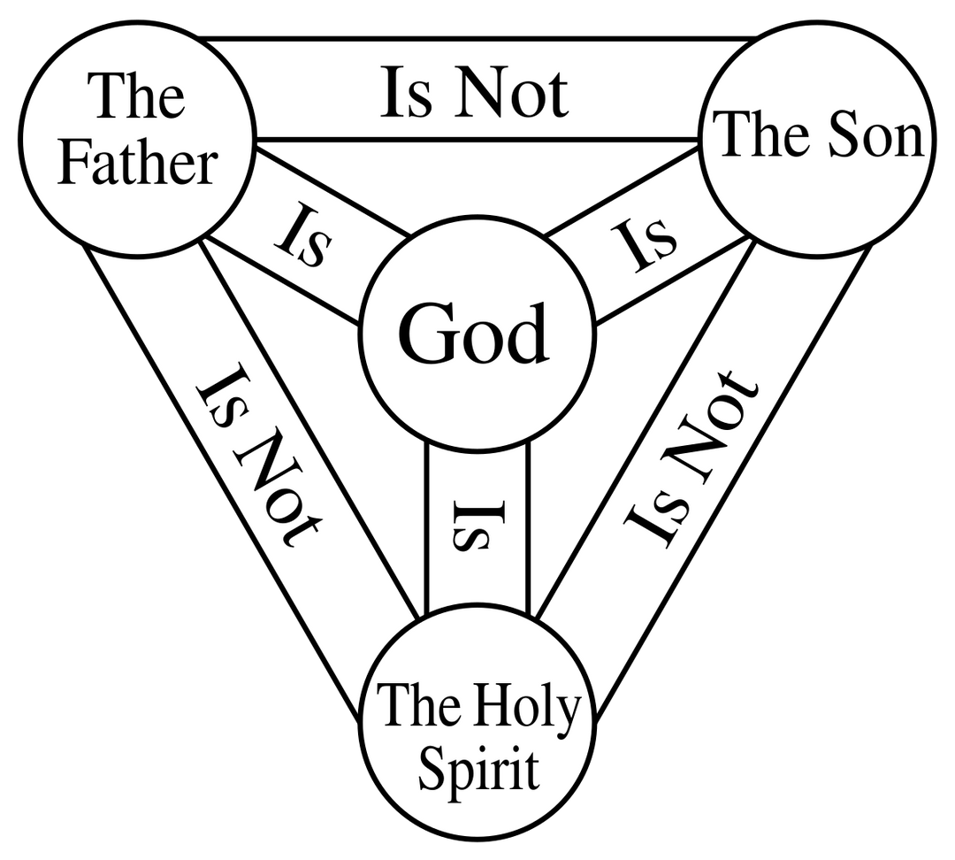
DOCTRINE #6
God the Father

Slide 3
GOD EXISTS IN THREE PERSONS—FATHER, SON, AND HOLY SPIRIT.
DOCTRINE #6
God the Father

Slide 4
The use of "person" originates from the Latin word "persona"
DOCTRINE #6
God the Father

Slide 5

DOCTRINE #6
God the Father

Slide 6
symbolizing different characters or roles
DOCTRINE #6
God the Father

Slide 7
Early Christian theologians adopted this term to articulate the complex relationship within the Godhead—three distinct "persons" (Father, Son, and Holy Spirit) united in one divine nature.
DOCTRINE #6
God the Father

Slide 8
So, when we say God has one nature, it means:
✔️ God is fully divine—He is all-powerful, all-knowing, and eternal.
DOCTRINE #6
God the Father

Slide 9
DOCTRINE #6
God the Father

Slide 10
NAMES OF GOD
YHWH (Yahweh) – יְהוָה
  Meaning: "I AM WHO I AM" (Self-existent, Eternal God)
  Exodus 3:14 – God reveals this name to Moses at the burning bush.
Elohim – אֱלֹהִים
  Meaning: "God" or "Mighty Creator"
  Genesis 1:1 – Used in creation to show God's power.
El Shaddai – אֵל שַׁדַּי
  Meaning: "God Almighty"
  Genesis 17:1 – Shows God's supreme power and ability to fulfill promises.
Adonai – אֲדֹנָי
  Meaning: "Lord" or "Master"
  Psalm 16:2 – Used to show God's authority and ownership
DOCTRINE #6
God the Father

Slide 11
NAMES OF GOD
YHWH Jireh – יְהוָה יִרְאֶה
  Meaning: "The Lord Will Provide"
  Genesis 22:14 – When God provided a ram for Abraham instead of Isaac.
YHWH Rapha – יְהוָה רָפָא
  Meaning: "The Lord Who Heals"
  Exodus 15:26 – Declares God as the healer of His people.
YHWH Nissi – יְהוָה נִסִּי
  Meaning: "The Lord Is My Banner"
  Exodus 17:15 – Given after Israel's victory over Amalek.
YHWH Shalom – יְהוָה שָׁלוֹם
  Meaning: "The Lord Is Peace"
  Judges 6:24 – Spoken by Gideon when he encountered God.
YHWH Tsidkenu – יְהוָה צִדְקֵנוּ
  Meaning: "The Lord Our Righteousness"
  Jeremiah 23:6 – Points to God's righteousness and salvation.
DOCTRINE #6
God the Father

Slide 12
NAMES OF GOD
YHWH Rohi – יְהוָה רֹעִי
  Meaning: "The Lord Is My Shepherd"
  Psalm 23:1 – David calls God his shepherd who provides and protects.
YHWH Sabaoth – יְהוָה צְבָאוֹת
  Meaning: "The Lord of Hosts" (Commander of heavenly armies)
  1 Samuel 1:3 – Shows God's power over all forces.
YHWH Shammah – יְהוָה שָׁמָּה
  Meaning: "The Lord Is There"
  Ezekiel 48:35 – Declares God's presence with His people.
El Elyon – אֵל עֶלְיוֹן
  Meaning: "God Most High"
  Genesis 14:18-20 – Used by Melchizedek to describe God's supremacy.
El Olam – אֵל עוֹלָם
  Meaning: "The Everlasting God"
  Genesis 21:33 – Shows God's eternal nature.
DOCTRINE #6
God the Father

Slide 13
DIFFERENT ROLES OF GOD THE FATHER:
DOCTRINE #6
God the Father

Slide 14
DIFFERENT ROLES OF GOD THE FATHER:
  CREATOR (CREATION)
i) "Originator" and "Planner"
ii) Source of Life – He gave life to all things (Gen. 2:7).
iii) Sustainer – He provides and upholds creation (Matt. 6:26, Heb. 1:3).
iv) Supreme Ruler – He governs all things (Ps. 103:19).
v) Giver of Purpose – He created with intention (Isa. 45:18).
vi) The One Who Receives Glory – Creation exists for His praise (Rev. 4:11)
DOCTRINE #6
God the Father

Slide 15
DIFFERENT ROLES OF GOD THE FATHER:
  CREATOR (CREATION)
i) "Originator" and "Planner"
  Originator = The One Who Starts It
  Planner = The One Who Organizes It
DOCTRINE #6
God the Father

Slide 16
DIFFERENT ROLES OF GOD THE FATHER:
  CREATOR (CREATION)
i) "Originator" and "Planner"
1 Corinthians 8:6, NIV
"Yet for us there is but one God, the Father, from whom all things came and for whom we live; and there is but one Lord (Kyrios), Jesus Christ, through whom all things came and through whom we live."
1 Corinthians 8:6, ASD
" para sa atin iisa lamang ang Dios, ang ating Ama na lumikha ng lahat ng bagay, at nabubuhay tayo para sa kanya. At may iisang Panginoon lamang, si Jesu-Cristo. Sa pamamagitan niya ay nilikha ang lahat ng bagay, at sa pamamagitan din niya ay nabubuhay tayo ngayon."
DOCTRINE #6
God the Father

Slide 17
DIFFERENT ROLES OF GOD THE FATHER:
  CREATOR (CREATION)
i) "Originator" and "Planner"
Genesis 1 (KJV, ESV, NIV)
1 In the beginning, God created the heavens and the earth.
2 The Spirit of God was hovering over the waters.
DOCTRINE #6
God the Father

Slide 18
DIFFERENT ROLES OF GOD THE FATHER:
  CREATOR (CREATION)
i) "Originator" and "Planner"
Hebrews 1:2
"In these last days He has spoken to us by His Son, whom He appointed heir of all things, and through whom also He made the universe."
Hebrews 1:2
"Ngunit sa mga huling araw na ito, siya'y nagsalita sa atin sa pamamagitan ng kanyang Anak. Sa pamamagitan ng Anak ay nilikha ng Diyos ang sanlibutan, at siya ang piniling tagapagmana ng lahat ng bagay."
DOCTRINE #6
God the Father

Slide 19
DIFFERENT ROLES OF GOD THE FATHER:
  CREATOR (CREATION)
i) "Originator" and "Planner"
Pahayag 4:11, ASD
“Karapat-dapat po kayo Panginoon naming Dios na tumanggap ng parangal, papuri at kapangyarihan,
dahil kayo ang lumikha sa lahat ng bagay.
At ginawa ninyo ang mga ito ayon sa inyong kagustuhan.”
DOCTRINE #6
God the Father

Slide 20
How to Determine Whether a Verse Refers to God the Father or God the Son:
by looking at the:
  context and
  the words used
DOCTRINE #6
God the Father

Slide 21
Pahayag 4
1 Pagkatapos nito, nakita kong nabuksan ang pinto sa langit. At narinig kong muli ang tinig na parang trumpeta. Sinabi niya, “Umakyat ka rito at ipapakita ko sa iyo ang mga mangyayari sa hinaharap.” 2 Bigla na lang akong napuspos ng Banal na Espiritu. At nakita ko roon sa langit ang isang trono na may nakaupo.
9 Habang nagbibigay sila ng parangal, papuri at pasasalamat sa nakaupo sa trono na nabubuhay magpakailanman,
DOCTRINE #6
God the Father

Slide 22
Pahayag 5
6 Pagkatapos, nakita ko sa pagitan ng matatandang pinuno at ng tronong napapaligiran ng apat na buháy na nilalang ang isang Korderong nakatayo na ang anyo ay tulad sa pinatay na. Ito'y may pitong sungay at pitong mata na siyang pitong espiritu ng Diyos na ipinadala sa buong daigdig. 7 Lumapit ang Kordero at kinuha ang kasulatang nakabalumbon sa kanang kamay ng nakaupo sa trono.

Slide 23
How to Determine Whether a Verse Refers to God the Father or God the Son:
by looking at the:
  context and
  the words used
1. If the Bible Says "God sent," "God gave," or "God speaks" → It Usually Refers to the Father
2. If the Bible Says "The Son," "Jesus," "The Word," or "The Lamb" → It Refers to Jesus
3. If the Bible Mentions "The One on the Throne" → It Usually Refers to God the Father

Slide 24
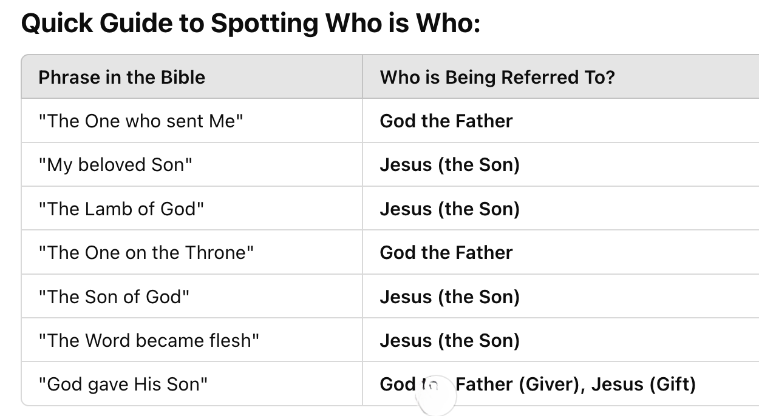

Slide 25
God the Father is the source of creation—He planned and willed everything into existence. Jesus (the Son) and the Holy Spirit carried out His plan. This shows that God the Father is in charge, has a purpose for everything, and wants a relationship with His creation.
God the Father ang pinagmulan ng lahat ng nilikha—Siya ang nagplano at nagtakda upang ito ay magkaroon ng buhay. Jesus (ang Anak) at ang Holy Spirit ang nagsakatuparan ng Kanyang plano. Ipinapakita nito na si God the Father ang namuno, may layunin sa lahat ng bagay, at nais magkaroon ng relasyon sa Kanyang mga nilikha.
DOCTRINE #6
God the Father

Slide 26
DIFFERENT ROLES OF GOD THE FATHER:
  CREATOR (CREATION)
1 Corinthians 8:6, ASD
" para sa atin iisa lamang ang Dios, ang ating Ama na lumikha ng lahat ng bagay, at nabubuhay tayo para sa kanya. At may iisang Panginoon lamang, si Jesu-Cristo. Sa pamamagitan niya ay nilikha ang lahat ng bagay, at sa pamamagitan din niya ay nabubuhay tayo ngayon."
1 Corinthians 8:6, NIV
"Yet for us there is but one God, the Father, from whom all things came and for whom we live; and there is but one Lord (Kyrios), Jesus Christ, through whom all things came and through whom we live."
DOCTRINE #6
God the Father

Slide 27
MEANING OF "KYRIOS" (ΚΎΡΙΟΣ)
  Kyrios means "Lord," "Master," or "Owner."
  In the Septuagint (LXX), the Greek translation of the Old Testament, Kyrios was used to translate YHWH (Yahweh), the covenant name of God.
  By calling Jesus "Kyrios", Paul is identifying Him with the divine title used for God in the Old Testament.
DOCTRINE #6
God the Father

Slide 28
Knowing God the Father as the originator and planner strengthens a Christian’s faith:
  Trusting God More – Since God planned everything, we can trust that He is in control, even when life is tough.
2. Knowing Life Has Purpose – God didn’t create the world by accident. He has a plan for everything, including your life. This helps you live with meaning.
3. Getting Closer to God – God didn’t just create the world and leave it alone—He wants a relationship with us. Understanding this helps us pray more and seek Him daily.
4. Following God's Plan – Since God is the planner, it makes sense to obey Him. The more we follow His way, the stronger our faith grows.
5. Finding Peace and Hope – Life can be hard, but knowing that God has a plan gives us comfort and hope for the future.

