Slide 1
DOCTRINE #6
God the Father

Slide 2
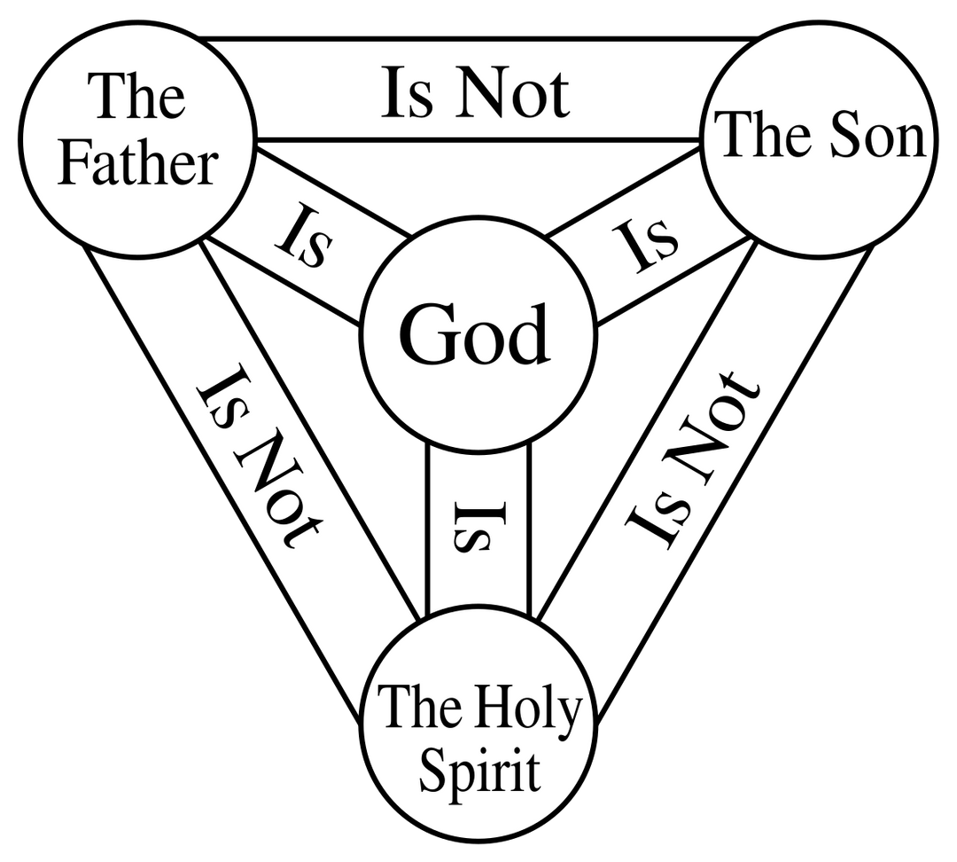
DOCTRINE #6
God the Father

Slide 3
GOD EXISTS IN THREE PERSONS—FATHER, SON, AND HOLY SPIRIT.
DOCTRINE #6
God the Father

Slide 4
DIFFERENT ROLES OF GOD THE FATHER:
  CREATOR (CREATION)
i) "Originator" and "Planner"
  Originator = The One Who Starts It
  Planner = The One Who Organizes It
DOCTRINE #6
God the Father

Slide 5
DIFFERENT ROLES OF GOD THE FATHER:
  CREATOR (CREATION)
  SALVATION
DOCTRINE #6
God the Father

Slide 6
GOD THE FATHER’S ROLE IN SALVATION
  God the Father is the source and initiator of salvation. He planned it, sent His Son to accomplish it, and gives the Holy Spirit to apply it.

Slide 7
HOW DOES THE HOLY SPIRIT APPLY SALVATION?
  Although Jesus completed the work of salvation on the cross, the Holy Spirit applies it in the lives of believers in the following ways:
DOCTRINE #6
God the Father

Slide 8
HOW DOES THE HOLY SPIRIT APPLY SALVATION?
1. He Opens the Hearts of People to the Gospel
Juan 16:8 – Tcb
“Pagdating niya, ipapakita Niya sa mga taong makamundo na makasalanan sila at ako namaʼy matuwid. At ipapakita rin niya na hahatulan sila ng Dios.”
John 16:8, nkjv –
“ And when He has come, He will convict the world of sin, and of righteousness, and of judgment"

Slide 9
HOW DOES THE HOLY SPIRIT APPLY SALVATION?
1. He Opens the Hearts of People to the Gospel
Juan 16:9 – Tcb
“Ipapakita niya sa mga tao na makasalanan sila dahil hindi sila sumampalataya sa akin.”
John 16:9, nkjv –
“ and of judgment: 9 of sin, because they do not believe in Me; "
DOCTRINE #6
God the Father

Slide 10
HOW DOES THE HOLY SPIRIT APPLY SALVATION?
1. He Opens the Hearts of People to the Gospel
1 Corinthians 2:14, nkjv –
“ But the natural man does not receive the things of the Spirit of God, for they are foolishness to him; nor can he know them, because they are spiritually discerned.
1 Corinto 2:14– Tcb
“Ngunit ang taong di ayon sa Espiritu ay hindi tumatanggap ng mga bagay na mula sa Espiritu ng Diyos, sapagkat ang mga ito ay kahangalan para sa kanya.”
DOCTRINE #6
God the Father

Slide 11
Without the Holy Spirit, we cannot understand salvation—He is the One who opens our minds.
DOCTRINE #6
God the Father

Slide 12
HOW DOES THE HOLY SPIRIT APPLY SALVATION?
1. He Opens the Hearts of People to the Gospel
2. He Confirms That We Are Truly Saved
DOCTRINE #6
God the Father

Slide 13
HOW DOES THE HOLY SPIRIT APPLY SALVATION?
2. He Confirms That We Are Truly Saved
ROMA 8:16
Ang Espiritu ang nagpapatotoo, kasama ng ating espiritu, na tayo'y mga anak ng Diyos.
ROMANS 8:16,NKJV
THE SPIRIT HIMSELF BEARS WITNESS WITH OUR SPIRIT THAT WE ARE CHILDREN OF GOD,

Slide 14
HOW DOES THE HOLY SPIRIT APPLY SALVATION?
2. He Confirms That We Are Truly Saved
EFESO 1
14 ANG BANAL NA ESPIRITU ANG KATIBAYAN NA MATATANGGAP NATIN MULA SA DIOS ANG IPINANGAKO NIYA SA ATIN BILANG MGA ANAK NIYA, HANGGANG SA MATANGGAP NATIN ANG LUBOS NA KALIGTASAN. AT DAHIL DITO, PAPUPURIHAN SIYA!

Slide 15
GOD THE FATHER’S ROLE IN SALVATION

Slide 16
GOD THE FATHER’S ROLE IN SALVATION
1. The Father Planned Salvation
EFESO 1
EPHESIANS 1,GNT
4 Bago pa likhain ang sanlibutan ay pinili na niya tayo upang maging kanya sa pamamagitan ng ating pakikipag-isa kay Cristo at upang tayo'y maging banal at walang kapintasan sa harap niya. Dahil sa pag-ibig ng Diyos,
4 Even before the world was made, God had already chosen us to be his through our union with Christ, so that we would be holy and without fault before him.

Slide 17
GOD THE FATHER’S ROLE IN SALVATION
1. The Father Planned Salvation
EFESO 1
EPHESIANS 1,GNT
5 Na tayo'y itinalaga niya nang una pa sa pagkukupkop na tulad sa mga anak sa pamamagitan ni Jesucristo sa ganang kaniya, ayon sa minagaling ng kaniyang kalooban
5 having predestined us to adoption as sons by Jesus Christ to Himself, according to the good pleasure of His will,

Slide 18
CHOSEN
  People who put their faith in Jesus (in response)
  Being "chosen" happens when someone believes in Christ.
  God's choice is based on Christ

Slide 19

CHOSEN
  People who put their faith in Jesus (in response)
  Being "chosen" happens when someone believes in Christ.
PREDESTINED
  Predestination is about what happens to those who are chosen.
  God has already determined (predestined) that those who believe in Jesus will be adopted as His children and will receive eternal life.

Slide 20



Slide 21
GOD THE FATHER’S ROLE IN SALVATION
1. The Father Planned Salvation
2. The Father Sent Jesus to Accomplish Salvation

Slide 22
GOD THE FATHER’S ROLE IN SALVATION
2. The Father Sent Jesus to Accomplish Salvation
1 JOHN 4:14
"Nakita namin at pinapatotohanang isinugo ng Ama ang kanyang Anak upang iligtas ang sanlibutan"
"And we have seen and testify that the Father has sent the Son as Savior of the world."

Slide 23
GOD THE FATHER’S ROLE IN SALVATION
1. The Father Planned Salvation
2. The Father Sent Jesus to Accomplish Salvation
3. The Father Accepts Jesus’ Sacrifice

Slide 24
GOD THE FATHER’S ROLE IN SALVATION
3. The Father Accepts Jesus’ Sacrifice
ROMANS 3:25
25 Siya ang inialay ng Diyos bilang handog, upang sa pamamagitan ng kanyang dugo ay mapatawad ang kasalanan ng lahat ng sumasampalataya sa kanya...
25 For God presented Jesus as the sacrifice for sin. People are made right with God when they believe that Jesus sacrificed his life, shedding his blood...

Slide 25
GOD THE FATHER’S ROLE IN SALVATION
1. The Father Planned Salvation
2. The Father Sent Jesus to Accomplish Salvation
3. The Father Accepts Jesus’ Sacrifice
4. The Father Adopts Believers as His Children

Slide 26
GOD THE FATHER’S ROLE IN SALVATION
4. The Father Adopts Believers as His Children
ROMANS 8
15 Sapagkat hindi espiritu ng pagkaalipin ang inyong tinanggap upang kayo'y mamuhay sa takot. Sa halip, ang inyong tinanggap ay ang Espiritu ng pagkupkop upang kayo'y gawing mga anak ng Diyos, kaya tayo'y tumatawag sa kanya ng, “Ama, Ama ko!”
15 So you have not received a spirit that makes you fearful slaves. Instead, you received God’s Spirit when he adopted you as his own children.[h] Now we call him, “Abba, Father.”

Slide 27
God the Father’s role in salvation is to plan it, send Jesus to accomplish it, accept His sacrifice, draw people to faith, and adopt them as His children. He is the loving source of our salvation, working through Jesus and the Holy Spirit to bring us back to Him.

Slide 28
  Assures us that our salvation is not accidental – God planned it before creation
  Helps believers appreciate the great cost of salvation – Jesus sacrificed Himself to accomplish it.
  Gives believers confidence to share the Gospel – We are chosen to be His messengers.

